Slide 1
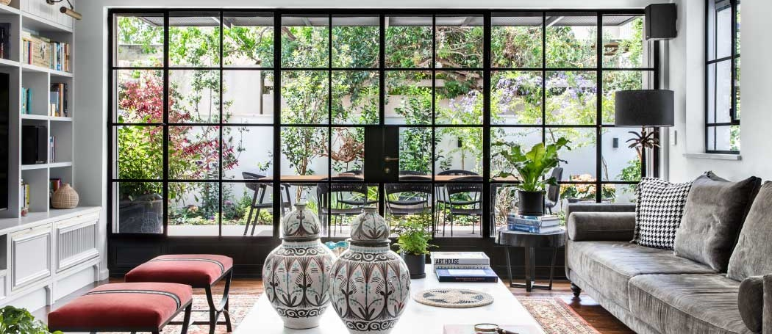
Designing with Steel Windows and Doors
Current market options from high-end steel manufacturers in the 21st century

Slide 2
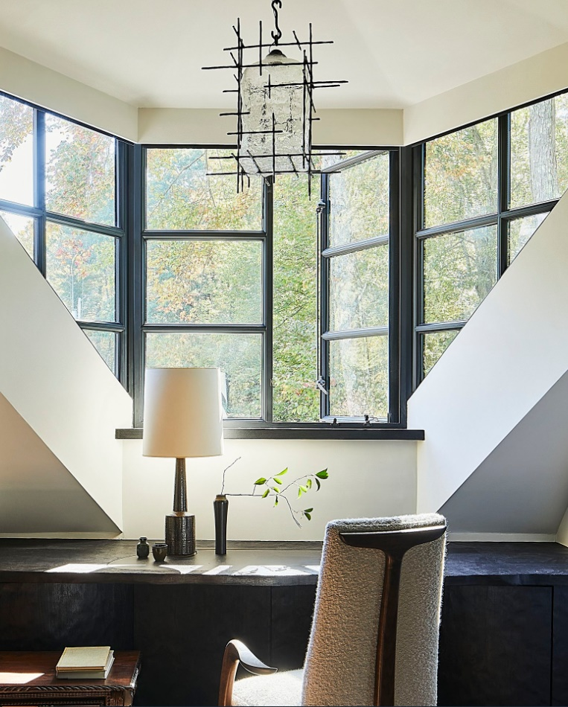
Agenda:
Types of alloys available
How they are produced- welding process
Finish processes- protect from corrosion
Energy efficiency
Performance- wind and rain
Design characteristics
Product types, glass & divided lites
Pros & cons of steel
Concluding thoughts
Notes:
Agenda per above.

Slide 3
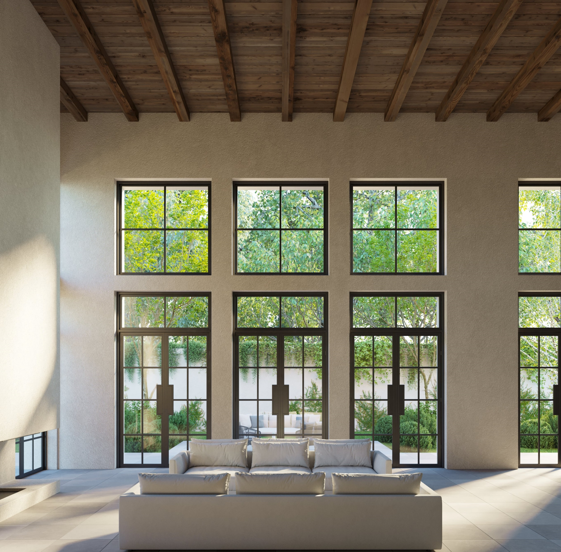
This presentation provides an overview of current exterior steel windows and doors available in the U.S. and international markets.
The contents here are under review with the AIA and intended for educational purposes only.
Notes:
Simple disclaimer. (Possibly remove this slide if needed).

Slide 4
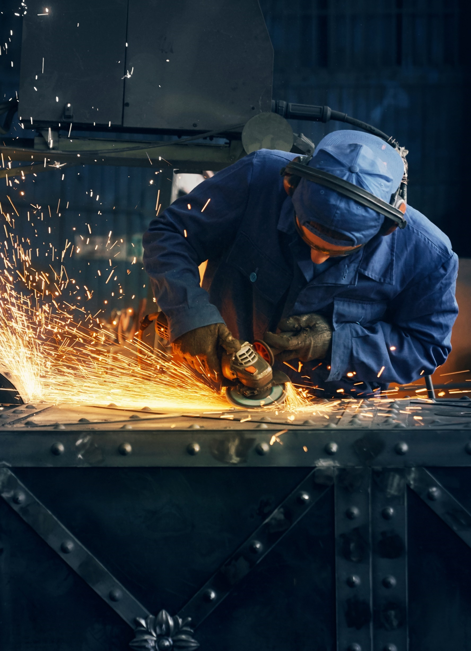
Hot Rolled Steel:
Steel billet is heated up to 1,700ºF and then cooled rapidly.
Steel profile is rolled into shape during the cooling process. This process is expedited with hot rolled steel
This then can cause the steel to stress and shrink
Not used often in precise machine work.
Often used for trailers, gates, RR tracks.
Cold Rolled Steel:
Steel billet is heated up to 1,700ºF like “hot rolled” but cooled slowly at room temperature.
Steel profile is form and can be thinned to sheet form. The cooling process is more precise and keeps the structural integrity of the steel consistent.
Used in machining for automotive or Industrial work for exacting requirements.
Notes:
Two main types of steel profiled. Hot rolled and Cold rolled. Think of the term “rolled” as the cooling process after the steel billet is heated up.

Slide 5
Types of Alloys:
An alloy is a metal made from 2 or more metallic elements.
Carbon Steel : carbon & iron-usually galvanized
Stainless Steel: iron & copper with nickel
Corten Steel: steel with a coating like phosphorus, copper, chromium, or nickel to create a patina look
Bronze: tin & copper
Titanium Steel: carbon, iron & titanium
Notes:
A few types of alloys are available, but by and large a painted Galvanized Steel is the most popular choice in Steel product.

Slide 6
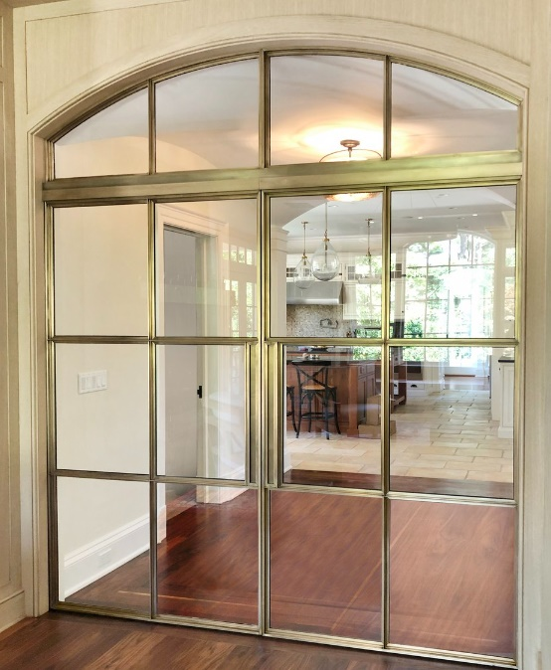
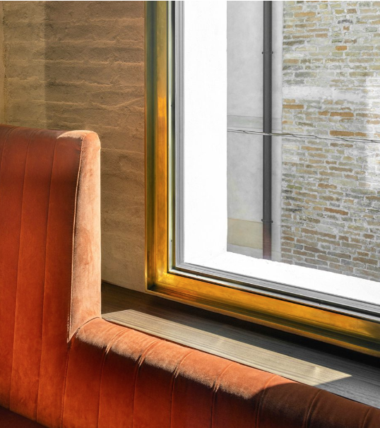
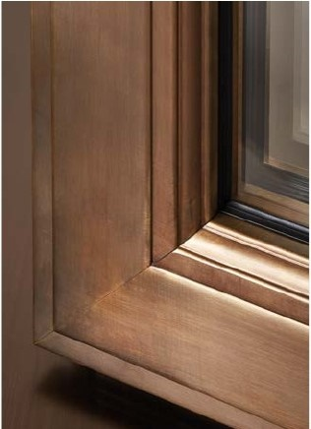
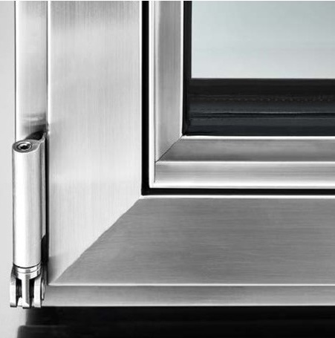
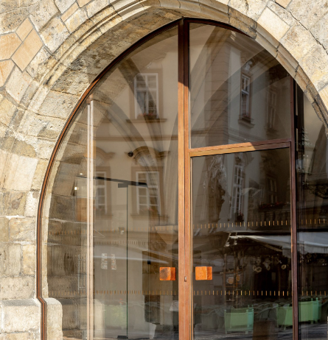
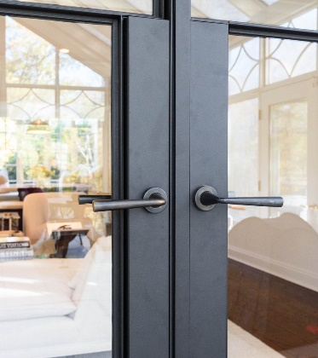
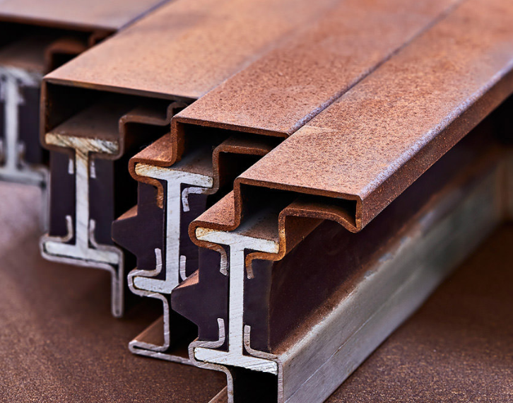
A
L
L
O
Y
S
Architectural Bronze
Architectural Bronze
Architectural Bronze
Stainless Steel
Cor-ten Steel
Galvanized Steel
Notes:
Here is a visual of some different alloys. A big concern with this type of material is corrosion and Bronze and Stainless Steel are the safest types of metal to use to avoid corrosion. This is due to their metallic make-up. But those safter environmental elements come at a premium price.

Slide 7
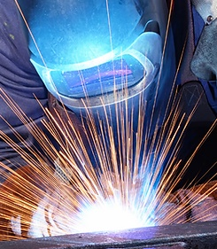
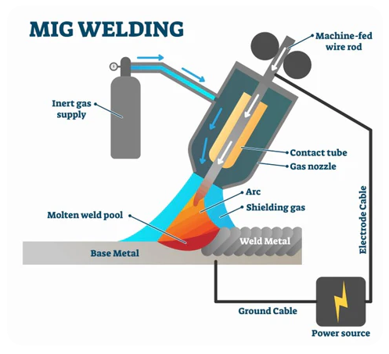
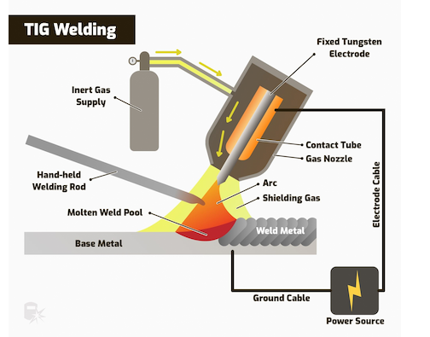
Welding
Two most common types by manufacturers today are:
MIG welding (Metal Inert Gas) process of joining two pieces using electric arc and wire electrode.
TIG welding (Tungsten Inert Gas) is a specialized form of MIG welding that uses different electrodes and some fillers.
MIG Welding
TIG Welding
Notes:
MIG welding is most common and easier to learn to become competent—used for galvanized. TIG welding is more complex and uses different electrodes for different types of alloys—used for bronze & stainless. An electrode is a metal stick that is coated to protect the metal when it is heated and fed through the welding gun.

Slide 8
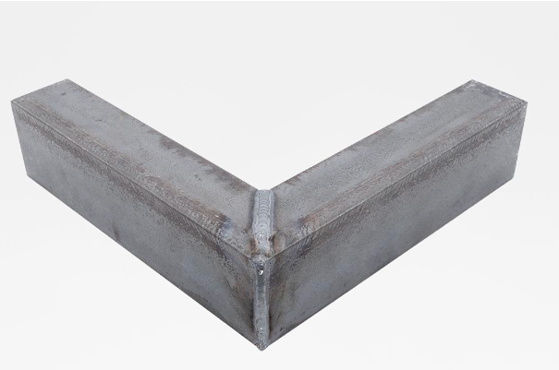
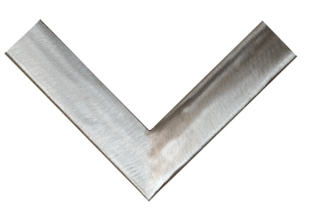
Surface Prep
Once the steel profile is welded to form a frame of a sash, it is cooled and all welds should be grounded flat, prior to any surface preparation.
This is where a less expensive (see cheaper) manufacturer will cut corners.
This is where the labor to construct a Steel window comes into play.
This process applies to all frame corners, sash corners and any joint where an intersection of frame parts come together, like True Divided lites (TDL’s) or Simulated Divided lites (SDL’s)
Notes:
This slide self explanatory, but clearly what is evident is the amount of hand labor required to manufacture high end steel products.

Slide 9
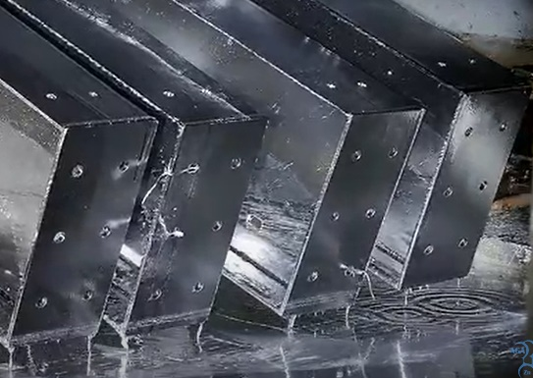
Zinc Application or Metallization
Zinc can be added to raw steel through a dip process or spray-applied.
It is applied to the raw steel, typically grinded, brushed and washed.
Zinc is ultimately the “protection” against corrosion.
In other industries hot dipped galvanization is its own finish.
In windows & doors, it is typically painted over.
Notes:
A Zinc coating is one of the best ways to prevent corrosion on steel. Hot dipped galvanization is essentially a zinc bath that the profile is subjected to. This applies to materials like bridge girders to box nails. Any steel material subjected to the elements should have some protection with a zinc coating.

Slide 10
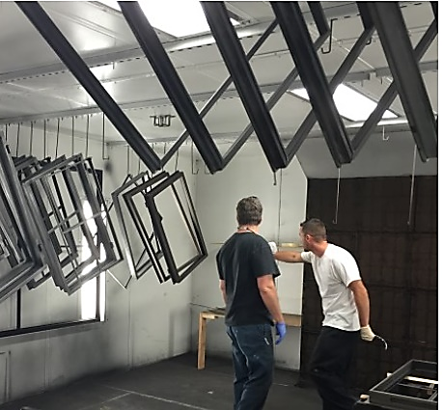
Finish Process
Wet applied: acrylic enamel, alkyd enamel (oil based), or urethane.
Dry applied: powder coat or electrostatic applied powder coat
Some manufacturers offer a “textured” finish created by the zinc undercoat. Other manufacturers offer a smooth and or texture from the finish itself.
Working Principle of Electrostatic Power Coating
Notes:
Acrylic paint is fast drying and made from many elements (polymers) and usually water based. Alkyd paints are oil based (petroleum) mixed w resin and pigments. Urethane is a mixture of acrylic and polyurethane. Has good durability. Powder coats are gaining in popularity as they are more environmentally friendly and depending on the powder itself and the undercoating, can perform as well or longer than wet finishes.

Slide 11
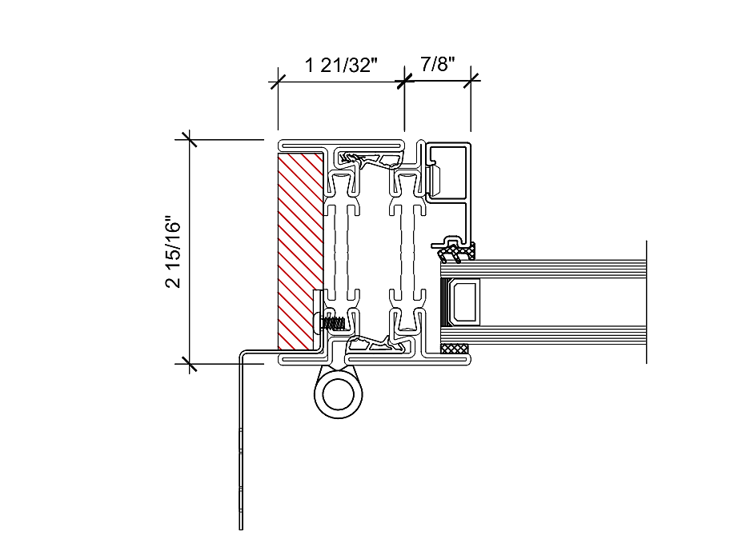
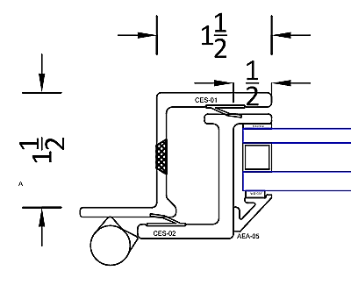
Steel Window & Door
Performance
Thermal break:
A highly insulative material that reduces—or stops completely— thermal transfer from out to in or in to out.
Notes:
You will note on the detail on the left (outswing door) that there are thermal breaks in both the panel and the frame. In the detail on the right (also and outswing door) there is no thermal break. An anesthetic benefit to no Thermal break is a very narrow site line, which is an attractive look from minimalist design perspective. But the tradeoff is very little performance and a very hot window on a hot day and a very cold window on a cold day.

Slide 12
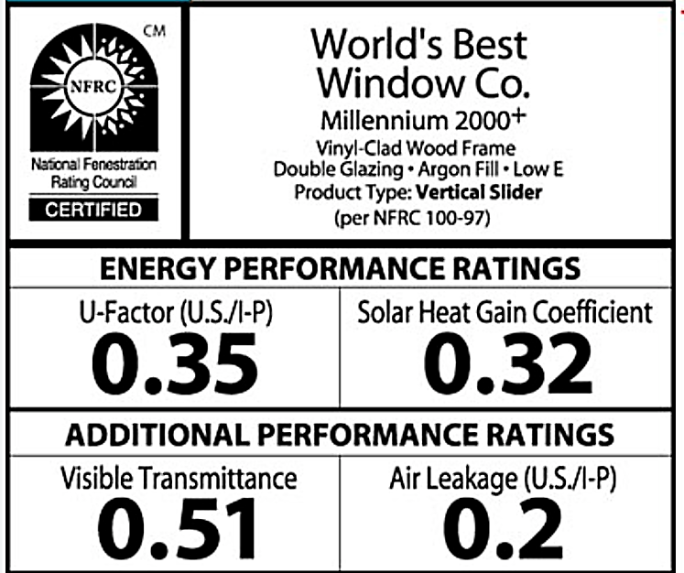
Steel Window & Door Performance
NFRC Label- National Fenestration Rating Council
Three Main NFRC Metrics:
U-Factor: Measures how well the window or door transfers heat. A lower number is better.
SHGC: Measures how much solar heat a window or door allows into a building.
A lower number is better for warm climates.
A high number is better for cool climates.
VLT: Visible Light Transmittance is the percentage of visible light that passes through a window.
A higher number means more visible light comes in but can lead to more glare.
A lower number means less visible light come in which can improve privacy
Usually, a higher VLT number is considered better.
Notes:
This slide shows us an NFRC (explain the acronym) and what each quadrant measures. Air Leakage is an optional rating that the manufacture may or may not list on this Temp label. In Steel windows and doors, these performance metrics are usually higher than, Vinyl, Wood or Aluminum windows, due to the thermal characteristics of steel.

Slide 13
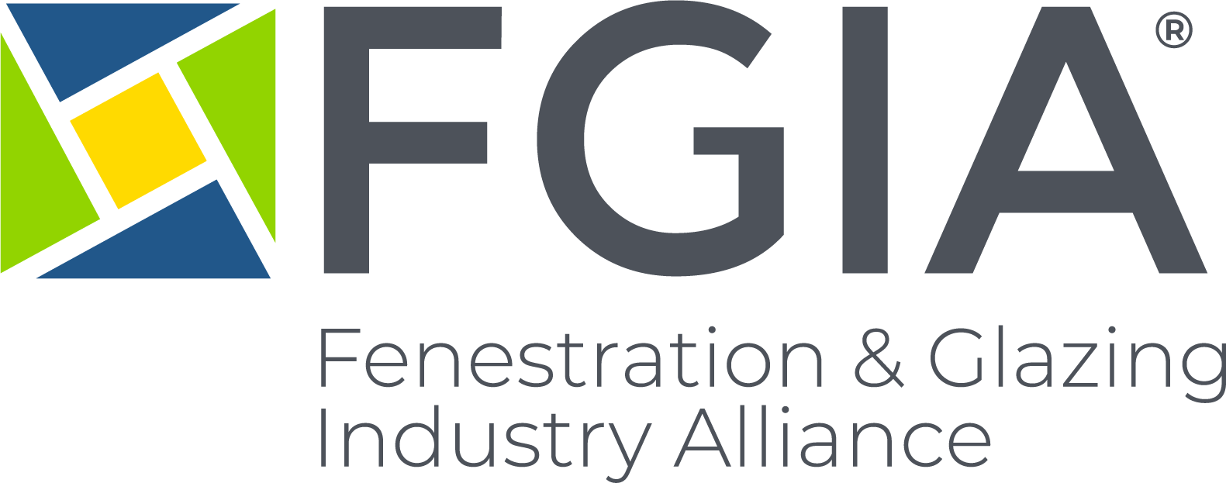
Steel Window & Door Performance
Aside from thermal performance, the other important way to measure a window is through NAFS Testing or often referred to as AAMA tests.
Performance Grade is made up of 5 metrics below. The top three are critical.
Structural wind load –defined in psf–pounds per square foot–known as design pressure
Wind & water performance
Air leakage
Operational force
Forced entry
Notes:
Many Steel window manufacturers do not test for AAMA or NAFS standards. Why? Part of this is due to cost, the other concern is the ability for a Steel window to withstand wind driven rain with minimal site lines and weather-stripping that other Aluminum and Wood products might achieve by thicker site lines and built in weep systems. Not all Steel manufacturers consider these items as their products are mostly designed for aesthetics and a certain architectural “look” the specifiers or designers want.

Slide 14
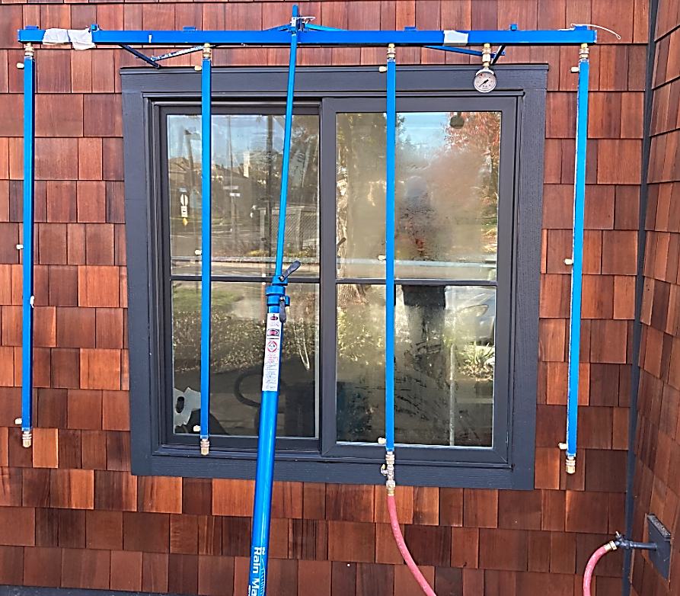
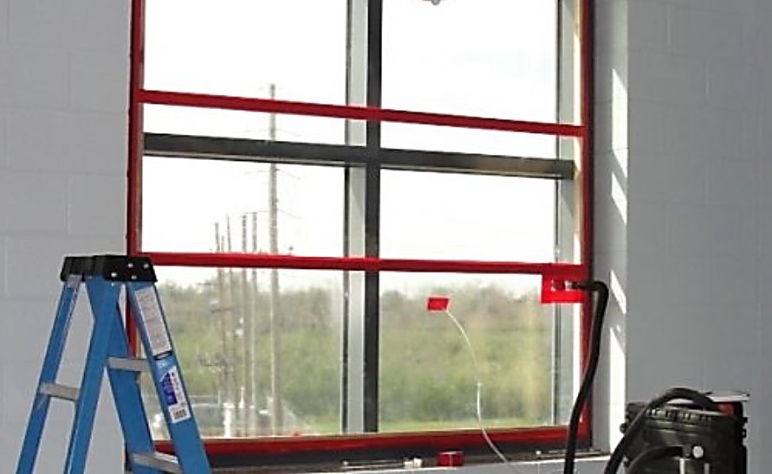
Steel Window & Door Performance
NAFS/AAMA performance measures how well a window or door can withstand wind driven rain.
Field simulation tests are often conducted for QC on projects.
Most steel manufactures do not have these metrics in place.
R = Residential
LC = Light Commercial
C = Commercial
AW= Architectural window (think storefront or curtain wall)
Notes:
Photo above right is the exterior field water test using an AAMA calibrated spray rack. Photo botton right is the interior where a test chamber is constructed to create a negative air pressure chamber to simulate positive pressure (think wind) against the window. If water enters anywhere inside of the inner most plane of the window after 20 minutes of “wind & water” it will not pass AAMA standards based on the product class (above left).

Slide 15
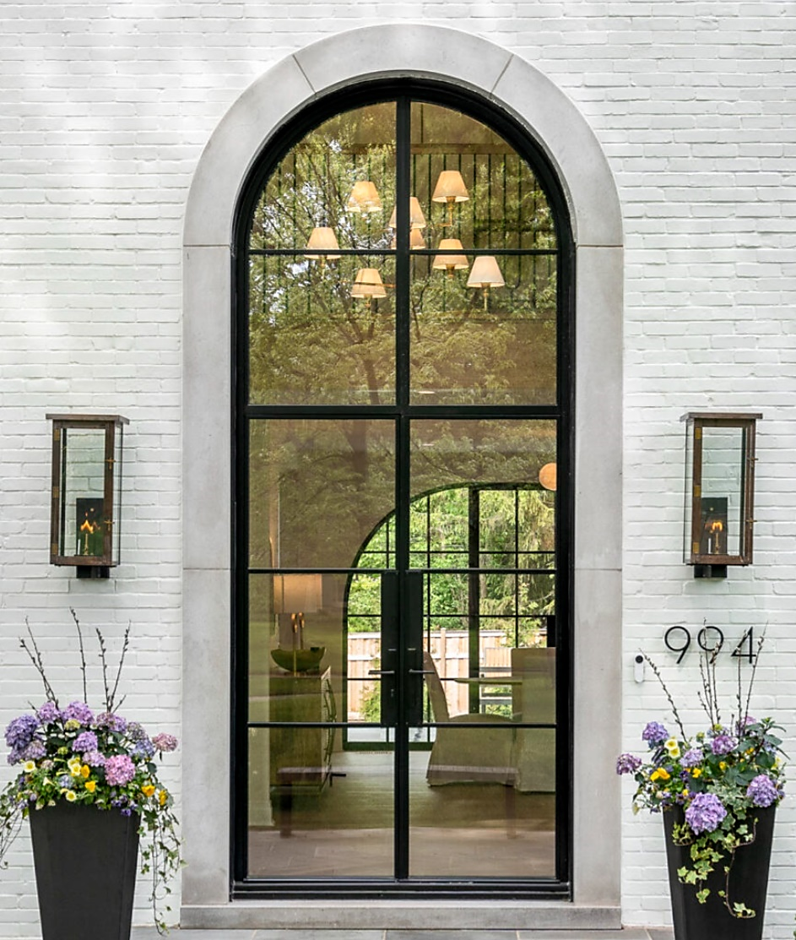
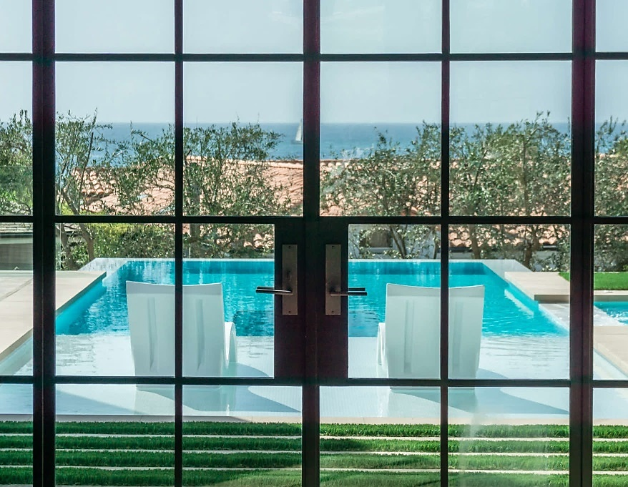
Design
Characteristics
of Steel
Steel door systems are defined by the iconic lock box built into a narrow steel door stile.
The shape and length of the lock box can vary
Coupled with the trim set (hardware) it creates a unique look not seen on other door systems.
Notes:
Probably the most defining characteristic of a Steel hinged door is its lock box. This is a traditional look that goes back over a century as the steel doors required room for a mortise lock to be installed for security. This detail stands out because the stile of the Steel door is so narrow. This lock box encroaches into the glass space and can be constructed in a variety of widths and heights. Putting this lock box in an IG (dual pane) unit is complex as the IG must be “notched” in a one-lite unit or a unit designed with SDL lites.

Slide 16
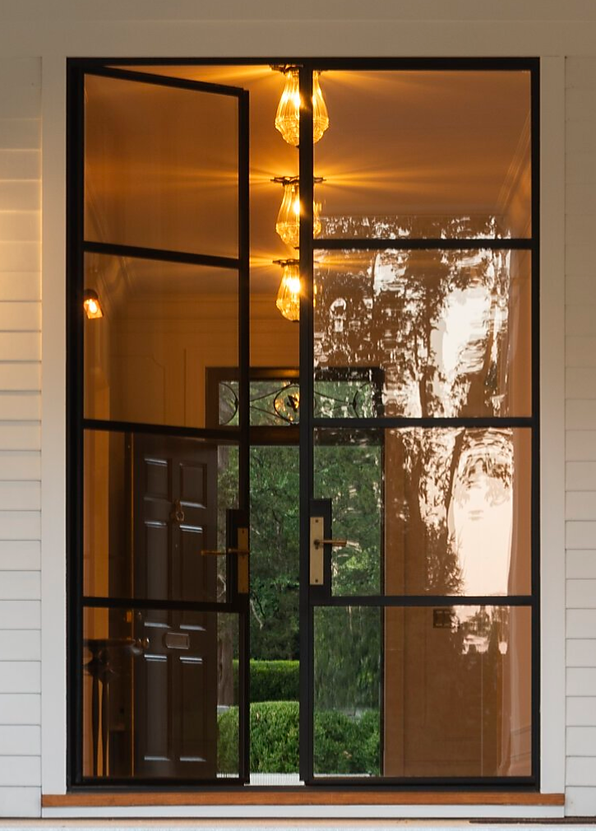
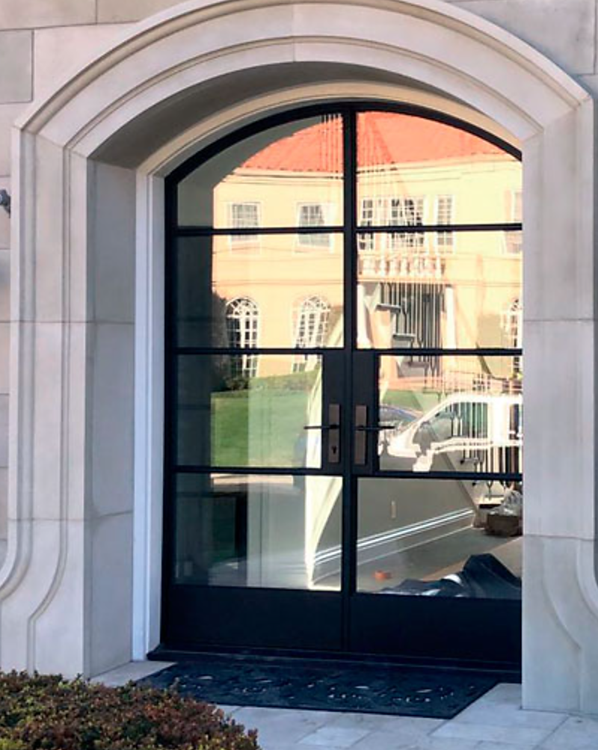
Design Characteristics of Steel

Slide 17
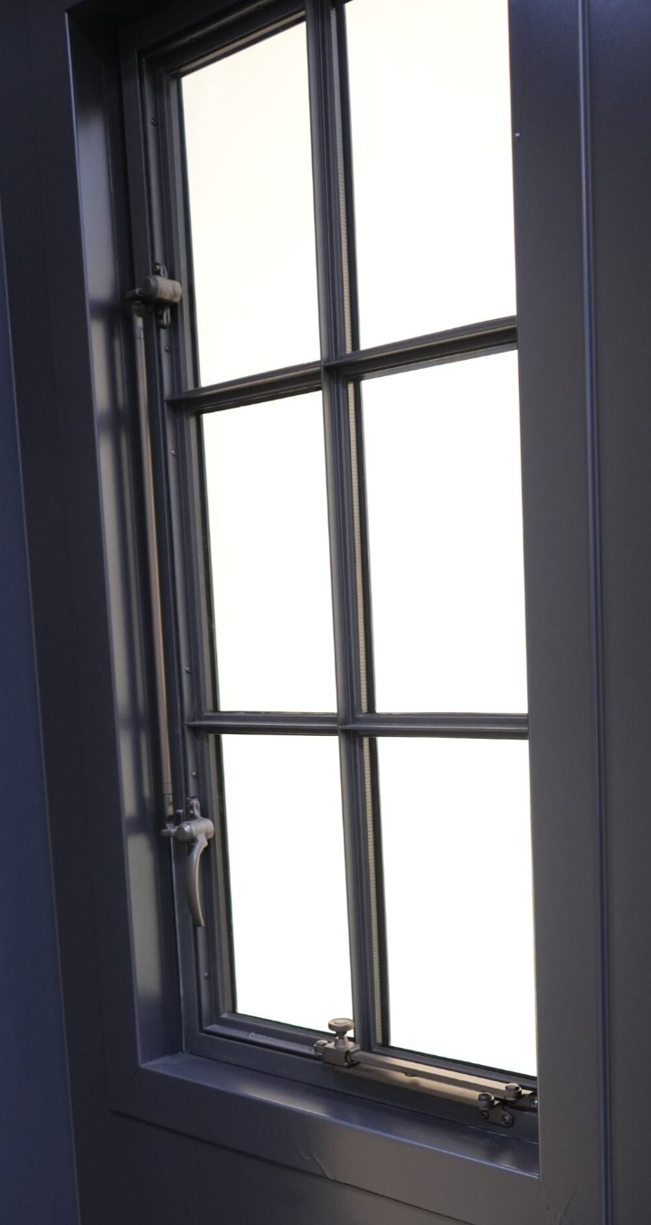
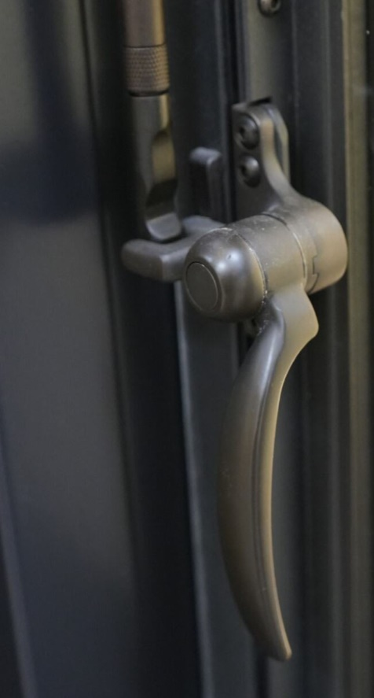
Design Characteristics of Steel
Steel windows can offer some unique historic hardware in various finish color options.
These can be ornate or very simple in design.
Notes:
On Casement, Awnings and even some Tilt-Turn (dual action) windows, the operating hardware can also be eye-catching. In the photo on the left, we see a tie bar allowing the sash to be locked in 2 locations on the frame, but only require one lever handle to operate. This can be said of tall units as well using (3) locking points. On the photo on the far right we see a “sash stay”. This may be required for a “project out” casement, where we are trying to stabilize the sash when it is open.

Slide 18
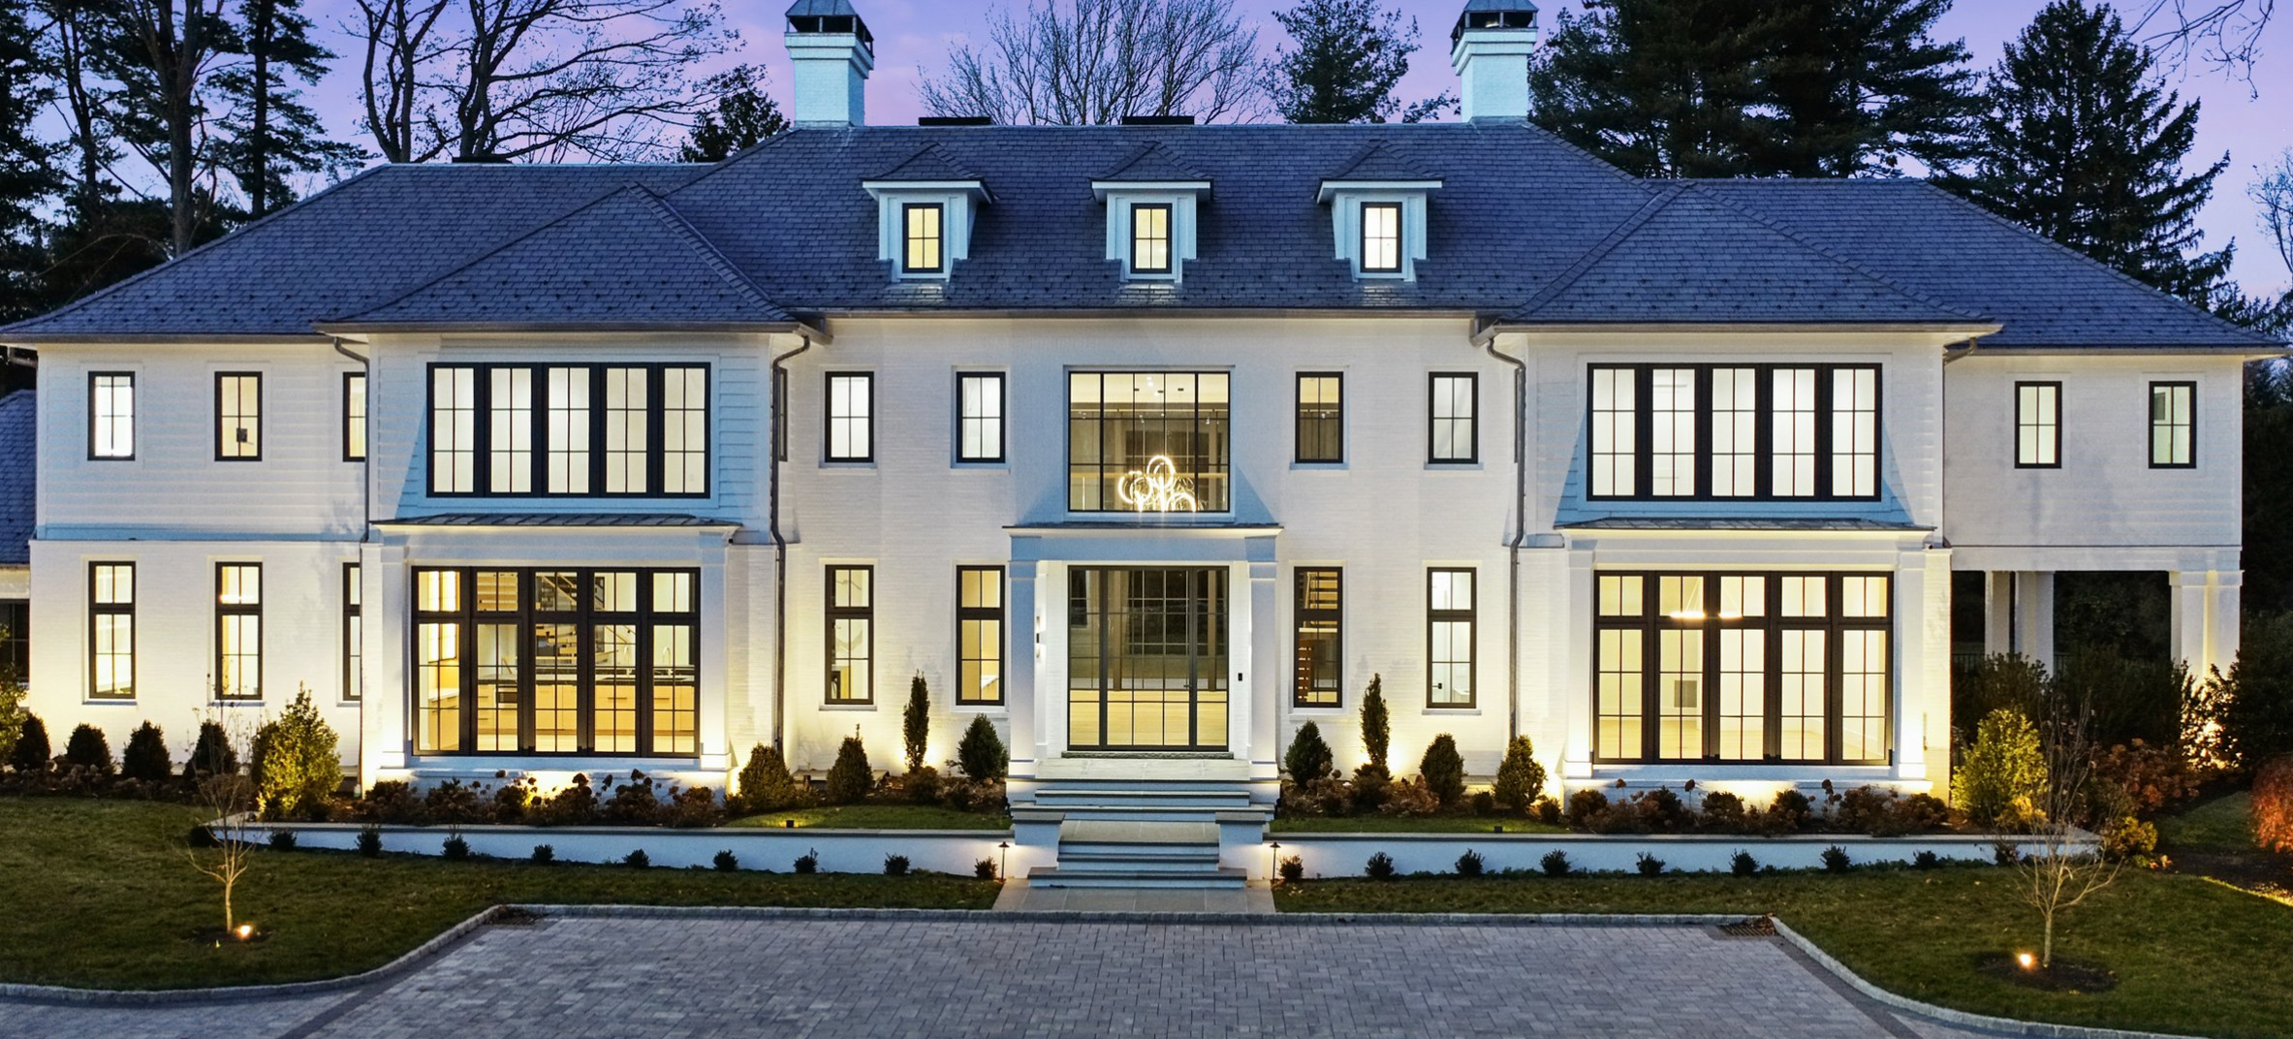
Design
Characteristics
of Steel
Another distinction of steel is to create large assemblies of windows, due to the strength. . . of steel.
Notes:
This is a large home, by a familiar window supplier in New England. The following slide shows a massive stacked assembly that is uniquely steel.

Slide 19
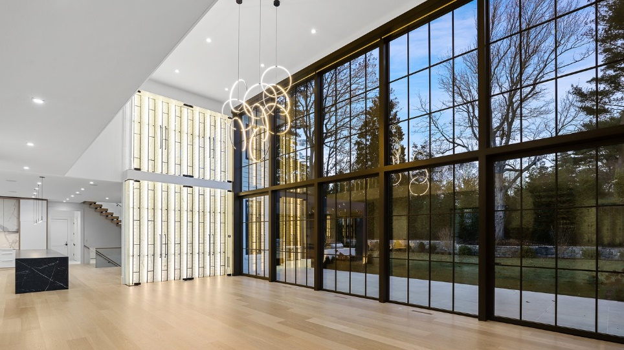
Design Characteristics of Steel
Notes:
An assembly like this would may require some flat or tube steel vertically at the mullions, but overall it would be difficult to build a massive window assembly that is close to 18’ in height out of anyh other window material.

Slide 20
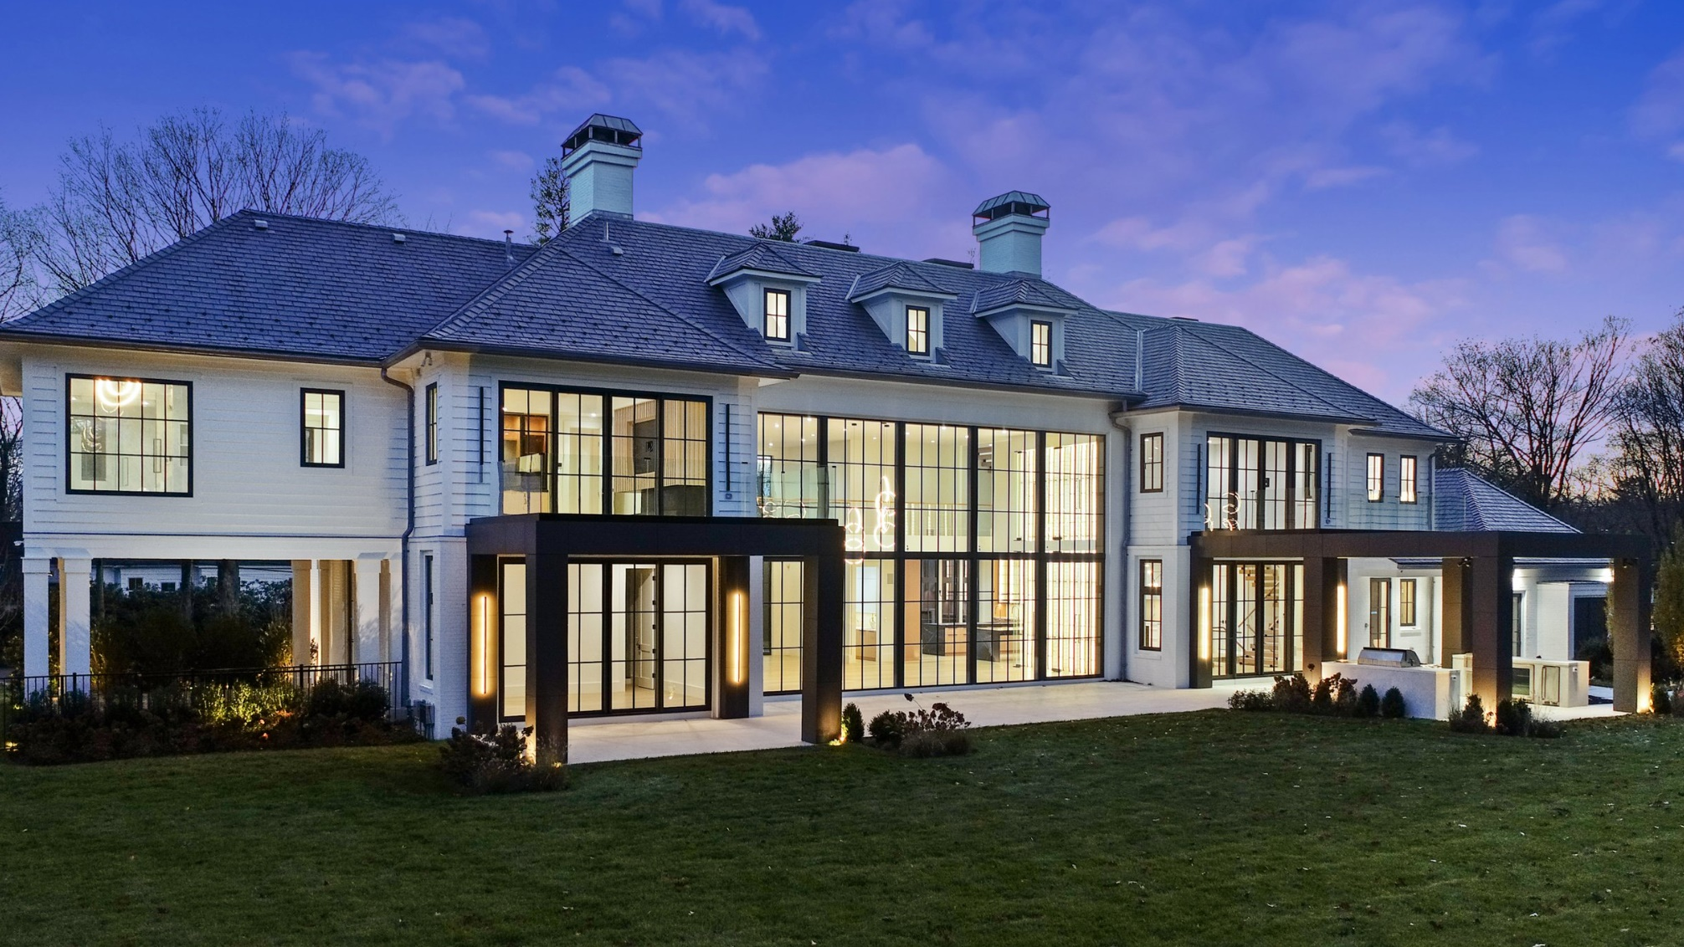
Design Characteristics of Steel
Notes:
Here is the exterior view.

Slide 21
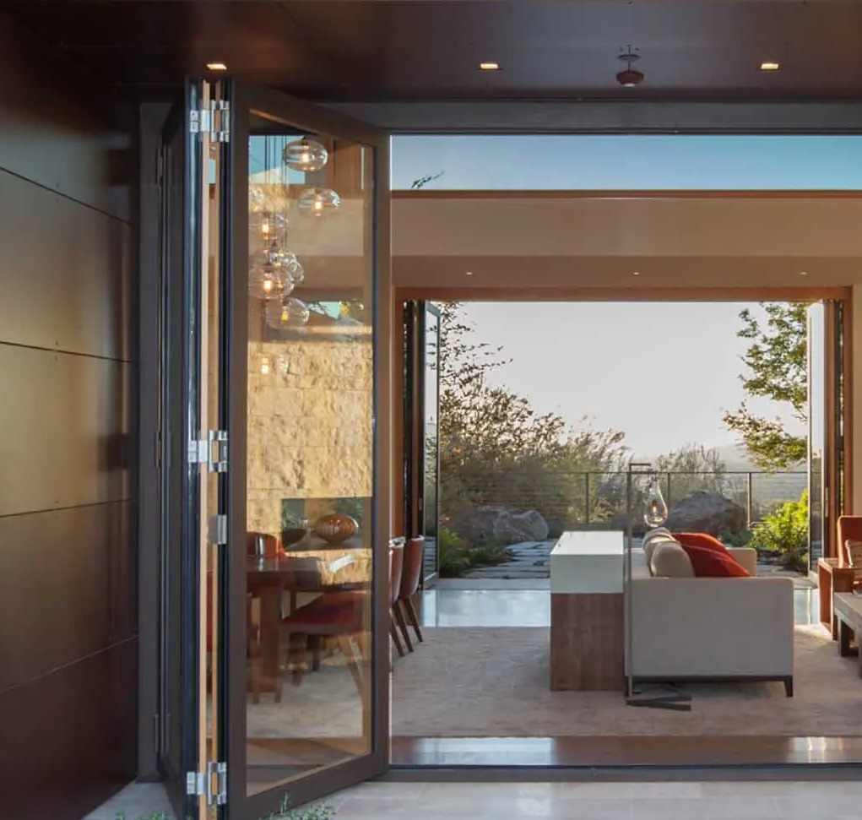
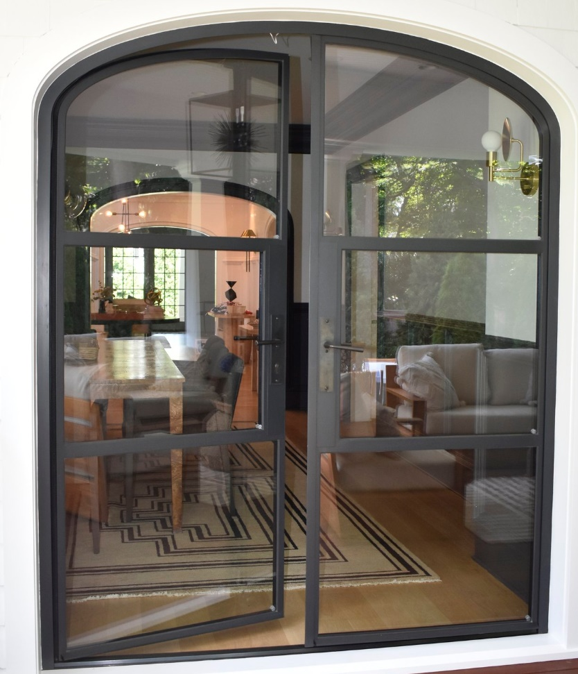
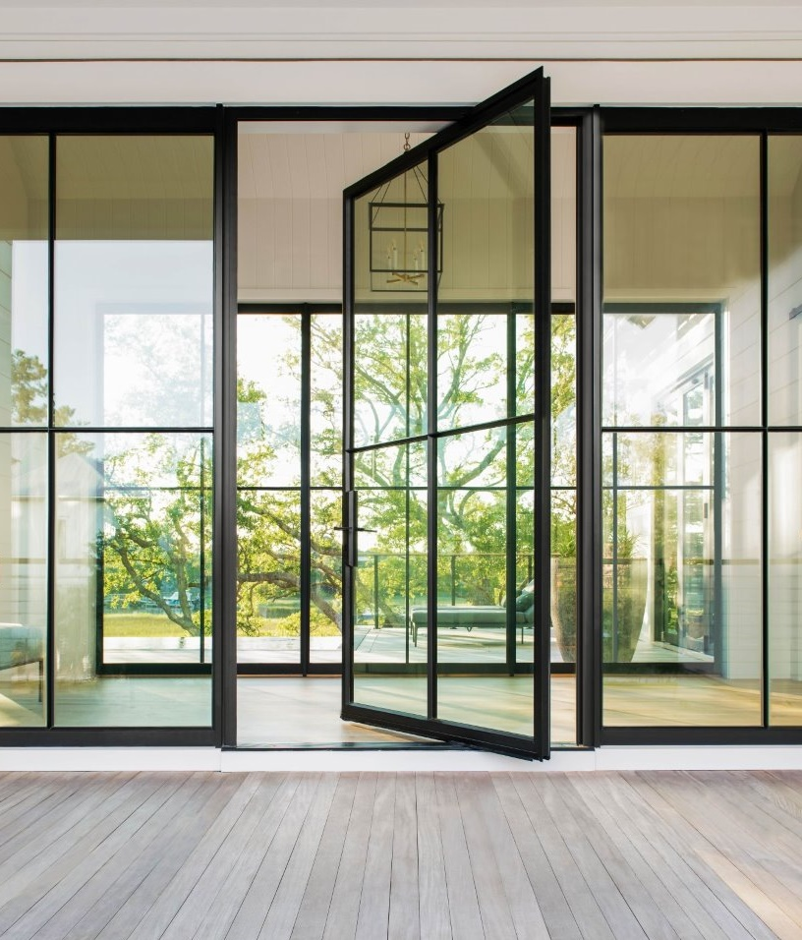
Product Operation Types - Doors
Hinged (inswing / outswing)
Lift n Slide
Multi-Slide
Bi-Fold
Pivots
Fixed panels
Notes:
In discussing Steel door operations, here are the most common types of operating doors. Keep in mind the hardware needed for all of these systems must be extremely well engineered to withstand the constant operation and the overall weight of these steel panels and frames. Pivot door systems should be able to carry panel weights that can be as heavy as 1,000 lbs.

Slide 22
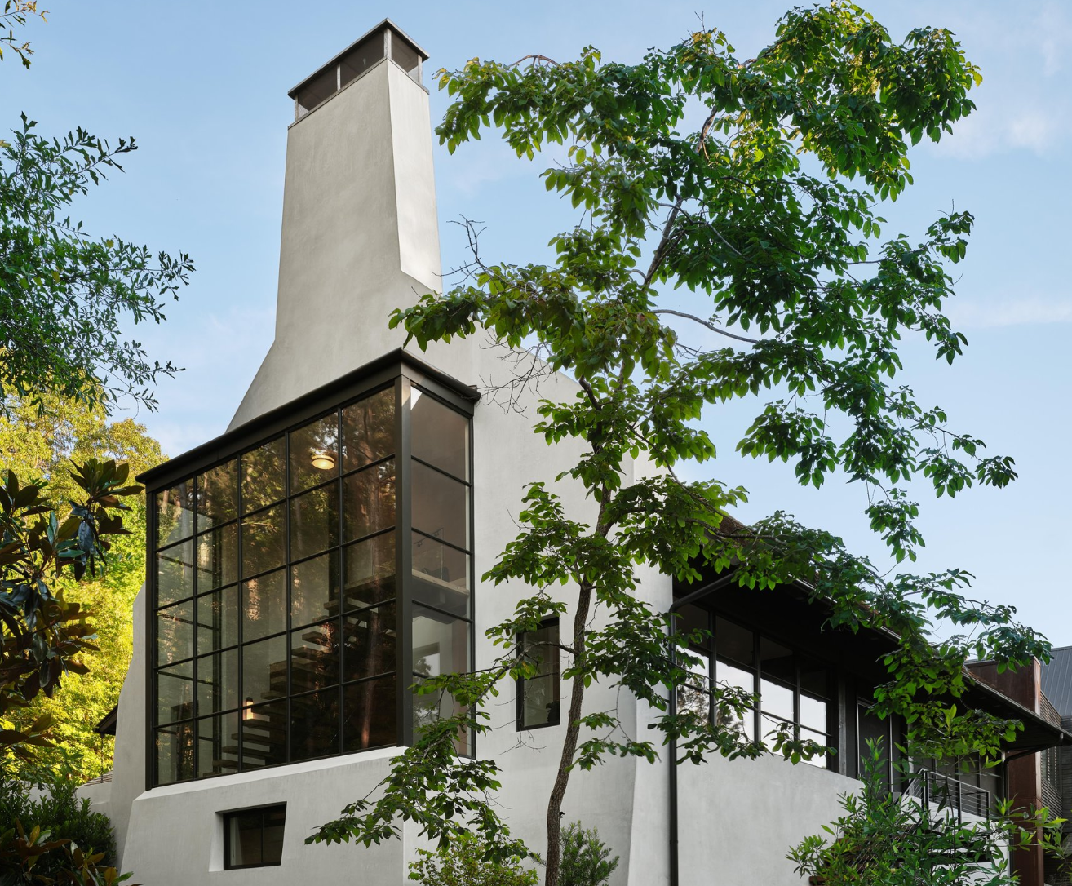
Product Operation
Types - Windows
Casements- Outswing & Inswing
Awnings-Project out
Hopper- Project In
Tilt-Turns
Pivot windows
Round tops
Arch tops
Polygon shapes
Fixed
Due to weight, typically, not featured in windows:
Sliding/Glider
Double-hungs
Notes:
Steel windows follow a very traditional operation in Casements and project out or project in windows. With some sophisticated hardware, they can even operate as a Tilt n Turn windows. We don’t often see “hung” or glider windows very often.

Slide 23
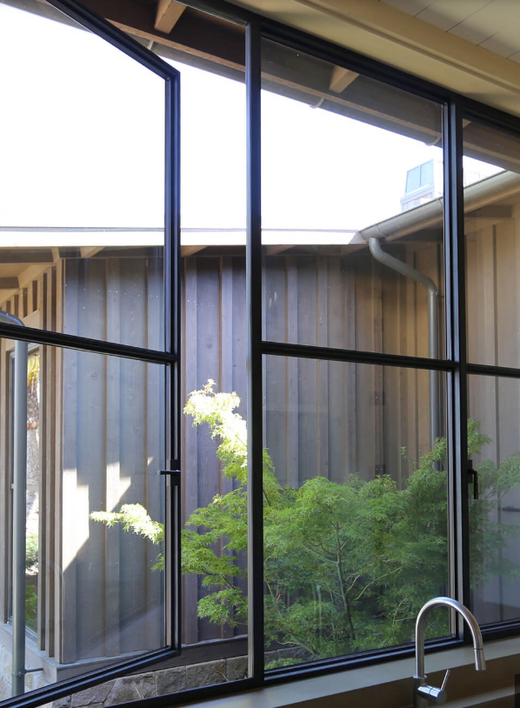
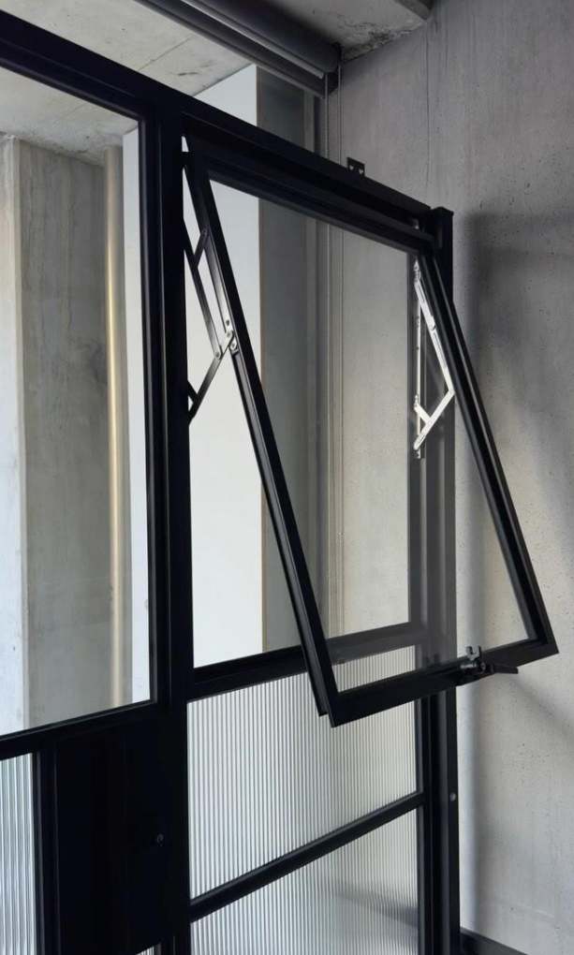
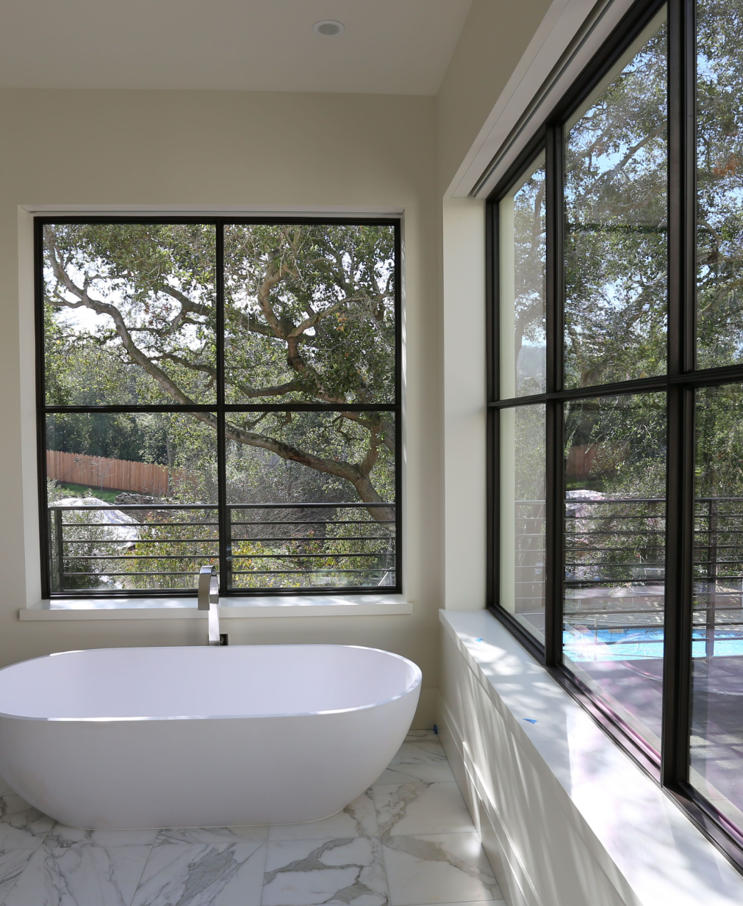
Notes:
Note the practicality of a pushout Casement. The sash can only swing so far, before the user can no longer reach the handle. Sash limiters can help with this issue.

Slide 24
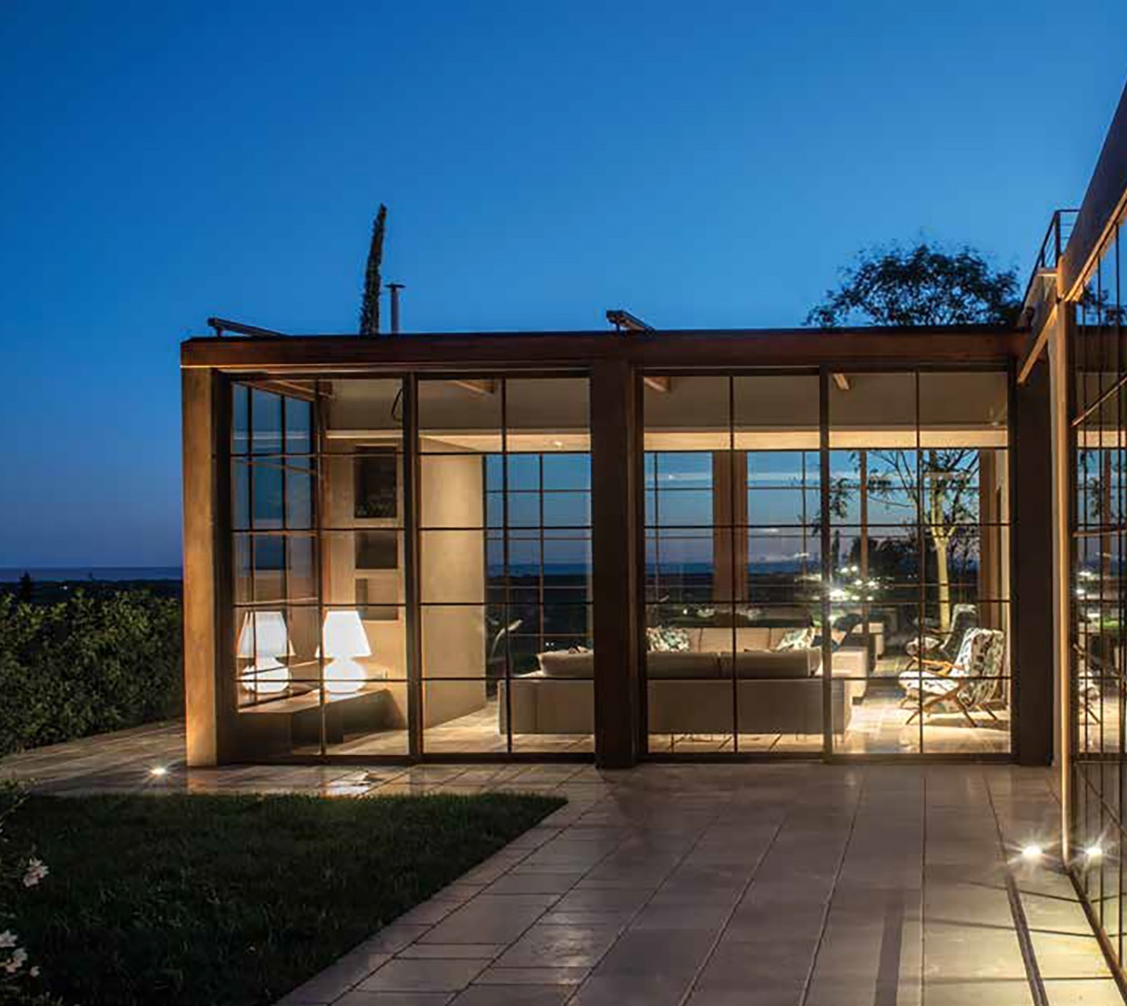
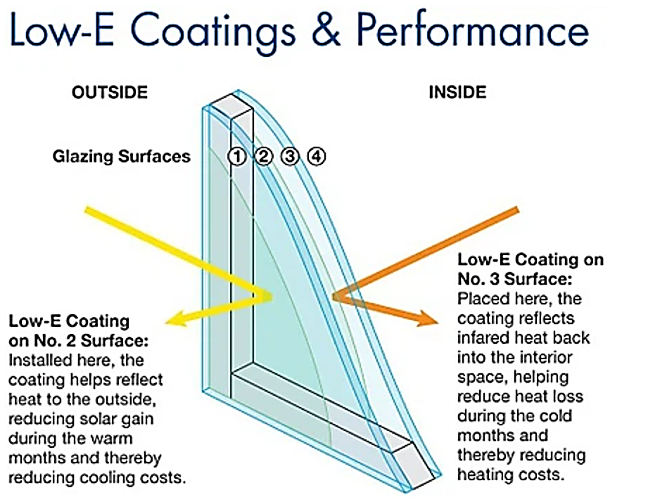
Glass & Glazing Options:
Steel window manufactures offer the current glazing technologies in their products.
Easy to access the high-performing Low E technology with gas fills for performance.
Non-thermally broken steel windows may show a measurable benefit even with the highest level of performance glazing.
Low E Coatings & Performance
Notes:
With the importance placed on energy usage in our world today, Practically all major Steel window manufactures offer the current glazing technologies in their products. It is easy to access the high performing Low E technology with gas fills for performance.
However, a non thermally broken steel window may not have a measurable benefit with overall performance even with the highest level of performance glazing.

Slide 25
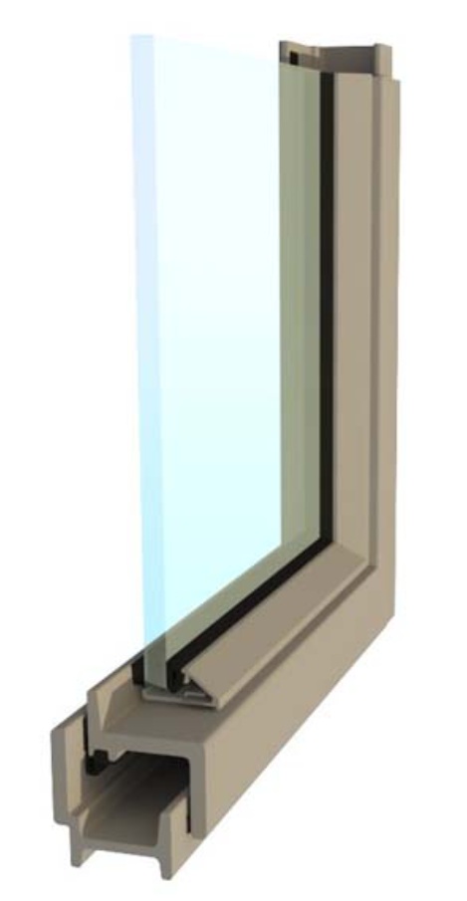
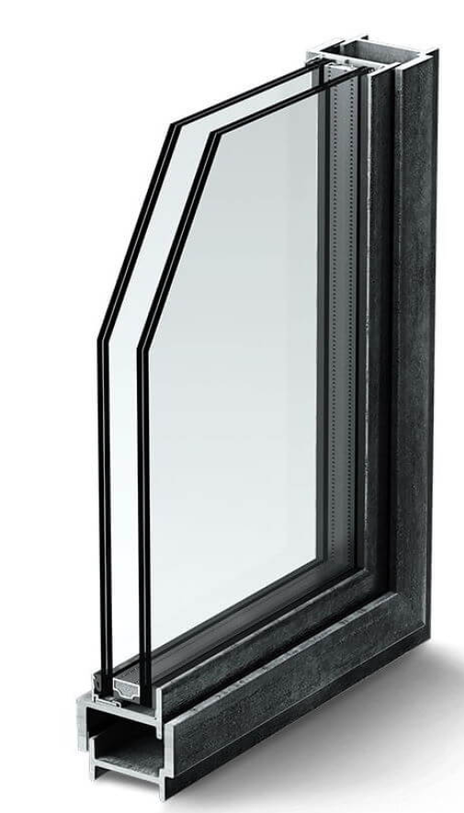
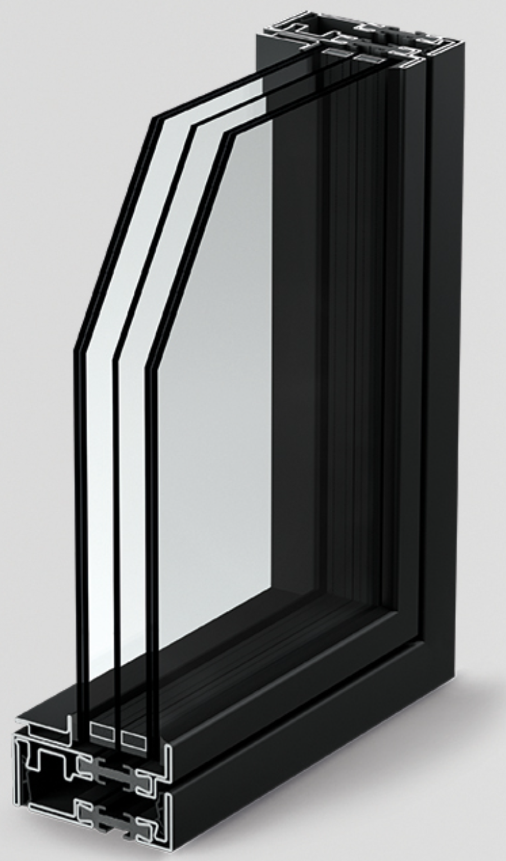
Glass & Glazing Options:
Single Pane
Dual Pane
Triple Pane
Notes:
Single, Insulated dual pane and Triple pane options with performance coatings are available in most major manufacturers.

Slide 26
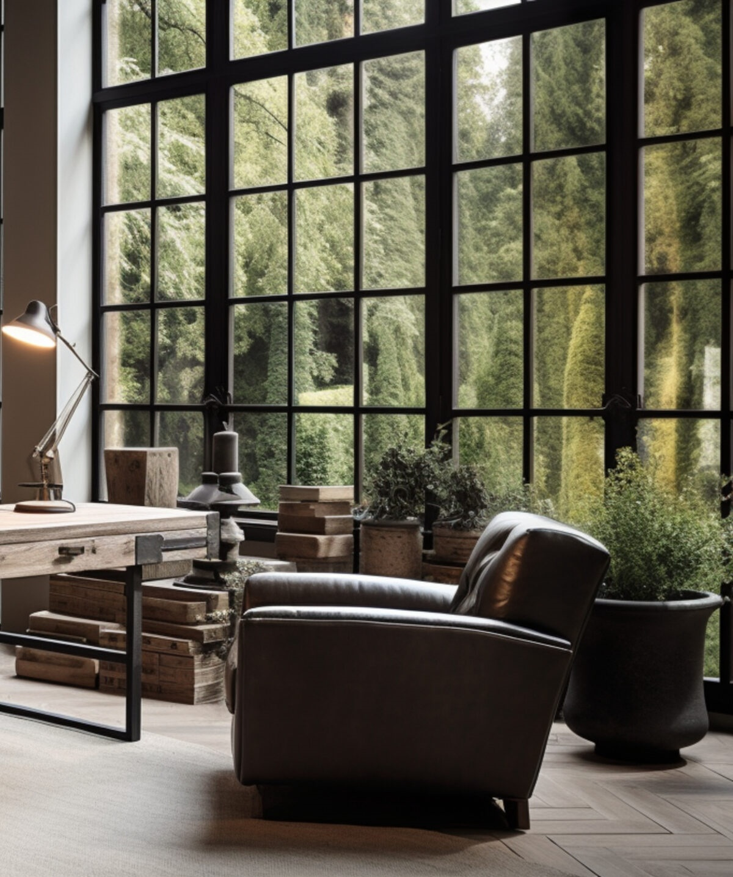
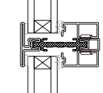
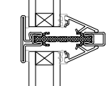
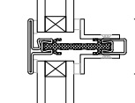
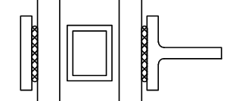
Divided Lite Options
True Divided Lites (TDL) or Authentic Divided Lites (ADL) come in a variety glazing beads.
Simulated Divided Lites (SDL) with options on the shape of the bar.
Notes:
Note some cross sections of various options in divided lites. True Divided (aka Authentic Divided Lites) are available from some larger manufacturers. Details like beveled or triangular glazing beads or the T-bar bead can provide a more historic look for Steel products.

Slide 27
Pros & Cons of Steel Windows & Doors
Pros:
Design Aesthetics
Historic & Modern
Structurally Strong
Durable–as long as finish is maintained
Large size capabilities
Security–with protective lock systems
Fire resistant–when UL certified
Sustainable–steel is a commonly recycled material.
Cons:
Conductive material compared to other materials–thermal break important
Cost–often 2x or 3x that of aluminum
Maintenance–avoid corrosion
Weight–extremely heavy
Requires expert installation with equipment
Aesthetic look is bold–not soft
Notes:
Discuss Pros & Cons of Steel product for overall qualification of a project.

Slide 28
In Summary:
Steel windows & doors may be the most dramatic material for use in fenestration today.
These products can often be specified based on the luxuriousness of the look and feel of the material and the aesthetic desires of the homeowner and designer.
When used in the right setting and location, the end result of a project can be highly successful and enjoyed for generations.

Slide 29
Thank you!
Scan Below To Register For Your CEU Credit

