Slide 1
Interior Steel and Glass
Product Line Overview

Slide 2
Types of Available Units
Standard Swing (single and double)
Pivot
Fixed
Pocket
Barn
Sliding
Variafold

Slide 3
Quick Facts
Steel Construction with Powder Coated Finish and Zinc Underlayer
Door/fixed slabs are 1-5/8” thick, units (with frame) are 1-7/8” thick
Designed to be installed into FINISHED openings
Determining unit size: take dimensions of FINISHED opening and subtract 3/8” from width and ¼” from height
If customer provides desired slab dimensions, add 1-7/8” to the width and 1-3/8” to the height to generate unit size dimensions
Swing and fixed units installed with screws through the frame
Pocket/Sliding/Barn/Variafold units mounted on tracks

Slide 4
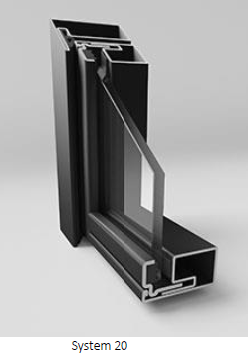
Standard Swing
Single and double door configurations
Sidelights and transoms available
Max width per panel: 48”
Max height per panel: 108”

Slide 5
Standard Swing – In-stock
Available as single and double doors
System 20 – single paned, CLEAR glass
W1, W3, W4, W6, W8
Single door
32” x 96” unit size
RHIS or LHIS
Square or Modern Handle (dummy set with magnet catch at top)
Double Door
60” x 96” unit size
Both Active INswing (small gap between door slabs)
Square or Modern Handle (dummy set with magnet catch at top)

Slide 6
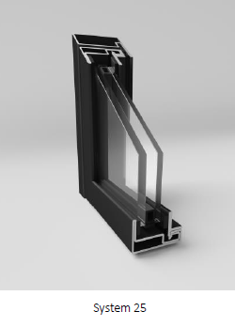
Standard Swing – Insulated
Double Paned Glass
System 25
ESG 4/ 12 / ESG 4
All glass options available
1-point locking handle preferred hardware option
Comes with threshold
Jamb Profile (matches the frame)
Standard option
Drop Sill (retractable seal)
Available upon request

Slide 7
Pivot
Equipped with pivot hinge
Available in all configurations
Slab width range: 30”- 60”
Slab height max: 108”

Slide 8
Fixed
Maximum Sizes: 60” x 108”
Any configuration (W1, W2, W3, etc.)

Slide 9
Pocket
Single Door
Double Door
Types of Pocket Hardware
Hafele Slido Set (default, in-stock option)
Hafele Hawa Porta (only in special cases)

Slide 10
Pocket Hardware – Hafele Slido
In-stock pocket door hardware option
Available for single doors, double doors, and double doors with synchronization
Includes fitting set, soft closers, track, and frame set
Available in 4 sizes for each type of door system
24-80
24-28” wide, 0-80” tall
24-96
24-28” wide, 80.01-96” tall
30-80
30-40” wide, 0-80” tall
30-96
30-40” wide, 80.01-96” tall
Maximum Weight Limit – 80kg

Slide 11
Pocket Hardware Cont. – Hafele Hawa Porta
Used for unique dimensions, something that does not fall within Slido parameters
Need to order from Hafele
Requires fitting set, aluminum track, soft closers
Does not have a frame kit like Slido
Fits 0-63” wide, 0-106” tall
Maximum Weight Limit – 100kg

Slide 12
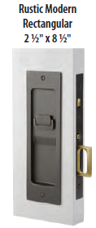
Pocket Hardware Cont. – Emtek Recessed Pulls
We can pair Emtek recessed pulls with our pocket door applications
Sandcast Bronze Rustic Modern Rectangular Pocket Door Mortise Lock
Keyed (2123)
Passage (2124)
Privacy (2125)
Dummy (2126)
Flat Black Bronze (FB)
We can use our standard pulls with the understanding that they will not enter the pocket unless pocket is wide enough to accept them.

Slide 13
Barn
Comes equipped with hardware from the factory
Not compatible with outside hardware (Emtek, Hafele, etc.)
Rails are available in lengths up to ~120”
Can connect multiple pieces to accommodate larger slabs
Maximum weight limit: 100kg

Slide 14
Sliding
Comes equipped with track hardware from the factory
Herkules 120 – comparable to Hafele in quality
Can be surface mounted on wall or mounted within the opening/ceiling
Standard distance of slab from wall is 5mm
Can be moved further if required (ex. larger baseboard on wall)
Max weight limit for sliding components: 120kg

Slide 15
Variafold
Comes equipped with standard hardware from the factory
Includes top and bottom track
Bottom track recessed into floor
Secured with flush bolts at bottom of the slab
~4mm (~1/8”) gap between panels when closed
Max size per panel: 36” x 96”
Max number of panels: 8 panels per direction

Slide 16
Finishes
5 Standard Finishes
RAL-7016 / ANTHRACITE GREY
RAL-7022 / UMBRA GREY
RAL-9003 / WHITE
RAL-9005 / BLACK
RAL-DB703 / LIGHT GREY
Other RAL options available upon request, but check with the Glenview Doors team before offering to a customer

Slide 17
Hardware
Handles/Pulls
1-point magnetic lock, opened only with a handle

Slide 18
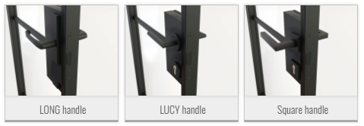
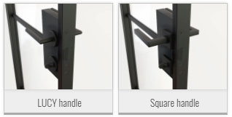
Hardware Cont.
1-point magnetic lock with a patent insert (keyed)
1-point magnetic lock with a WC type insert (thumbturn)

Slide 19
Glass
10 custom options
Clear (standard)
Privacy Options (addtl. $400 per panel)
Satinato
Bronze
Graphite
Satinato Graphite
Dark Graphite
Fluted
Fluted Matte
Estriado
Wired

