Slide 1
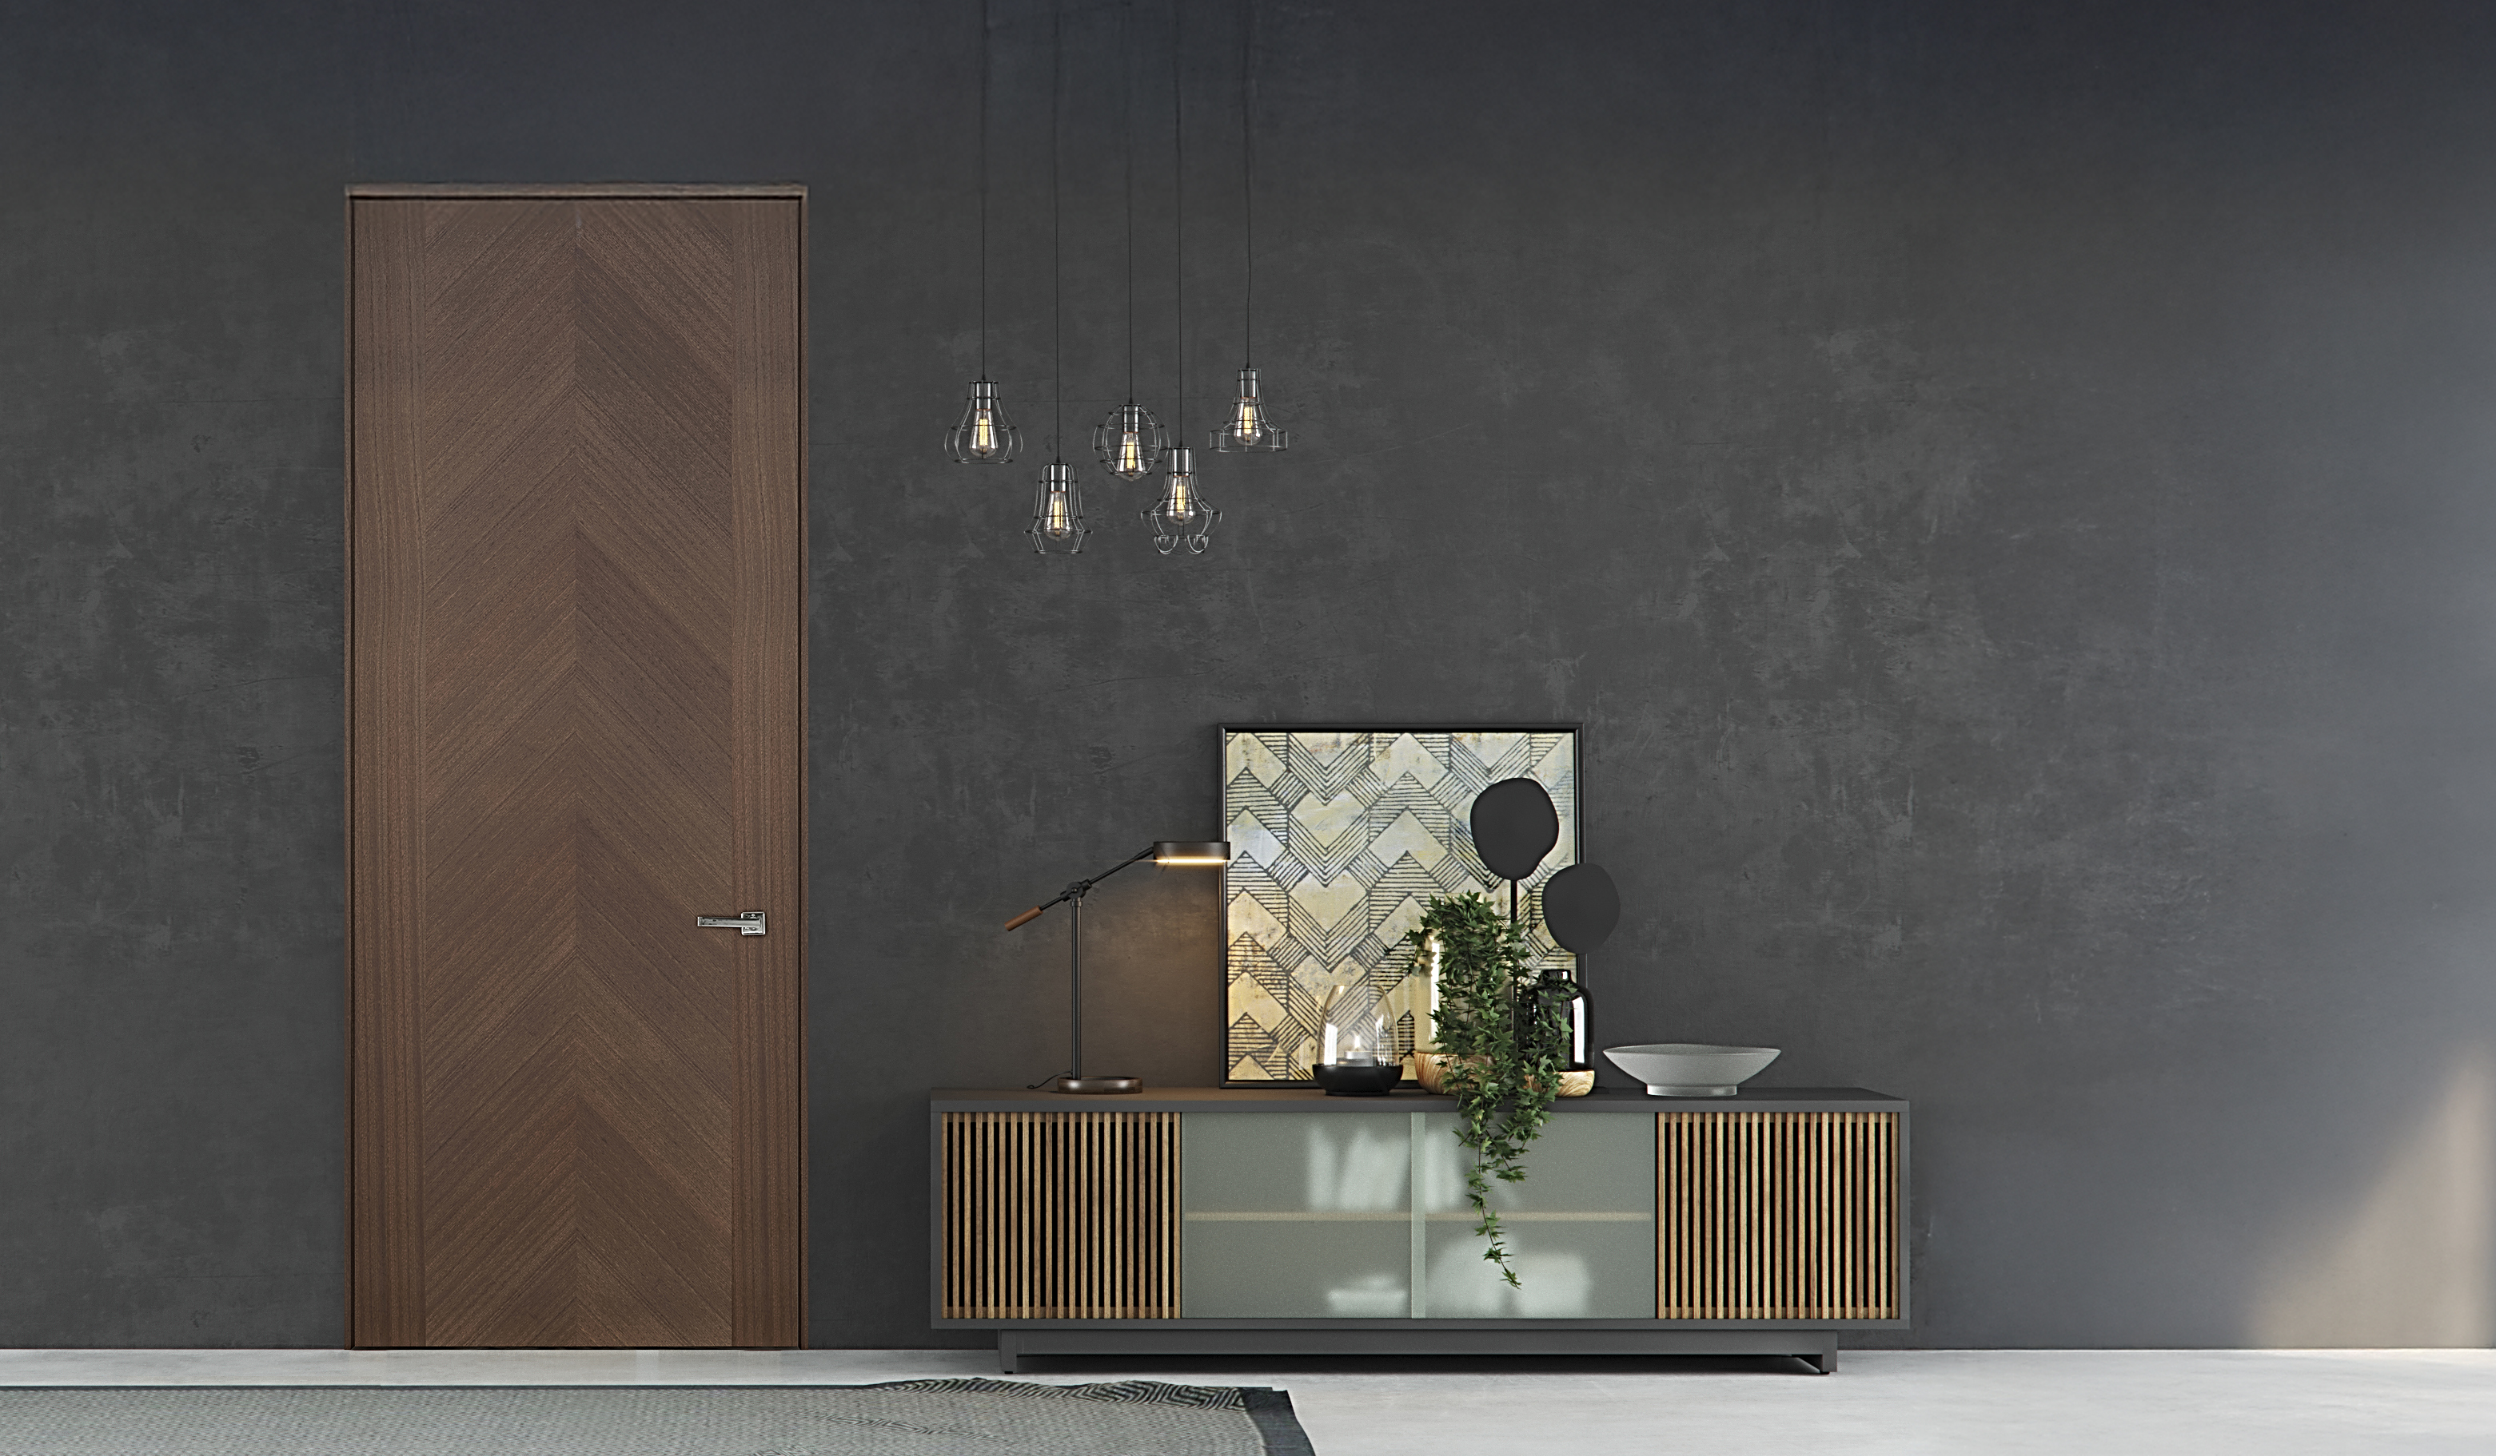


Designing with Solid-Core Interior Doors
Performance, Aesthetics & Application Considerations
Notes:
Welcome, and thank you for joining us today. In this session, we’ll explore the performance, aesthetics, and application considerations for solid-core interior doors. We’ll look at how construction choices, materials, hardware, and installation methods all work together to impact durability, functionality, and design outcomes. Our focus will be on equipping you with practical information you can apply to your own projects, whether residential or commercial.

Slide 2
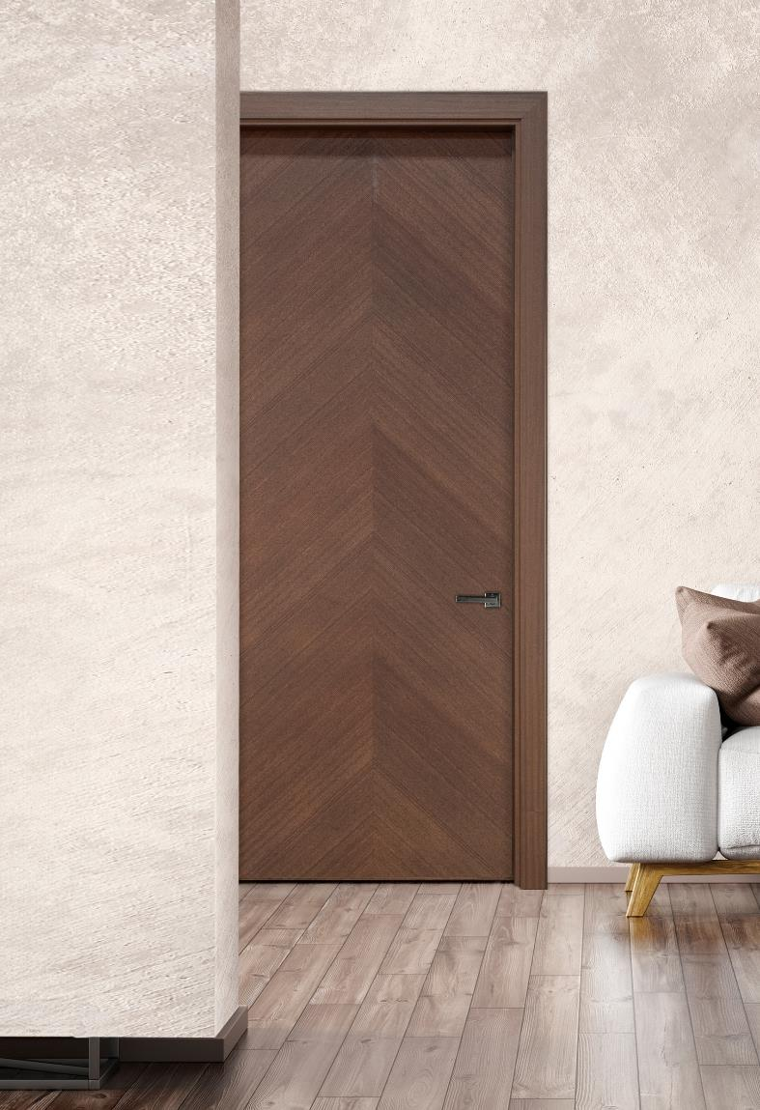

Learning Objectives
Construction
Understand the differences between solid-core and hollow-core interior doors
Design & Performance
Explore design and performance factors (sound, durability, finish options)
Configurations & Architectural Integration
Learn about configuration types and architectural integration (frameless, trimless, pocket, etc.)
Materials & Hardware
Compare materials, veneers, and hardware to support design intent and longevity
Notes:
By the end of today’s course, you’ll be able to: First, understand the differences between solid-core and hollow-core interior doors and why these differences matter for performance. Second, evaluate key design and performance factors, including sound control, durability, and finish options. Third, identify configuration types and how they integrate into various architectural styles, from frameless and trimless to pocket and barn doors. And finally, compare materials, veneers, and hardware so you can make informed specifications that align with both design intent and long-term durability

Slide 3
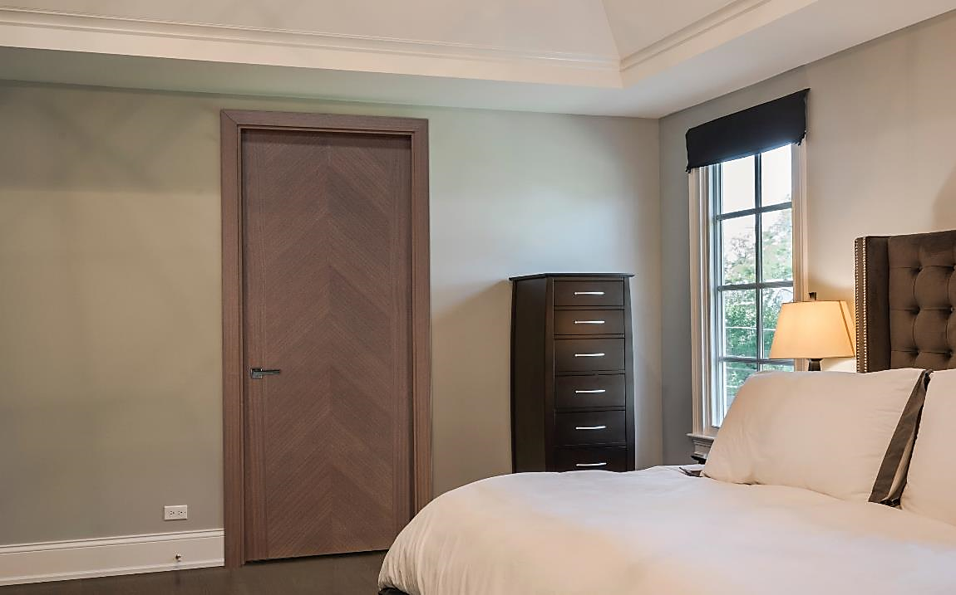
Why Door Construction Matters
Feature | Solid-Core Doors | Hollow-Core Doors
Sound Control | Superior acoustic performance | Minimal sound blocking
Durability | Withstands daily use in high traffic areas | Prone to dents, cracks and punctures
Weight | Heavier, more substantial, high-end feel | Lightweight, less substantial, lower quality
Fire Resistance | Easier to meet requirements | Rarely meet requirements
Repairability | Easy repair on small dents/scratches | Often irreparable
Aesthetics | Crisper edges and higher-quality finishes | Basic finishes, surface can feel thin/hollow
Perception | Premium quality | Entry-level or builder-grade
Notes:
Door construction is more than just a structural choice—it directly impacts how a space looks, feels, and performs. Solid-core doors offer a heavier, more substantial feel, better sound control, and higher durability. They can last decades in the right application. Hollow-core doors, while lighter and more economical, often lack acoustic performance and can feel less substantial. From an architectural perspective, the choice between the two affects occupant comfort, privacy, and perceived quality.

Slide 4
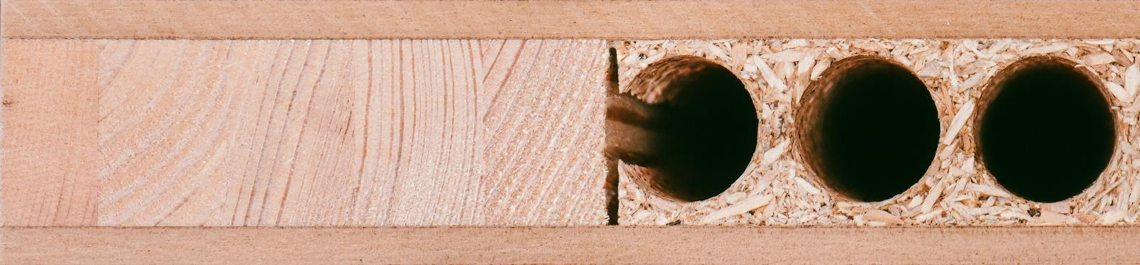
Anatomy of a Solid-Core Door
CROSSBAND:
MDF - Fiberboard of medium density.
CORE:
Durable, long-lasting RT8 natural fiber board, which decreases sound.
STILES & RAILS:
FACE VENEER:
FINISH:
Solid engineered wood stiles and rails with matching edges.
Available in popular wood species Mahogany, Oak or MDF.
Our factory-finish is water based and has a UV cured finish.
Notes:
Let’s look at the anatomy of a typical solid-core interior door. The stiles and rails are built from solid engineered wood, which provides structural integrity and reduces warping. A dense core material—often MDF or natural fiberboard—adds weight and dramatically improves sound attenuation. A crossband layer stabilizes the face veneer, and the finish layer—whether it’s wood veneer, painted MDF, or a synthetic finish—provides the final aesthetic and surface protection. This layered approach ensures both performance and design flexibility.

Slide 5
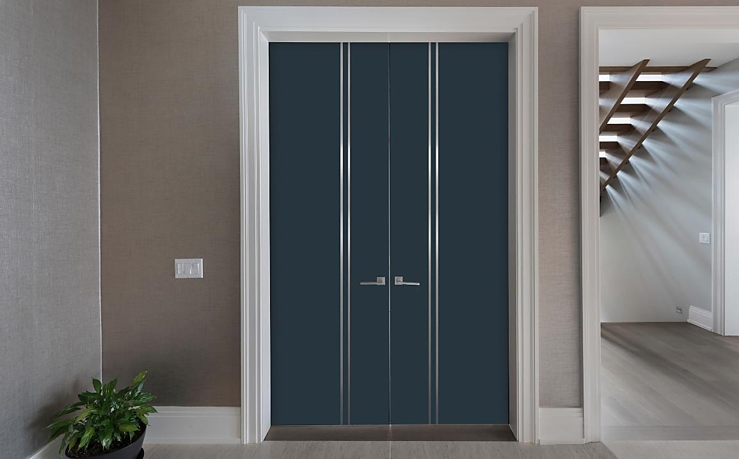
Veneer & Finish Technologies
Natural Wood Veneers (oak, mahogany): premium look, can be stained or painted.
Lacquered MDF: smooth, consistent finish for modern designs.
Eco-synthetic veneers: durable, abrasion-resistant, moisture-resistant, mimics real wood.
Considerations:
Thickness of veneer (1/32” vs. 1/16”).
UV-cured water-based finishes for durability.
Matching finishes across multiple spaces.
Notes:
There are three primary veneer and finish categories we’ll discuss: Natural wood veneers, such as oak or mahogany, provide a premium, authentic look that can be stained or painted. Lacquered MDF delivers a smooth, consistent surface that works well in contemporary designs. And eco-synthetic veneers offer exceptional durability, abrasion resistance, and moisture resistance, while replicating the appearance of real wood. When specifying veneers, consider thickness, finish type, and how to maintain a consistent look across multiple spaces.

Slide 6
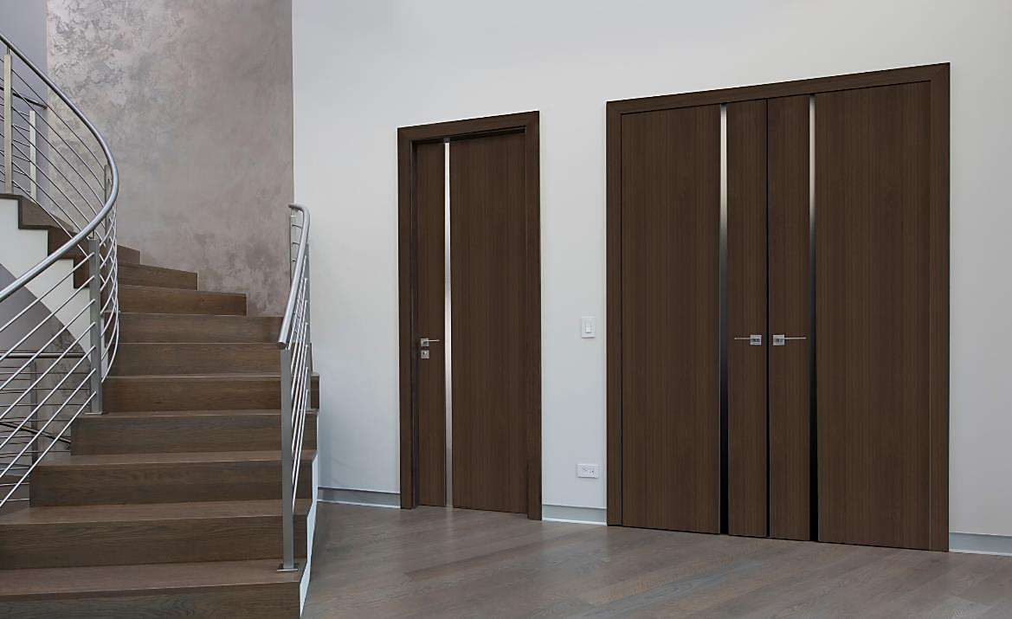
Hardware That Elevates Performance
Magnetic latches:
Quieter, smoother operation than traditional spring latches.
Minimal protrusion for a cleaner look.
Concealed hinges:
Hidden from view for seamless aesthetics.
3D adjustability for precise alignment.
Hardware finishes can coordinate or contrast with design palette.
Notes:
Hardware choices can significantly influence both performance and aesthetics. Magnetic latches, for example, offer smoother, quieter operation than traditional spring latches, and their minimal projection creates a cleaner look. Concealed hinges hide the mechanics from view while allowing precise 3D adjustments for perfect alignment. Hardware finishes can either blend in or intentionally contrast, depending on your design goals. Early coordination between hardware and door specification avoids fit and function issues later.

Slide 7
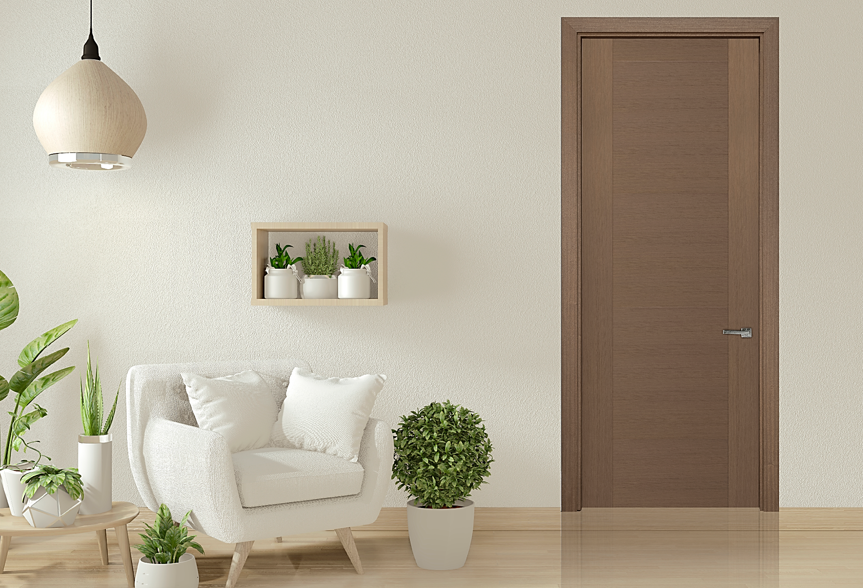
Acoustic Performance
Core material and density significantly influence Sound Transmission Class (STC) rating.
Solid-core with engineered fiberboard achieves superior privacy in bedrooms, offices, or hospitality settings.
Thicker slabs (1-3/4”) contribute to lower sound transfer.
Solid-core doors can reduce sound transfer by up to 50% more than hollow-core doors in comparable installations.
Hollow-core doors may allow normal speech to be heard clearly from adjacent spaces, while solid-core options significantly muffle voices and background noise.
Notes:
Acoustic performance is often underestimated in interior spaces. Core material and density directly affect a door’s Sound Transmission Class, or STC, rating. Solid-core doors with dense engineered cores can reduce sound transfer by up to 50% compared to hollow-core doors in similar installations. They’re ideal for bedrooms, offices, and hospitality environments where privacy is a priority. Hollow-core doors, by contrast, often allow normal speech to carry clearly between rooms, which can undermine privacy and comfort.

Slide 8
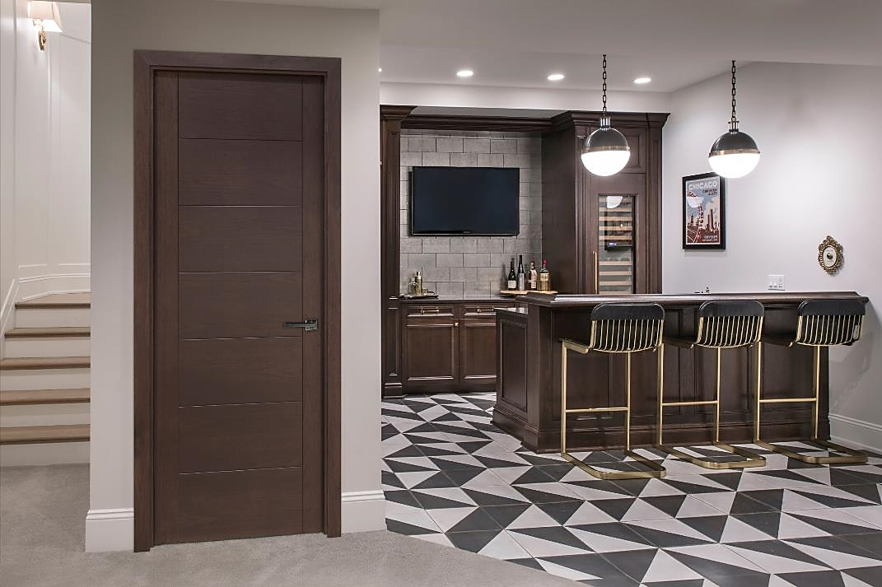
Fire-Rated Interior Doors
Certain applications require 20-minute fire-rated doors for safety compliance.
Key differences:
Solid wood or equivalent high-density frame materials.
Specific hardware approvals (UL-listed locks, closers).
Size limitations for rating compliance.
Not all veneer types can be applied to fire-rated doors, early specification is key.
Notes:
In some applications, a fire-rated interior door is required to meet safety codes. A 20-minute rating is common for certain residential and light commercial uses. To achieve that rating, the door and frame must be made from specific materials—often solid wood or equivalent high-density substrates—and paired with approved hardware, such as UL-listed locks and closers. It’s important to note that not all veneer or finish types are compatible with fire-rated construction, so early coordination in the design process is essential

Slide 9
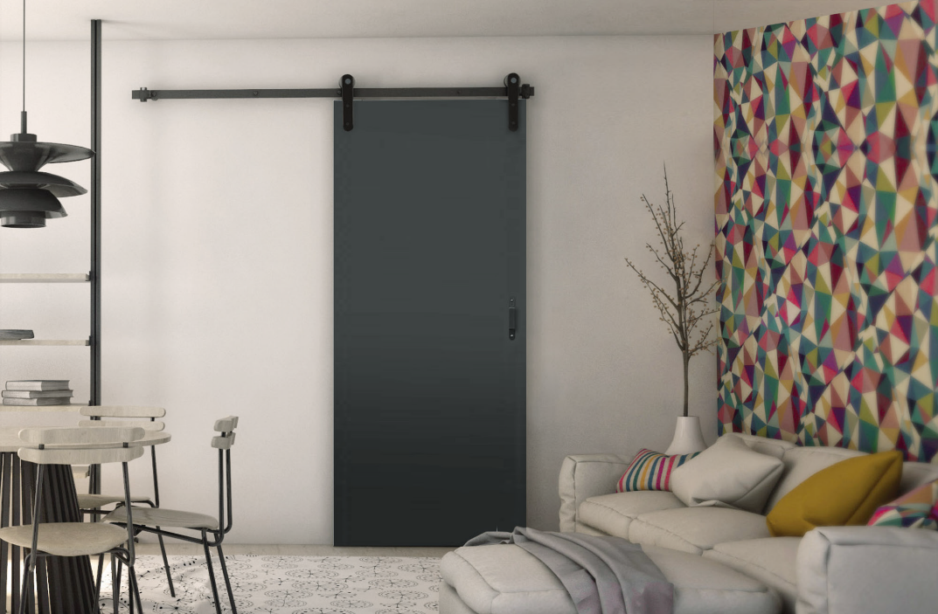

Configurations
For Modern Design
Notes:
Solid-core interior doors can be specified in a range of configurations. Swing doors remain the most common, but frameless and trimless installations create a clean, contemporary look. Pocket doors save space in tight layouts, while barn doors and sliding systems can function as design statements. Choosing the right configuration depends on both the functional needs of the space and the overall design intent.

Slide 10
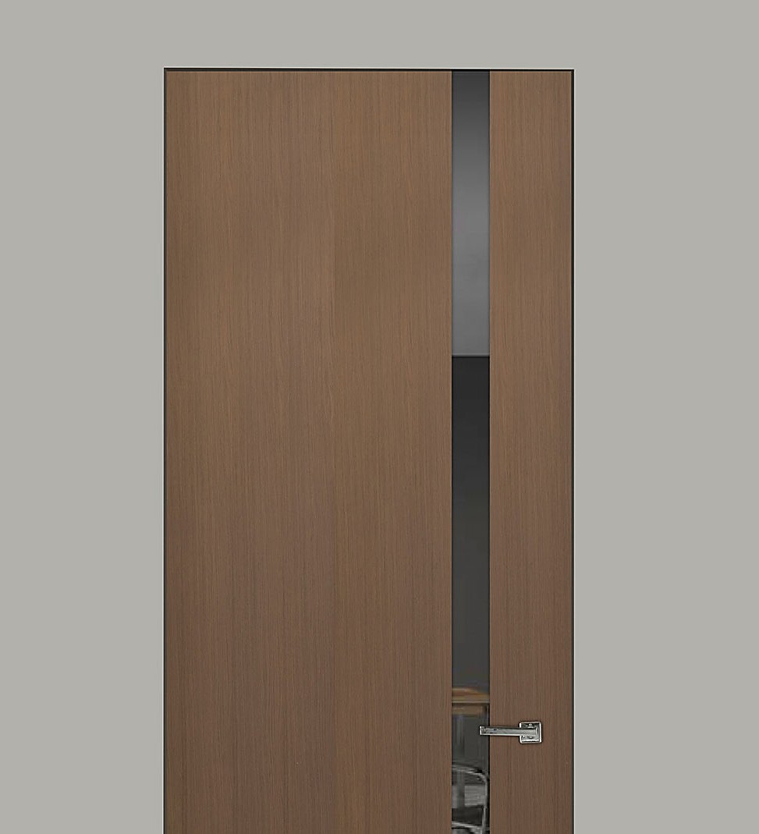
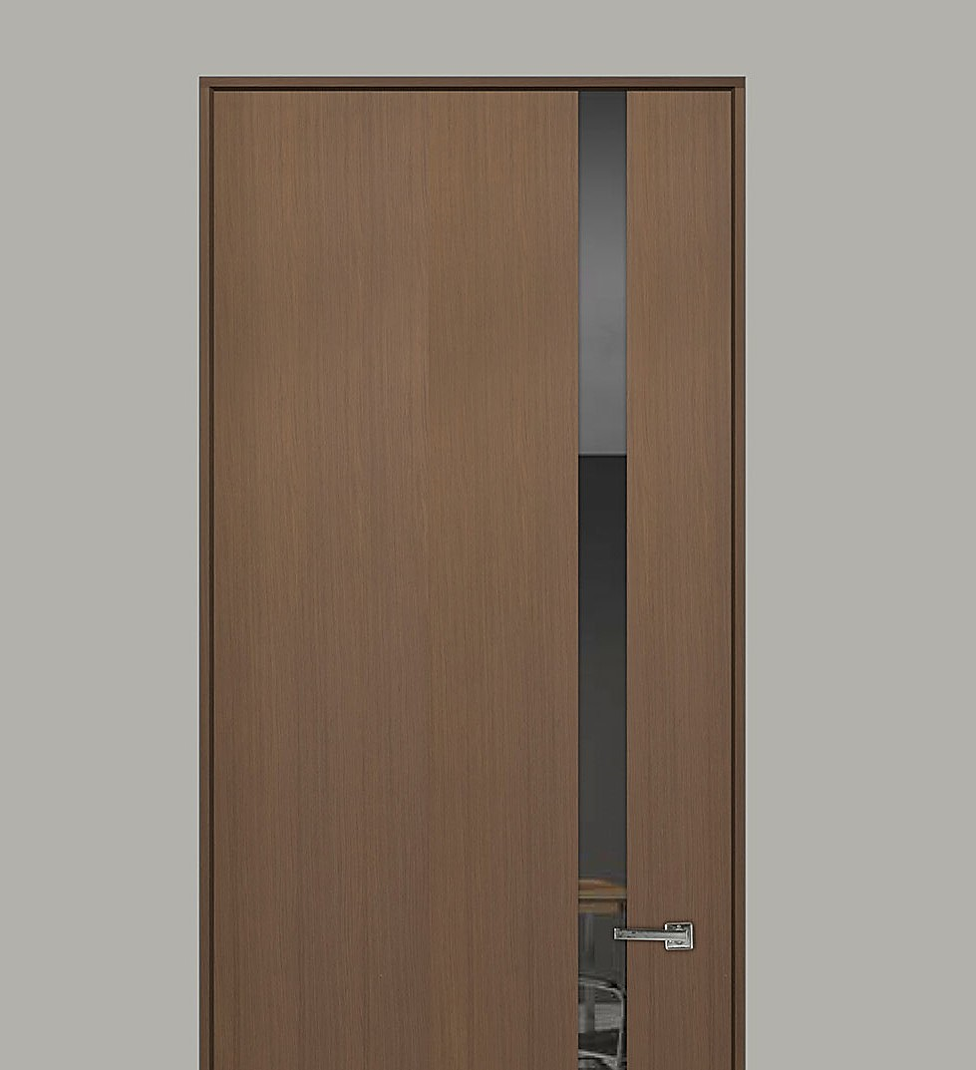
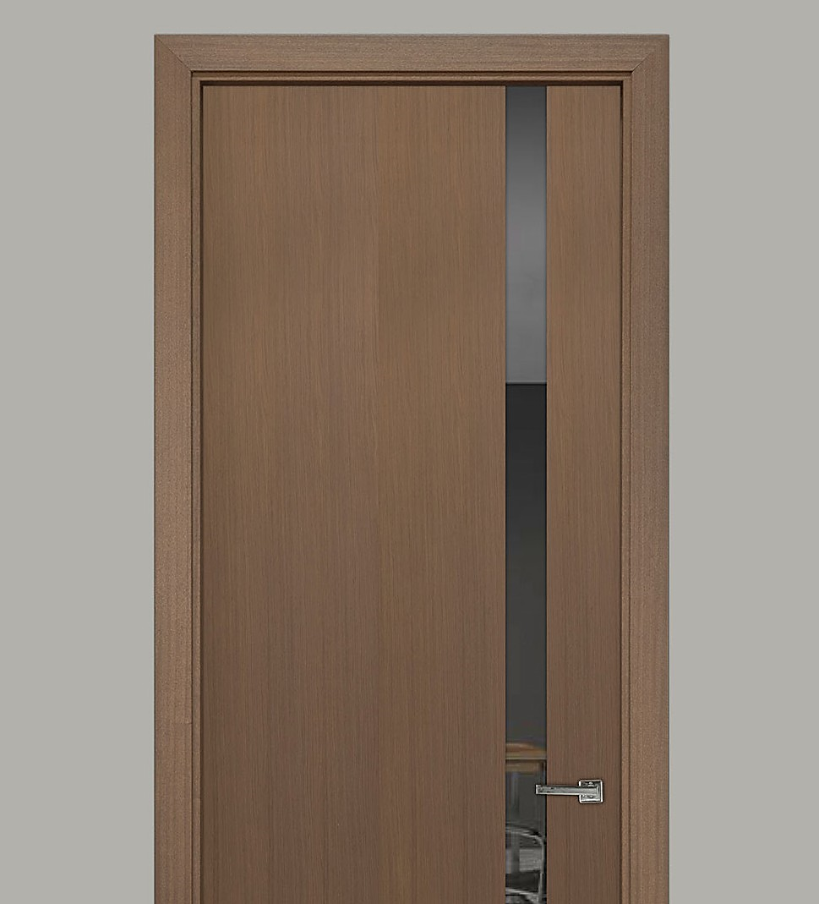
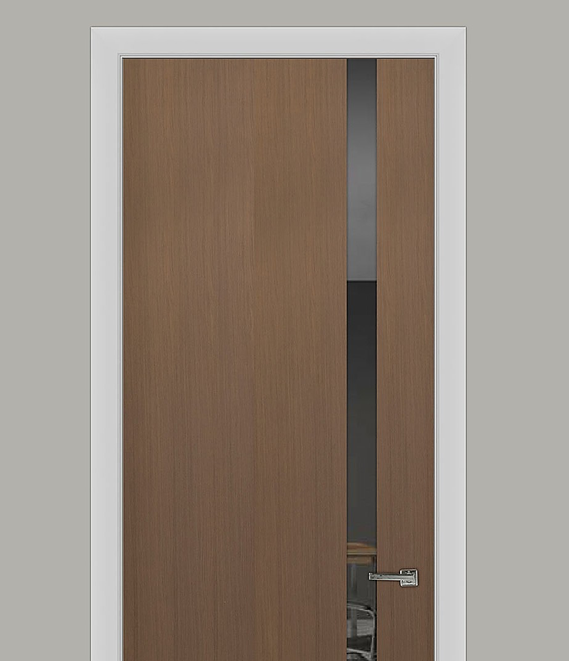
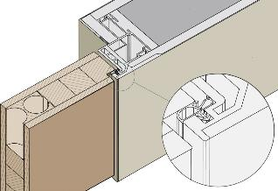
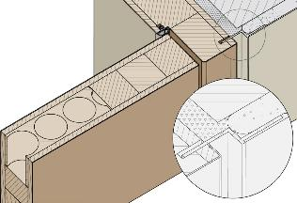
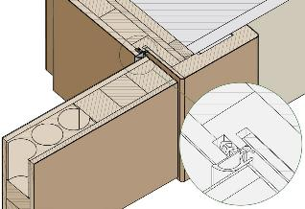
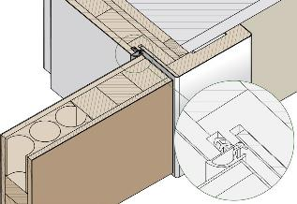
L-Bead, Z-bead and Trimless Installations
FRAMELESS
TRIMLESS
MATCHING
WHITE
Notes:
Installation detailing impacts the finished look of the door and wall interface. L-bead and Z-bead trimless jambs integrate directly with drywall, creating a minimal reveal or completely flush look. Frameless jambs eliminate casing altogether, aligning the door face with the wall plane. These approaches are especially popular in modern architecture, where the goal is to maintain clean lines and visual simplicity.

Slide 11
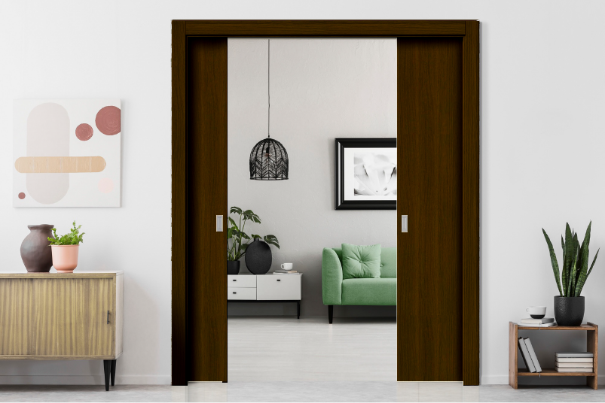
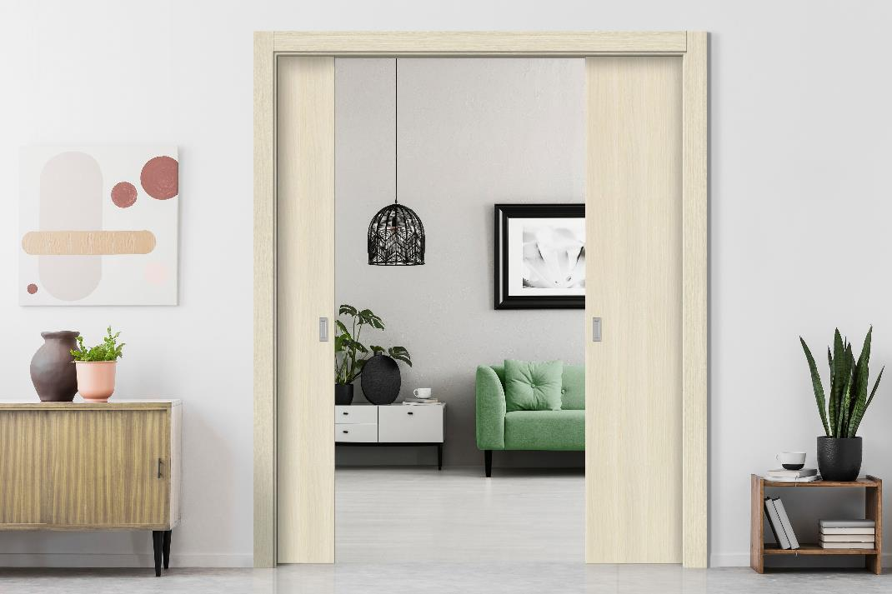
Finish & Color Considerations
Stains highlight wood grain and bring warmth.
Painted finishes offer versatility in color matching.
Synthetic wood-looks provide durability for high-traffic or humid areas.
Consider light exposure — dark stains can fade; light colors can yellow over time without UV protection.
Notes:
Finish choice is about more than just color—it affects durability, maintenance, and how the door ages over time. Stains enhance natural wood grain and bring warmth. Painted finishes offer versatility for color matching and design coordination. Synthetic wood-look finishes are a practical choice for high-traffic or humid environments. Consider how light exposure will impact the finish—dark stains can fade, and lighter tones may yellow without UV protection.

Slide 12
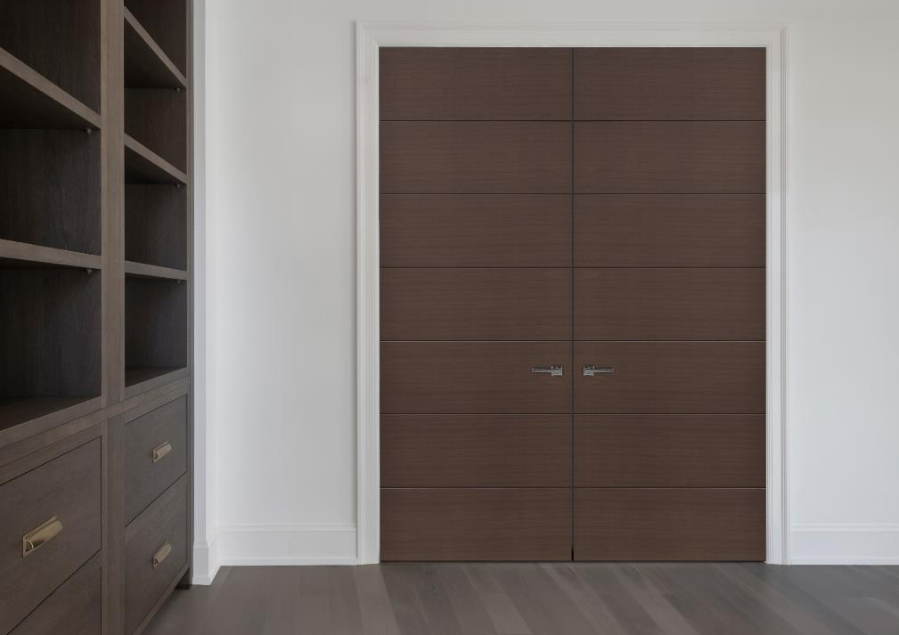
Glass & Inlay Options
Glass Inserts
Allow natural light flow and visual connection between spaces.
Common types: clear for openness, frosted for privacy, tinted for glare reduction, textured for decorative effect.
Use laminated or tempered glass for safety compliance.
Metal & Decorative Inlays
Add linear or geometric accents for modern or custom aesthetics.
Materials include stainless steel, aluminum, and brass.
Flush designs improve durability and ease of maintenance.
Design Tip: Always balance aesthetics with privacy, light control, and code requirements.
Notes:
Glass inserts and decorative inlays can transform an interior door from a simple divider into a design feature. Glass can range from clear for openness, to frosted for privacy, to tinted or textured for a specific design effect. Metal inlays add linear or geometric accents, enhancing modern aesthetics. Always balance these decorative choices with privacy needs, light control, and safety requirements, such as using laminated or tempered glass.

Slide 13
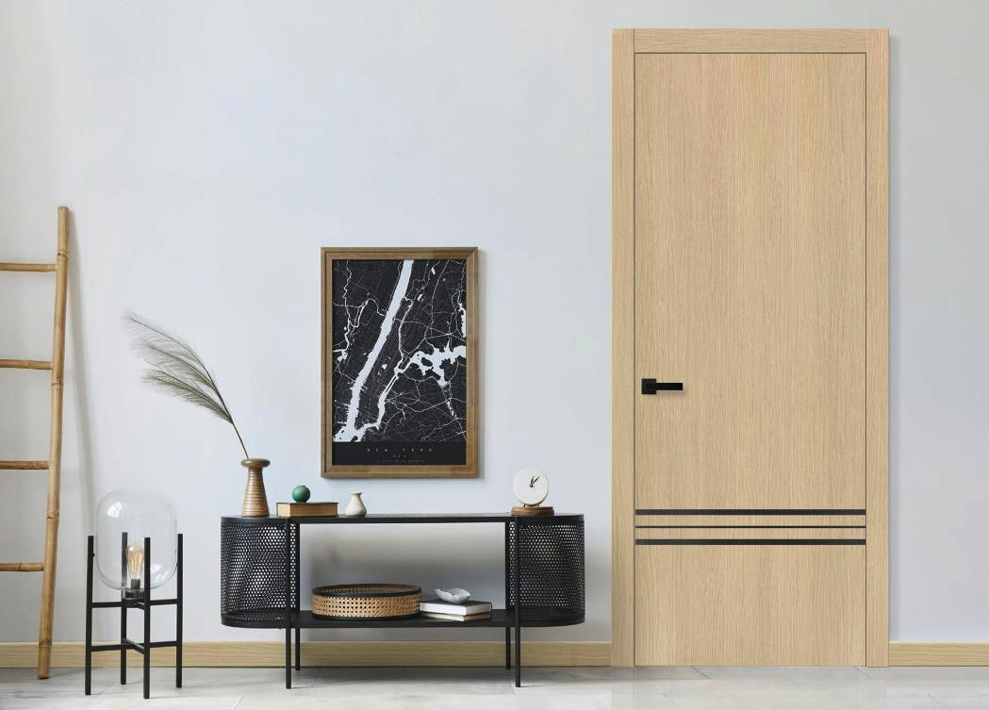
Environmental & Performance Standards
Low-VOC adhesives and finishes improve indoor air quality.
FSC-certified cores support sustainable sourcing.
Eco-synthetic veneers reduce reliance on exotic hardwoods while preserving design flexibility.
Moisture-resistant cores ideal for bathrooms or humid climates.
Notes:
Environmental considerations are becoming increasingly important in material selection. Low-VOC adhesives and finishes improve indoor air quality. FSC-certified cores support sustainable sourcing. Eco-synthetic veneers help reduce the use of exotic hardwoods while offering similar visual qualities. In some cases, moisture-resistant cores may be the best choice for bathrooms, kitchens, or other humid environments.

Slide 14
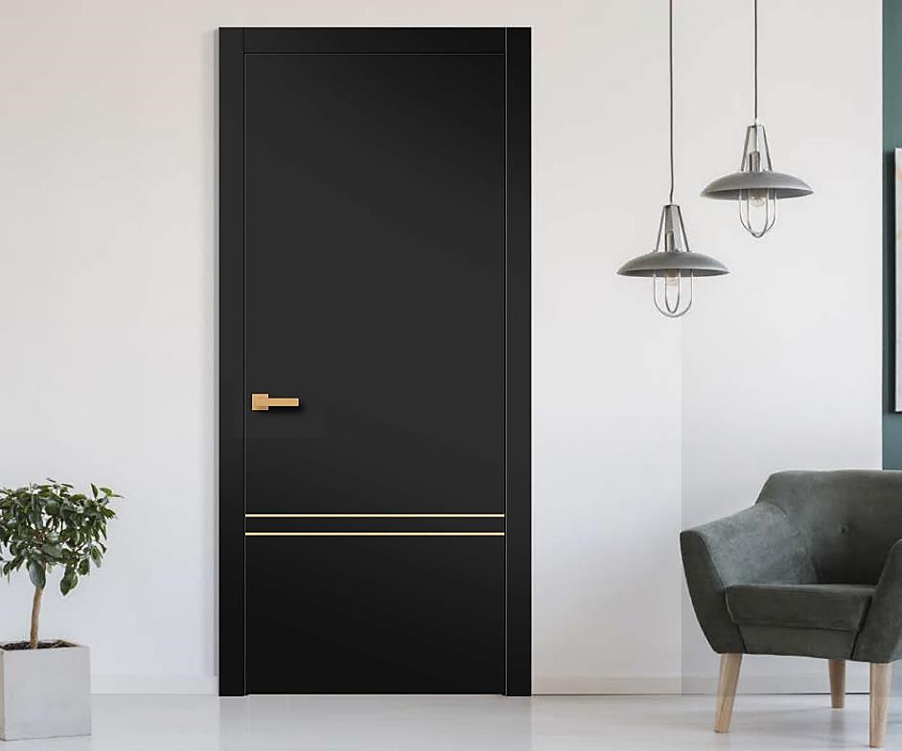
Common Specification Mistakes
Not accounting for jamb width with wall thickness.
Overlooking hinge load capacity for tall or wide slabs.
Specifying veneers incompatible with required fire rating.
Failing to coordinate finish samples across multiple suppliers.
Notes:
There are a few recurring issues we see when doors are specified. Not accounting for jamb width in relation to wall thickness can cause fit issues. Overlooking hinge load capacity for tall or wide slabs can lead to sagging. Choosing a veneer incompatible with a required fire rating can cause delays. And failing to coordinate finish samples across multiple suppliers can result in visible mismatches.

Slide 15
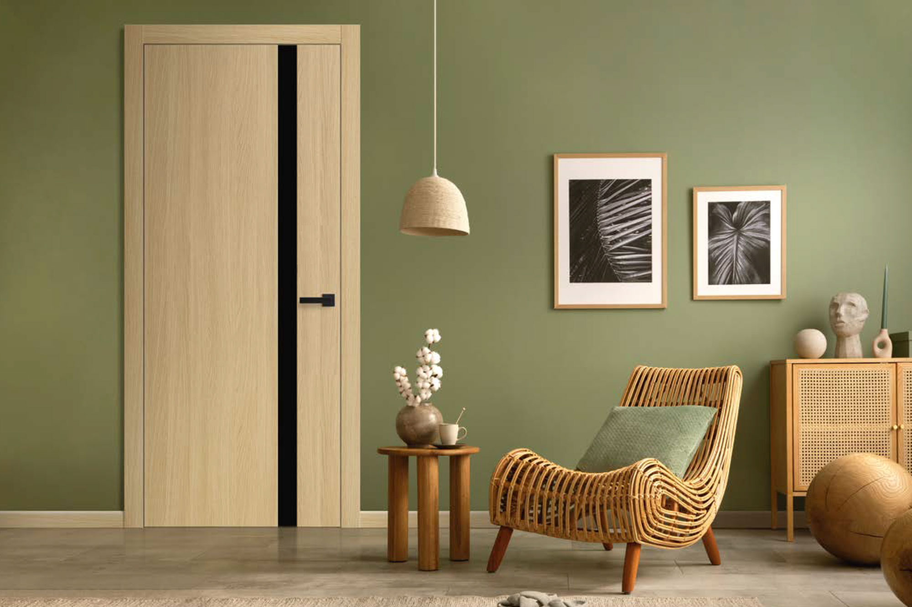
Installation Best Practices
Knocked-down jambs ease transportation but require precise on-site assembly.
Use silicone instead of nails for modern veneers — avoids unfillable holes.
Verify rough openings before ordering to reduce field modifications.
Always follow manufacturers recommended installation instructions
Notes:
Even the best-designed door will underperform if installation is poor. Knocked-down jambs make transport easier but require precision during assembly. For modern veneers, using silicone instead of nails prevents unfillable holes. Always verify rough openings before ordering to avoid costly adjustments. And follow the manufacturer’s recommended installation steps to maintain warranty coverage and ensure optimal performance.

Slide 16
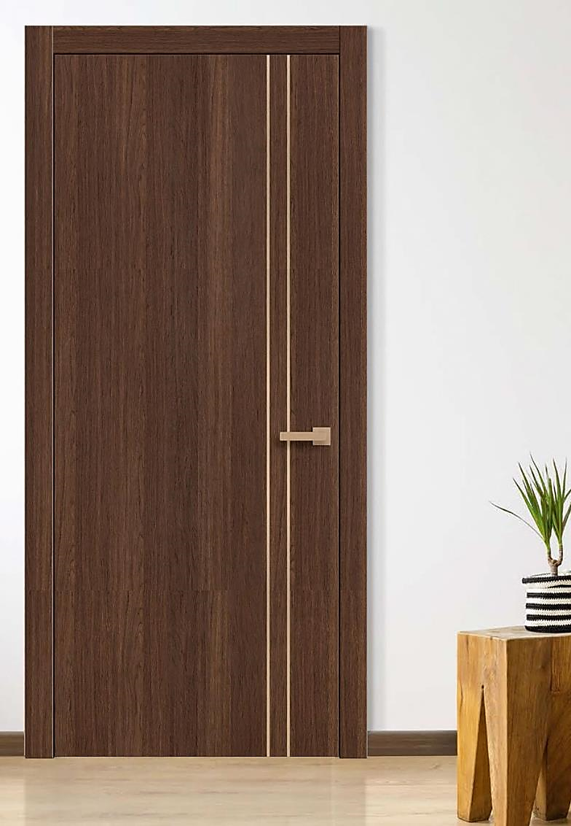
Evaluating Quality in the Market
Signs of high-quality construction:
Consistent veneer seams and edge banding.
Dense, balanced core.
Precision hinge and latch prep.
Questions to ask vendors:
How is the veneer applied and sealed?
What is the core density?
Are hinges adjustable post-install?
Notes:
When comparing interior doors, there are several indicators of quality. Look for consistent veneer seams and edge banding, a dense and balanced core, and precise hinge and latch preparation. Ask vendors about veneer application methods, sealing processes, and whether hinges are adjustable after installation. These factors will help you choose doors that meet both performance and design expectations.

Slide 17
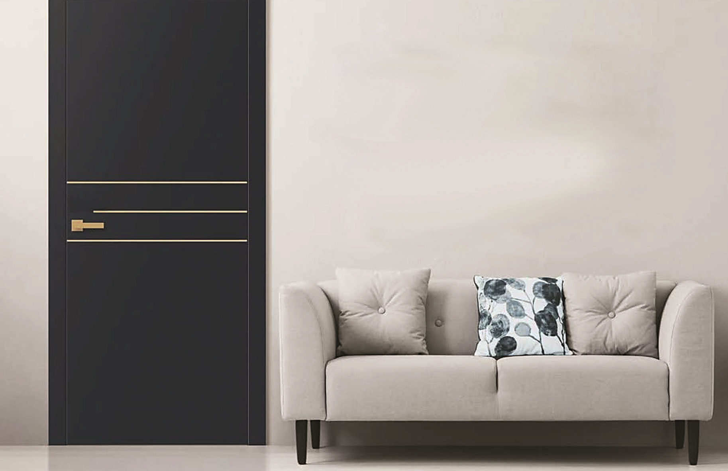



Summary & Key Takeaways
Solid-Core Door Benefits
Durable, stable and long-lasting construction
Superior sound control compared to hollow-core doors
Suitable for both residential and commercial applications
Material Highlights
Engineered wood cores for strength and performance
Variety of veneer, paint, and eco-synthetic finish options
Glass and metal inlays for added design flexibility
Design & Installation
Choose configurations based on space and function
Coordinate hardware for aesthetics, accessibility and code compliance
Proper jamb, hinge, and latch selection impacts performances and appearance
Notes:
In summary, solid-core interior doors offer unmatched durability, sound control, and aesthetic flexibility compared to hollow-core options. Material and finish selection can dramatically impact longevity and appearance. Thoughtful hardware and configuration choices enhance both function and design. And early coordination with suppliers helps ensure the right product is specified for the space.

Slide 18
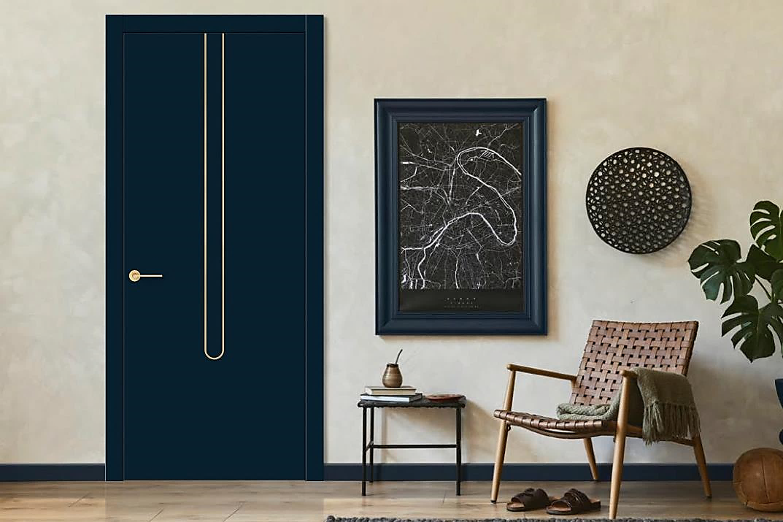

Thank You!
Scan For Your AIA
Registration & Certificate
Notes:
Thank you for attending this course on interior steel and glass doors. Please scan the QR code on screen to receive your AIA credit and certificate. I’d be happy to answer any questions you may have now.

