Slide 1
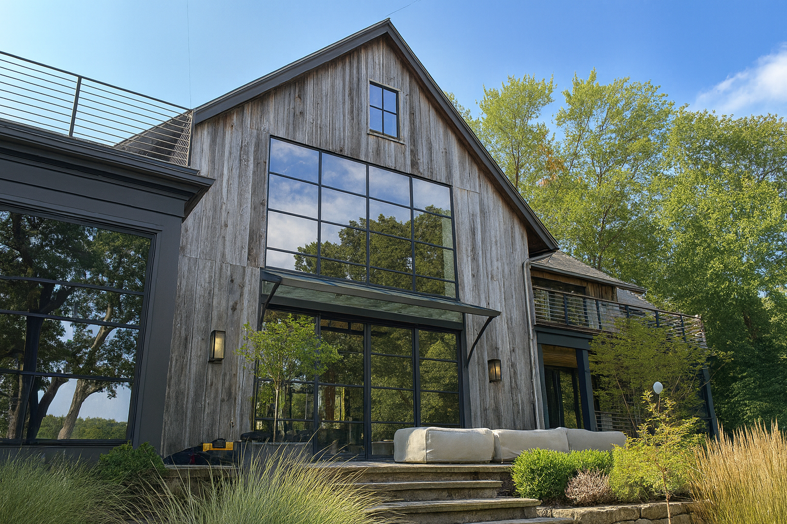
Where luxury meets precision
Steel Windows + Doors
START NOW
INICIOwindows.com | 2025

Slide 2
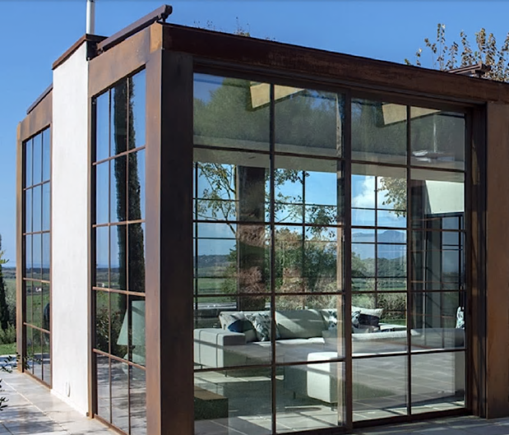
INICIO Steel Construction
Steel & bronze profiles are manufactured by Ottostumm – an Italian and Swiss company.
INICIO Windows + Doors offers multiple architectural base metals: standard steel, galvanized steel, Corten steel, stainless steel & bronze.
Our primary steel is a galvanized steel with a zinc primer and a powder coating.

Slide 3
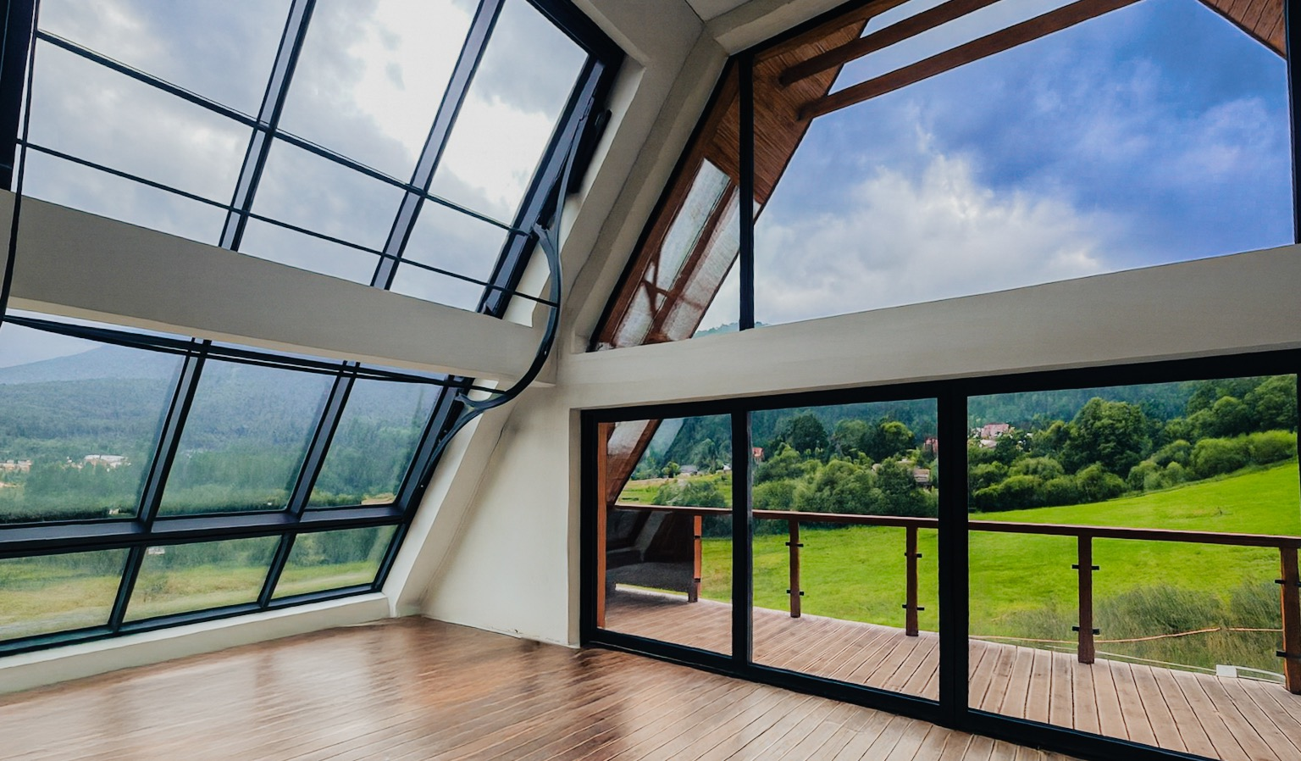
Steel Windows + Doors
INICIOwindows.com |

Slide 4
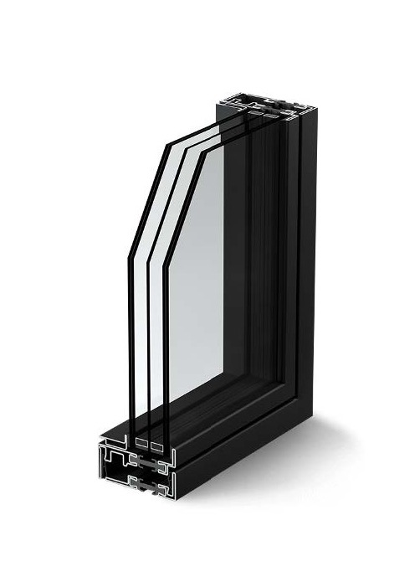

Key points about our profiles:
01.
All INICIO Windows + Doors are thermally broken using an insulator made of polyamide reinforced with glass fibers.
INICIO STEEL Construction
02.
Profiles are tubular steel extrusions that are a luxurious 1.5 mm thick–allowing for more detail and options.
03.
INICIO Windows + Doors uses cold rolled steel, which provides a far more precise, beautiful consistent finish.

Slide 5
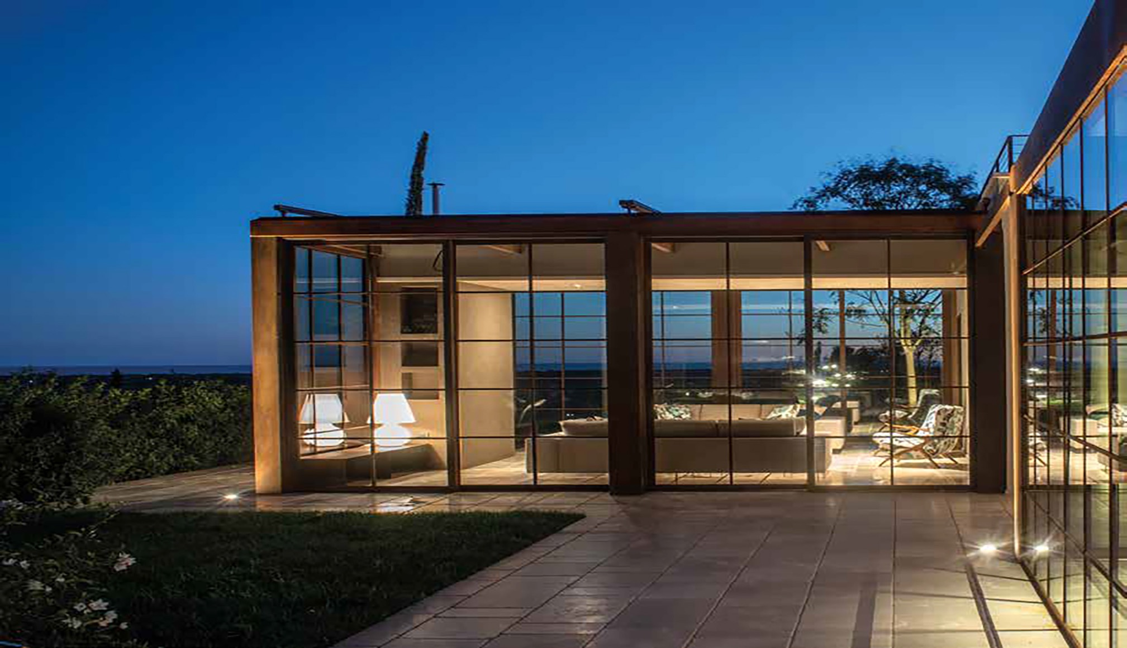
Steel offers unmatched
luxury through its sleek
lines, strength, and
timeless sophistication.
With slender profiles and expansive glass, INCIO Steel Windows + Doors create a sense of refined elegance while delivering durability that lasts for generations.
INICIO STEEL Construction
The Luxury of Steel
Notes:
All Sales associates: Commit these key points to MEMORY.

Slide 6
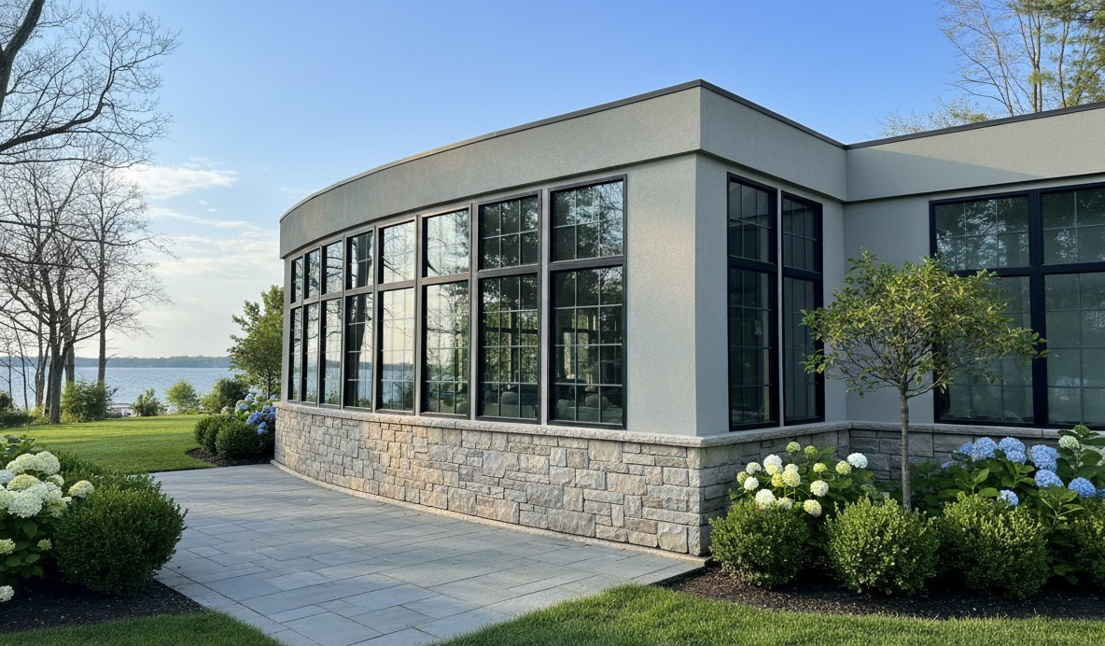
Steel Windows + Doors
INICIOwindows.com |

Slide 7
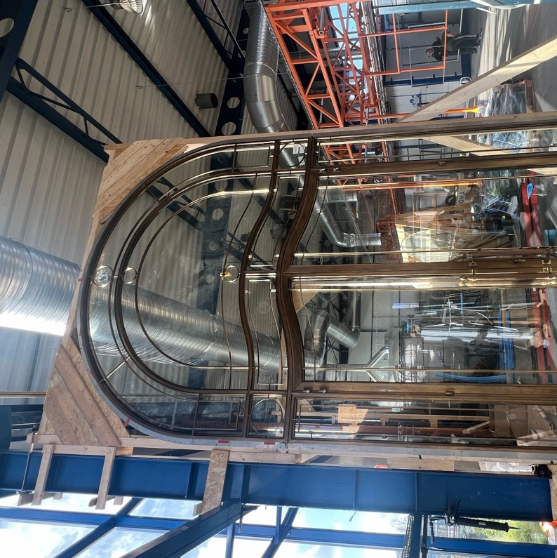
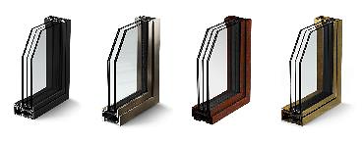
Architectural Metals & Finishes
Base Metals:
Galvanized Steel Stainless Steel
Corten Steel Bronze
Finish Systems:
Natural patina —Corten steel or bronze
Polished or brushed — stainless steel
Painted — galvanized or stainless steel
  Five standard premium colors including four shades of black and crisp white
  Optional full RAL color chart match
  For more personalized expression, custom color match
  Available in smooth & textured
INICIO STEEL Construction
Galvanized Steel
(Painted)
Stainless Steel
Corten Steel
Bronze

Slide 8
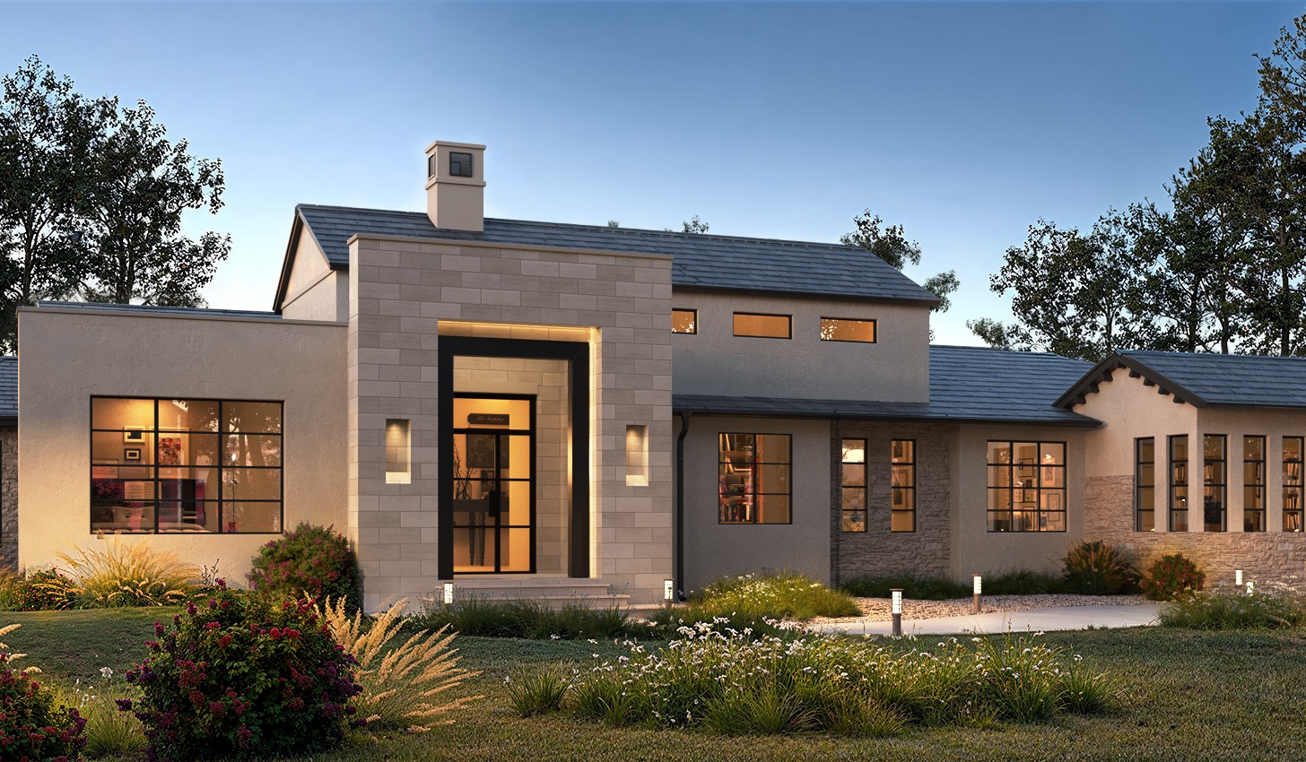
Steel Windows + Doors
INICIOwindows.com |

Slide 9
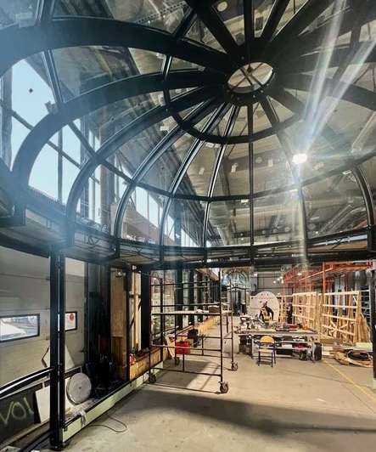
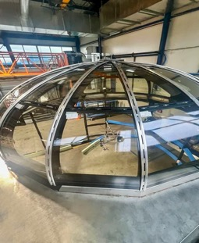
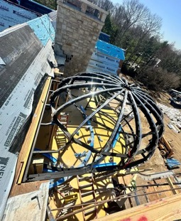
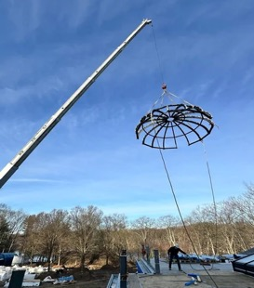
If you can dream it…
INICIO brings your vision to life with limitless customization in size, style, and finish.
INICIO STEEL Construction
From bold architectural statements to subtle details, our team partners with you to design windows and doors as unique as your project
No standard solutions, only precision-crafted steel systems.

Slide 10
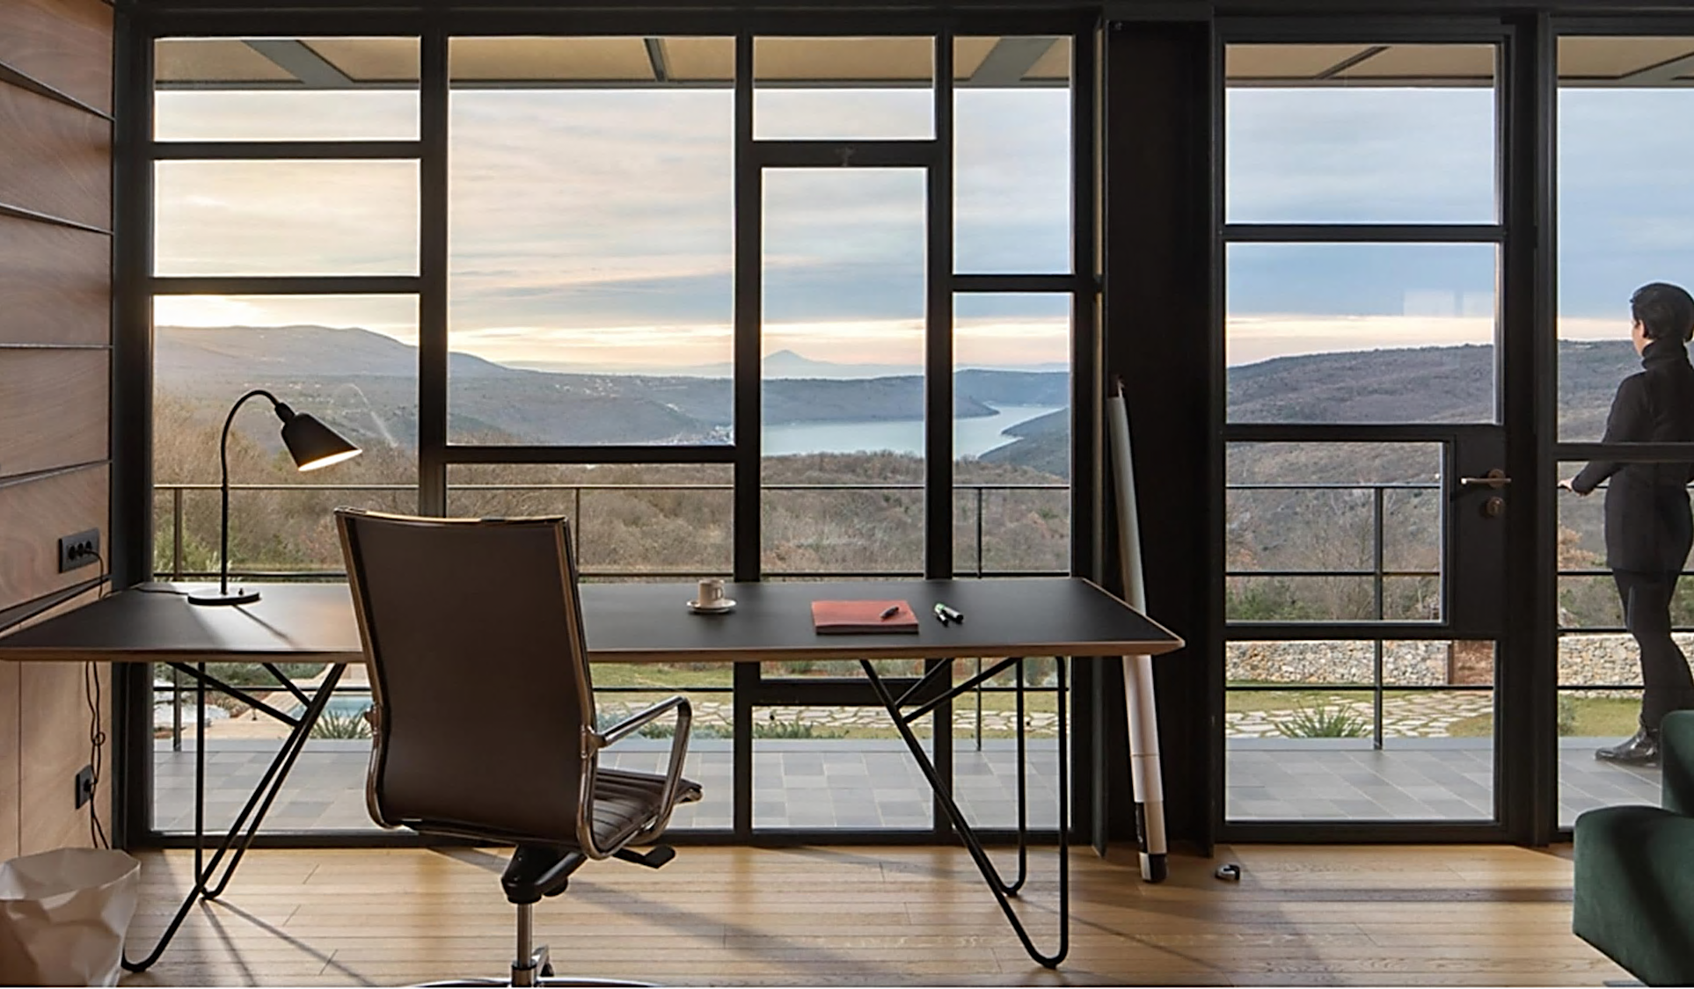
Steel Windows + Doors
INICIOwindows.com |

Slide 11
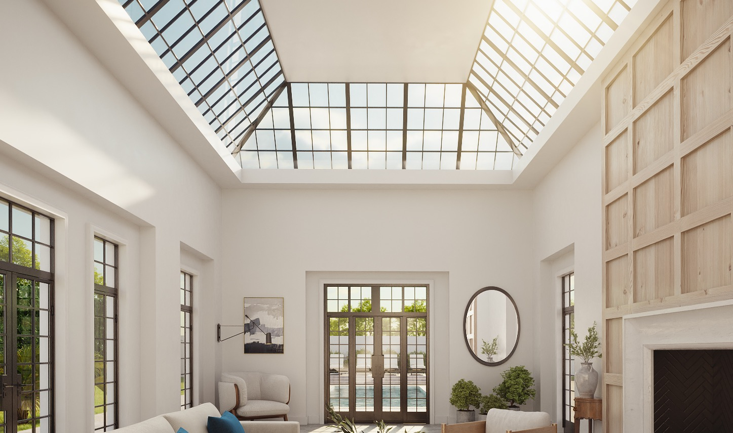



Steel Finishing Process
Zn
Cleaning
Blasting
Surface prep
Metallization (optional)
Provides lasting performance.
Pure zinc formula applied to our bare steel product.
Primer coat
Prep steel surface to
accept final color coat.
Zinc primer is applied
as a powder coat.
Final color
powder coating

Slide 12
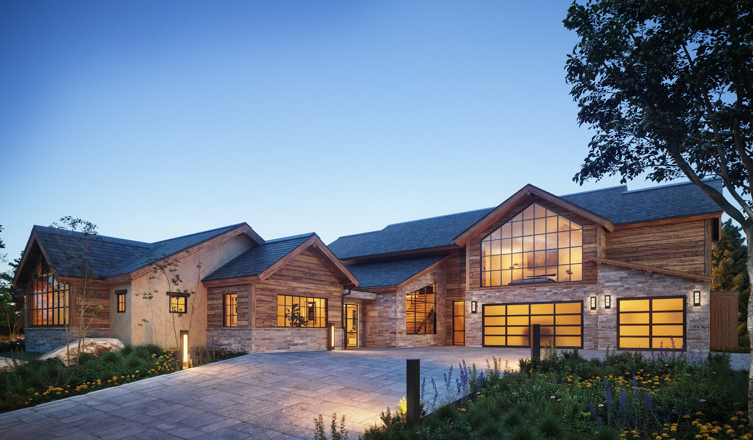
Steel Windows + Doors
INICIOwindows.com |

Slide 13


Glazing Options
INICIO Windows + Doors offers several primary performance glass offerings:
Dual Pane Options
Low E2
Low E3 Higher Visible Light Transmission
Low E3 Lower Solar Heat Gain Coefficient
All coupled with your choice of either clear, ultra-clear low iron, or clear laminated
Bright Silver + Low E3
Bright Silver + Low E3
Low E3 + PLK K
All dual pane available with air or Argon gas filled & tempered options
Triple pane options available with Low E2 SKN 183, Low E3 CLX 70-33, and Low E3 CLX 61-29
Notes:
INICIO Windows + Doors offers several primary performance glass offerings:
Dual Pane
Low E2 SKN 183
Low E3 CLX 70-33 Higher Visible Light Transmission
Low E3 CLX 61-29 Lower Solar Heat Gain Coefficient
All coupled with your choice of clear (Planiclear), ultra-clear low iron (Diamant),
or clear laminated (STADIP)
Bright Silver + Low E3 CLX 70-33
Bright Silver + Low E3 CLX 61-29
Low E3 CLX 70-33 + PLK K
All dual pane available with air or Argon gas filled & tempered options
Triple pane options available with Low E2 SKN 183, Low E3 CLX 70-33, and Low E3 CLX 61-29

Slide 14
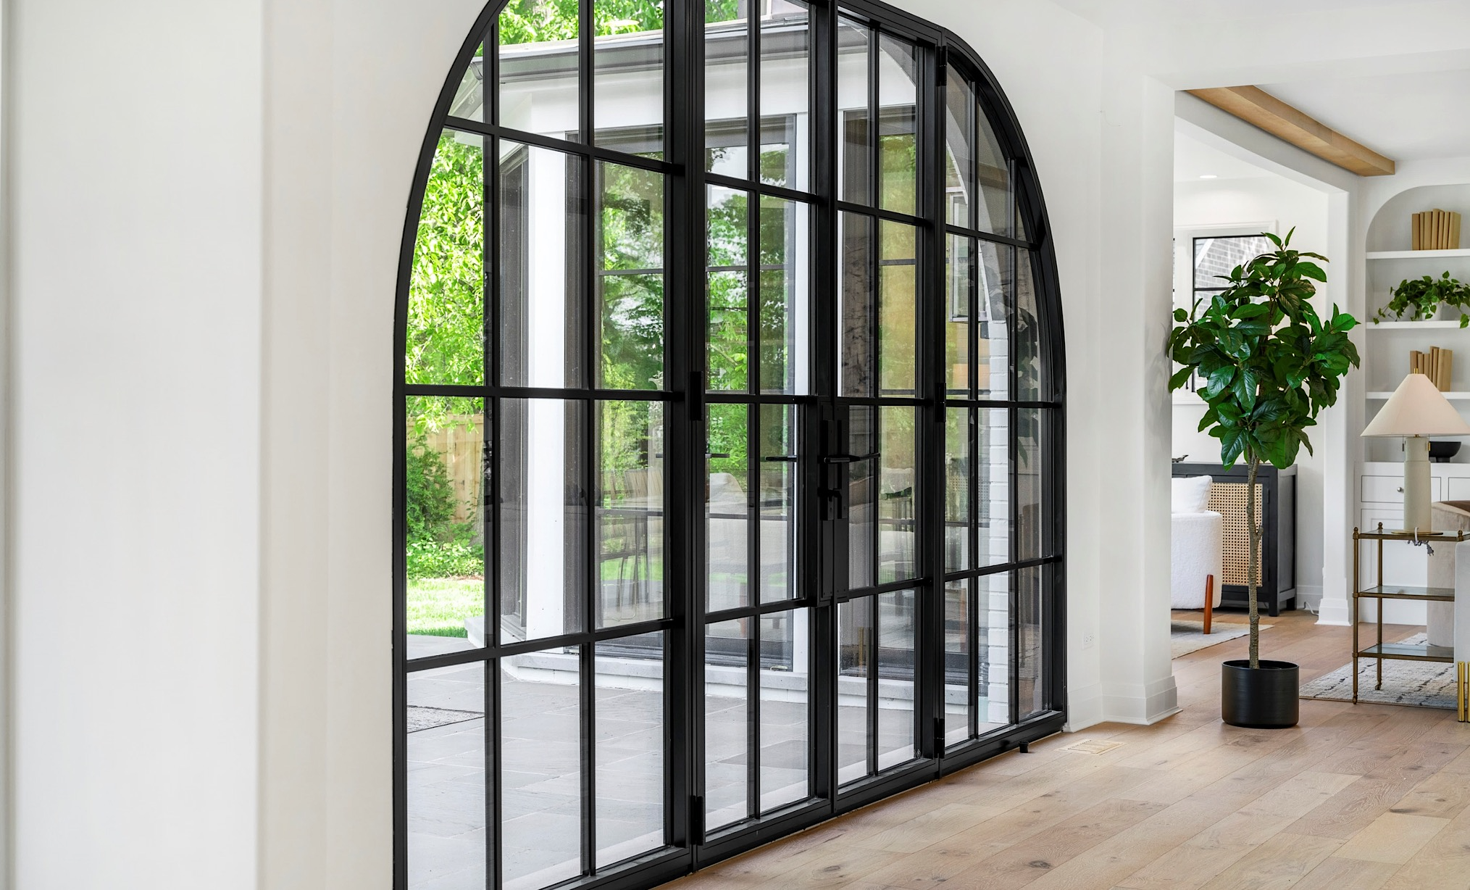
Steel Windows + Doors
INICIOwindows.com | 2025

Slide 15
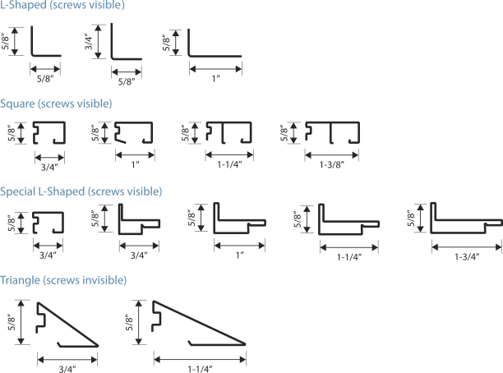
Steel
Glazing
Beads

Slide 16
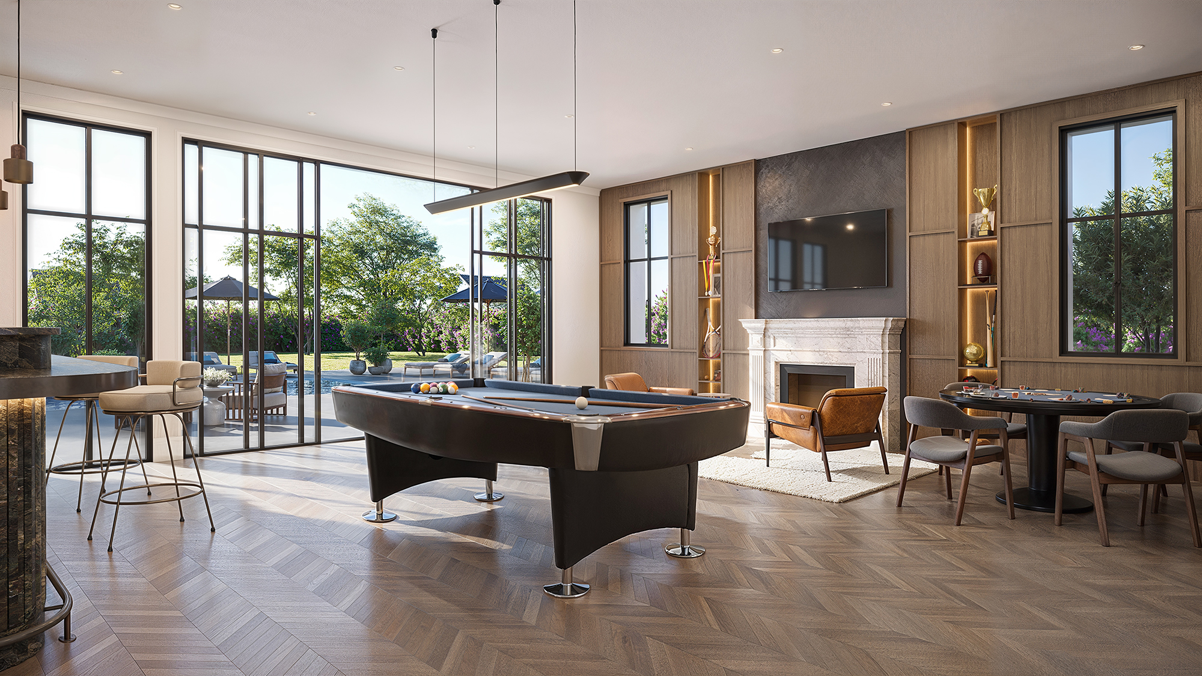
Steel Windows + Doors
INICIOwindows.com |

Slide 17
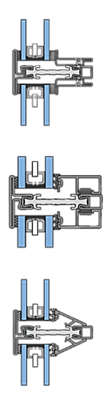
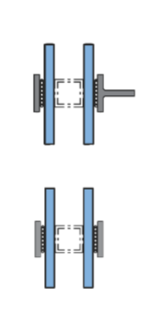
True Divided Lite (TDL)
Each light is its own pane of glass.
Every opening contains a separate insulated glass unit (IGU).
Each IGU is held in place with its own individual glazing beads.
Provides an authentic, traditional divided appearance.
Typical Bar Profiles:
L-Shaped
Square
Pyramid
Special L-Shaped (system-specific)
Simulated Divided Lite (SDL)
One large pane of glass with applied bars.
A single IGU spans the full opening.
Exterior bars are applied to the glazing; interior bars match the profile for alignment.
A spacer bar is placed inside the IGU to mimic the look of true divided construction.
Creates the divided look with improved energy performance and reduced cost.
Bar Options:
T-Bar
Flat Bar
Standard Bar Widths: 3/4”, 1”, 1 -1/8”
Divided
Lite
Options

Slide 18
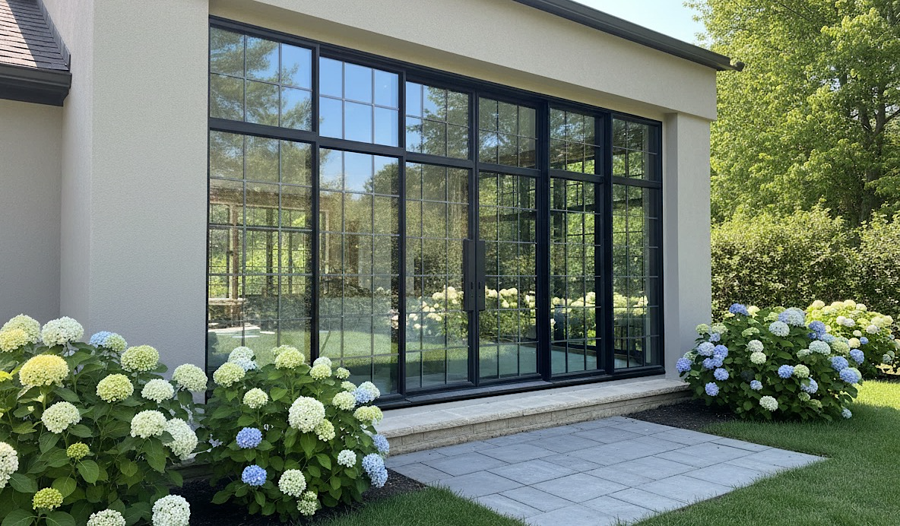
Steel Windows + Doors
INICIOwindows.com | 2025

Slide 19
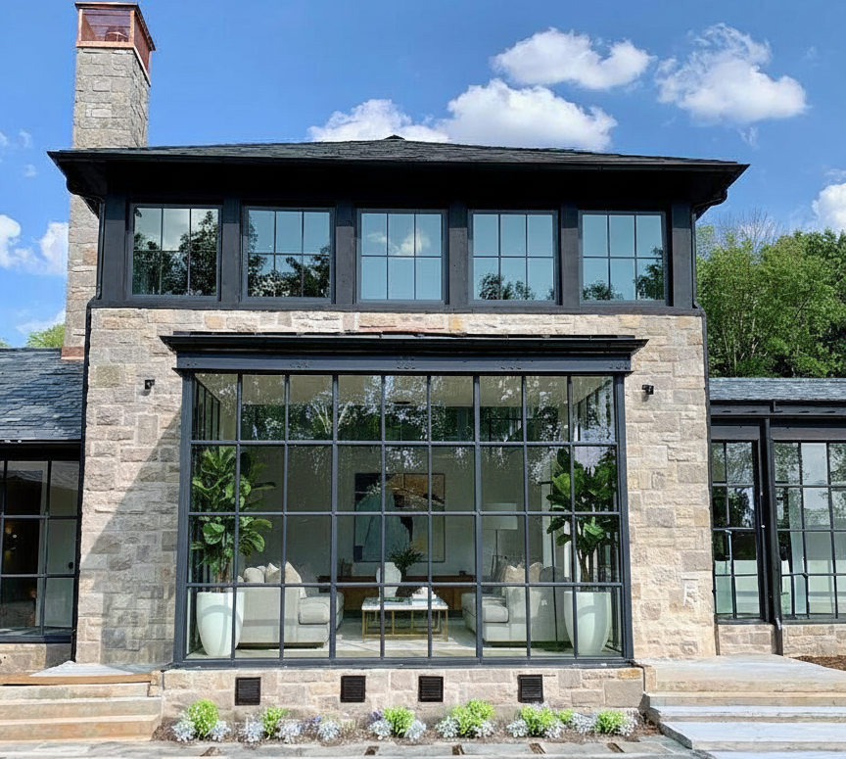

INICIO STEEL Construction
  Casement windows
  Awning windows
  Direct glazed windows
  Hopper windows*
  Tilt-Turn windows*
  Pivot windows*
  *Requires testing for US market
01.
Window Systems

Slide 20
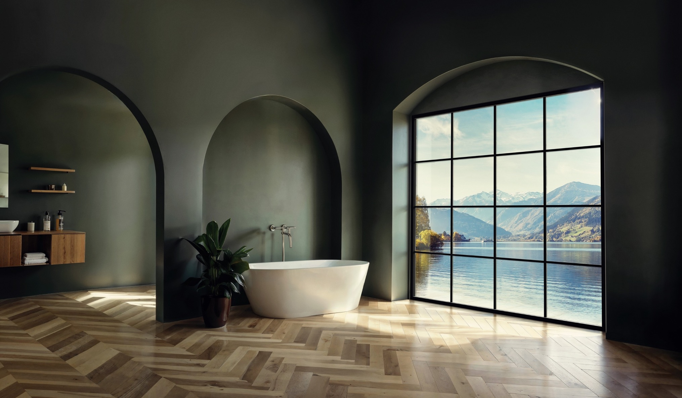
Steel Windows + Doors
INICIOwindows.com | 2025

Slide 21
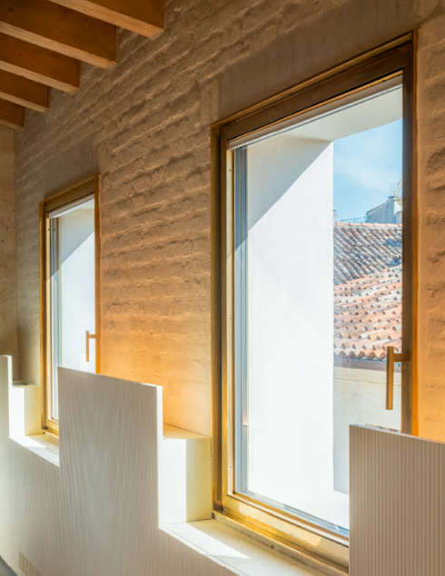
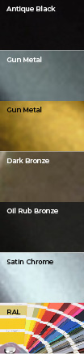
INICIO STEEL Construction
  Arched, straight, curved, or scroll classic handles
  Single, duplex, or triplex handles
  Classic slide stay with round knob
  Available in 6 finishes + any RAL pallet color
Window Hardware

Slide 22
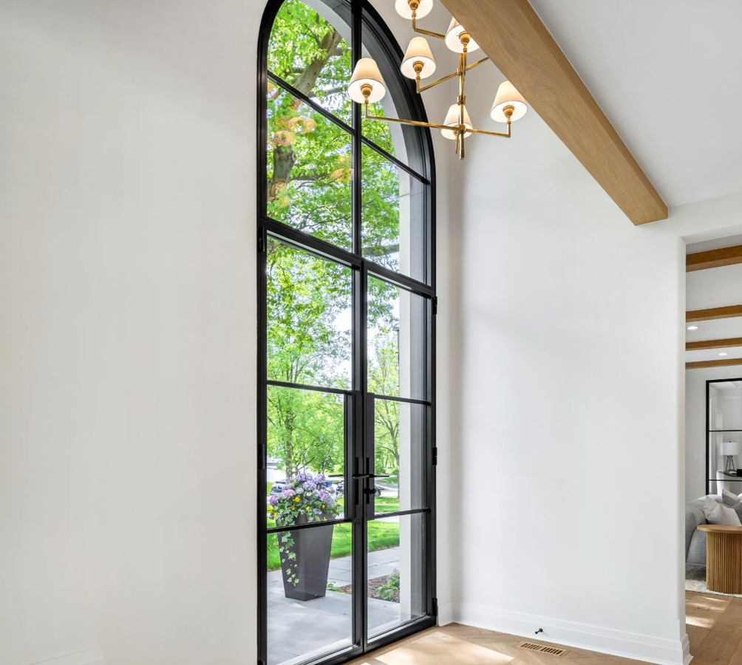
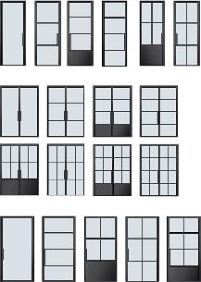
INICIO STEEL Construction
  Hinge doors (inswing and out)
    Single and double panel systems
  Pivot doors (inswing and out)
    Single and double panels systems
  Lift+ Slide door systems
  Multi-fold door systems
02.
Door Systems
Notes:
These operator types represent the breadth of our product line. Note: Casements and Awnings are PUSH-OUT only and do not currently have screen systems. This will be address in some upcoming product enhancements.

Slide 23
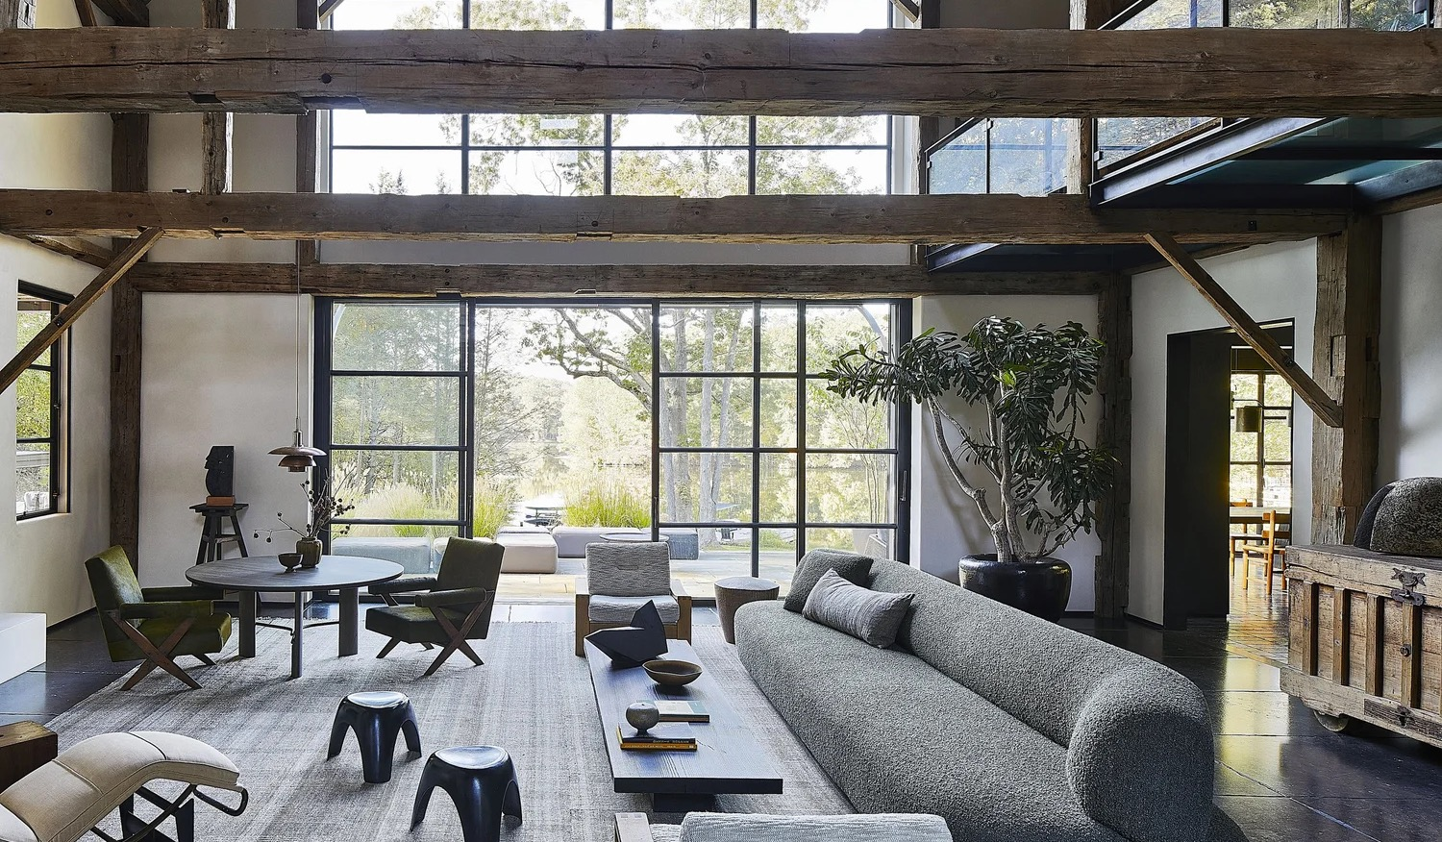
Steel Windows + Doors
INICIOwindows.com |
Notes:
All Sales associates: Commit these key points to MEMORY.

Slide 24
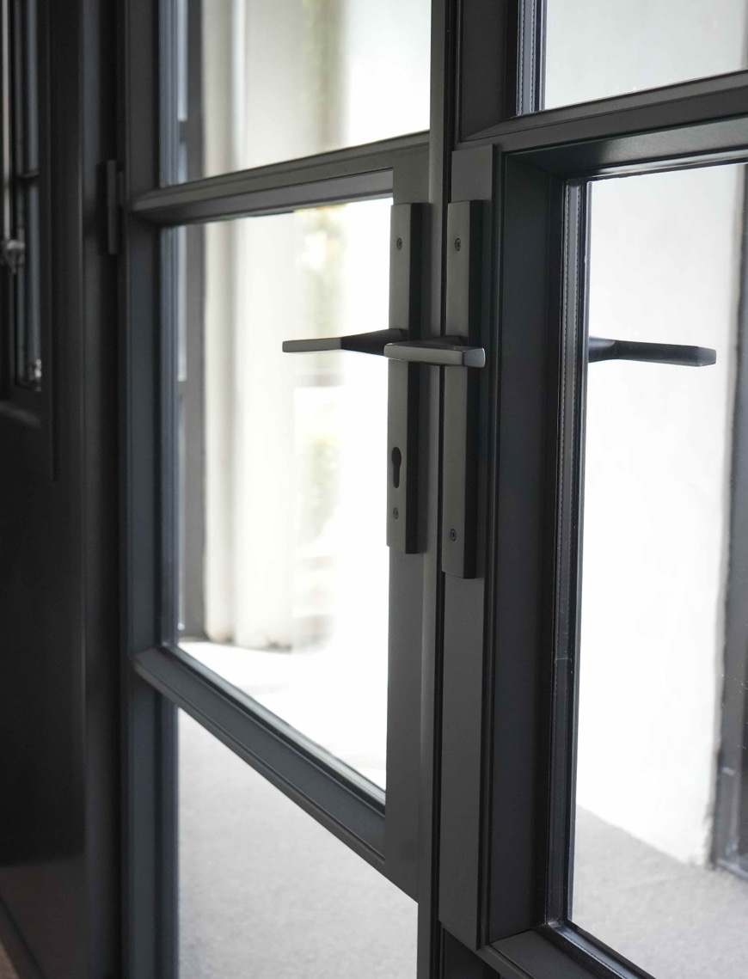
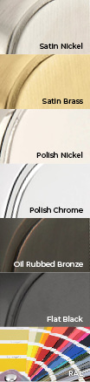
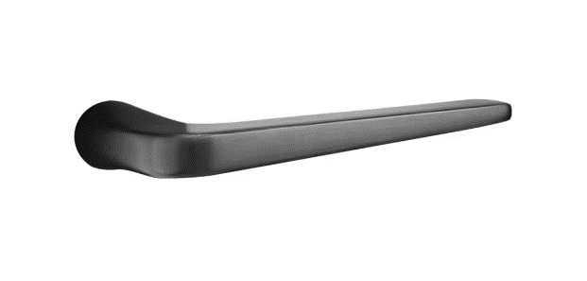
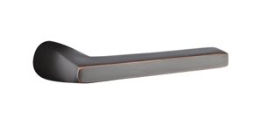
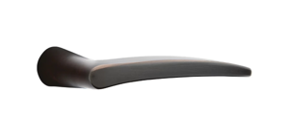
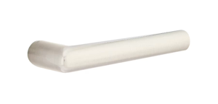
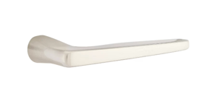
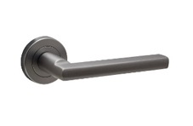
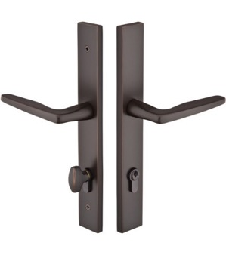
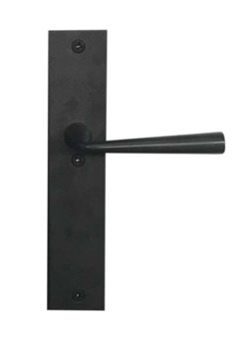
INICIO STEEL Construction
  Our primary hardware offerings include Emtek, Weijntjes–Bauhaus, and Weijntjes–Lancia handles.
  Athena, Helios, Hermes, Poseidon, and Stuttgart Lever styles are featured above
Available in 6 finishes + any RAL pallet color
For elevated customization, integrate premium hardware, such as Ashley Norton and Rocky Mountain Hardware.
Door Hardware
Notes:
(5) different Emtek handles above that we are offering with INICIO Steel hinge and Bi-folding doors. All Escutcheons will be rectangular and designed to fit the narrow stile on an INICIO Door as defined on this slide. Note: all thumb turns and cylinders are a special European cylinder and not available through Emtek. Cylinders with Thumbturns are supplied with hardware when purchased through BMD-mfg.
We are offering (6) Emtek Finishes for INICIO Aluminum hinge doors.

Slide 25
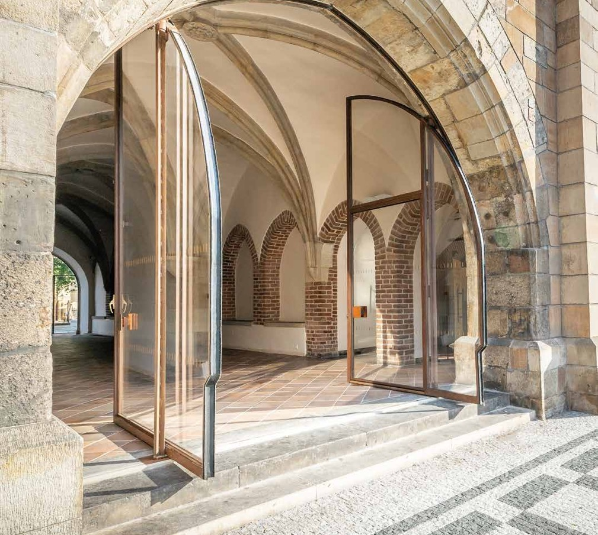
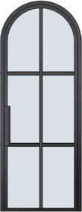
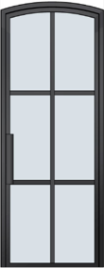
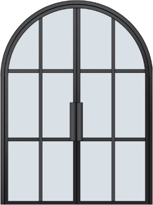
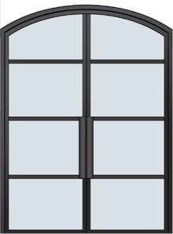
INICIO STEEL Construction
Single & double door
Swing out or in
Pivot
03.
Arch Top Door Systems
Notes:
Arched top steel doors are available and are gaining popularity in steel architectural designs.
Minimum radius is 12”

Slide 26
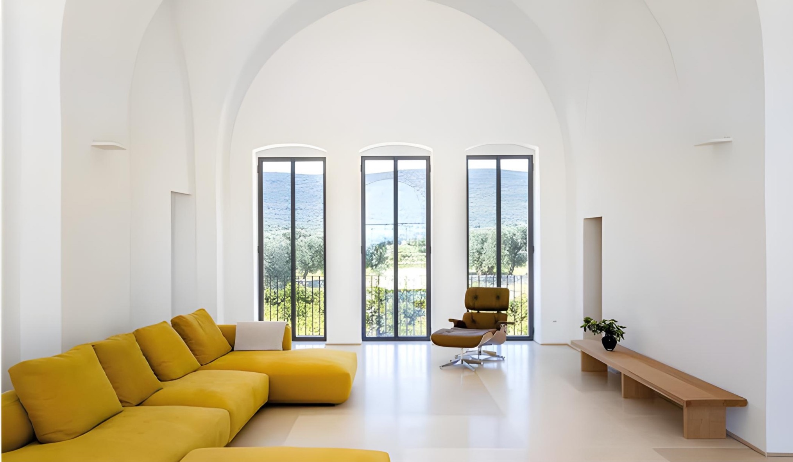
Steel Windows + Doors
INICIOwindows.com |
Notes:
All Sales associates: Commit these key points to MEMORY.

Slide 27
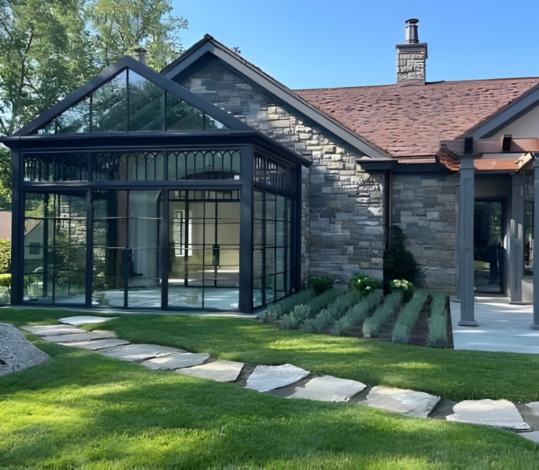
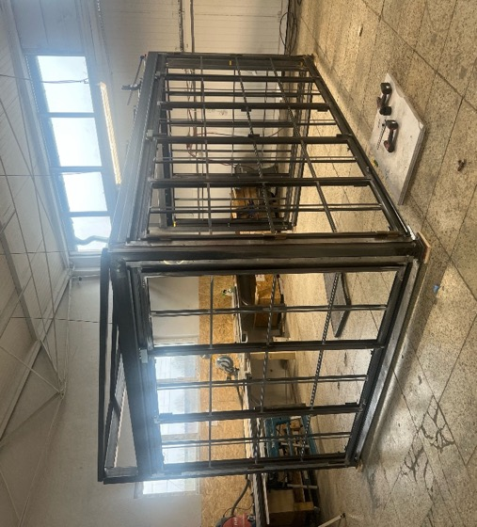
INICIO STEEL Construction
Maximize natural light and transparency with exceptionally
slender steel sightlines.
Achieve expansive, column-free
spaces using high-strength profiles
for large structural spans.
04.
Atrium Systems
Notes:
Arched top steel doors are available and are gaining popularity in steel architectural designs.
Minimum radius is 12”

Slide 28
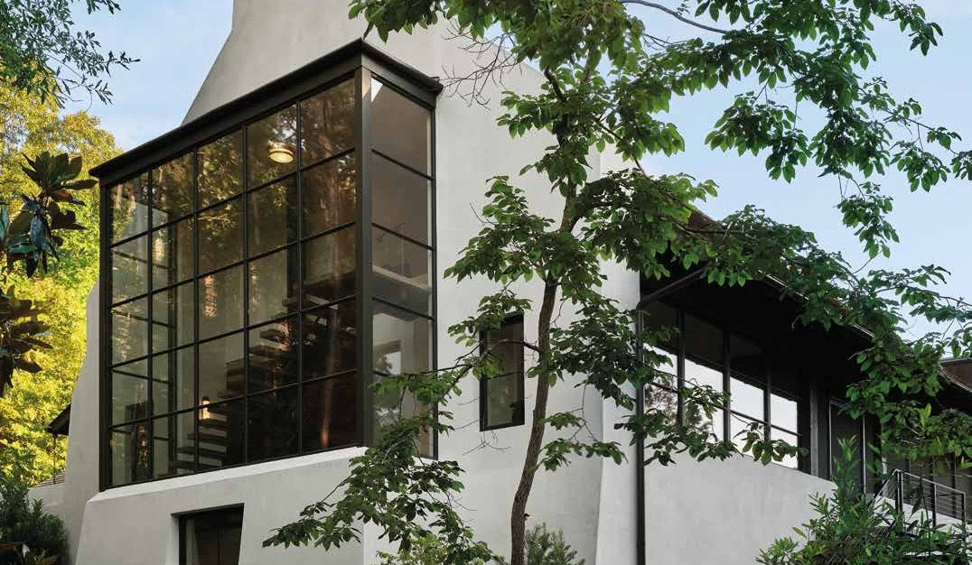
Steel Windows + Doors
INICIOwindows.com |
Notes:
All Sales associates: Commit these key points to MEMORY.

Slide 29
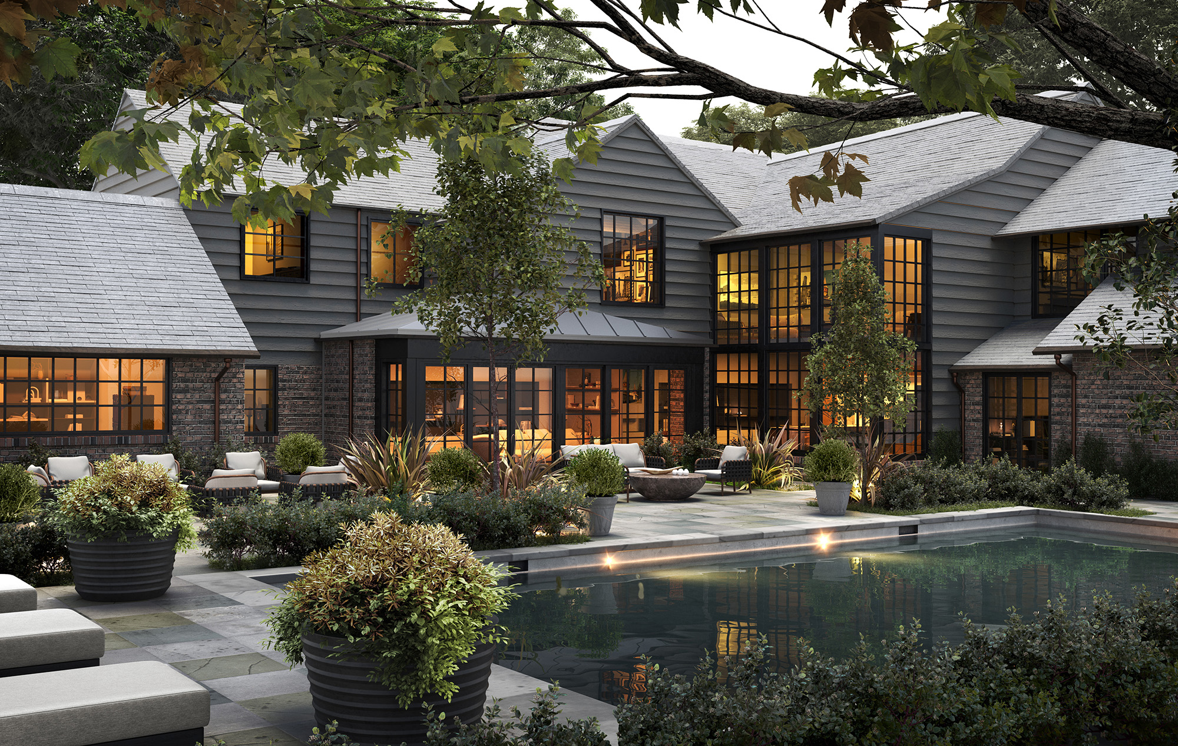
Where luxury meets precision
Steel Windows + Doors
THANK YOU
+ 800-334-4263
Info@INICIOwindows.com
INICIOwindows.com | 2025

Slide 30
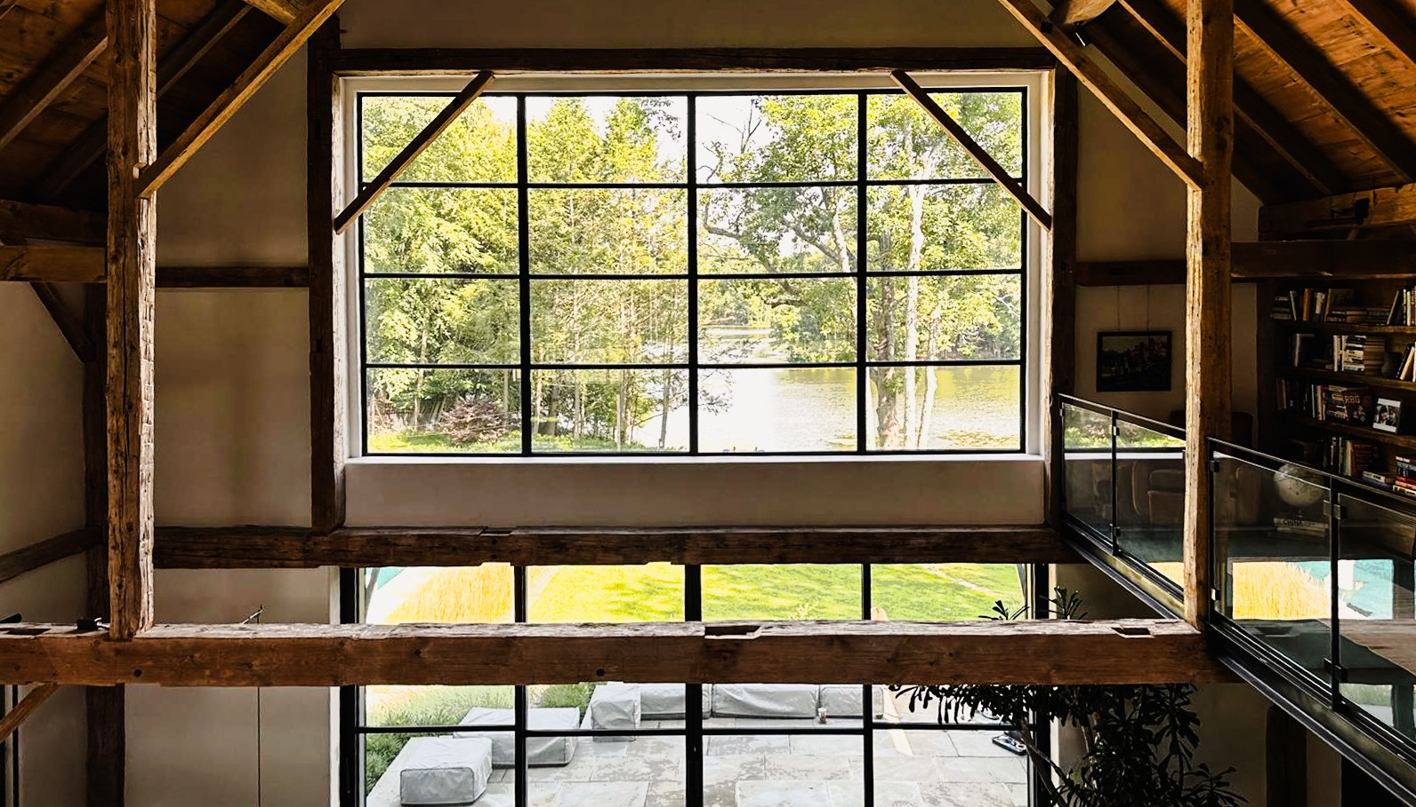
Steel Windows + Doors
INICIOwindows.com |

Slide 31

Glass
Options
Notes:
Note that INICIO Steel products have various glazing beads available across our products. L-Shape glazing profiles shown above can come as solid extrusions, but applied with visible screws to fasten to our panels and sash. The image below shows tubular L shapes glazing beads also available. Some divided lite configurations will dictate which glazing bead is compatible with bar profiles. In both cases these glazing beads are actual steel profiles. Also to note is that a visible fastener will always be evident when using either “L” glazing bead.

