Slide 1
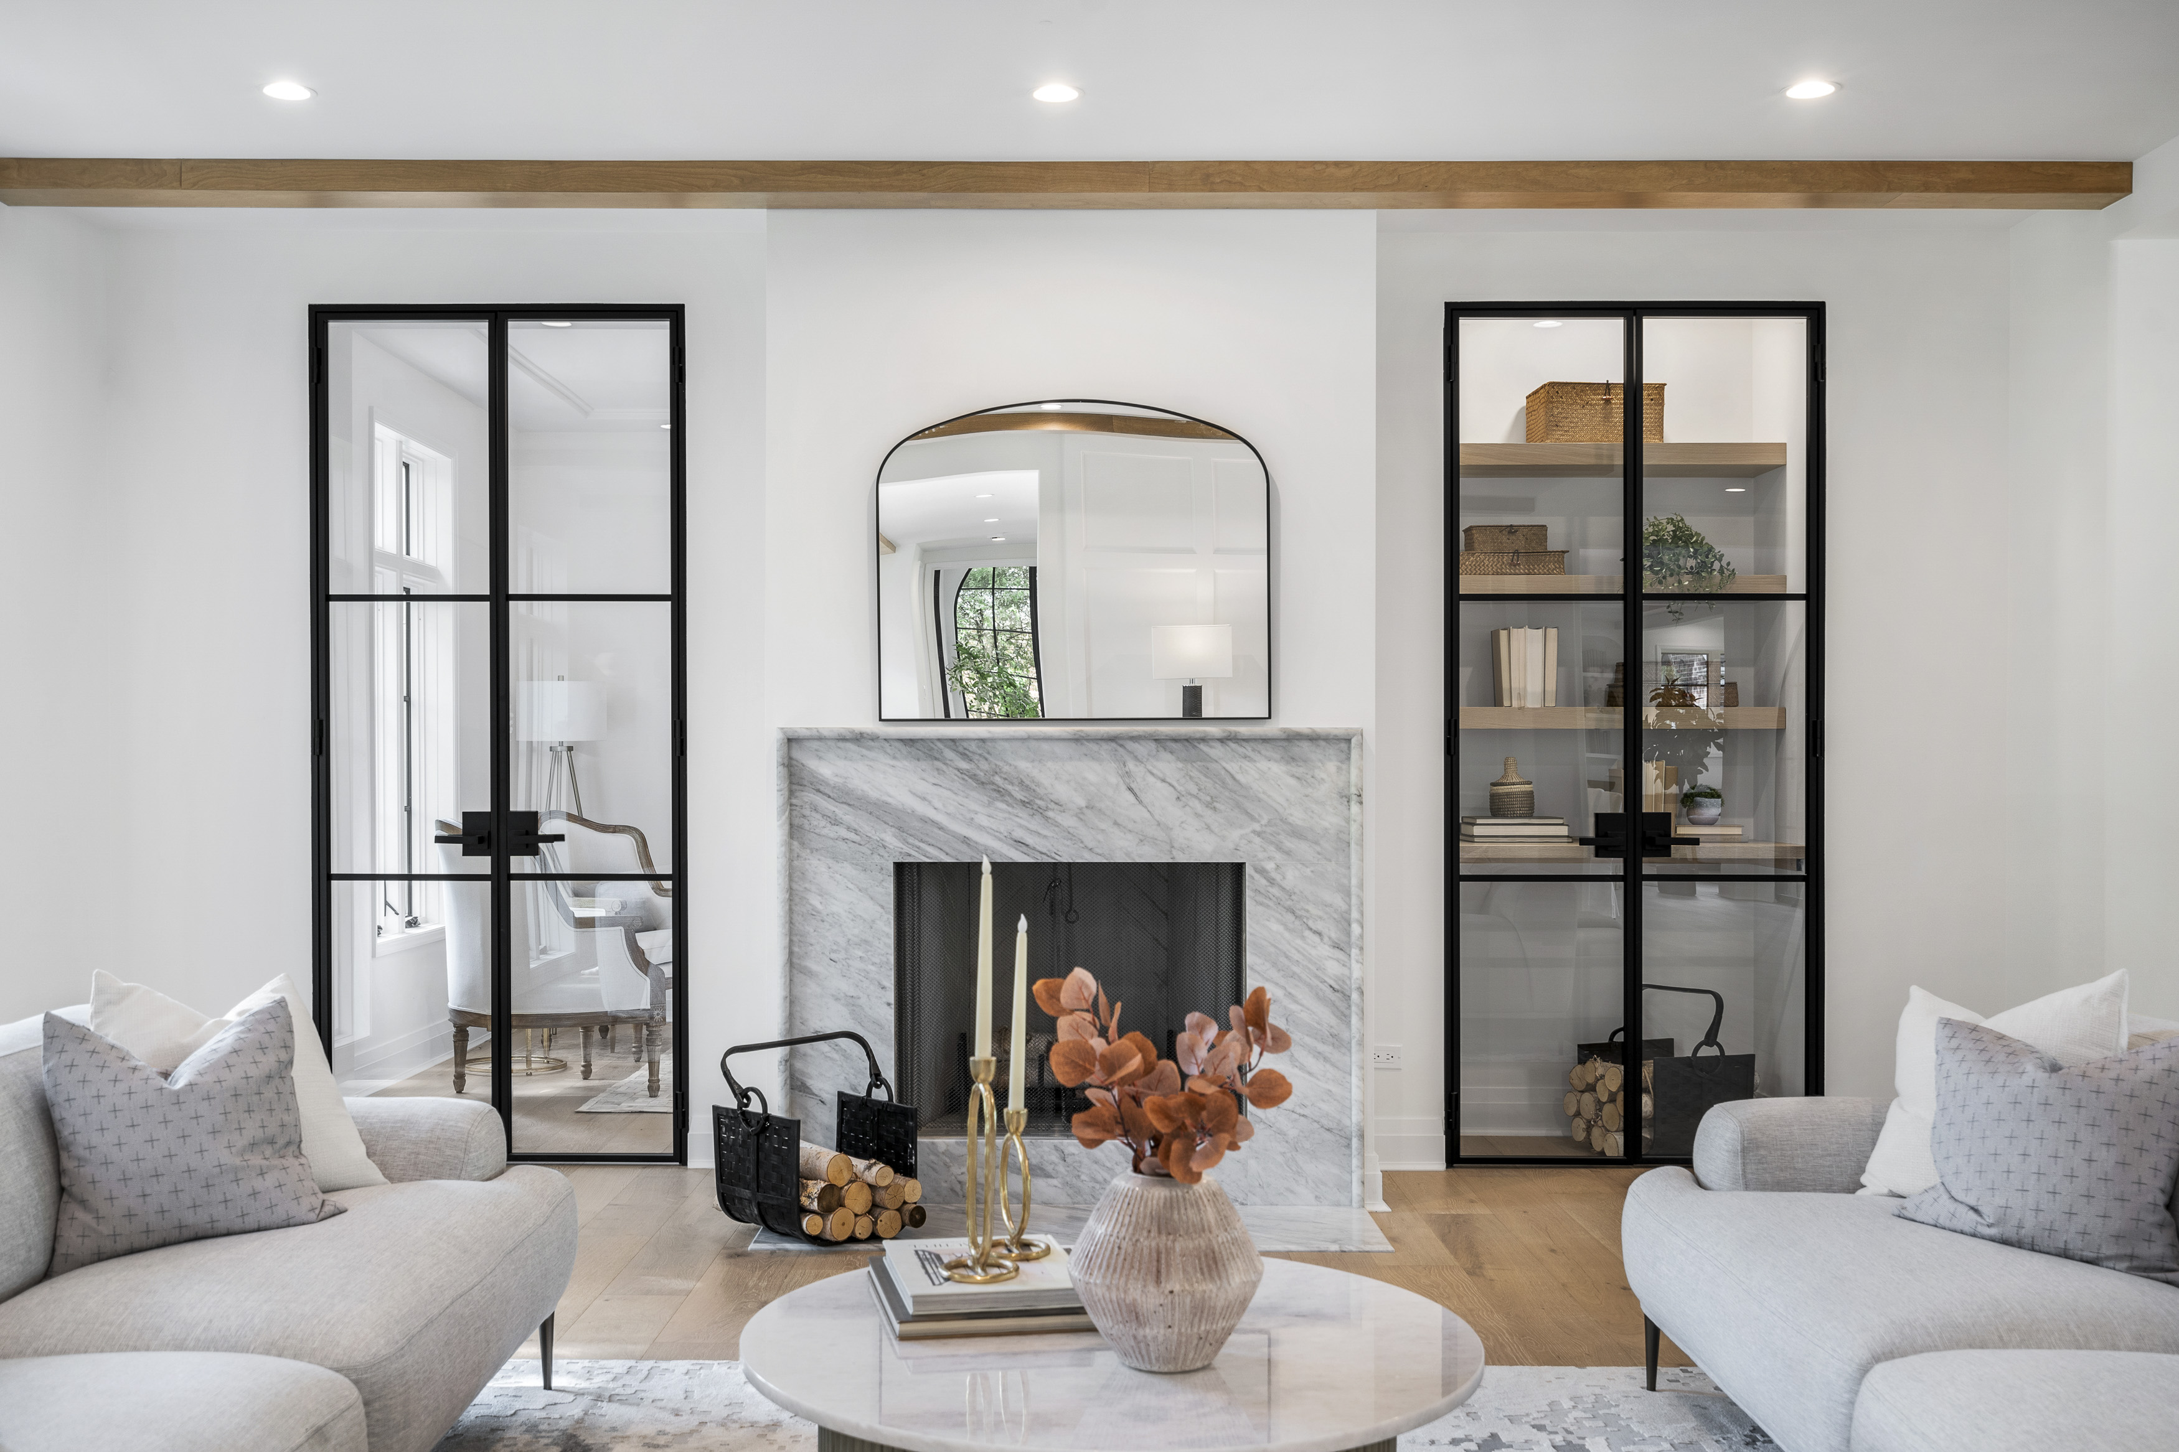

Interior
Steel & Glass
Notes:
This presentation focuses on Glenview INTERIOR Steel doors. These doors are branded NOT as INICIO, but a Glenview door product. These are high quality fit and finish doors systems designed specifically for interior door applications.

Slide 2
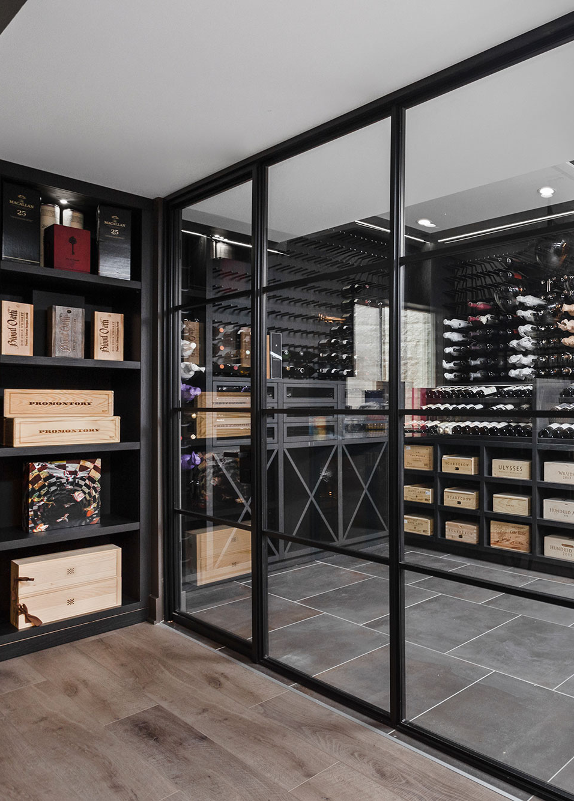
Types of Available Units
01
04
Standard interior doors
Pocket interior doors
02
05
Pivot interior doors
Barn interior doors
03
06
Fixed interior doors
Sliding interior doors
Notes:
As noted here, we offer 6 different types of operating door systems inclusive of all necessary hardware. The seventh option is for a fixed door panel or multiple panels to act as a partition between rooms.

Slide 3





Quick Facts
Cold rolled steel construction with (Electro-static) Powder Coated Finish and Zinc Underlayer.
Door/fixed slabs are 1-5/8” thick, units (with frame are 1-7/8” thick).
Designed to be installed into FINISHED openings.
Determining unit size: take dimensions of FINISHED opening and subtract 3/8” from width and ¼” from height.
If customer provides desired slab dimensions, add 1-7/8” to the width and 1-3/8” to the height to generate net unit size dimensions.
Swing and fixed units installed with screws through the frame.
Pocket/Sliding/Barn/ units mounted on tracks.
Notes:
Here are some product basics for Glenview Interior steel doors. Note that jamb thickness is very narrow at 1-7/8” thick. This product is designed to be installed into finished wall (drywall or wood-wrapped) openings. Also of note is Glenview Interior Steel doors are not Thermally broken as they are designed for INTERIOR applications only.

Slide 4
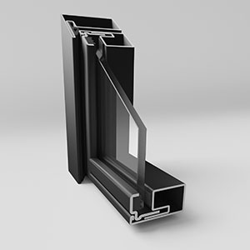
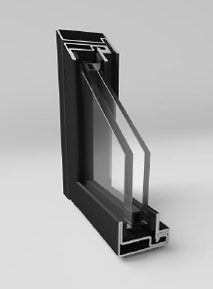
System 20 and 25
Frames are slightly different in sight lines.
System 20
Only available single glazed.
Available with thru-jamb fasteners
System 25
Available in single or dual pane insulated (20) mm units.
Available in thru-jamb and bracket installation.
Notes:
The two frame options are not something that one needs to specify. Just note that a System 20 is most popular, gives you a slightly larger glass area and is only available in single glazed 6mm glass. The system 25 is slightly thicker with 5mm more of frame profile. System 25 is available as Insulated using 4mm-12mm spacer – 4mm, or available in single glazed using 6mm glass. System 25 is used most often in Wine storage areas due to it’s IG and better insulating capability. Both systems have an overall jamb size of 1-7/8”.

Slide 5
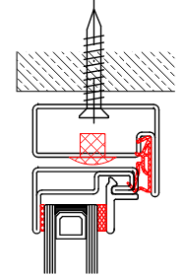
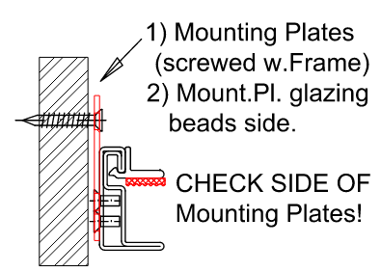
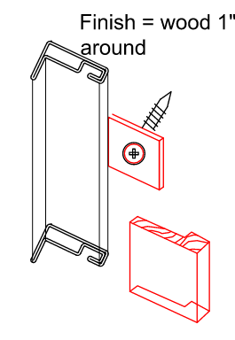
Installation – Thru jamb or mounting plates
1
System 20
System 25
Example of thru-jamb fastening with plastic cap.
Example of mounting plate method of fastening.
Note plate and screw head will need to be covered by small wood stop painted to match wall condition or Glenview door color. Trim and finishing by others.
1
Notes:
Depending on your configuration and door type, the installation can be handled one of two ways. Thru-jamb when an operating panel can be swung open and the fastener applied thru the jamb. In cases where a fixed unit is installed, we will provide a mounting plate as seen above on the right. Additional trim may be required by others in this instance.

Slide 6
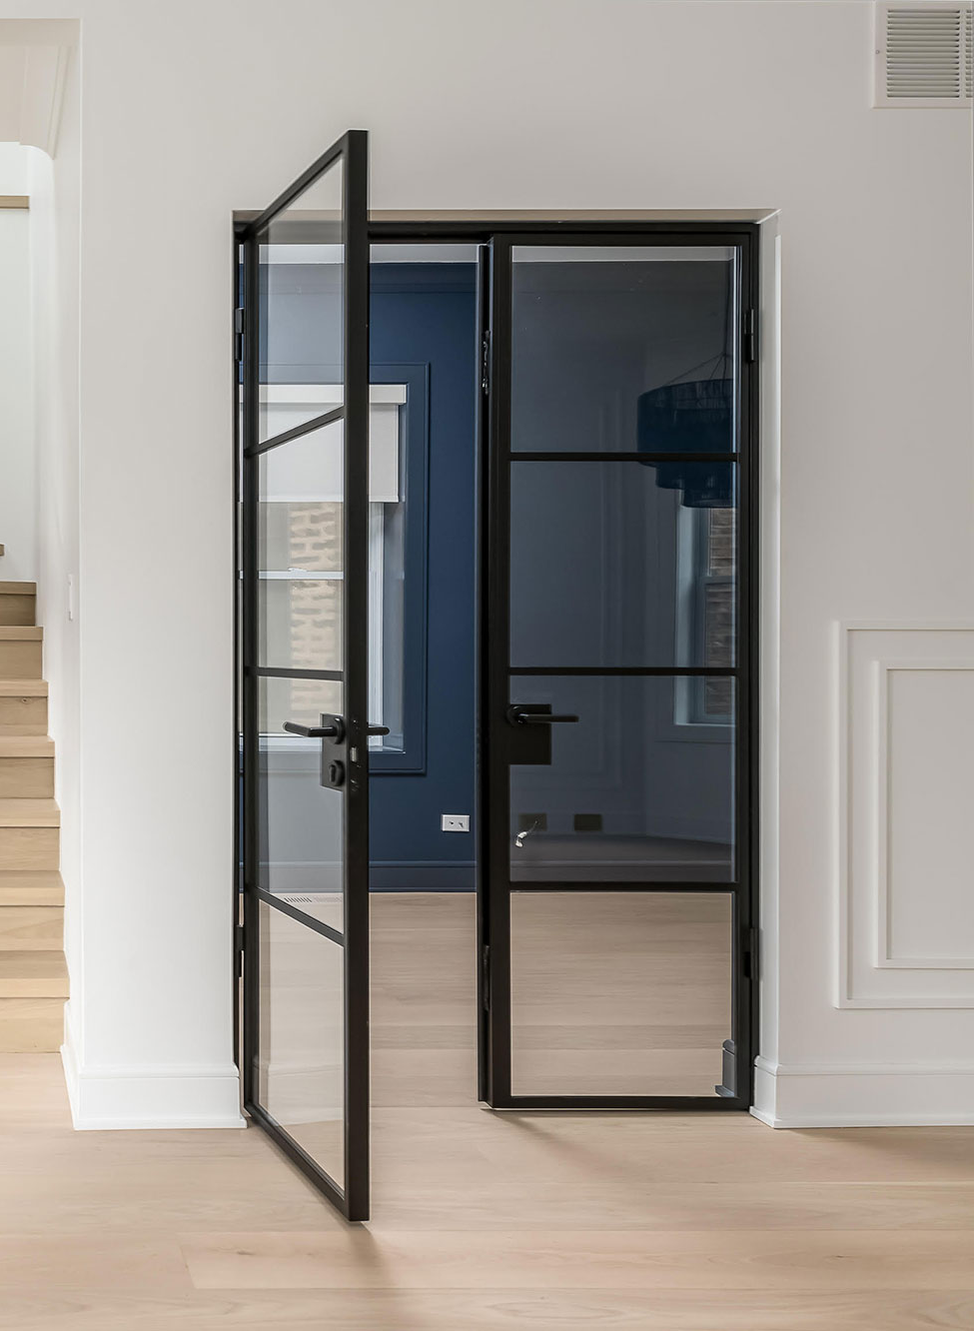
01 Standard Swing
Single and double door configurations
Sidelights and transoms available
Available as quick-ship or custom order
SWING
Notes:
QS- 3-4 weeks
Custom- Up to 20 weeks

Slide 7
01 Standard Swing
Single and Insulated glass available
Two systems: 20 and 25
Single Glass 6 mm (System 20 and System 25)
Double Glass (System 25 only)
ESG Paned 4 / 12 / ESG 4
All glass options available
1-point locking handle preferred hardware option
Jamb Profile (matches the frame)
Standard option
Drop Sill (retractable seal)
Available upon request
Notes:
With an option to go w dual paned interior doors, one can achieve a greater sound control. This is not a measured value in terms of STC (Sound Transmission Class) as we have not formally tested a single glazed interior door vs. a dual glazed one, but given two panes of glass, there is a notable difference, we just have not formally quantified it as a manufacturer. Overall glass is 20mm or slightly over ¾”. Glazing as you can see is using 4mm glass w a 12mm spacer bar. ESG stands for European Safety Glass.

Slide 8
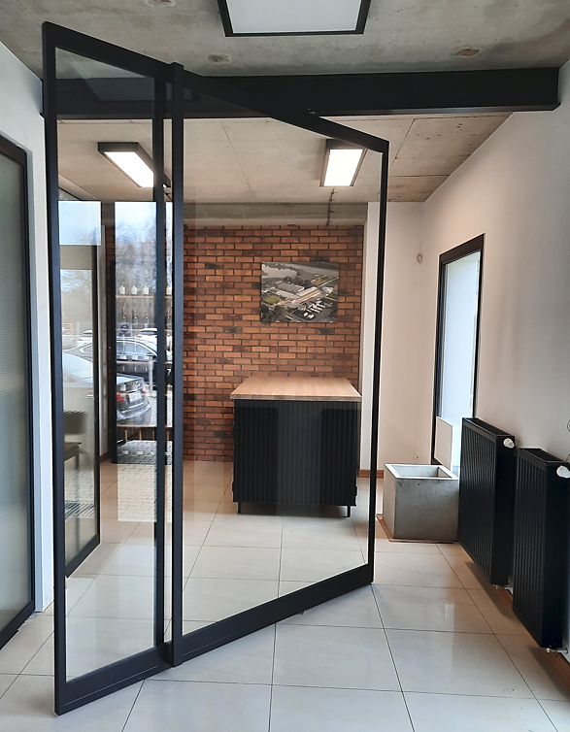
02 Pivot
Equipped with pivot hinge
Available in all configurations
Hold open feature at 90 degrees
Maximum opening angle of 150 degrees
Custom order only
Currently only available as slab only
(no framing pieces)
PIVOT
Notes:
With our Interior Pivot door we use a unique European pivot hinge (manufacturer is ARLU) . Both top and bottom hinges are adjustable. This pivot has a hold open feature at 90 degrees. It has a maximum opening angle of 150 degrees. These doors are primarily passage on and not secured by a lock mechanism. Check with BMD-mfg. inside sales if lock mechanism is available.

Slide 9
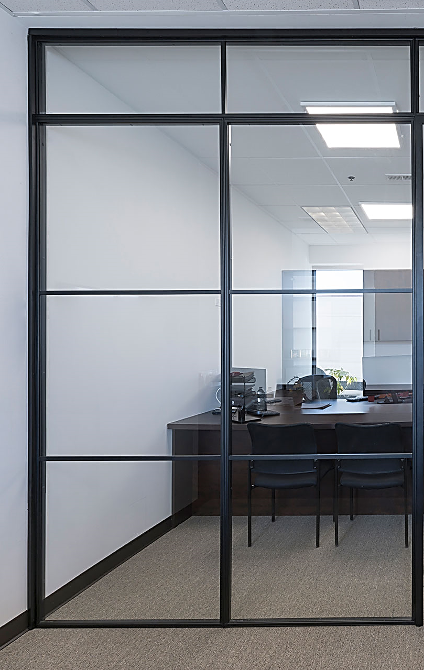
03 Fixed
Configurations can be a single- or multiple- panels aligned next to each other.
Maximum dimensions applicable on full assembly
Contact BMD Manufacturing tech division for maximums on assembly widths.
FIXED
Notes:
Fixed panels can be aligned to make a see-through wall partition.

Slide 10
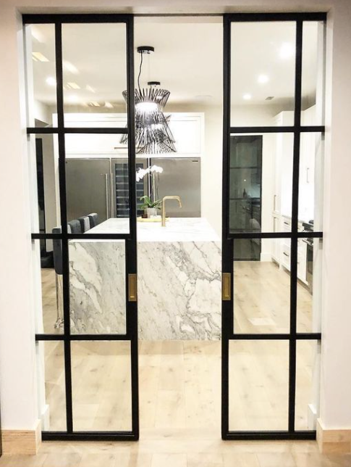
04 Pocket
POCKET
Single Door
Double Door
Types of Pocket Hardware
  Hafele Slido Set (default, in-stock)
  Recessed pull handles- Emtek
Notes:
For pocketing systems, we are offering the Hafele “Slido” system as a standard. The Hafele hardware can be pre-shipped prior to panels for phasing construction. Also, be sure to check with BMD Inside sales for “pull” options on pocketing system panels. Pulls should be factory prepped for proper fit and clearance in a pocket door application. Emtek recessed locks are primarily used in these systems.

Slide 11
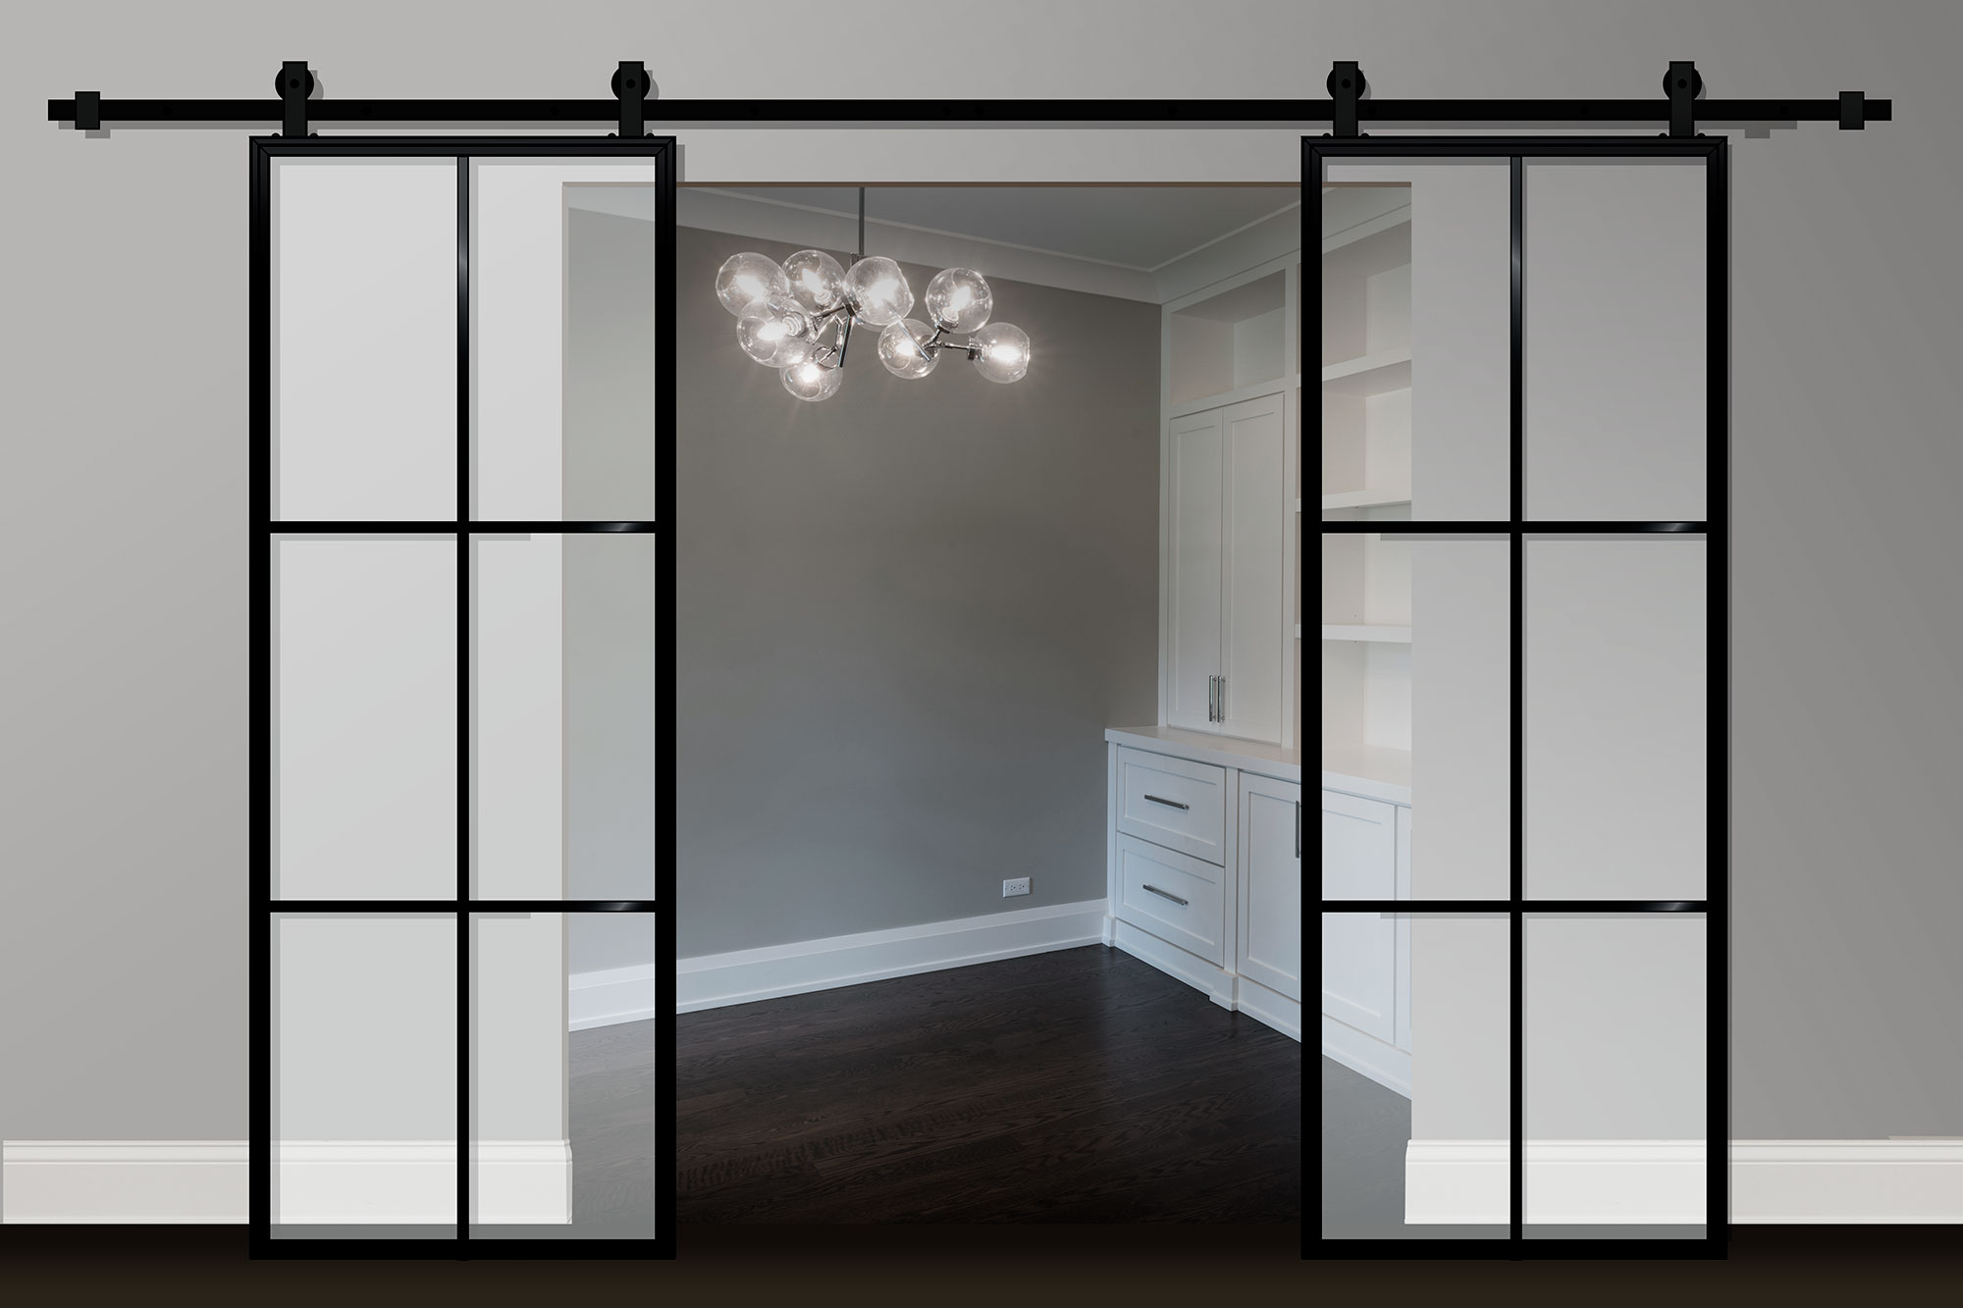
05 Barn
Comes equipped with hardware from BMD-mfg.
Not compatible with outside track systems (Emtek, Hafele, etc.)
Rails available in lengths of 78-3/4”, 98-3/8” and 118”.
Cutting rails to specific size not recommended.
BARN
Notes:
Barn Style doors utilize a European hardware system made by Gustavson (Loft Art). Due to the thickness and the powder-coat on our rails, we do not recommend cutting to size in the field. This could damage the finish and be difficult to get a clean finish on the ends as this is an exposed profile.

Slide 12
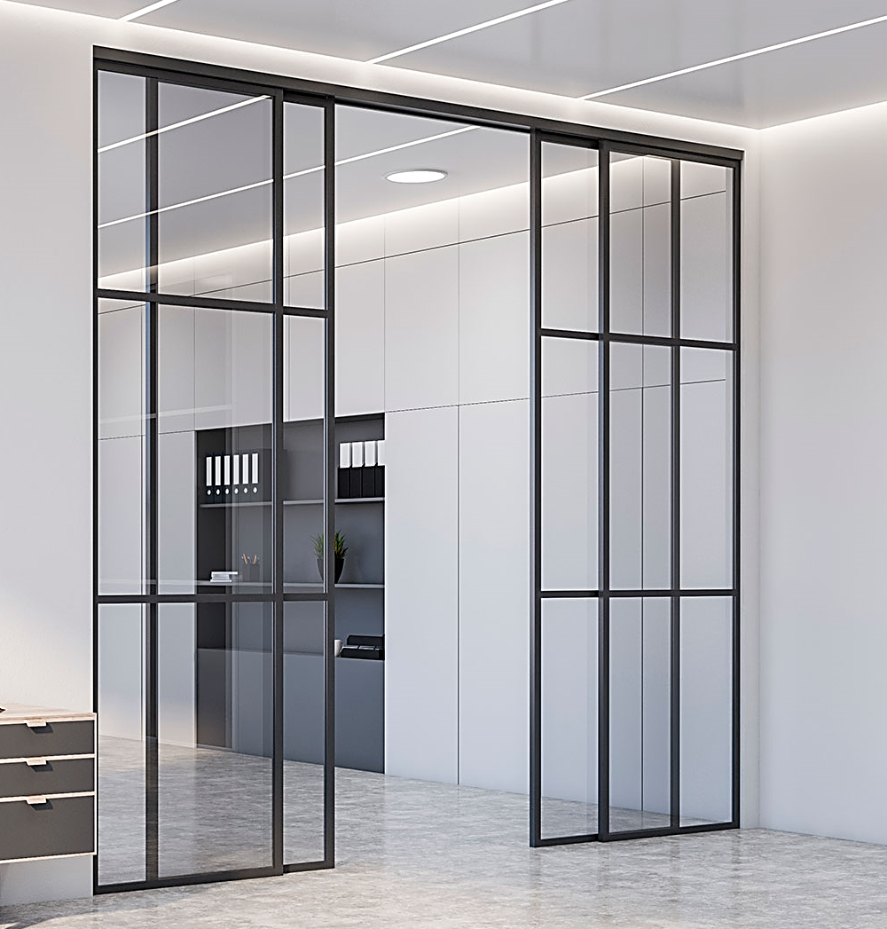
06 Sliding
SLIDING
Equipped with track hardware from the factory
  Hurkules 120
Surface mounted on wall or mounted within the opening/ceiling
Standard distance of slab from wall is 5mm (just over 3/16”)
  Can be moved further if required
  (ex. larger baseboard on wall)
Notes:
Sliding Door systems will typically mount in a wide finished opening where no pocket exists. The hardware system for Sliding doors is made by an EU company called Herkules. We are utilizing the Herkules 120 track and wheel system. This system typically mounts up under a finished openings, but can also be face mounted like a barn door.

Slide 13





Finishes
RAL 7016 STR
RAL 2021 STR
RAL 9004 STR
RAL 9005 STR
RAL 9003
Anthracite Grey Textured
Black Grey Textured
Signal BlackTextured
Jet Black Textured
Signal White
Other RAL options available upon request but check with the Glenview Doors team before offering to a customer.
Notes:
As noted earlier, our Steel Interior systems are made from cold rolled steel and our finish is an electro-static powder coat in the five finishes listed here.

Slide 14
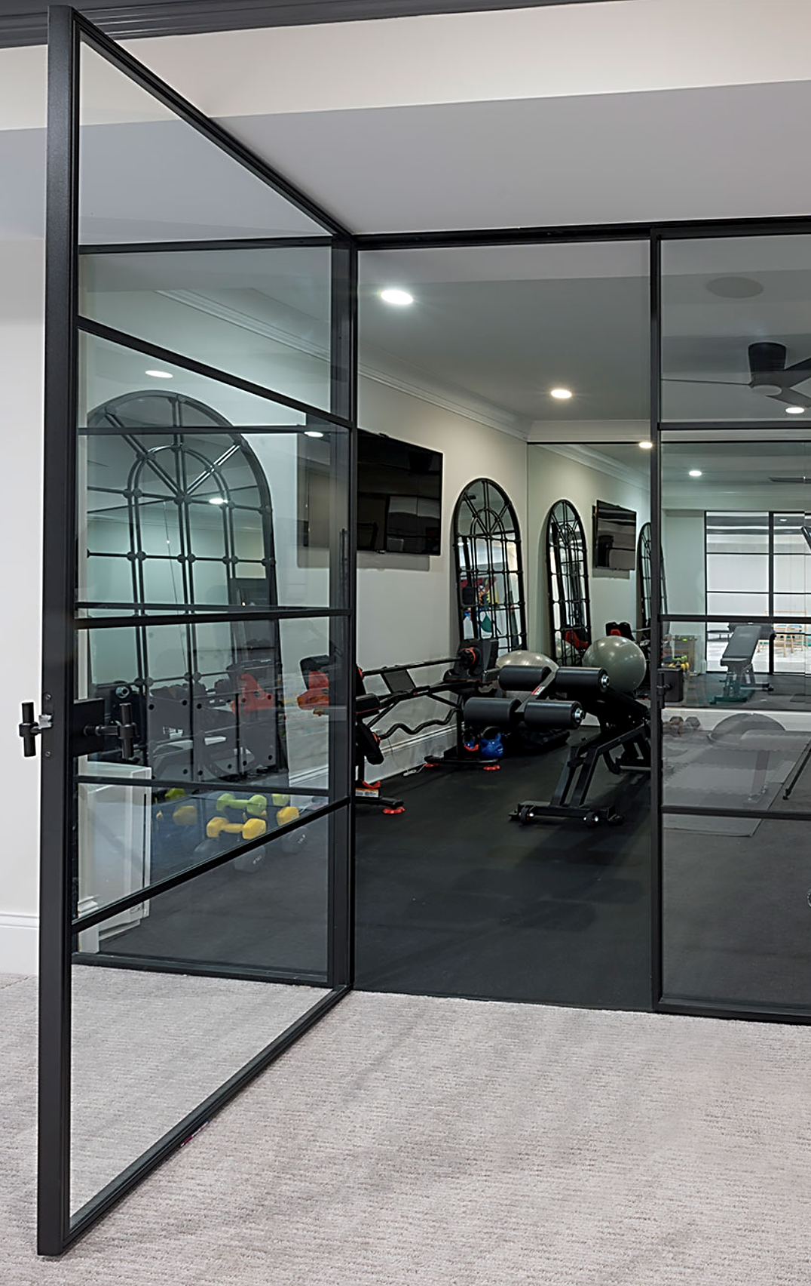
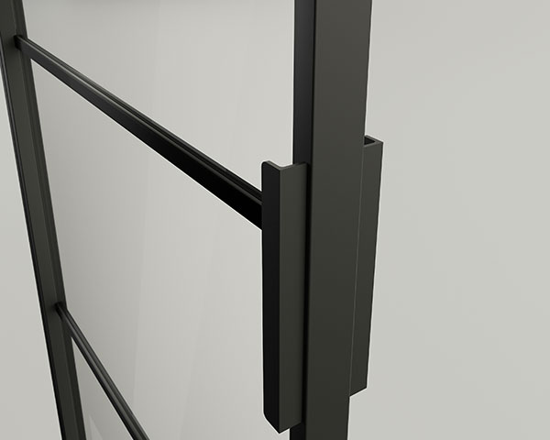
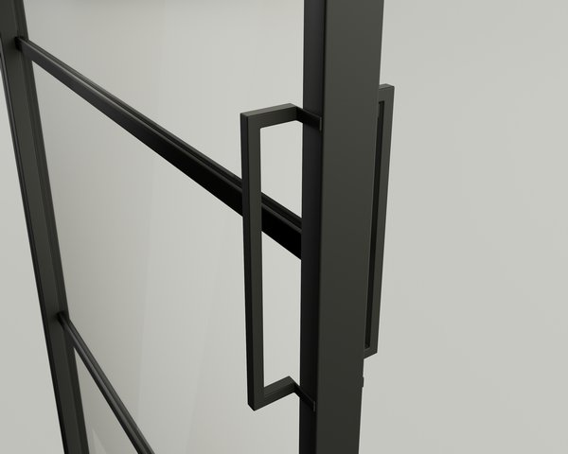
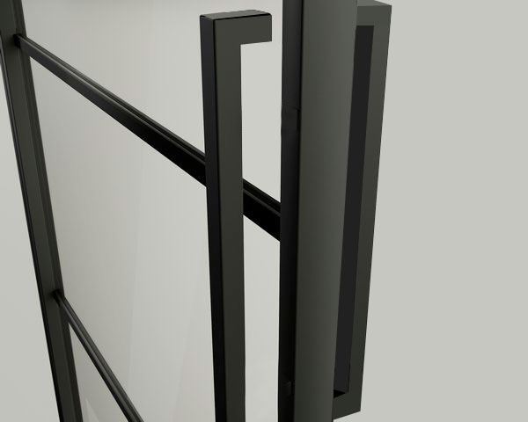
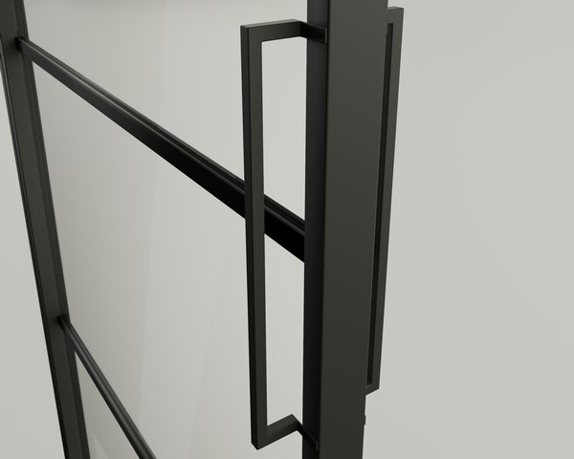
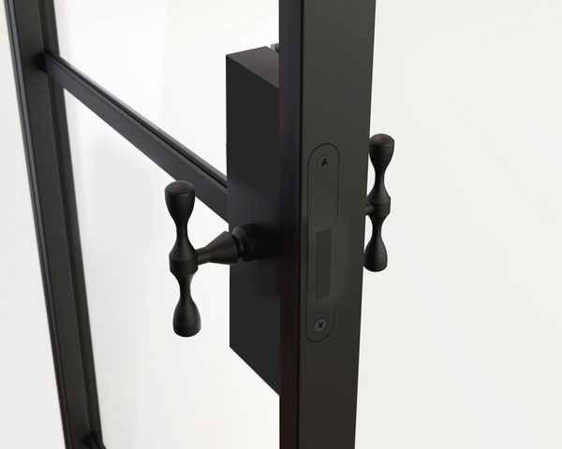
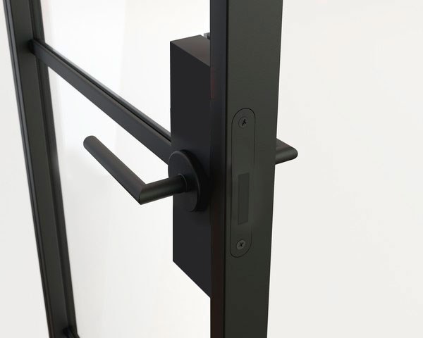
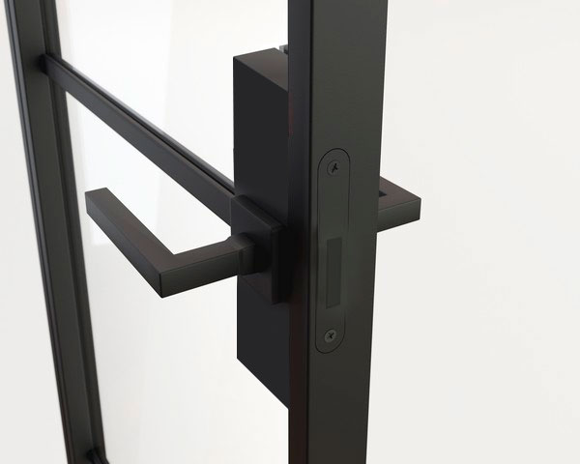
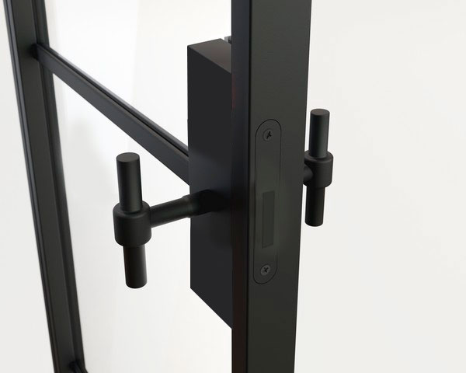
Hardware
Handles / Pulls
Pull 20
Pull 25
Pull 30
Pull 50
1-Point Magnetic Lock, opened only with a handle
Loft Handle (standard)
LUCY Handle
Square Handle
Modern Handle
Notes:
Sliding door systems provide (4) pull choices. Pocketing systems will have flush pulls in the lockbox, so that panels can fully engage into a pocket. Hinge doors offer magnetic latches made by Bonaiti, which is an Italian hardware company. Note that for Lever handles on Interior Steel the Lucy and the Square handle choices are the most popular. Note on sliding doors we mount the pulls on one side only due to clearance issues.

Slide 15
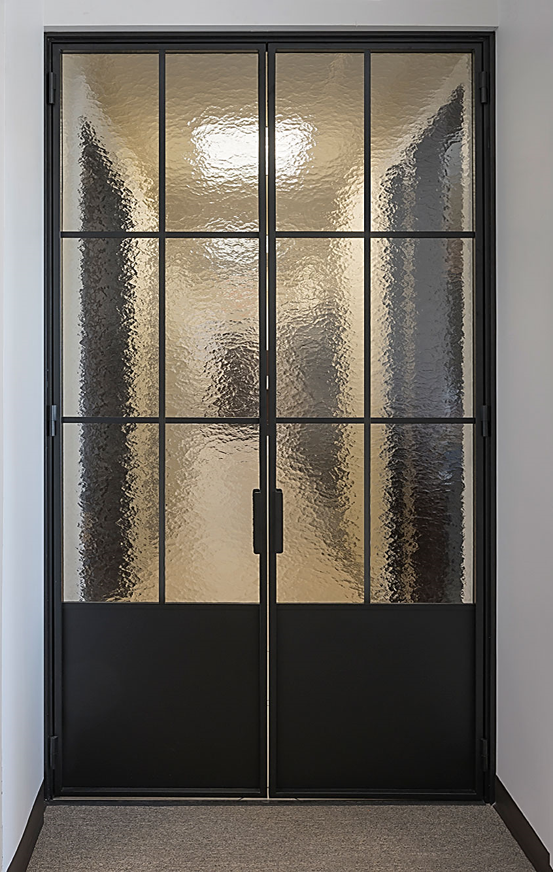
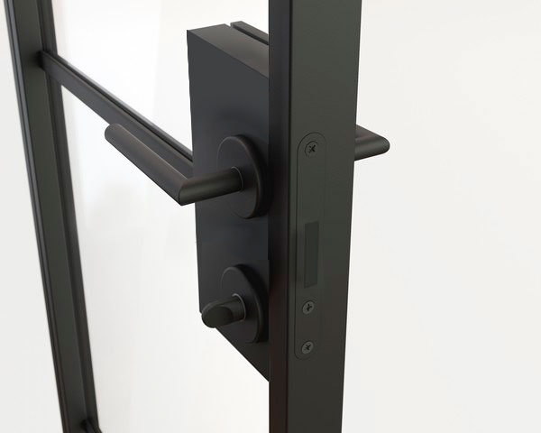
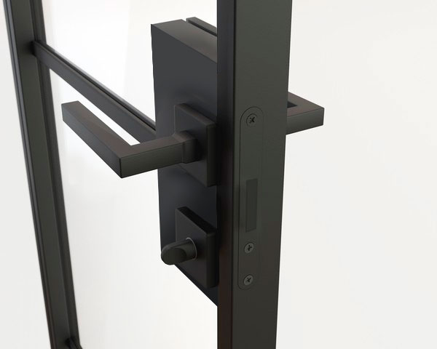
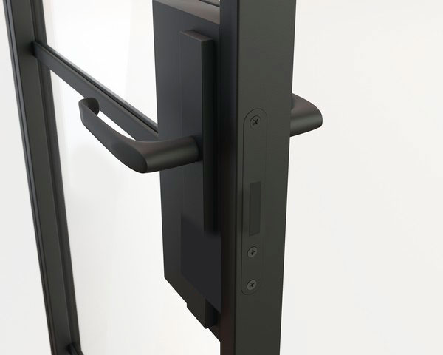
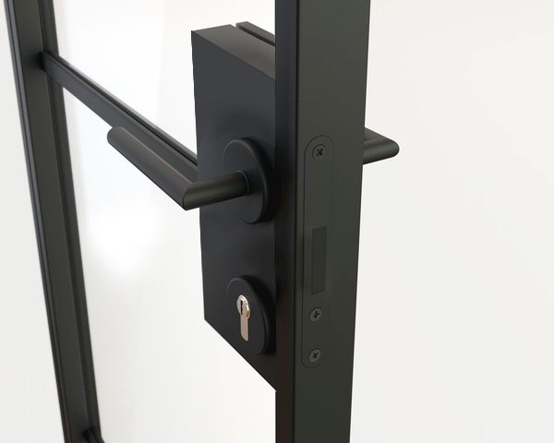
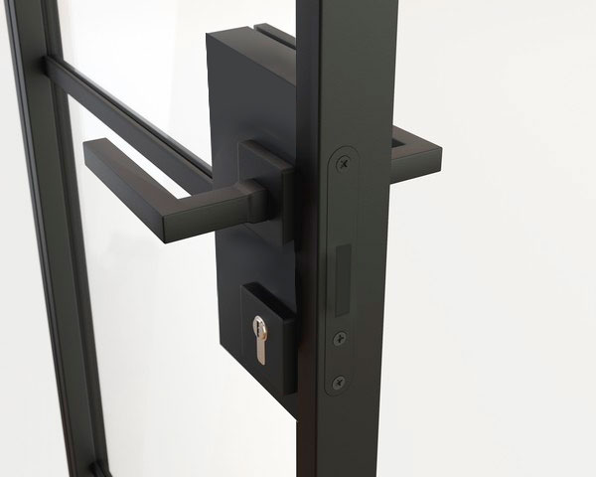
Hardware Cont…
1-Point Magnetic Lock with a WC type insert (thumbturn)
LUCY Handle
Square Handle
1-Point Magnetic Lock with a patent insert (keyed)
LONG Handle
LUCY Handle
Square Handle
Notes:
You will note that here that we offer a fourth type of lever handle referred to as the Long handle. This slide also defines how a keyed lock box on the exterior would look in the event of a client wanting a privacy option.

Slide 16
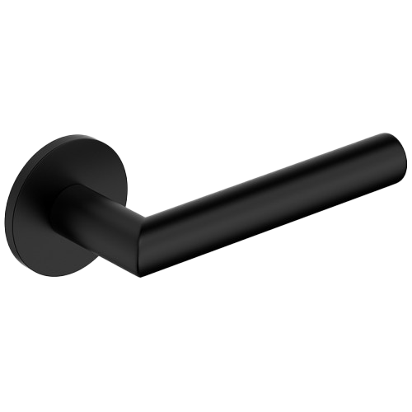
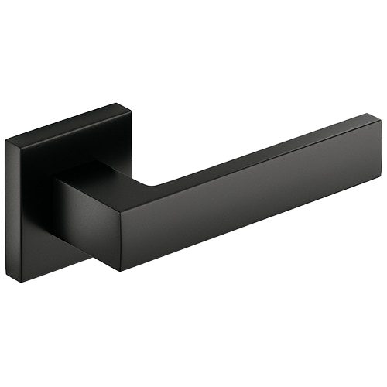
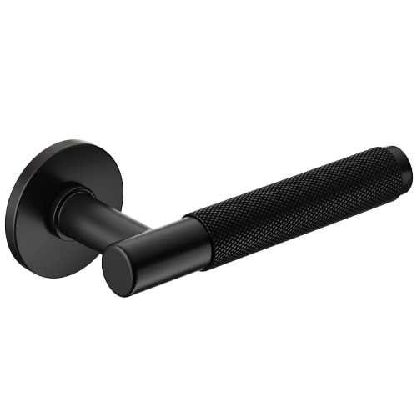

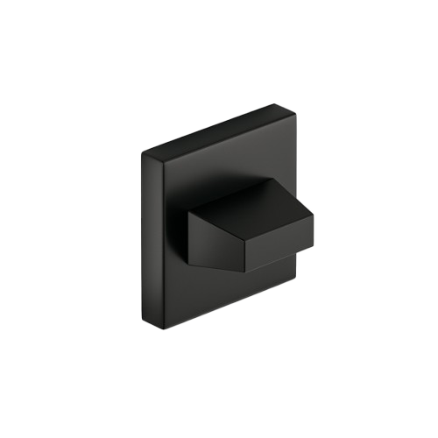
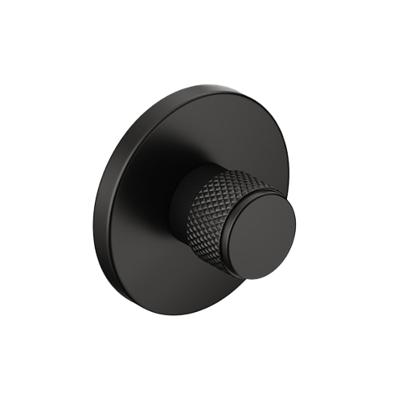
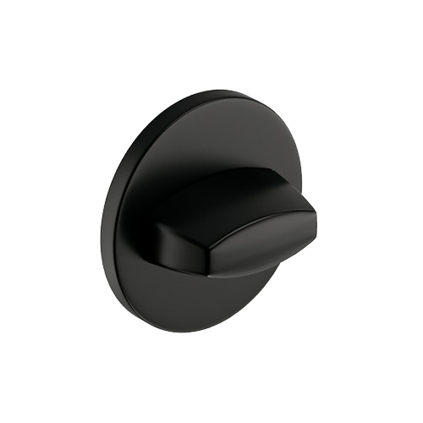

Hardware Sets
Lucy Handle
Square Handle
Time Handle
Notes:
Here is a closer look of a Glenview Interior Steel display board showing three of our four handle choices. There is of course the Loft and the Modern handles, so technically we have 5 lock handle choices for Glenview Interior Steel hinged doors.

Slide 17
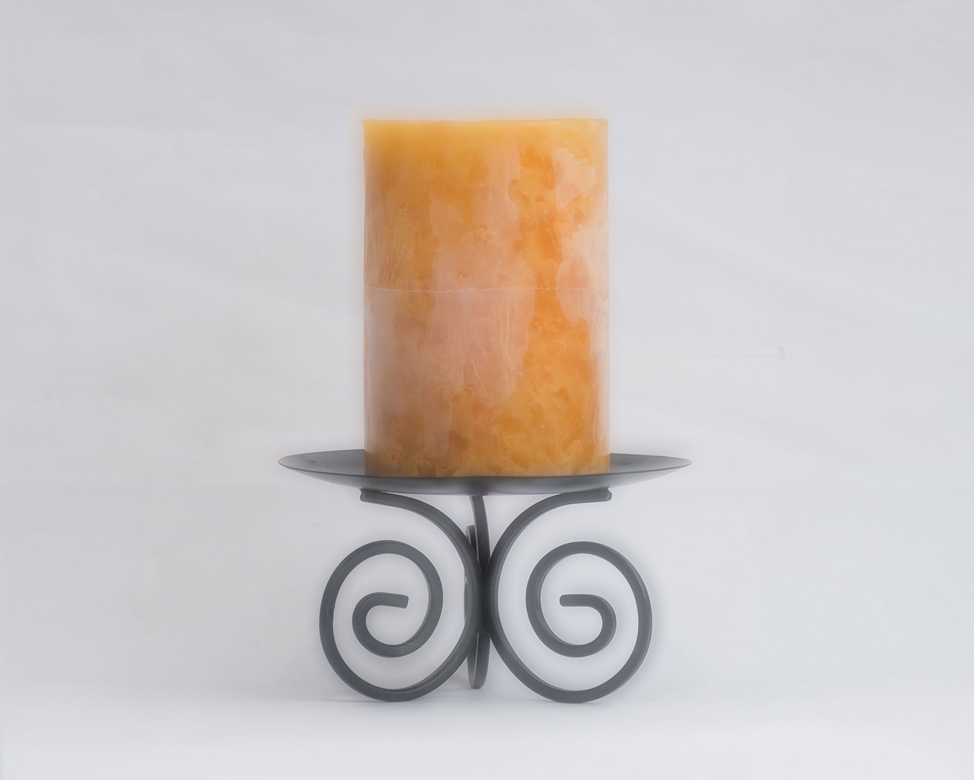

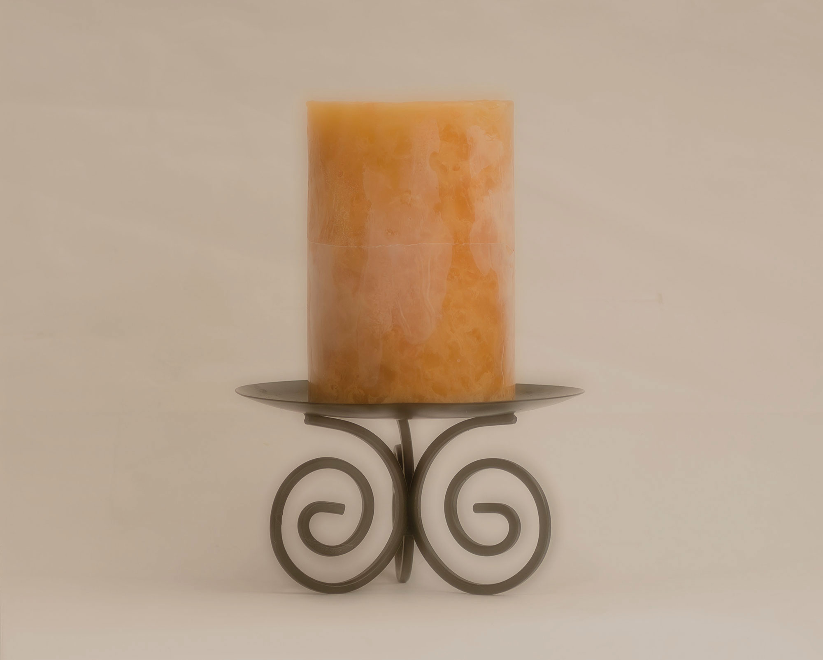






Glass Options
Clear Glass
ESG (Tempered)
Satinato Glass
ESG (Tempered)
Bronze Glass
ESG (Tempered)
Graphite Glass
ESG (Tempered)
Satinato Graphite Glass
ESG (Tempered)
Dark Graphite Glass
ESG (Tempered)
Fluted Glass
ESG (Tempered)
Fluted Matt Glass
ESG (Tempered)
Estriado Glass
ESG (Tempered)
Notes:
Different glass options are available per the choices about. All glazing is Tempered and depending on the choice, it may vary between 4mm and 6mm for single glazed options. Check in with BMD-mfg. tech for IG options with one of the decorative glazing options listed here.

Slide 18
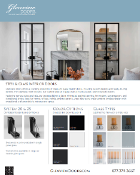
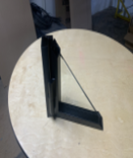


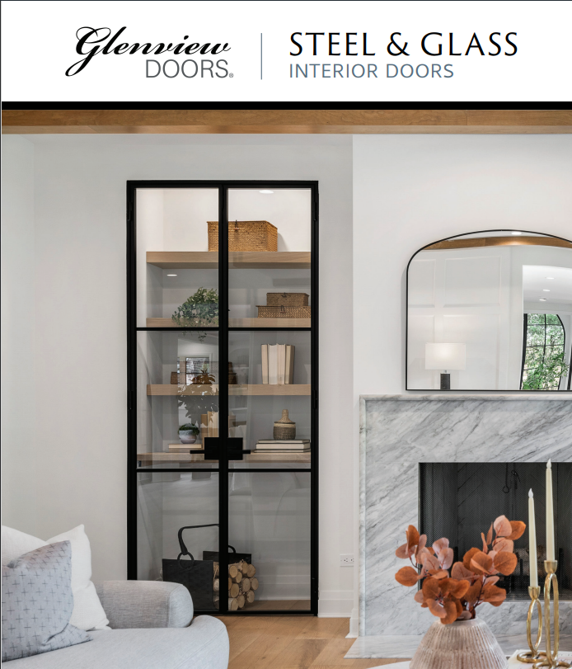
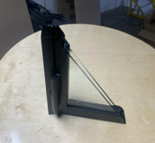
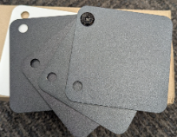
RESOURCES
DEALERS
HOMEOWNERS
Resources | BMD Manufacturing
Steel and Glass Modern Interior Doors
glass and steel modern interior doors - Gallery | Front Doors, in-Stock and Custom Euro Technolody by Glenview Doors
Notes:
This slide highlights the resources available to support both homeowners and dealers when selling steel and glass interior doors.
For homeowners, we focus on inspiration and clarity. We have sell sheets and brochures that are easy to send as follow-ups, plus our website pages for deeper information, photography, and design ideas. These tools help homeowners visualize the product and feel confident in the decision.
For dealers, we provide more hands-on support. In addition to the same literature and website resources, dealers have access to sales samples—including corner cuts, finish samples, and hardware samples—to physically show quality, profiles, and finishes. Finally, dealers are not on their own. Our inside sales team and product team—including me—are always available to answer questions, support quoting, and set up product overviews or quote training sessions as needed.
The goal is simple: make steel and glass interior doors easy to understand, easy to present, and easy to sell.

Slide 19
BMDQ
You can now quote Steel & Glass Interior Doors directly in BMDQ
Full steel & glass configurations available to build and price
Real-time quoting for accurate, dealer-ready proposals
Steel-Specific BMDQ Trainings
We are hosting dedicated Steel & Glass BMDQ trainings:
Next Week
Week of March 30
Support When You Need It
Our Inside Sales Team is always available for:
Product questions
Configuration guidance
BMDQ quoting assistance
Troubleshooting
Notes:
Before we wrap up today, I want to remind everyone that Steel & Glass is now fully live in BMDQ.
We’re hosting steel-specific BMDQ trainings next week and again the week of March 30. These are quick, practical walkthroughs to make sure you’re comfortable building quotes.
And as always, our Inside Sales team is here for both product questions and BMDQ support. If you’re unsure about anything, please reach out to us! We’re here to help you quote with confidence.

Slide 20
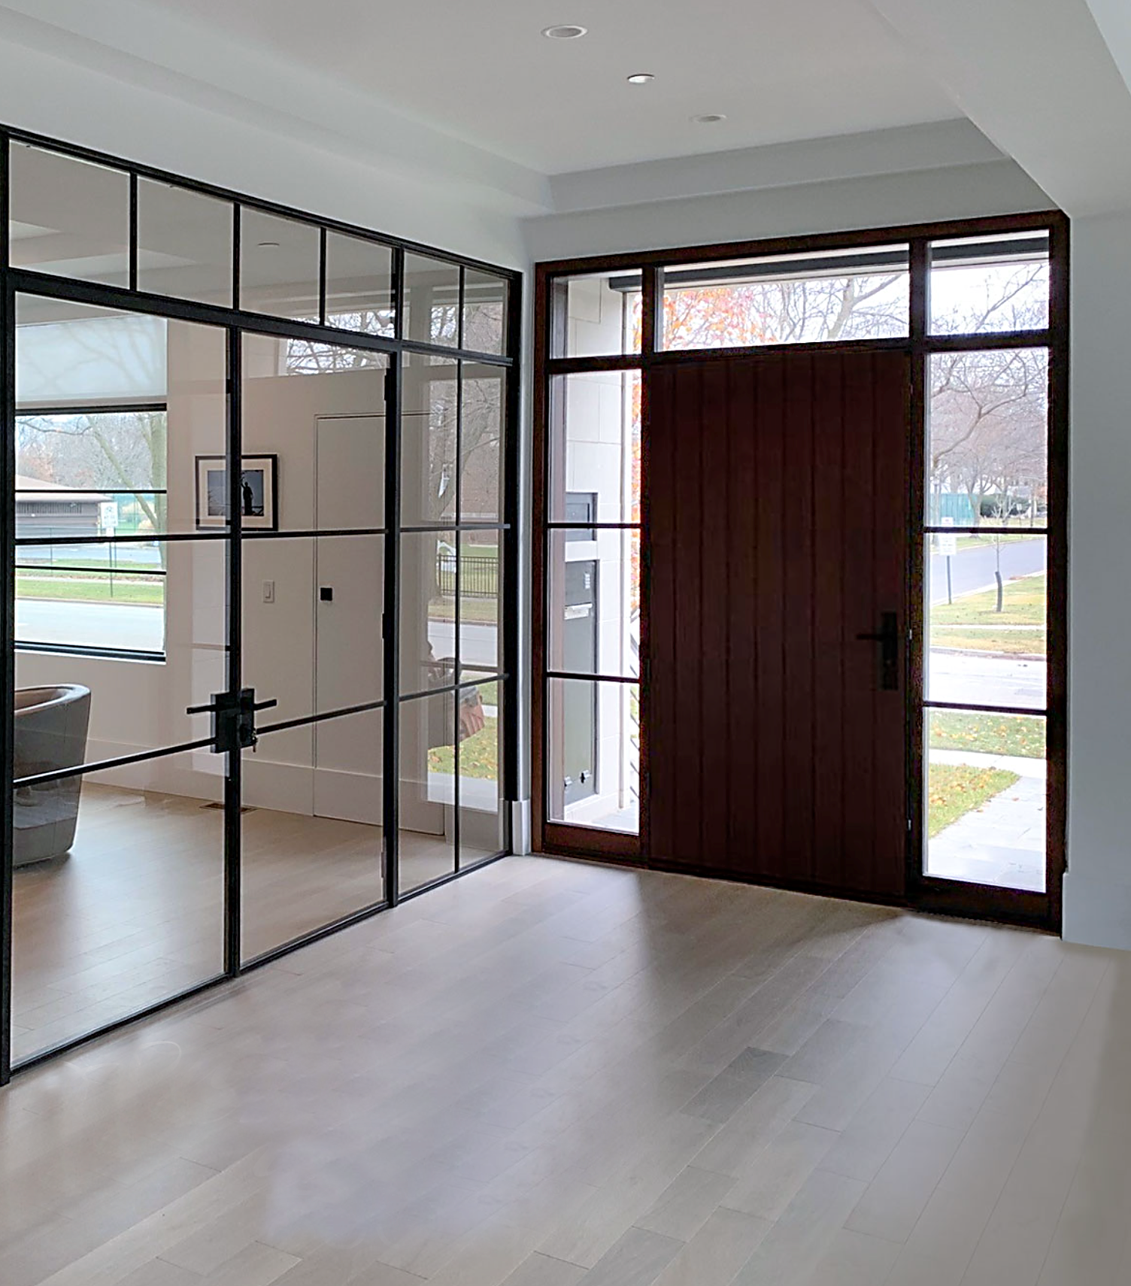
Thank You!
Glenview Doors – The Right Choice for Entry Doors, and Interior Steel doors
www.glenviewdoors.com
Notes:
Thank you and as always, for further questions, reach out to BMD-mfg. or contact your BMD-mfg. Territory Manager.

