Slide 1

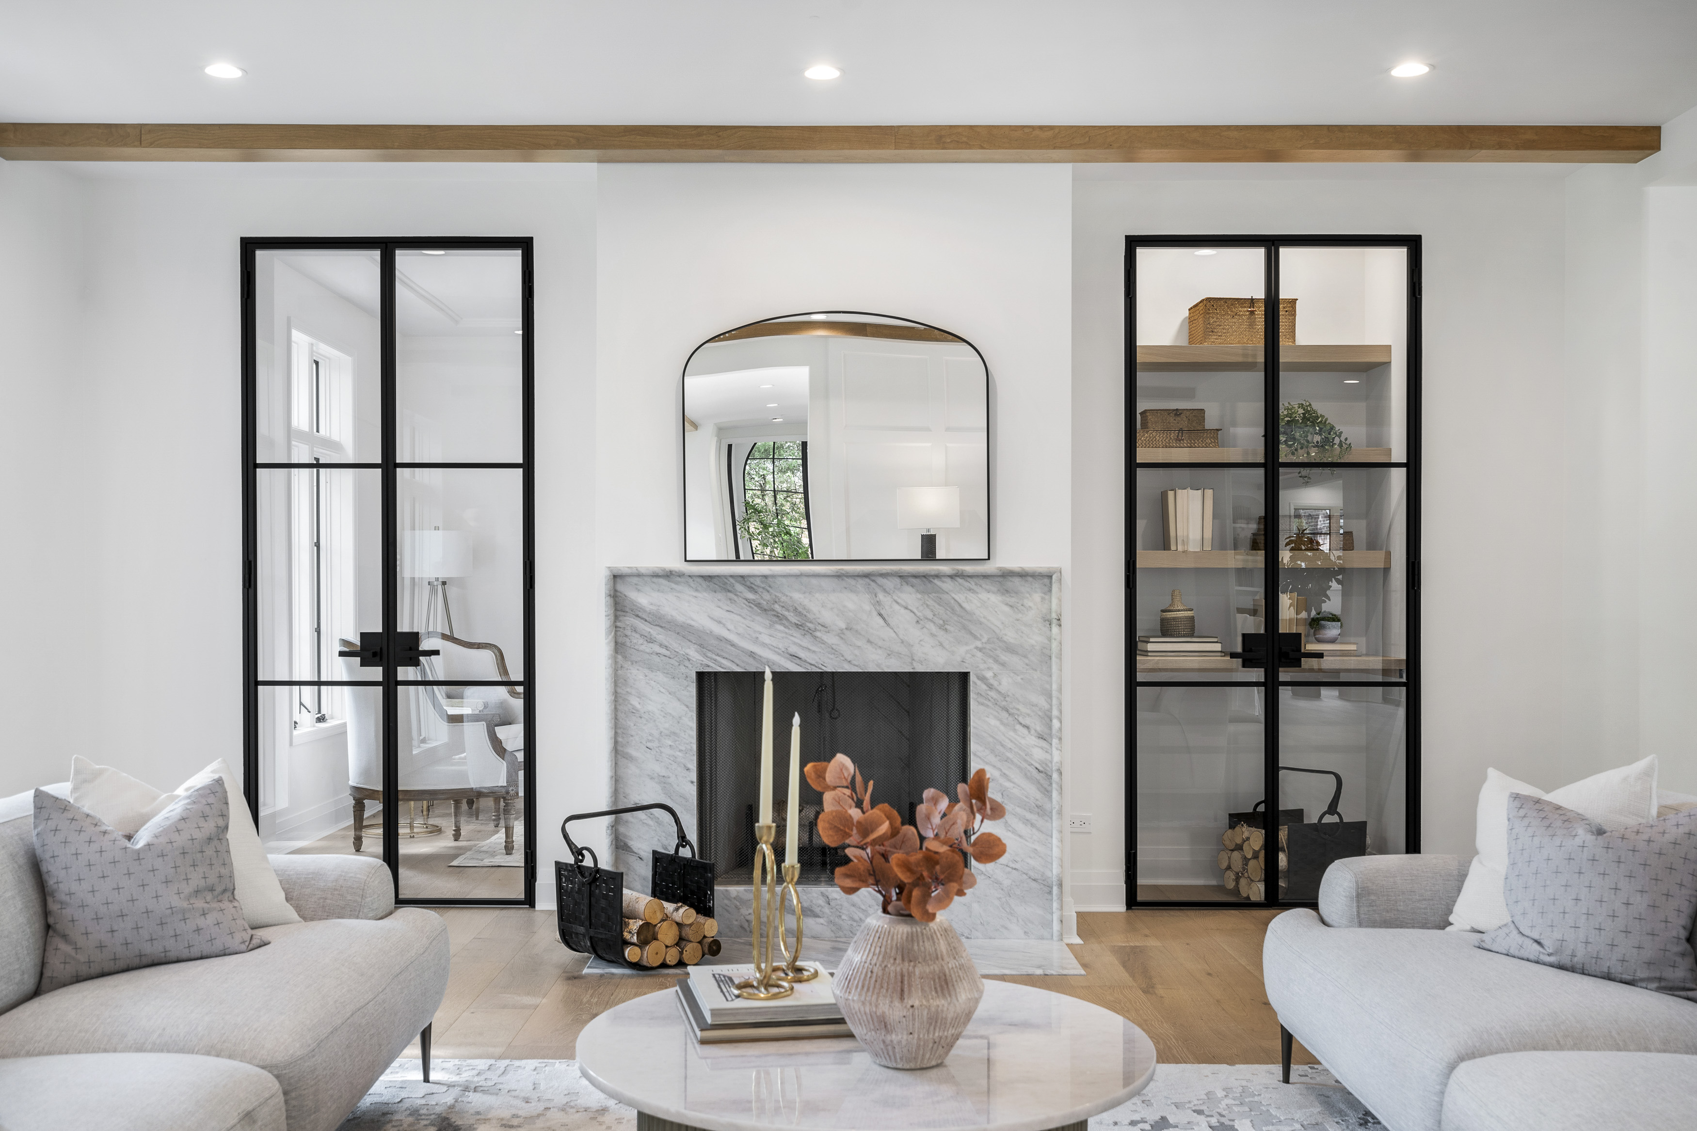

Designing with Interior
Steel & Glass Doors
Notes:
Welcome, and thank you for joining this AIA-accredited course on interior steel and glass doors. Today, we’ll explore the design and specification of these systems from an architectural perspective, with a focus on performance, aesthetics, and integration into modern spaces. My name is [Name], and I’m with [Company], and I’ll be guiding you through today’s session.

Slide 2
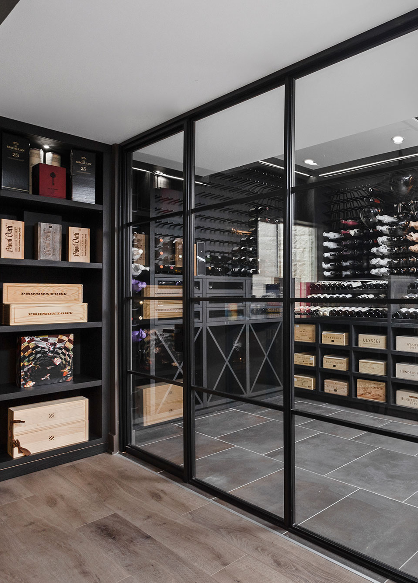

Learning Objectives
Construction & Installation
Describe the construction and installation requirements for steel and glass interior door systems.
Door System Types & Use Cases
Compare different door system types (swing, pivot, sliding, barn, pocket) and their applications
Glass Types & Design Impact
Explain how glass types and finishes affect privacy, durability, and aesthetics in interior design
Integration Challenges & Considerations
Identify challenges and considerations for integrating steel interior doors into modern residential or commercial projects.
Notes:
By the end of this course, you’ll be able to describe construction and installation requirements for interior steel doors, compare various system types and their applications, understand how glass types influence design outcomes, and recognize key considerations when integrating these products into residential or commercial projects.

Slide 3





Construction & Operation
Cold-formed Steel vs. Hot-rolled: Cold-rolled steel construction with a corrosion-resistant finish, commonly achieved through powder coating and protective underlayers.
Interior steel and glass doors typically feature slab thicknesses around 1-5/8”, with frames bringing the total unit thickness to approximately 1-7/8”.
Units are generally designed for installation into finished openings.
Net unit size is calculated by subtracting standard installation clearances from rough opening dimensions.
Alternatively, door slabs can be sized and framed by adding allowances for jamb and frame profiles.
Swing and fixed units are often installed using direct screw attachment through the frame, with pre-drilled holes or concealed anchoring systems.
Pocket, sliding, and barn-style doors typically rely on overhead track systems for operation, either surface-mounted or integrated into wall/ceiling construction.
Notes:
Let’s walk through the typical construction and operation details of interior steel and glass doors — and highlight some of the nuances that make certain systems more durable and design-forward than others.
Starting with material types: One key distinction in the market is cold-rolled steel versus hot-rolled steel.
Cold-rolled steel is processed at room temperature, which allows for tighter tolerances, smoother surface finishes, and crisper profiles — essential when aiming for clean, modern sightlines in interior applications.
In contrast, hot-rolled steel is shaped at high temperatures, resulting in a rougher finish and less precision, which may require additional grinding or finishing.
For this reason, cold-rolled steel is preferred in architectural interiors where both fit and finish matter.
Steel doors typically have slab thicknesses around 1-5/8 inches, with full unit thickness closer to 1-7/8 inches once you account for the frame. These units are most often installed into finished openings, and size is calculated accordingly. Depending on the manufacturer, allowances can be added or subtracted to accommodate the frame profile.
Swing and fixed doors usually use direct screw attachment, either through pre-drilled holes or with concealed anchoring systems — especially important when aesthetics call for uninterrupted lines. Pocket, sliding, and barn-style systems instead rely on overhead track systems, which can be surface-mounted or built into the ceiling or wall depending on the design intent.
Every installation method has its own advantages and implications for planning, so it's important to match the right system to the spatial and architectural goals of the project.

Slide 4
Steel vs. Iron: Understanding the Difference
Property | Steel | Iron
Composition | Iron + Carbon (and other alloys) | Elemental Iron
Strength & Flexibility | High tensile strength, can be formed into thin profiles | Brittle and prone to cracking
Corrosion Resistance | Enhanced with coatings like powder coating | More prone to rust without treatment
Common Use in Doors | Structural framing, clean sightlines, custom designs | Decorative grills or legacy applications
Appearance | Sleek, modern, customizable finishes | Heavier, traditional aesthetic
Notes:
When specifying interior doors, it's important to understand the fundamental differences between steel and iron, especially since these terms are sometimes used interchangeably in the marketplace.
Steel is an engineered alloy — primarily iron mixed with carbon — and is widely used in architecture for its strength, formability, and consistency. Cold-rolled steel in particular allows for precise fabrication, resulting in slimmer profiles, cleaner sightlines, and compatibility with modern interior aesthetics. It also responds well to powder-coated finishes that resist corrosion and wear over time.
Iron, including “wrought iron” or “cast iron” components, tends to be more brittle, heavier, and less dimensionally stable. While it may offer a certain decorative or traditional appeal — and often appears at a lower material cost — it’s generally not well-suited for interior applications where fine detailing, frequent use, or alignment with minimalist design language is desired.
Additionally, iron-based systems may lack the surface uniformity and finish versatility that steel systems provide, which can impact both performance and aesthetics over time.
Ultimately, for residential interiors that demand refinement, flexibility, and longevity, steel tends to offer more consistent results across both form and function.

Slide 5
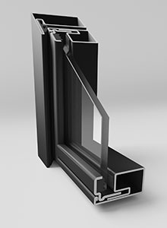
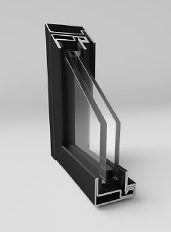
Single vs. Dual Pane
Single-Pane Glazing
Composed of a single layer of tempered or laminated glass.
Offers a minimal profile with narrow sight lines.
Suitable for interior applications where thermal or sound insulation is not critical.
Typically used in minimalist or industrial designs.
Dual-Pane (Insulated) Glazing
Constructed with two layers of glass separated by an air or gas-filled space.
Improves sound dampening and adds a layer of thermal separation
Often slightly thicker than single-pane options, which may result in broader frame sight lines.
Requires compatible frame profiles designed to accommodate the added depth.
Notes:
Next, we look at glazing. Single-pane glass offers a minimalist profile and is common in purely interior settings where insulation isn’t critical. Dual-pane glazing adds an air or gas-filled layer between glass for better sound control and thermal separation. It’s especially useful when doors separate conditioned and unconditioned spaces or where acoustics matter—like conference rooms or wine rooms. Note that dual-pane options require deeper frames.

Slide 6
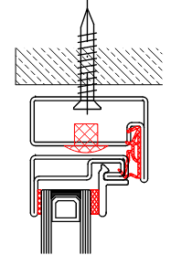
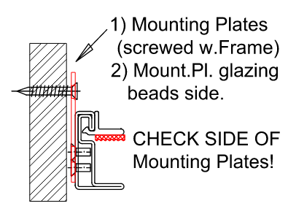
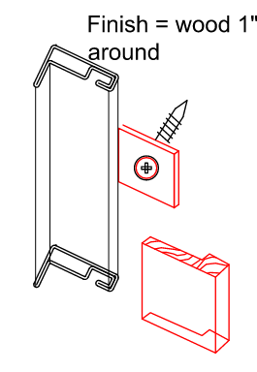
Installation – Thru jamb or mounting plates
Single Pane
Dual Pane (Insulated)
Example of thru-jamb fastening with plastic cap.
Example of mounting plate method of fastening.
Notes:
There are two common mounting types: thru-jamb fasteners and mounting plates. With thru-jamb installation, fasteners go directly through the jamb and are often capped for a clean finish. Mounting plates, on the other hand, require a wood stop or trim element to conceal the plate and screw heads, blending into surrounding wall finishes

Slide 7
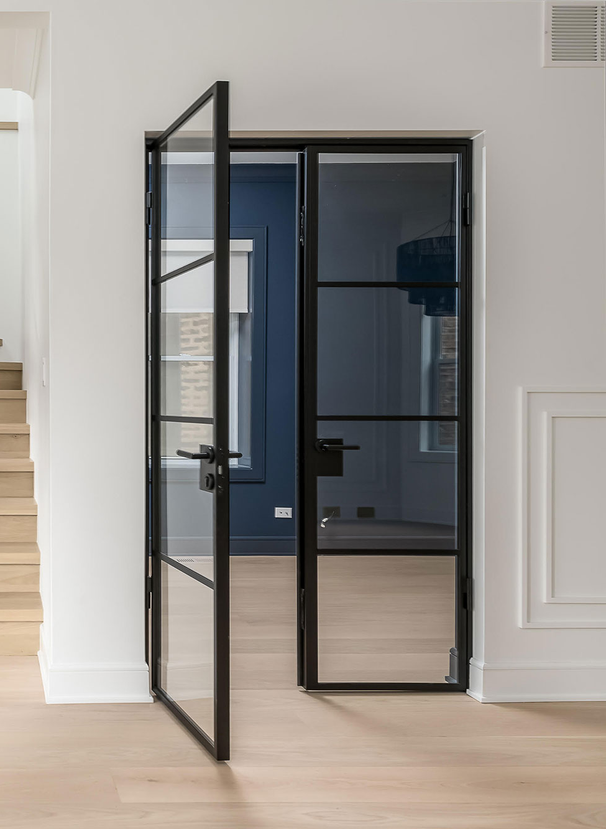
01 Standard Swing
Standard Swing Door Systems
Single or double-panel configurations
Compatible with sidelights and transoms
In-swing or out-swing orientations
Hinged at jamb or pivot-mounted
Common in residential, office, and light commercial interiors
Architectural Considerations
Requires clear swing path
Allows for privacy and acoustic control
Glass and frame options affect aesthetics and performance
SWING
Notes:
Swing doors are a familiar, functional solution. They’re available in single or double-panel formats, can be paired with sidelights or transoms, and allow in- or out-swinging action. They’re ideal for private offices, bathrooms, and residential transitions. Because they require a swing radius, space planning is key. They can provide privacy or sound control with the right glazing and frame configuration.

Slide 8
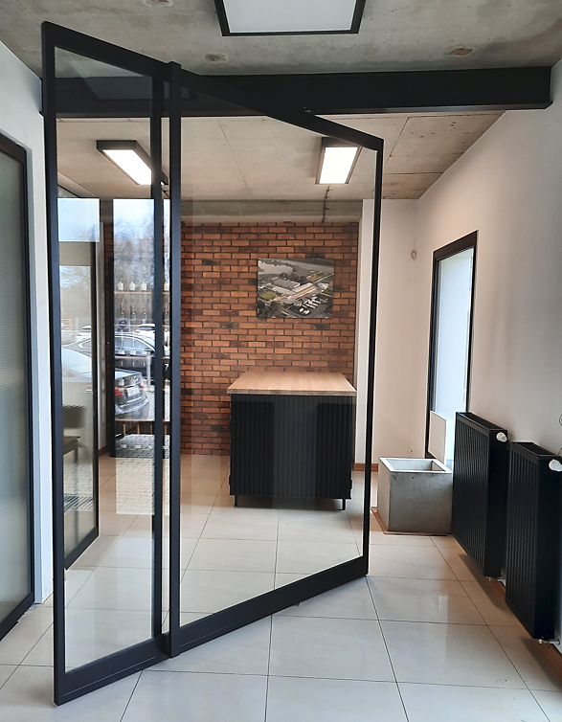
02 Pivot
Operate on a central or offset pivot hinge
Suitable for wide, tall, or heavy panels
Clean, modern aesthetic with minimal hardware visibility
Allows for smooth, dramatic movement
PIVOT
Architectural Considerations
Opens up to 150° depending on hinge type
Optional hold-open at fixed angles (e.g., 90°)
Requires floor and ceiling support for hinge system
Ideal for feature entrances or open-plan transitions
Notes:
Pivot doors offer a modern alternative to traditional hinges. Mounted at the top and bottom, often offset from the edge, they can handle larger, heavier panels with ease. These doors are visually striking, ideal for entry transitions or statement spaces. Depending on the hinge system, they can open up to 150° and include hold-open features at certain angles. They do require structural support at the floor and ceiling.

Slide 9
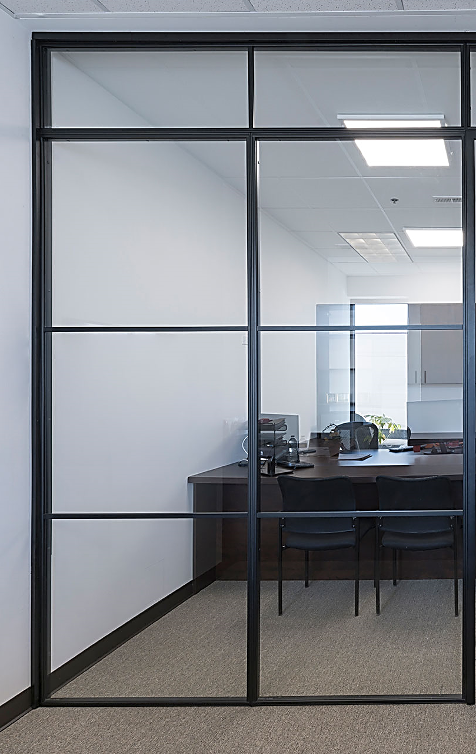
03 Fixed
Non-operable glass panels within a steel frame
Used for dividing space without restricting visibility or light
Can be standalone or paired with operable doors
Architectural Considerations
Enhances openness in interiors
May require floor and ceiling anchoring
Supports modular configurations with transoms or sidelights
FIXED
Notes:
Fixed steel panels provide the transparency of glass with the stability of a non-operable unit. These are often used to divide space, create light corridors, or frame entries. They can stand alone or be integrated into multi-panel layouts with swing or sliding units. Anchoring at the floor and ceiling ensures long-term stability.

Slide 10
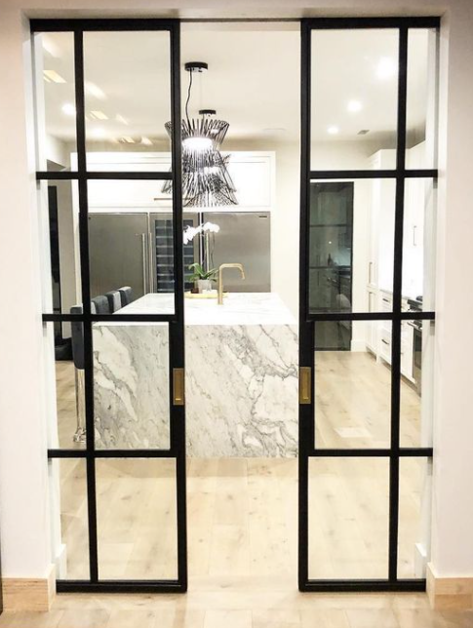
04 Pocket
Slide into a wall cavity for full concealment when open
Space-saving solution for rooms with limited swing area
Often used for bathrooms, closets, or transitional zones
POCKET
Architectural Considerations
Requires a dedicated cavity within the wall
More complex framing than surface-mounted systems
Limits access to wall interiors post-installation
Notes:
Pocket doors slide into a wall cavity, making them ideal for space-limited areas like bathrooms or closets. Because they disappear entirely, they save square footage, but require advanced wall framing and preplanning. Note that wall access is limited after installation, so final positioning and hardware must be carefully considered.

Slide 11
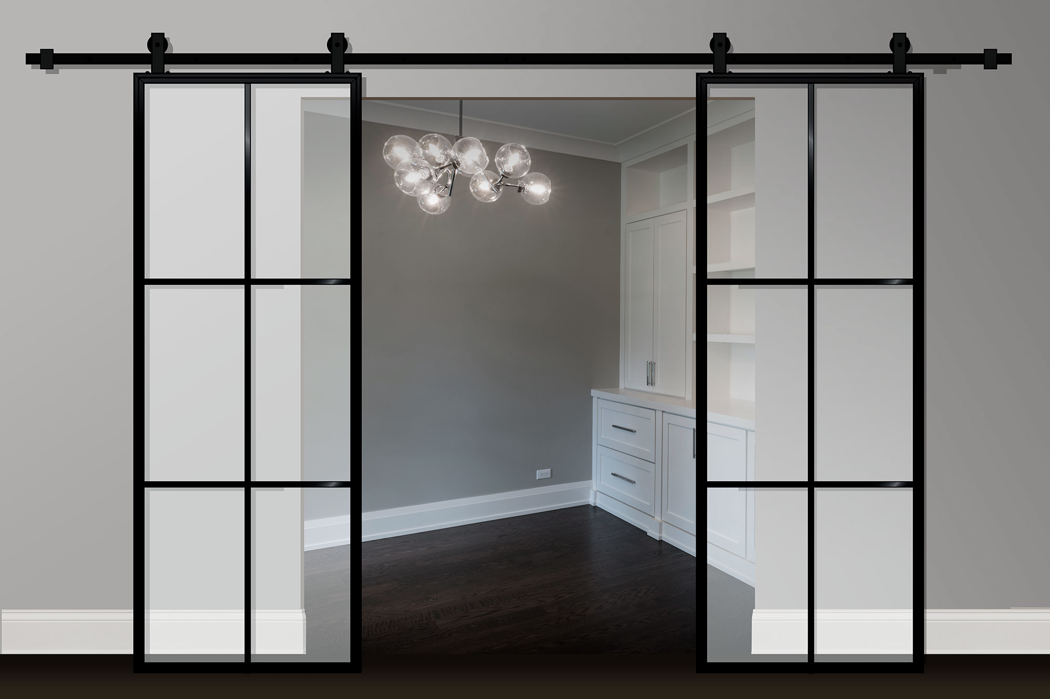
05 Barn
Surface-mounted sliding doors with exposed hardware
Offers a rustic or industrial design aesthetic
Easy to install and retrofit
Architectural Considerations
Visible track and rollers impact design style
Limited sound and light control compared to traditional doors
Track length and alignment must be carefully measured
BARN
Notes:
Barn doors mount to a surface track, sliding across the wall when opened. They’re simple to install and retrofit, and they add a bold or industrial design statement. However, they provide less sound and light control than enclosed systems. Track alignment and visibility are part of the design aesthetic, so careful measurement and selection is key.

Slide 12
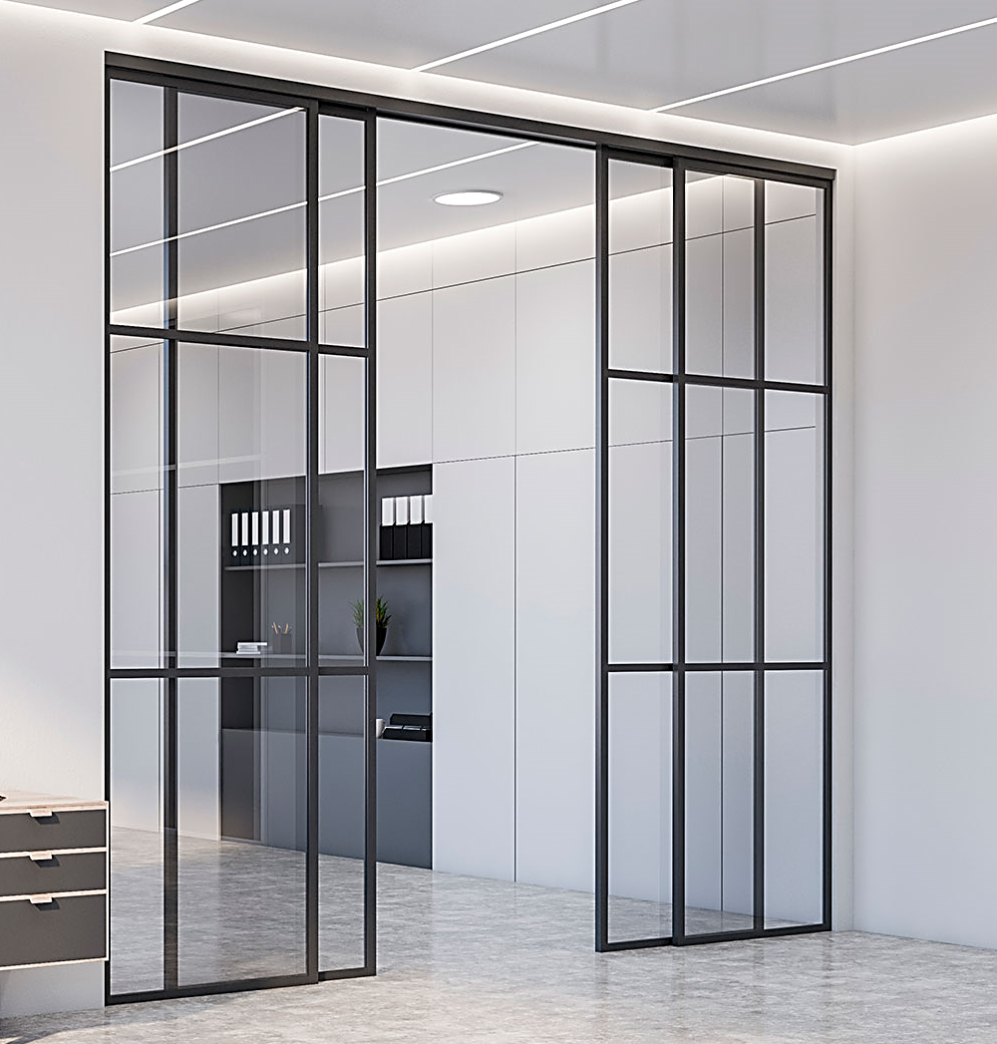
06 Sliding
SLIDING
Operate along an overhead track system
Can be wall-mounted or recessed within the opening
Smooth lateral movement ideal for tight spaces
Architectural Considerations
No swing clearance required
Standard offset from wall allows for hardware clearance
Must consider wall construction for concealed tracks
Notes:
Sliding doors move laterally across a wall or within a framed opening, often with overhead hardware. These systems are ideal for tight spaces that can’t accommodate swing clearance. Tracks may be surface-mounted or recessed, and the door’s offset from the wall must accommodate baseboards or trim. They offer smooth operation with a clean look.

Slide 13





Finishes
Powder-Coated Finishes
  Durable and commonly used for steel doors. Applied electrostatically and cured to create a hard, protective layer that resists scratches and corrosion.
Textured Matte Options
  Frequently used to reduce glare and fingerprints. Available in popular tones like black, white, and various greys.
Color Standards
  Many manufacturers utilize RAL color codes, a universal system for color matching across architectural applications.
Custom Colors
  Custom RAL or matched finishes may be available depending on the manufacturer and project requirements.
Design Considerations
  Choose darker finishes to emphasize framing lines
  Use lighter tones for minimalist or blended aesthetics
  Consider how finish texture affects maintenance and appearance over time
Notes:
Finishes significantly affect visual impact and long-term maintenance. Most doors are powder-coated for durability and resistance to scratches and corrosion. Matte and textured finishes help conceal fingerprints and reduce glare. RAL colors are commonly used, allowing for consistent color matching. Some manufacturers offer custom colors to meet project needs. Keep in mind: darker finishes accentuate framing, while lighter finishes help doors blend in.

Slide 14
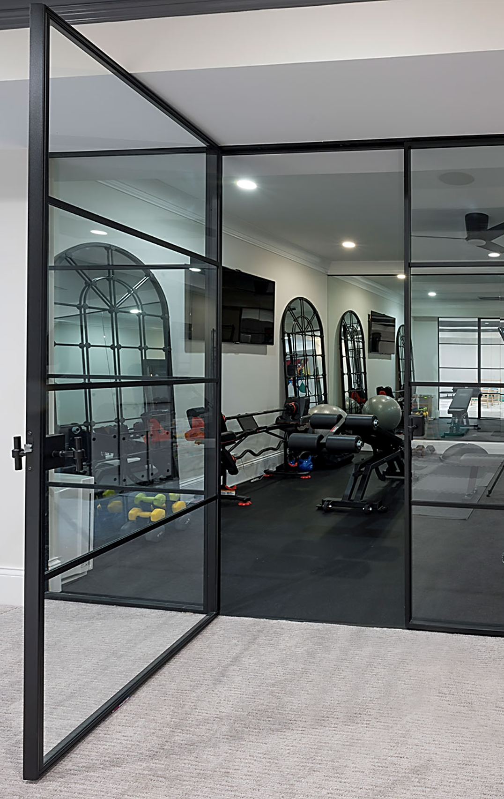
Hardware
Handles & Pulls
Interior steel doors can be equipped with a variety of handle types, including:
Fixed pull bars – provide a minimalist aesthetic and are commonly paired with non-latching doors or magnetic systems.
Lever-style handles – more ergonomic and typically used when integrated with a latching mechanism.
Latch & Locking Mechanisms
Magnetic Latch (Non-locking):
  Offers quiet and seamless operation.
  Activated by closing force; opened via handle only.
  Ideal for offices, living areas, or where privacy is not required.
Thumbturn Lock (WC-style):
  Includes interior thumbturn for privacy (e.g., restrooms).
  Does not require a key and is operable from inside only.
Keyed Lock (Patent Lock):
  Offers keyed access for added security.
  Suitable for private offices, shared suites, or multi-use commercial spaces.
Notes:
Hardware choices affect both usability and code compliance. Handles range from fixed pull bars for non-latching applications to lever handles that engage locking systems. Common latching options include magnetic (non-locking), thumbturn privacy locks, and keyed locks.

Slide 15
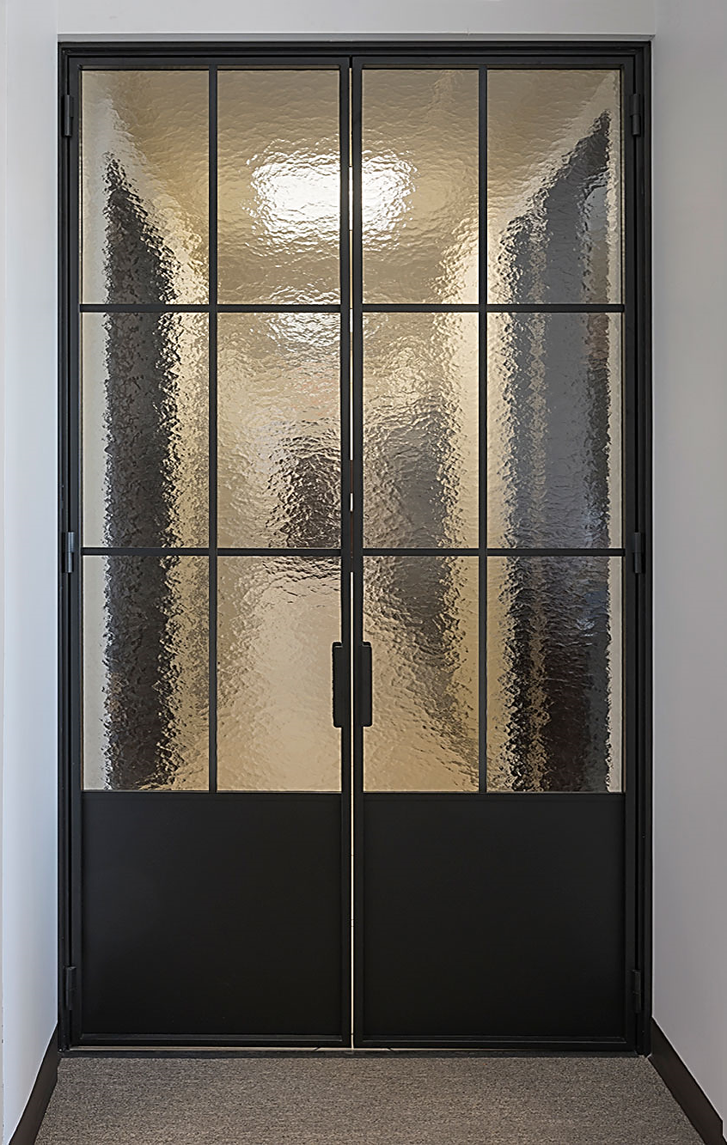
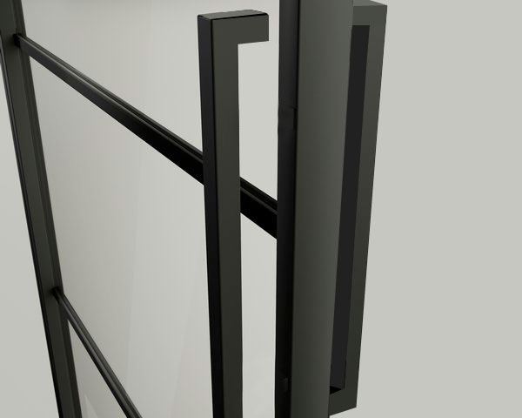
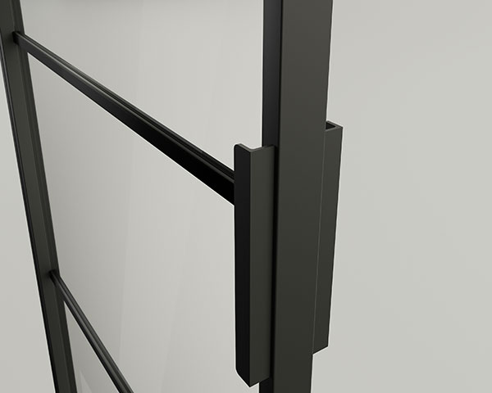
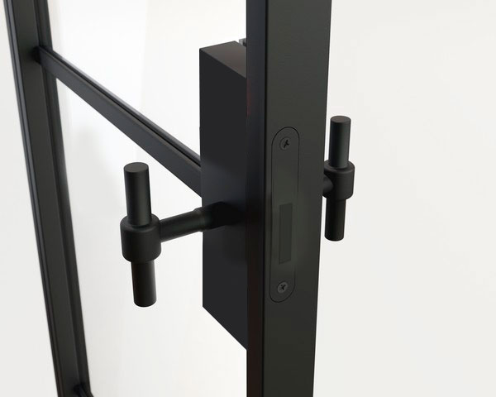
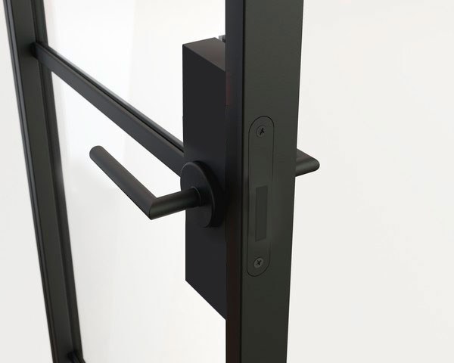
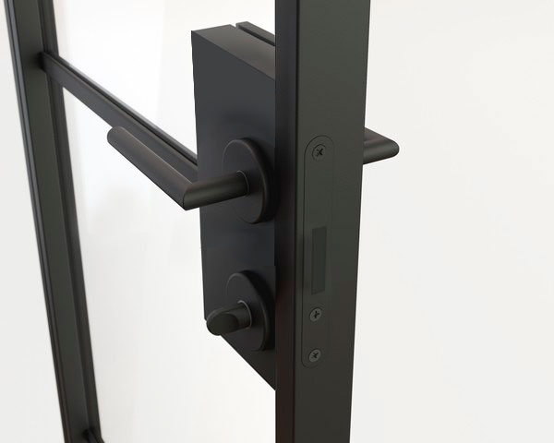
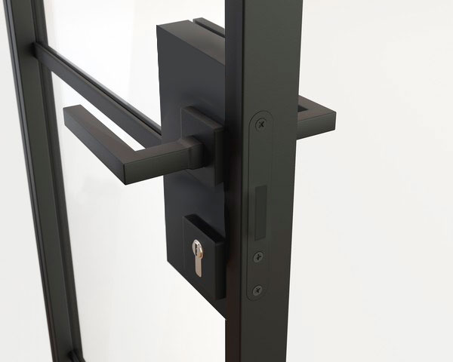
Hardware Cont.
Architectural Considerations
Select hardware based on use case: traffic flow, privacy, accessibility, and aesthetics.
Confirm compatibility between handles and latch types.
Ensure hardware complies with local accessibility and fire code requirements where applicable.
Notes:
When specifying hardware, start by considering the door’s function: does it need to lock, provide privacy, or meet accessibility requirements? Match handle types to use—pulls for non-latching doors, levers for locking applications.
Ensure hardware components are compatible and aligned with the door system. Not all latches work with all handles.
Finally, verify compliance with local codes—especially for ADA and egress needs. Hardware impacts not just appearance, but also performance and safety.

Slide 16
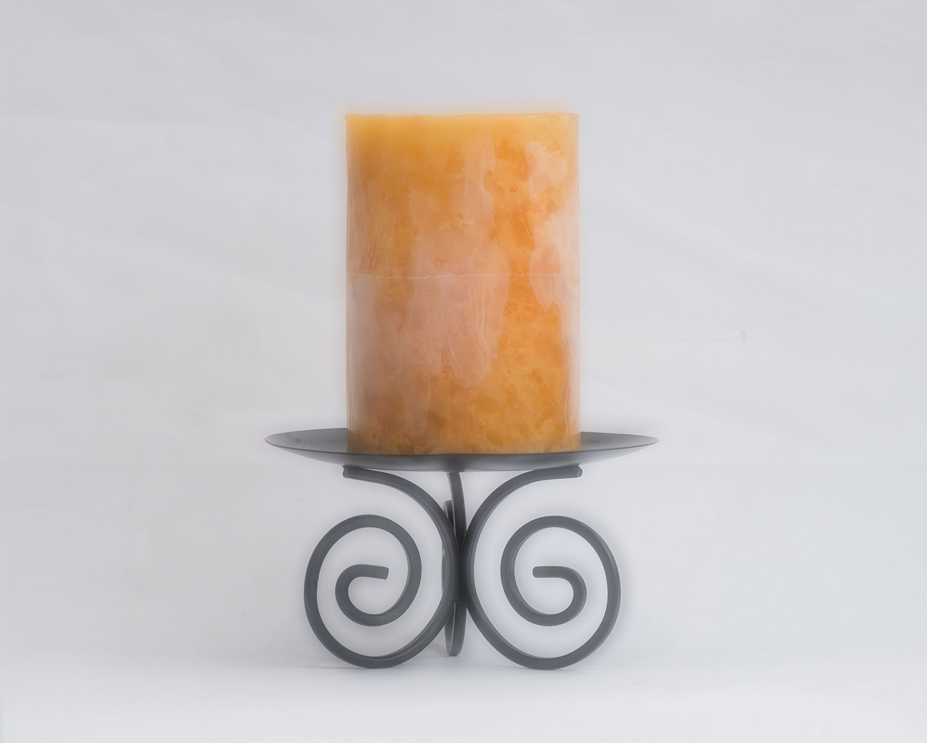
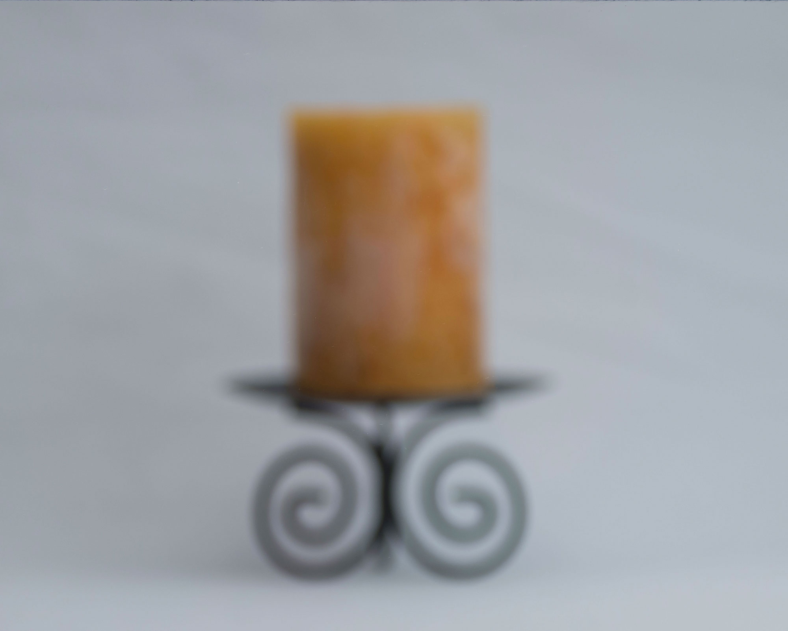
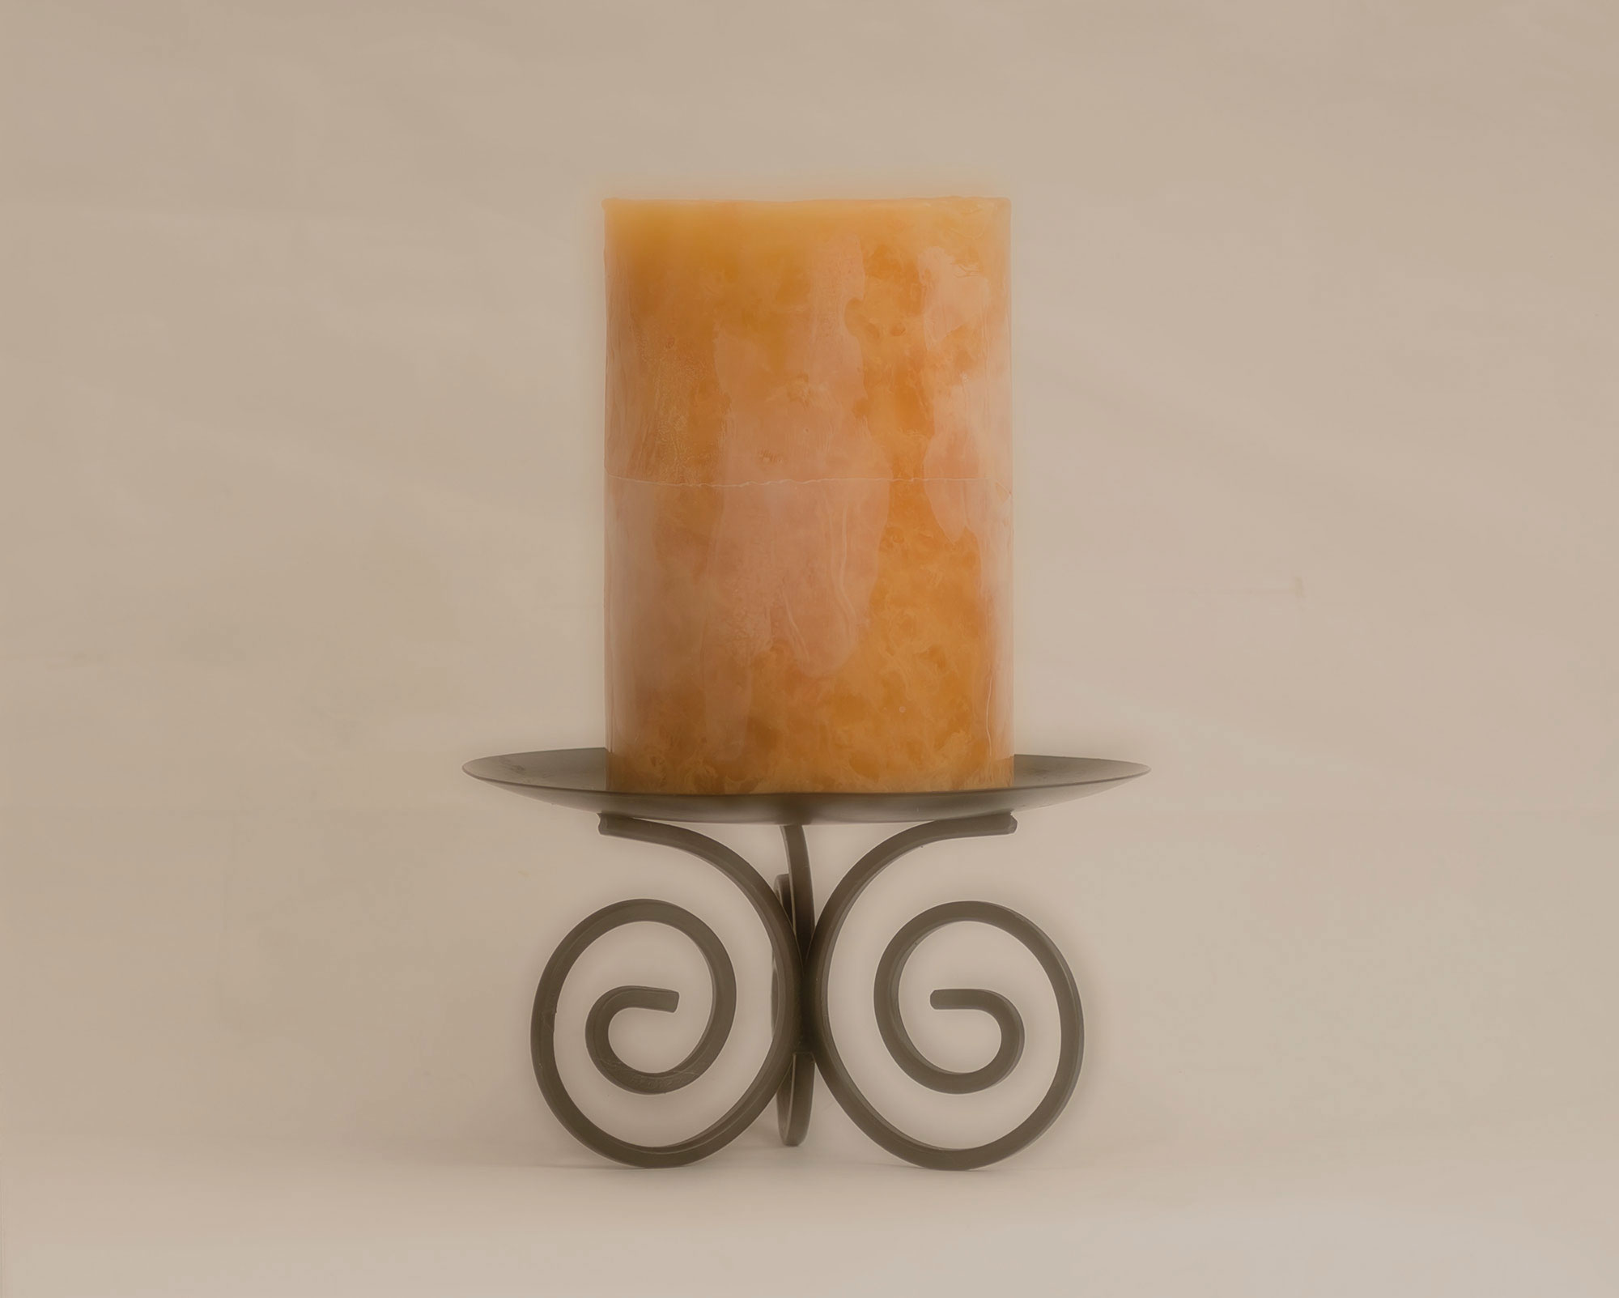



Glass Options
Interior glass choices impact privacy, light transmission, acoustic performance, and overall design aesthetic. Common options include:
Visibility & Privacy
Clear Glass – Maximum visibility
Tinted Glass – Reduces glare, adds ambient tone
Frosted / Satin Glass – Light-diffusing with moderate privacy
Matte Glass – Soft finish; conceals fingerprints
Decorative & Textured Options
Fluted / Ribbed / Reeded Glass – Obscures detail, allows light
Patterned Glass – Decorative focal point
Safety & Performance
Tempered (ESG) Glass – Standard safety glazing
Laminated Acoustic Glass – Used for sound control
Notes:
Glass is central to the performance and design of interior steel doors. Clear glass offers visibility; tinted glass reduces glare and creates mood. Frosted or matte glass adds privacy while still allowing light. Textured options like fluted or ribbed glass provide subtle diffusion and style. For safety, tempered glass is the norm; laminated glass may be used for sound control or added security.

Slide 17
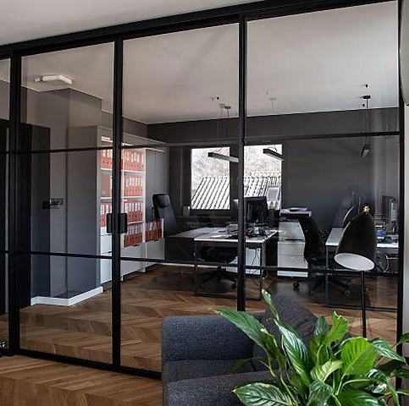
Glass Options Cont.
Architectural Considerations
Match glass selection to the door’s function: privacy, light sharing, or visual transparency.
Consider how glass interacts with finishes, framing, and adjacent spaces.
Confirm code requirements for safety glazing in specific use cases (e.g., bathrooms, corridors).
Notes:
Selecting the right glass depends on how the space is used. Think about how much light, privacy, and acoustic separation is needed. Consider nearby finishes, sight lines, and code requirements—especially where safety glazing is mandated in bathrooms, corridors, or near walking paths.

Slide 18
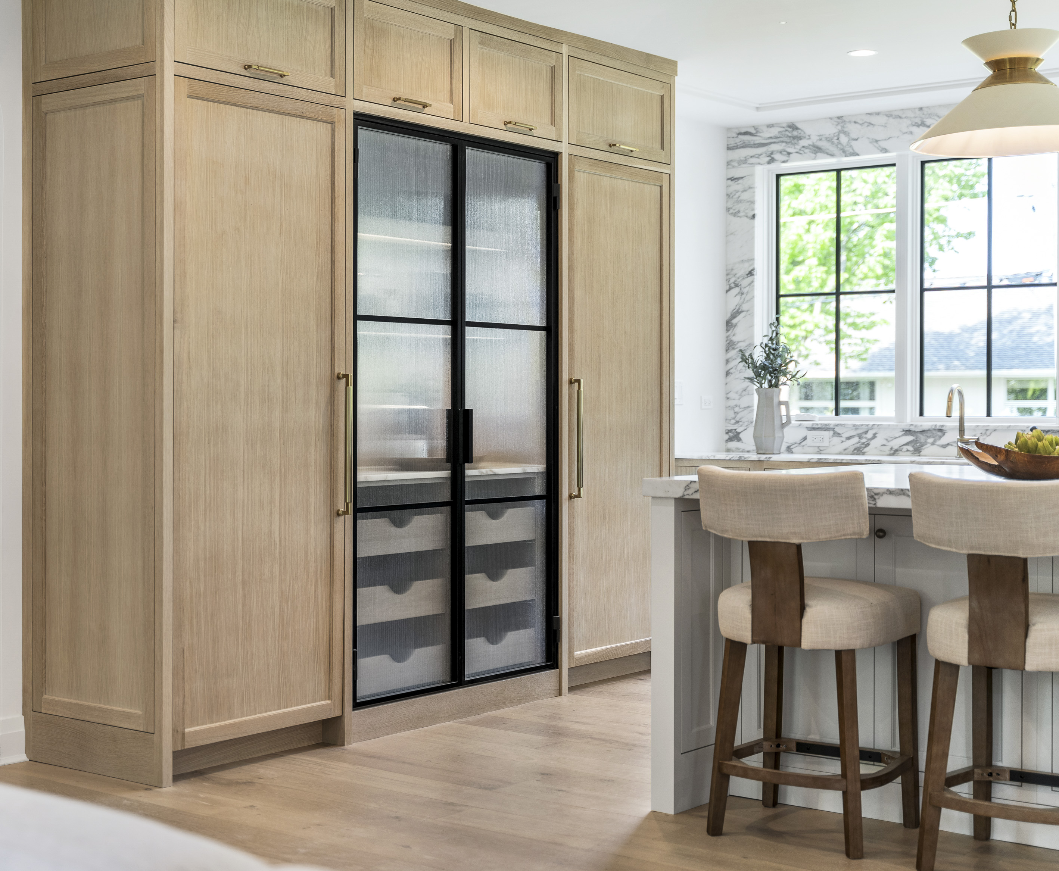



Summary & Key Takeaways
Steel Door Benefits
Sleek, durable, and versatile
Multiple configurations (swing, pivot, sliding, etc.)
Works across residential and commercial styles
Material Highlights
Slim-profile steel frames
Durable powder-coated finishes
Clear, frosted, tinted, and textured glass options
Design & Installation
Choose systems based on space and use
Match hardware to function and code
Frame, glass, and mounting affect look and performance
Notes:
Architect Takeaways
Steel doors serve as design features
Plan early for size, clearance, and integration
Confirm safety glazing, acoustics, and ADA needs
To summarize, interior steel doors offer sleek, durable solutions with wide flexibility in form and function. They're available in many configurations and finishes, with customizable glazing and hardware options. Architects should evaluate each project’s needs—privacy, accessibility, aesthetics, and code—and select systems that integrate seamlessly into the overall design.

Slide 19
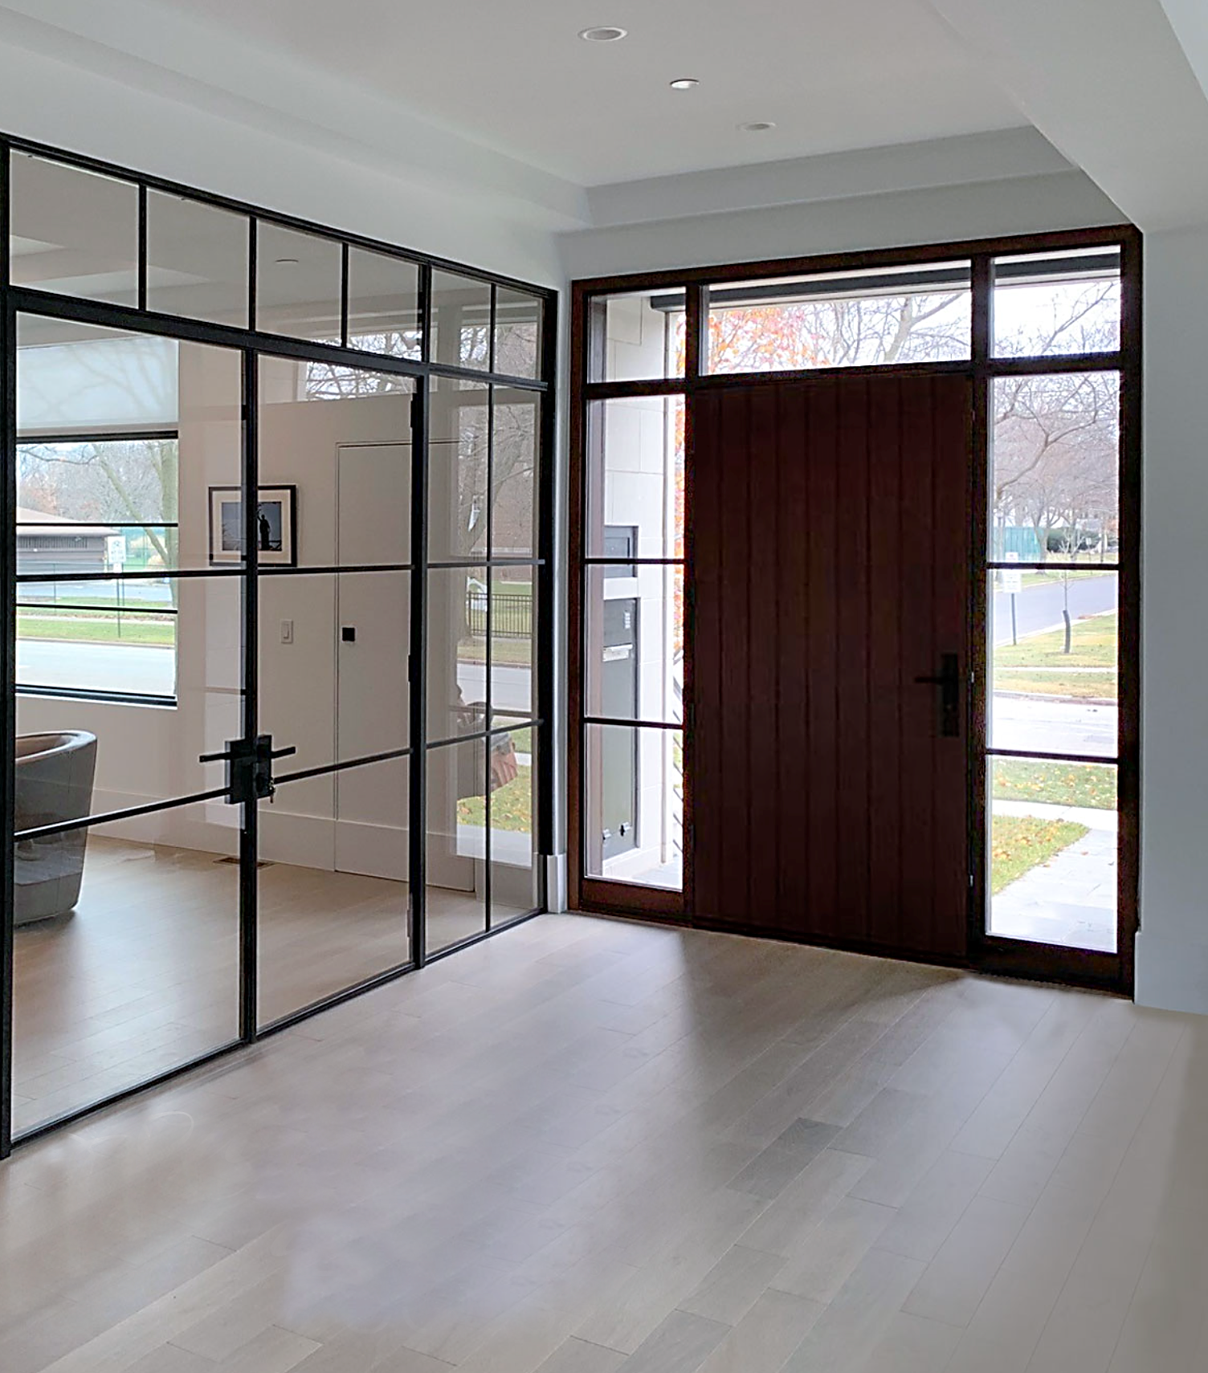

Thank You!
Scan For Your AIA
Registration & Certificate
Notes:
Thank you for attending this course on interior steel and glass doors. Please scan the QR code on screen to receive your AIA credit and certificate. I’d be happy to answer any questions you may have now.

