Slide 1
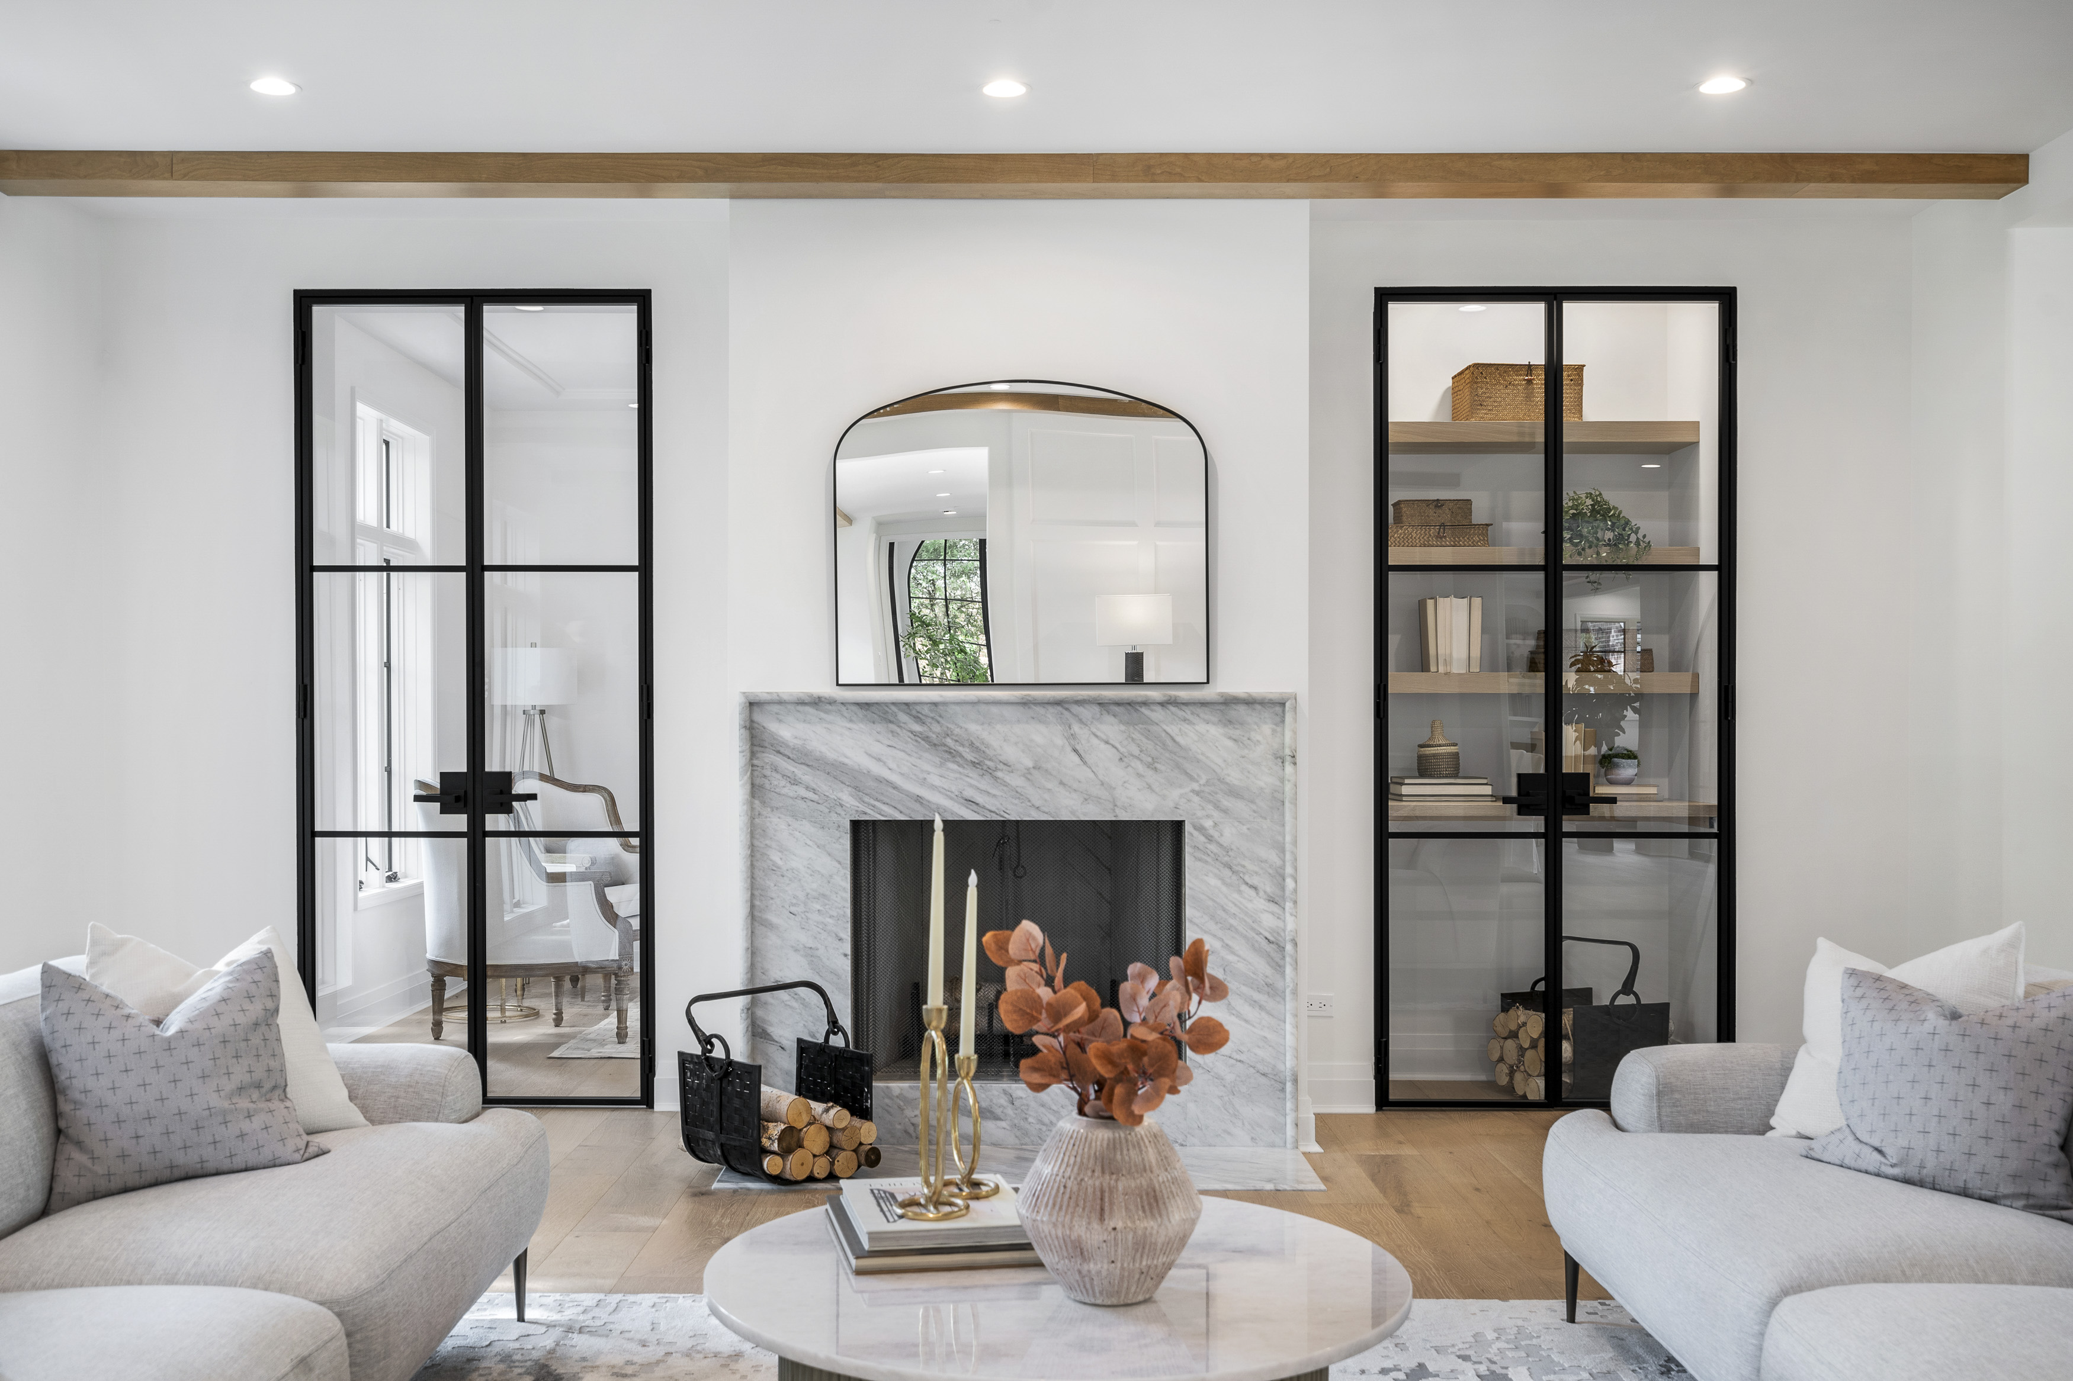

PREMIUM DOOR SOLUTIONS
Notes:
Welcome. This presentation will serve as an overview for Glenview Doors Product Lines

Slide 2

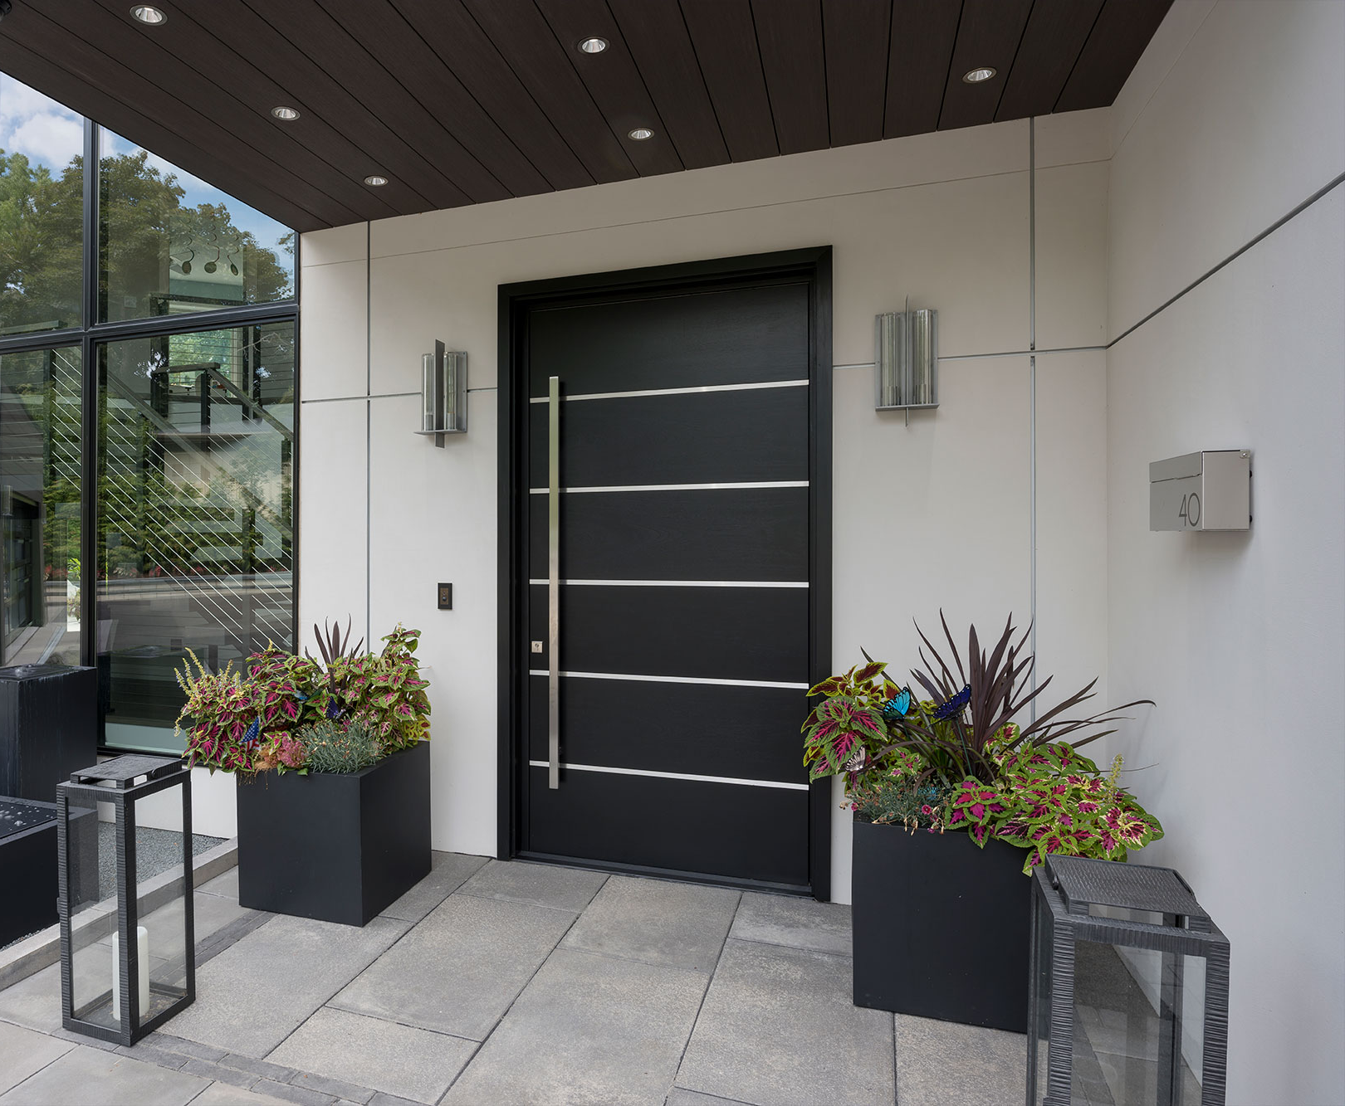
WHO IS GLENVIEW DOORS?
Glenview Doors was founded by Greg Wozniak in 2006. As a General Contractor and Entrepreneur, he was looking for an entry door company that built exquisite high end wood entry door systems and were engineered beyond any doors that existed in the marketplace. After several years to research and diligent study, he created Glenview Doors.
Engineered to outperform. Designed to impress.

Slide 3
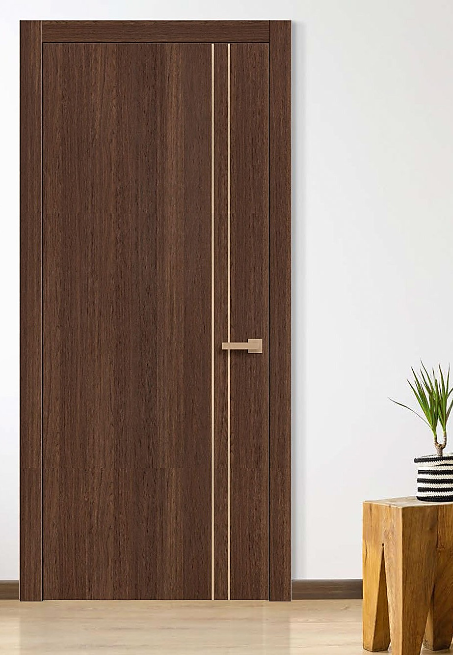

Glenview Doors’ Premium Products
Luxury performance. Custom craftsmanship. Endlessly configurable.
Product Line | Application | Core Strength
EuroTech™ Entry | Exterior | Energy efficiency, strength, and beauty
Luxeline | Interior (custom) | High-design flexibility, solid-core construction
Ecoline | Interior | Value-focused, pre-configured package
Interior Steel | Interior | Sleek modernism with industrial edge
INICIO Collection | Exterior | Thermally broken steel and aluminum with premium detailing

Slide 4
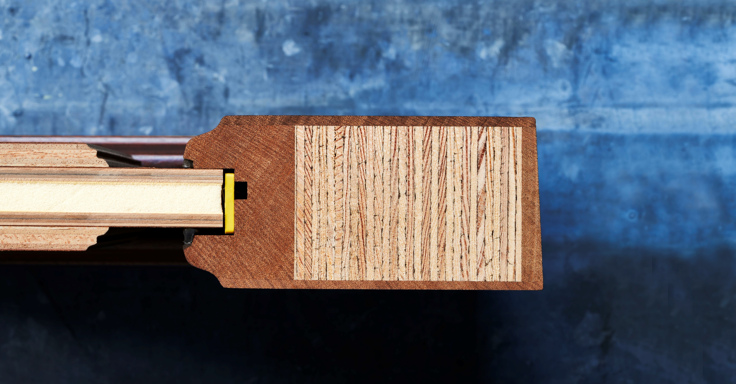
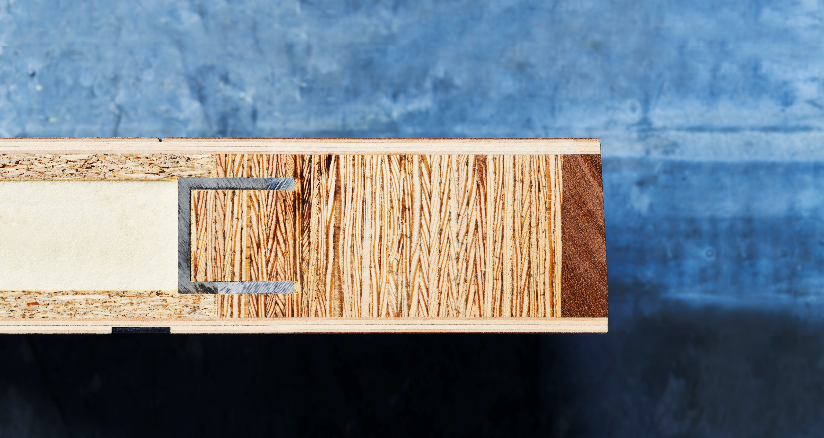

Real wood veneer with 2K finish for superior hardness, scratch resistance, and UV protection.
LVL construction with opposing grains to resist wood expansion and contraction.
Rigid polyurethane foam core offers twice the thermal insulation.
Why EuroTech™ Entry Doors
2 ¾ ”
Aluminum barrier adds durability, stabilizes panels, and resists moisture.
No “free-floating” panels. Every seam is sealed.
Beveled edge creates the tightest seal preventing leaks and drafts.
Real wood veneer with 2K finish for superior hardness, scratch resistance, and UV protection.
LVL construction with opposing grains to resist wood expansion and contraction.
Rigid polyurethane foam core offers twice the thermal insulation.
Benefits
Superior thermal insulation
Durable against elements
Timeless wood finishes, unmatched details
Low maintenance, high longevity
2 ¾ ”
Aluminum barrier adds durability, stabilizes panels, and resists moisture.
Beveled edge creates the tightest seal preventing leaks and drafts.
Metal U bar to prevent bowing and warping.
Notes:
At the core of every EuroTech™ door is our rigid polyurethane foam core, which offers twice the thermal insulation of standard wood core doors. This makes a big difference in energy efficiency, especially in extreme climates. Surrounding that core, we use LVL (Laminated Veneer Lumber) construction with opposing grain directions to prevent the natural expansion and contraction you typically see with wood. That means better long-term performance and fewer issues in the field. One of our standout features is the aluminum stabilizing barrier. This is embedded within the panel to prevent warping, add rigidity, and protect against moisture. It’s what gives EuroTech™ doors their structural integrity even in demanding conditions. We also seal every seam — there are no floating panels — which ensures durability and longevity over time. And on the surface, we use real wood veneers with a 2K factory finish for unmatched aesthetics, scratch resistance, and UV protection. It’s a timeless wood look with none of the high maintenance. Lastly, our beveled edges are not just for show — they create the tightest seal at the door’s edge, helping to block out wind, water, and drafts. So when you’re talking to a customer who wants an entry door that performs like a modern system but still looks like real wood, EuroTech™ is the clear solution.

Slide 5
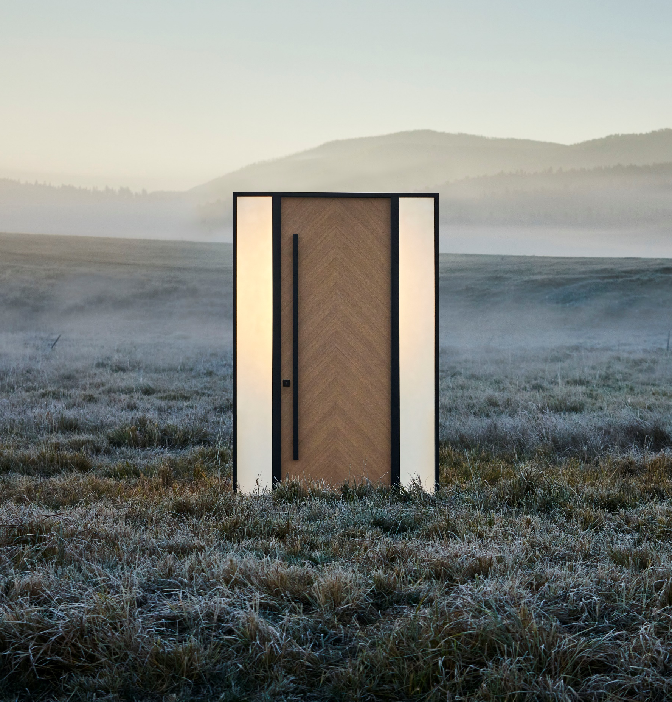
Luxury Quick-Ship
-Over 150 modern to traditional models to choose from
-Pre-finished, pre-hung and ready to install
-Comes in standard sizes (single doors, double doors, and sidelight options)
-Same exceptional craftsmanship as our custom doors
-Competitively priced
-3-4 week lead time
Notes:
Our Luxury Quick Ship program is an essential part of our business. Your best tool is to use our Glenview Website and our inside sales team. Keep in mind, as these are quick-ship, they are not customizable (you cannot change finishes, glass, sizes, etc.) what you see is what you get. All 3 locking systems are available (tubular, mortise and multipoint).
Single Doors (slab size)- 36” x 80”, 36” x 96”, and 42” x 96”
Doors w/ Sidelights (unit sizes)- 65” x 81-1/2”, 65” x 98” and 71-1/8” x 98”
Designs on these appear on both sides (inlays and v-grooves)

Slide 6

Custom Flexibility
Powered by EuroTech™
Nearly unlimited design possibilities with EuroTech™ construction
Customizable sizing, configurations, and finishes to match any style
Design support from our expert team—send us your vision and we’ll help bring it to life
Prefinished, pre-hung, and ready for installation
Competitive pricing with 12–16 week lead times
Notes:
The above bullets represent just a few points of our custom capabilities. Photos and drawings are critical in helping us determine your design requirements. We design each entry system around your project’s needs. Whether it's size, configuration, or architectural style, we offer solutions that are as unique as the homes they’re built for. This platform allows for custom sizing without sacrificing performance. From oversized pivot doors to intricate sidelights and double rabbeted designs, our construction ensures strength, stability, and thermal efficiency. All custom doors are prefinished, pre-hung, and packaged for easy installation, keeping timelines tight and craftsmanship intact.

Slide 7
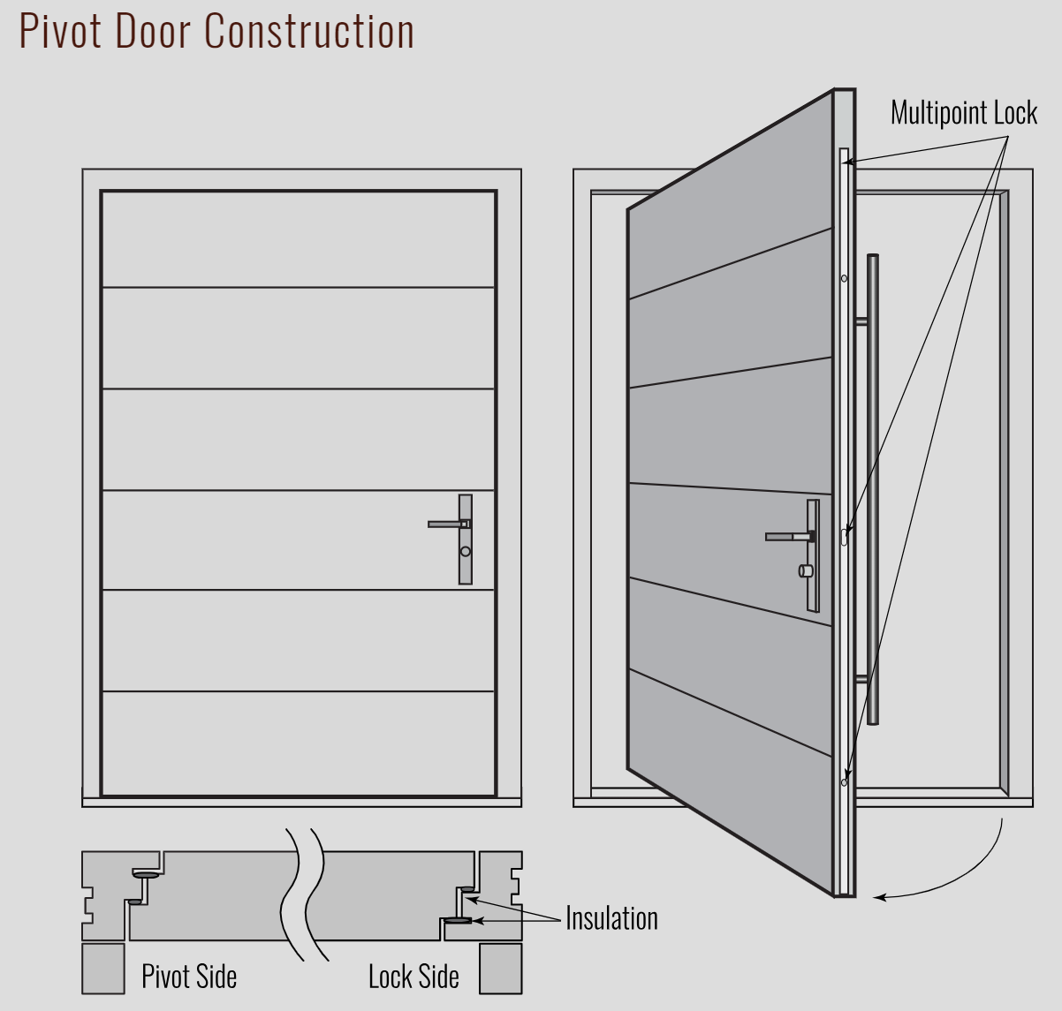
Glenview Pivot Doors:
Built to Perform. Designed to Impress.
3 ½ " EuroTech™ slab for superior insulation and strength
Double-rabbeted jambs to block air and water infiltration
FritsJurgens pivot hinge – precision-engineered, fully adjustable, and invisible
Multipoint locking system standard for security and performance
Outperforms leading competitors in thickness, hardware, and weather resistance
Notes:
At the core is our EuroTech™ construction, but upgraded to a full 3½" thick slab, giving it unmatched strength, insulation, and presence. Unlike typical pivot doors, Glenview uses a double-rabbeted jamb, which dramatically improves air and water sealing. You’ll rarely see this in a pivot design—especially not at this level of craftsmanship. We use the FritsJurgens pivot hinge, precision-engineered and completely concealed—no recessing into the floor, no onsite surprises. It’s fully adjustable and built to last. Every pivot door includes a multipoint locking system plus extra weatherstripping, these doors are built to handle the harshest environments. We can build single slab pivot door systems in 5’-0” widths and 8’-0” heights. Our pivot systems are unequaled in the market today anywhere in the U.S.

Slide 8
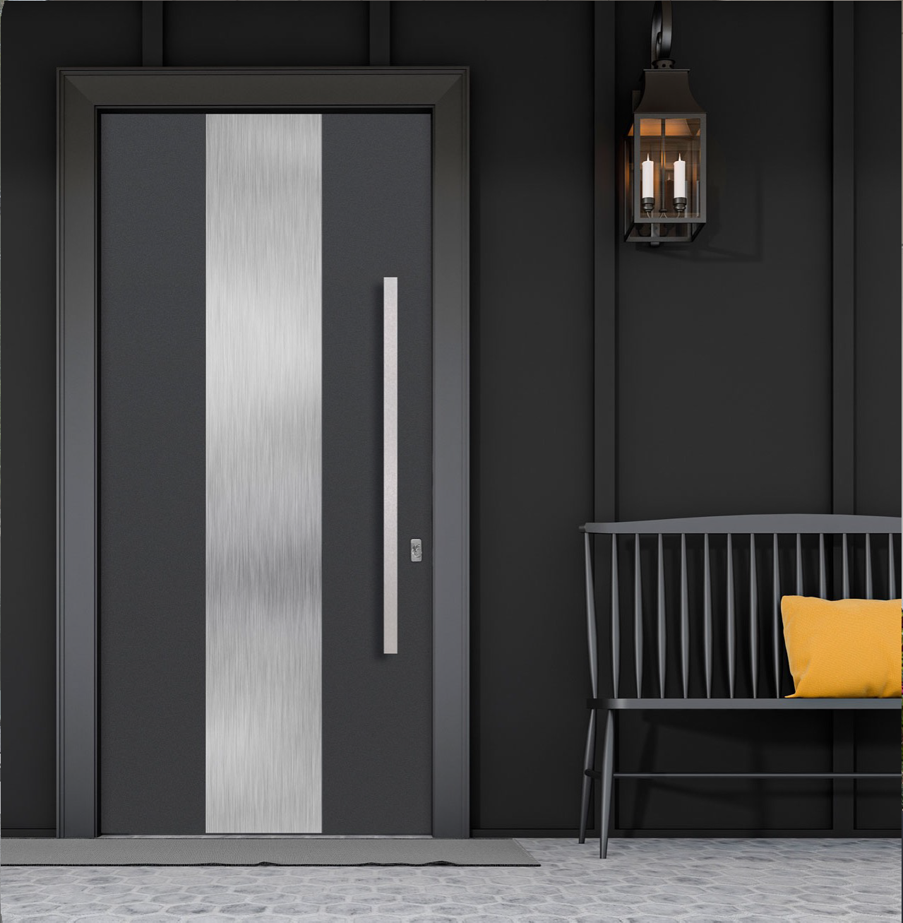
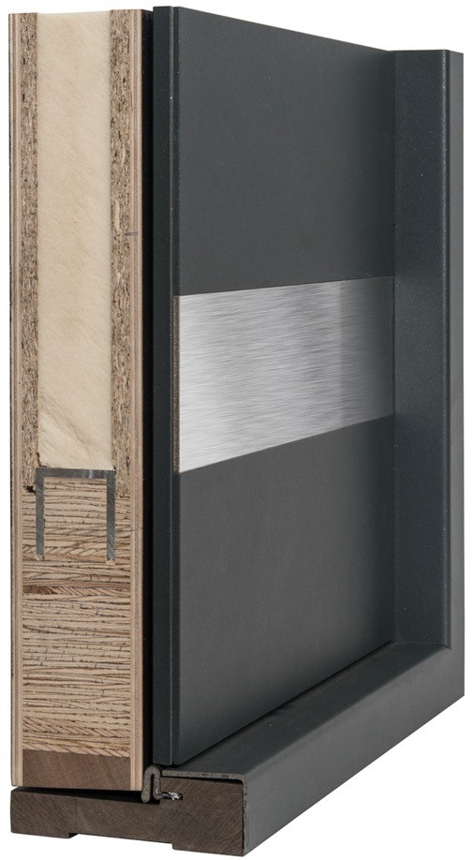
Aluminum Clad Entry Doors
Engineered to Impress. Built to Endure.
½" of solid aluminum cladding fastened to our EuroTech™ core
Pivot x Aluminum= 3 ½” pivot door + ½” aluminum cladding= 4” thick door
Powder coated in a wide range of colors, textures, and finishes
Design flexibility with options like metal inlays, glass panels, steel plates, and U-grooves
Our powder coating calls under Qualicoat standards. Their standards are in line with AAMA 2604.
Notes:
Our aluminum cladding is ½’” thick and would make our standard panel over 3” thick. Very durable and able to withstand the elements. Various design options are available with this addition including metal plates, metal inlay, glass and more. By adding the aluminum cladding to our pivot doors, you get a 4” thick door with the exceptional features of our pivot doors PLUS the unbeatable durability of our aluminum cladding. Our powder coating calls under Qualicoat standards. Their standards are in line with AAMA 2604.

Slide 9

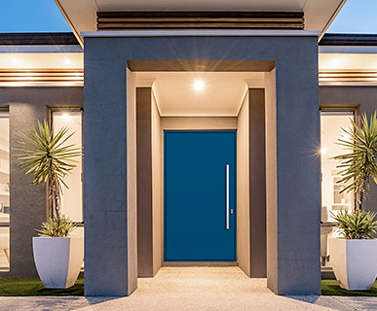
Hurricane Rated Doors
Certified Rating: Design Pressure (DP) ± 60 PSF & Large Missile Impact tested (8ft 2x4 at 50 fps).
Approved Models:
Inswing Flush (including grooved panels, inlays, steel plates)
Inswing Aluminum Clad (Flush ALU-A1 only)
Inswing Glazed (F4 model with 8” or smaller glass & steel plate surround)
Outswing Flush doors
Compliance: Meets Florida TAS standards – approved for Miami-Dade County installations.
Overhang Required: All hurricane-rated doors must be protected by a 1:1 overhang ratio.
Notes:
Our entry doors don’t just look beautiful—they’re built to stand up to the toughest conditions. Glenview Hurricane Rated Doors are certified to a Design Pressure of plus or minus 60 PSF and have passed the Large Missile Impact test, which means they can withstand an eight-foot two-by-four traveling at 50 feet per second.
We offer multiple approved models, including inswing flush doors with grooved panels, inlays, or steel plates, our Flush ALU-A1 aluminum clad model, the F4 glazed model with narrow impact-rated glass, and outswing flush doors.
All hurricane-rated doors comply with Florida TAS standards, which also means they’re approved for Miami-Dade County installations. One important requirement: every hurricane-rated unit must be installed with a one-to-one overhang ratio to protect against water infiltration.

Slide 10
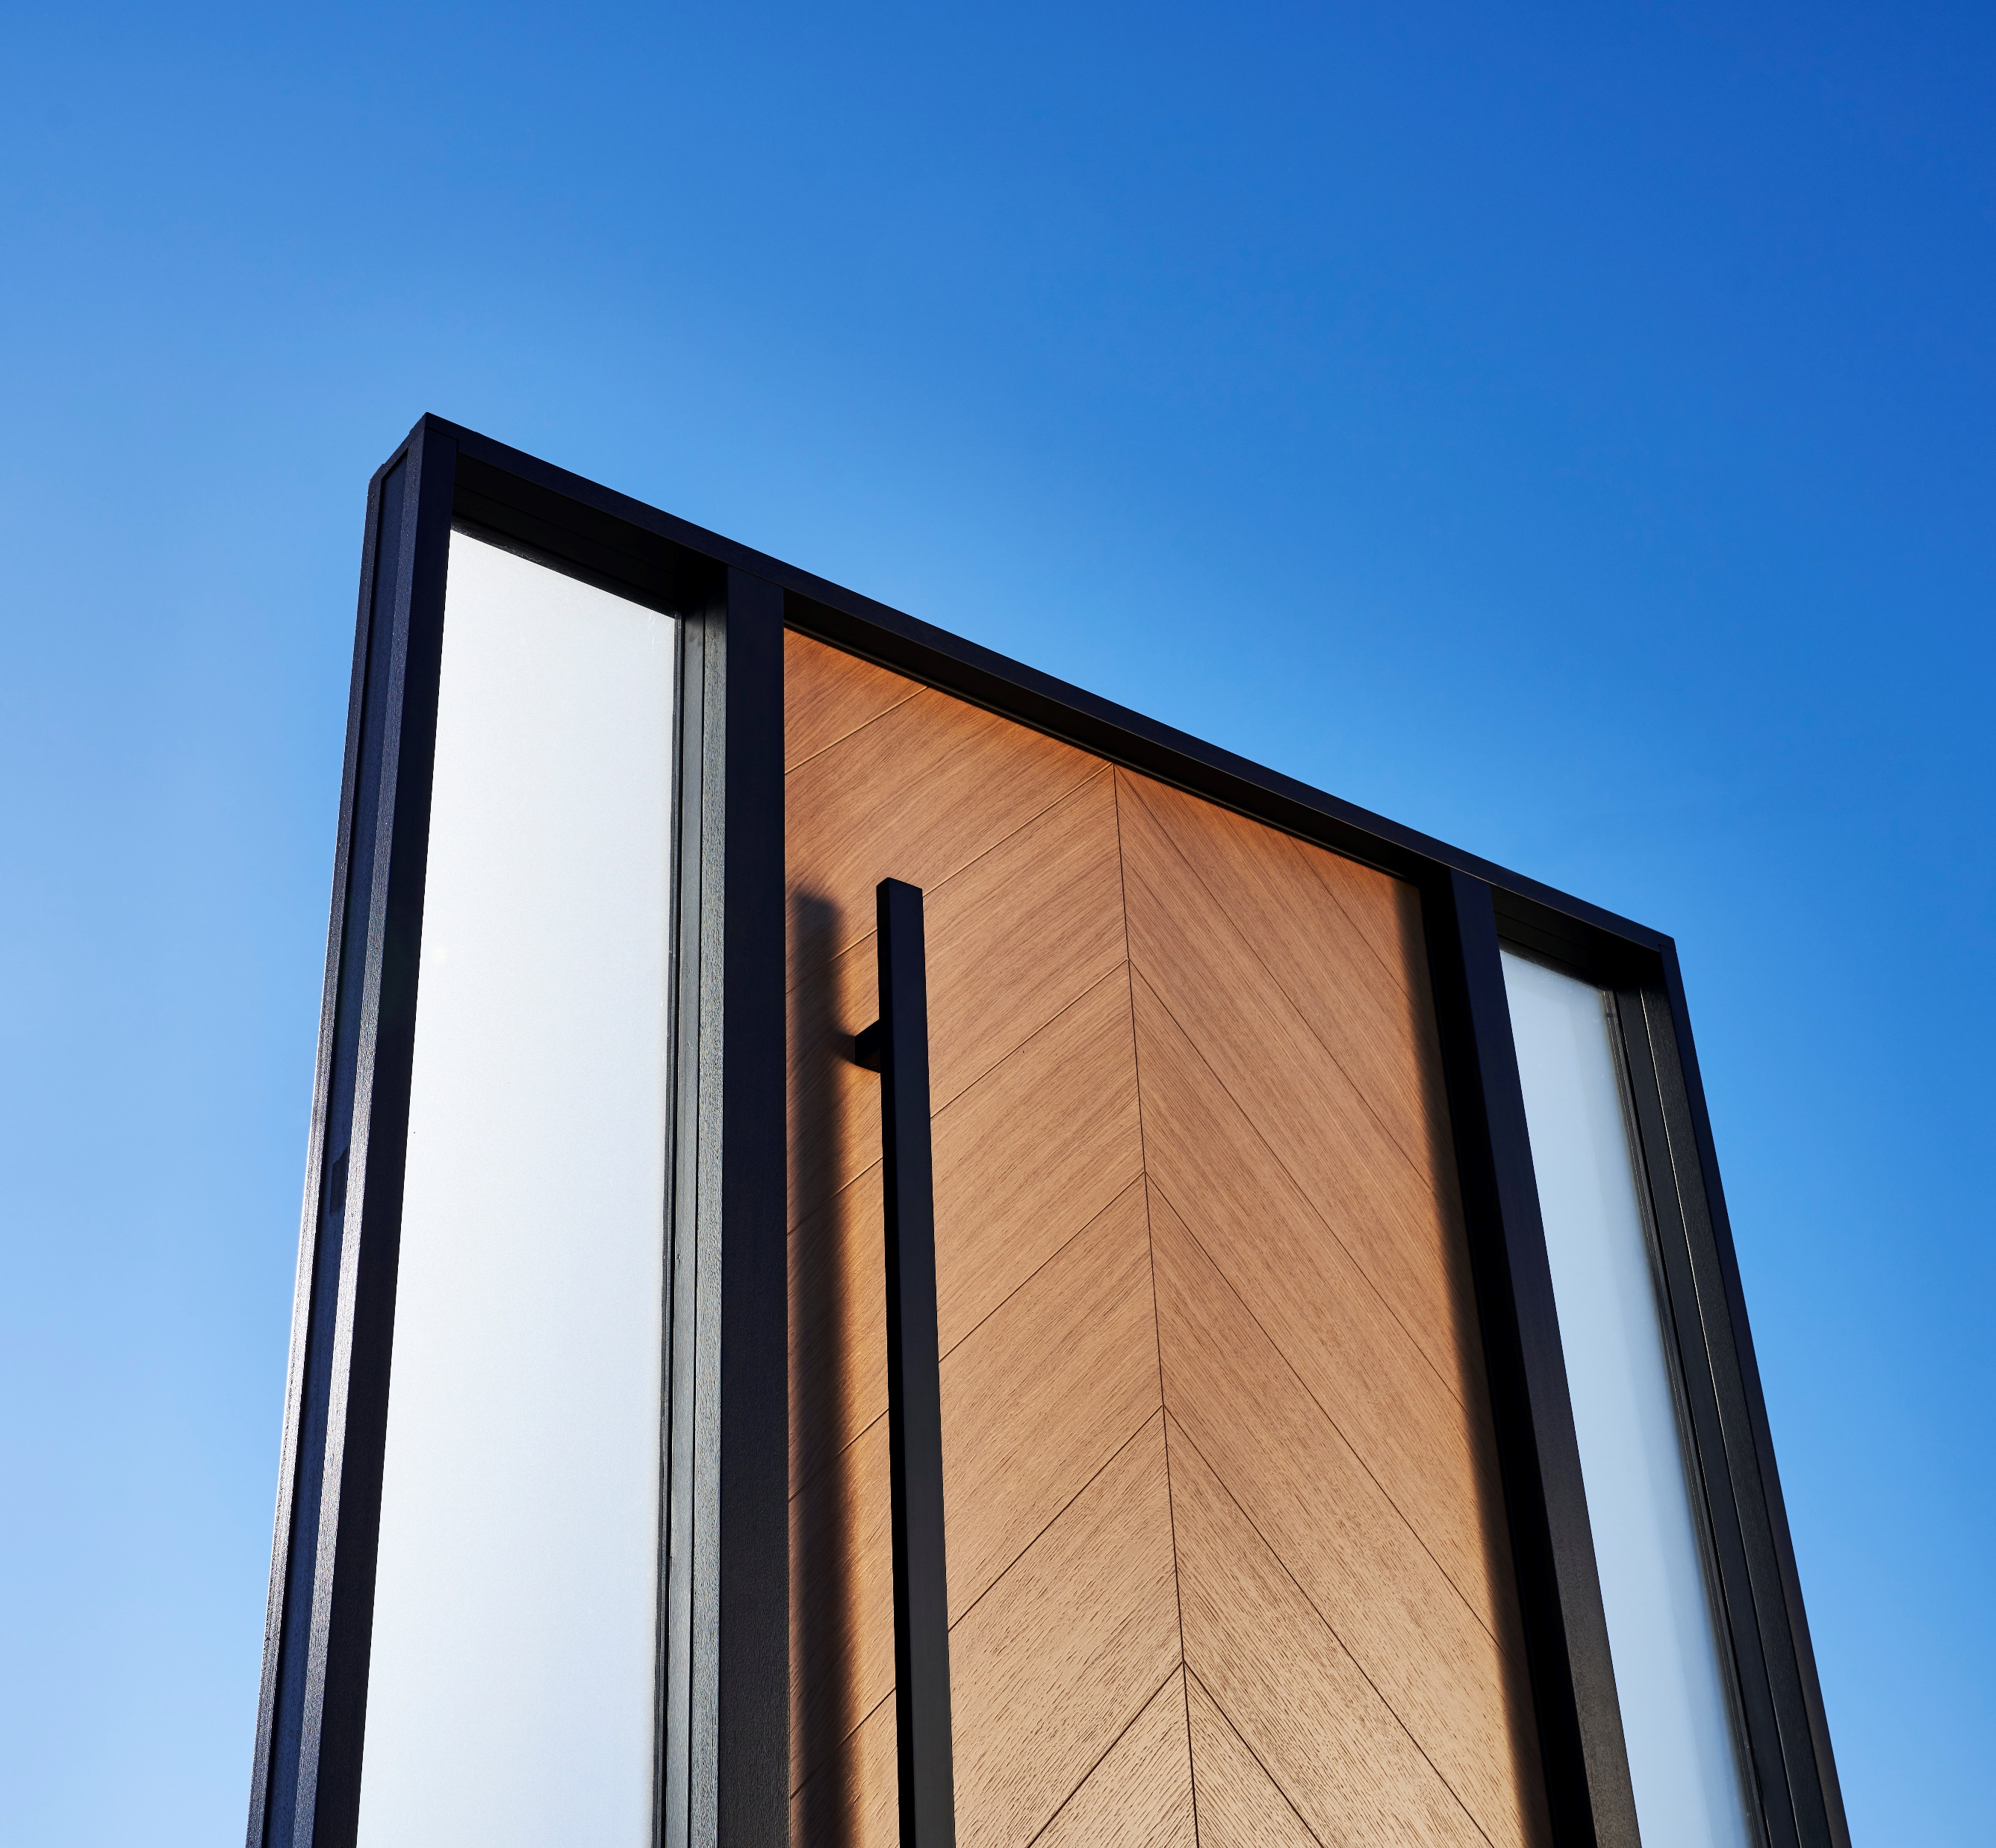
Hardware Options
Security, Style, and Seamless Integration
Tubular Locks: A classic one-point locking option for standard entry sets.
Mortise Locks: A more secure and substantial solution, with 2 points of security.
Multipoint Locking Systems: Offers enhanced security with locking points at multiple positions
Electronic Locks: Smart integration available via Emtek’s keypad deadbolt system or FUHR Multitronic multipoint systems.
All hardware is factory prepped and can be pre-installed for your convenience!
Notes:
We offer a range of locking systems to meet the needs of any project—from classic to contemporary, and from standard to high-security. First, tubular locks- These are the traditional go-to for most residential entry doors. They're simple, familiar to installers, and compatible with a wide selection of Emtek handle sets (we also offer Rocky Mountain hardware and Baldwin). Great for projects where design flexibility and quick installation are priorities. Next, mortise locks-These offer a more premium, secure locking experience. They’re a bit more substantial and often used in higher-end homes. They provide a clean aesthetic and are perfect for clients who value both form and function. The multipoint lock- Our pivot and oversized units come equipped with multipoint locking as the default. This system engages at multiple locations along the door, providing a vault-like seal for increased security and superior weather performance. For those seeking smart solutions, we also offer electronic options- We support the EMPowered™ keypad deadbolt system from Emtek, giving your clients seamless keyless access. When selected, Glenview will handle all hardware prep and installation before the door leaves the factory to ensure perfect functionality. We also offer the FUHR multitronic smart system for an electronic multipoint option.

Slide 11
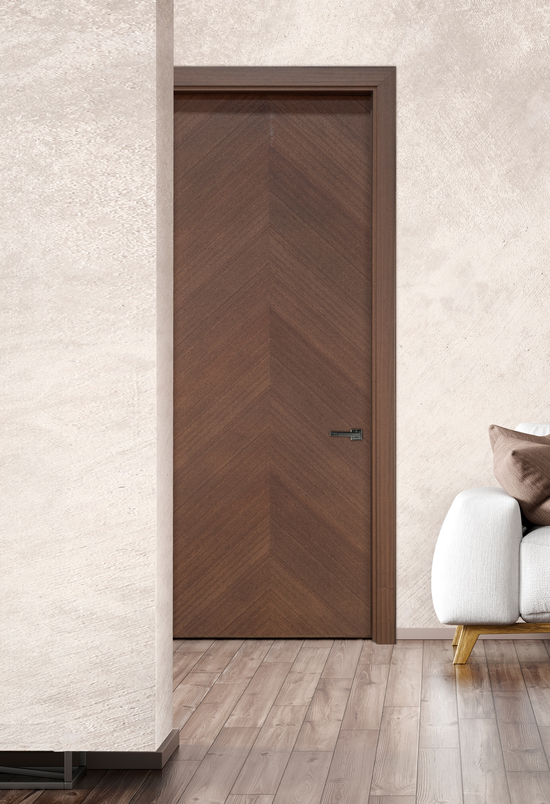
Luxeline Interior Doors
Fully Custom. Modern. Sophisticated.
HIGH QUALITY CONTRUCTION,
VENEERS, AND FINISHES
OAK OR MAHOGANY VENEERS OR LACQUERED MDF
DESIGNS
SOLID PANEL, METAL INLAY, OR GLASS INLAY
FIRE RATED
20-MINUTE FIRE RATING ON SELECT DESIGNS
CONFIGURATIONS
MATCHING CASING AND JAMB / FRAMELESS / TRIMLESS
MAGNETIC LATCHES AND CONCEALED HINGES
12-16 WEEK LEAD TIME
Notes:
We offer real oak or mahogany veneers for a rich, natural look, or lacquered MDF for a smooth, painted finish. Customers can choose from a variety of designs, but fully customizable designs also available (still have to fall into the construction parameters of flush doors). With several different jamb options including frameless and trimless, these doors are perfect for any home project. For the glass designs, there are limitations on glass flexibility due to construction of the doors. We use inifinity glass that will run the full height of the door with no horizontal rails. We cannot do special shapes or double-glazing currently. Magnetic latches and concealed hinges are standard on this product line and speak to the high quality you can expect to receive from Glenview Doors.
We can produce a maximum size of 42" x 120" on swing doors- we only warranty up to 36" x 96" currently. Custom sizing is available- we can match sizing down to 1/16”
20-minute fire rating available on all designs (except glass doors)- only for swing doors- max size of 42” x 96”- will have UL listed listed locking system (not manetic)- concealed hinges

Slide 12
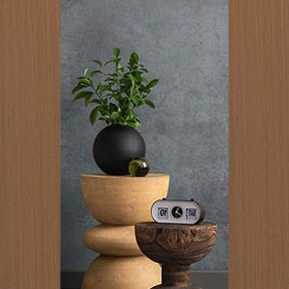
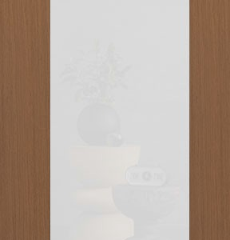
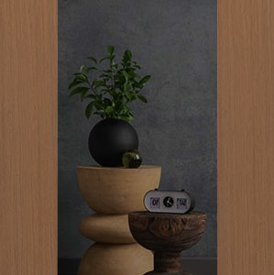
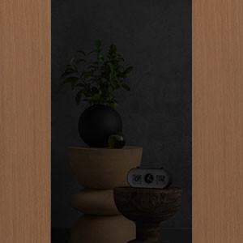
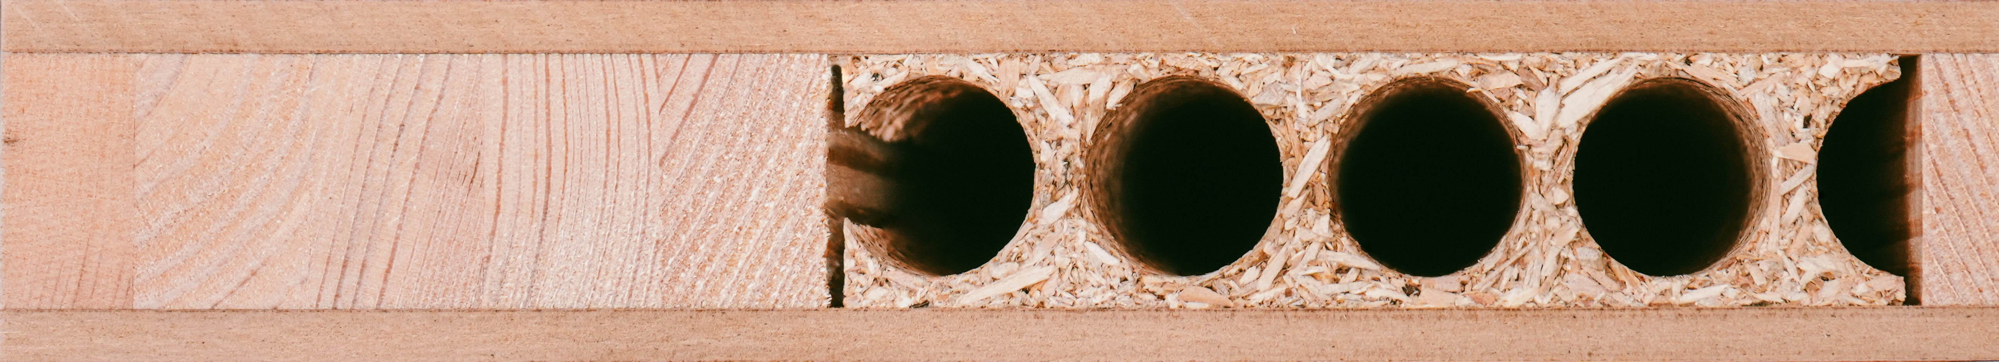
Luxeline Designs & Finishes
Crafted for Performance. Designed for Elegance.
Rift-Cut Wood
Painted Wood
Lacquered
MDF
Dozens of stain and color options. All factory applied with UV-cured finish for lasting protection
Clear Glass VSG
Satinato Glass VSG
Smoke Glass VSG
Black Glass VSG
Inlays
Chrome or black metal inlay accents available for added detail
Premium Core Construction
Solid engineered wood stiles, sound-reducing core, MDF crossbands, and natural wood or MDF face veneers
→ Ensures strength, stability, and noise control
Notes:
These doors are crafted to elevate interiors with modern forms, refined materials, and seamless detailing. We offer dozens of stain and color options—everything from warm wood tones to clean, modern paints. All finishes are factory-applied using a UV-cured process, ensuring long-lasting durability and a consistent, professional look across every door. Inside every Luxeline door is a solid engineered wood stile system for strength, a sound reducing core, and MDF crossbands to prevent warping. These are then wrapped in either real wood veneers or lacquered MDF panels, depending on the selected design. You can choose from chrome or black metal accents that run vertically, horizontally, or diagonally, adding architectural flair and a high-end feel. We offer four types of VSG laminated safety glass—Clear, Satinato, Smoke, and Black. These pair beautifully with wood and metal to create a striking, upscale interior statement. Whether your client wants something bold or minimal, Luxeline offers the construction quality and design variety to match any luxury interior.
*our standard undercut is ½”. The minimum undercut we offer is ¼” and the maximum is 1”.

Slide 13
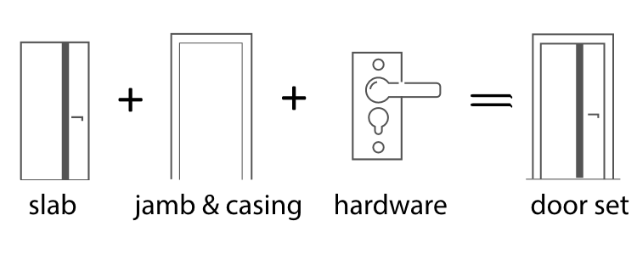
Ecoline Interior Doors
Project-Ready Luxury for Volume Builds.
HIGH QUALITY CONTRUCTION, VENEERS, AND FINISHES
FEATURING ECO-FRIENDLY SYNTHETIC VENEERS THAT CAN BE PAIRED
WITH SECURITY GLASS INSERTS OR METALLIC INLAYS TO PRODUCE A ONE OF-A KIND DESIGN
DEVELOPED ESPECIALLY FOR BUILDERS, DESIGNERS, & ARCHITECTS
ALL-IN-ONE PACKAGE
DOOR
JAMB &CASING
HINGES, LATCH & LEVER SETS
ECOLINE DOOR PACKAGE
12-14 WEEK LEAD TIME AT THE TIME OF ORDER
10 YEAR LIMITED WARRANTY
Notes:
Ecoline is our project-ready solution tailored for builders, designers, and architects who need a streamlined, consistent interior door package without sacrificing style or quality. This is an all-in-one system—everything comes together in one package. Each set includes the door slab, matching jamb and casing, and hardware, including concealed hinges, a magnetic latch, and your choice of lever handle. This simplifies install and reduces site coordination headaches. Ecoline uses eco-friendly synthetic veneers that mimic real wood grain beautifully. You also have options to add security glass inserts or metallic inlays to create one-of-a-kind looks, even across large-scale projects. It’s ideal when you want reliable lead times and clean design continuity across dozens—or even hundreds—of openings. We offer a 12–14 week lead time and a 10-year limited warranty. So your teams and your clients can count on us from spec to site.

Slide 14
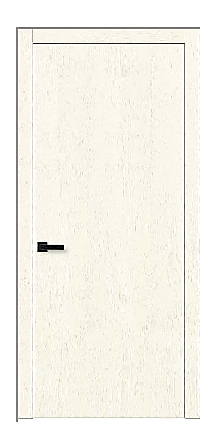
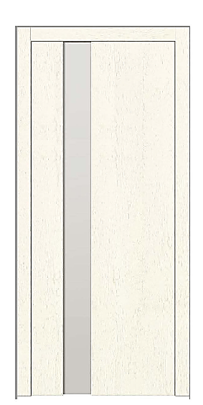
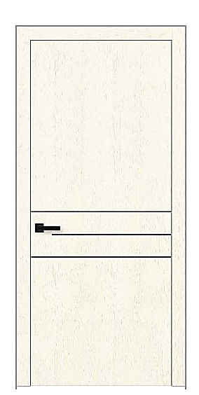


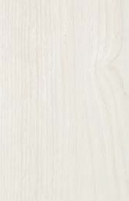
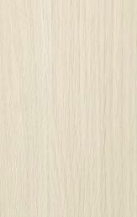
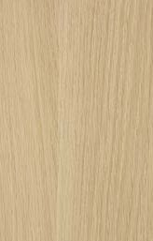
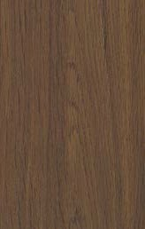
Ecoline Designs & Finishes
Smart Design. Seamless Delivery. Scaled for Success.
Veneer Quality- Exceptional resistance to abrasion and moisture, ensuring durability in everyday use.
Set sizing with 3 different heights and 18-36” wide
Swing, barn, pocket and sliding door configurations
Concealed hinges and magnetic latches are standard
13 different veneer options
GD-ECV-SB2
with Glass
GD-ECV-TA3
with Inlay
GD-ECV-SA0
MONOCHROME
Clear Glass VSG
Satinato Glass VSG
Smoke Glass VSG
Black Glass VSG
01 White Matte
15 Light Gray
14 Midnight Blue
12 Black Matte
WOOD-LIKE
03 Ash Walnut
05 Ecru Oak
07 Cappuccino Oak
11 Chocolate Oak
Notes:
We’ve taken the same Glenview craftsmanship and applied it to a project-forward model that performs in high-volume environments. These are eco-friendly synthetic veneers that offer excellent resistance to scratching, moisture, and daily wear—perfect for multi-family, single-family, and other high-traffic interiors. We offer 3 standard heights and widths ranging from 18 to 36 inches. That keeps quoting simple while still giving flexibility to fit most floorplans. It’s all about ease of execution. Whatever the interior flow calls for, Ecoline can be adapted to match. Every door comes standard with the premium touches Glenview is known for. That means concealed hinges and magnetic latches—details that elevate the design without driving up complexity or cost. You can choose from monochrome finishes like white matte and black, or go warmer with wood-look veneers like Ash Walnut, Cappuccino Oak, or Chocolate Oak. There are 13 finish options in total, all designed to offer flexibility across an entire development. Glass and metal inlay models are also available. Choose from clear, satinato, smoke, or black VSG laminated safety glass plus 4 different inlay color options (black, chrome, gold and copper).

Slide 15
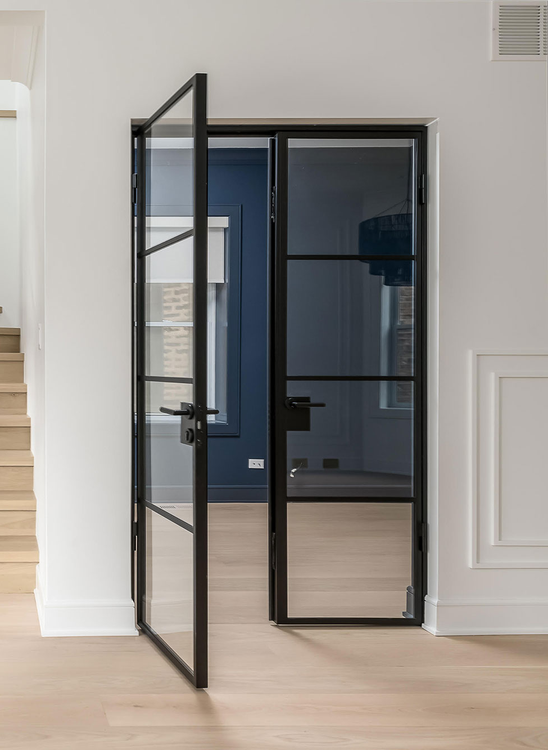
Interior Steel & Glass Doors
Premium Aesthetic. Endless Functionality.
Cold-rolled steel construction with durable electrostatic powder-coated finish
Available in 6 configurations: Standard, Pivot, Fixed, Pocket, Barn, and Sliding (Sidelights, Transoms and Corner units also available)
Single pane and dual-pane glass frame options for tailored sightlines and insulation levels
Designed to be installed into finished openings for cleaner installations
Notes:
These doors are constructed with cold-rolled steel and finished in a durable electrostatic powder coat over a zinc underlayer. That means they're built to last and designed to look sharp in any modern home, office, wine room, or gym.
We offer six versatile configurations: standard hinged doors, pivot doors, fixed panels, pocket, barn, and sliding units, plus transoms, sidelights and corner units. This allows builders and designers to create continuous steel-glass partitions or integrate doors seamlessly into modern interiors. We also give you a choice between System 20 and System 25 frames—offering different sightlines and glass options. System 20 is single glazed only, while System 25 can be either single or dual-glazed and installed with thru-jamb or bracket hardware. Overall, this is a premium steel offering that brings both form and function and it's something your customers will not only notice but fall in love with.

Slide 16
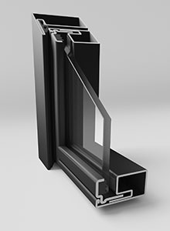
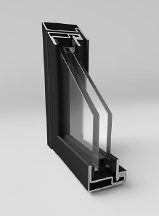
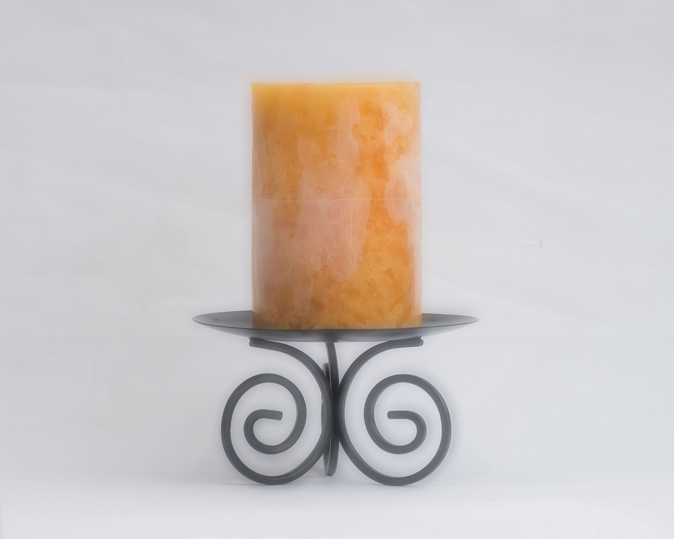




Interior Steel & Glass Doors
Customizable Details
Several different pull bar and lever set options to select from
Magnetic latches available in passage and privacy options (Thumb turn or keyed)
Choose from five standard matte finishes
Wide range of tempered glass options including fluted, satinato, graphite, and more
Clear Glass
ESG (Tempered)
Satinato Glass
ESG (Tempered)
Graphite Glass
ESG (Tempered)
Fluted Glass
ESG (Tempered)
Estriado Glass
ESG (Tempered)
Notes:
We offer a range of sleek, modern handle styles and pull handles. Our doors use a magnetic latch system that allows for smooth, silent operation. That latch can also be configured for privacy use. either with a WC thumb turn or keyed patent insert, depending on the room and application. Next, we provide a stunning variety of tempered glass options. These are ESG (European Safety Glass)-rated for safety and come in both transparent and privacy styles. And when it comes to finishes, we offer five core RAL colors, with more options available upon request. These finishes are textured, durable, and elegant, elevating any space. This is a designer-forward product that’s engineered to fit perfectly and perform flawlessly—whether it’s a home gym,wine room, or luxury living room.

Slide 17
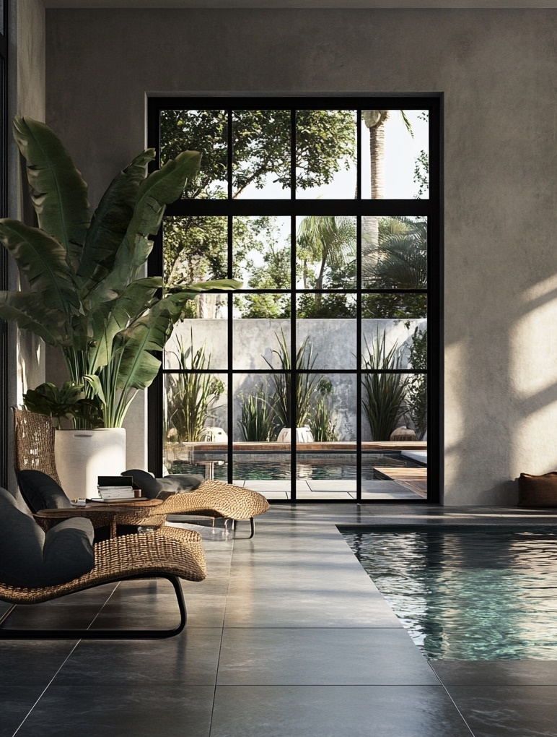
INICIO by Glenview
Steel exterior doors that set the standard.
Cold-rolled galvanized steel construction (also available in bronze, corten steel and stainless steel)
Advanced multi-point locking system
Thermally broken for performance: insulator made of polyamide reinforced with glass fibers
Hinged and Pivot door systems with transom and sidelight configurations
Custom sizes available
Notes:
Our INICIO by Glenview collection exterior steel doors are built for homeowners and builders who want the ultimate in modern performance, security, and durability, without compromising on aesthetic. These doors are crafted from cold-rolled galvanized steel, making them resistant to warping, rotting, and rust. All of our products are thermally broken and fully insulated to provide the highest performance. We pair this with a multi-point locking system for enhanced security, and weather seals to handle the most demanding climates. INICIO doors are available in a range of configurations—single, double, and units with sidelights—plus custom sizing options for projects that need a unique fit. And while steel is our core focus here, aluminum versions are also available for certain applications.

Slide 18
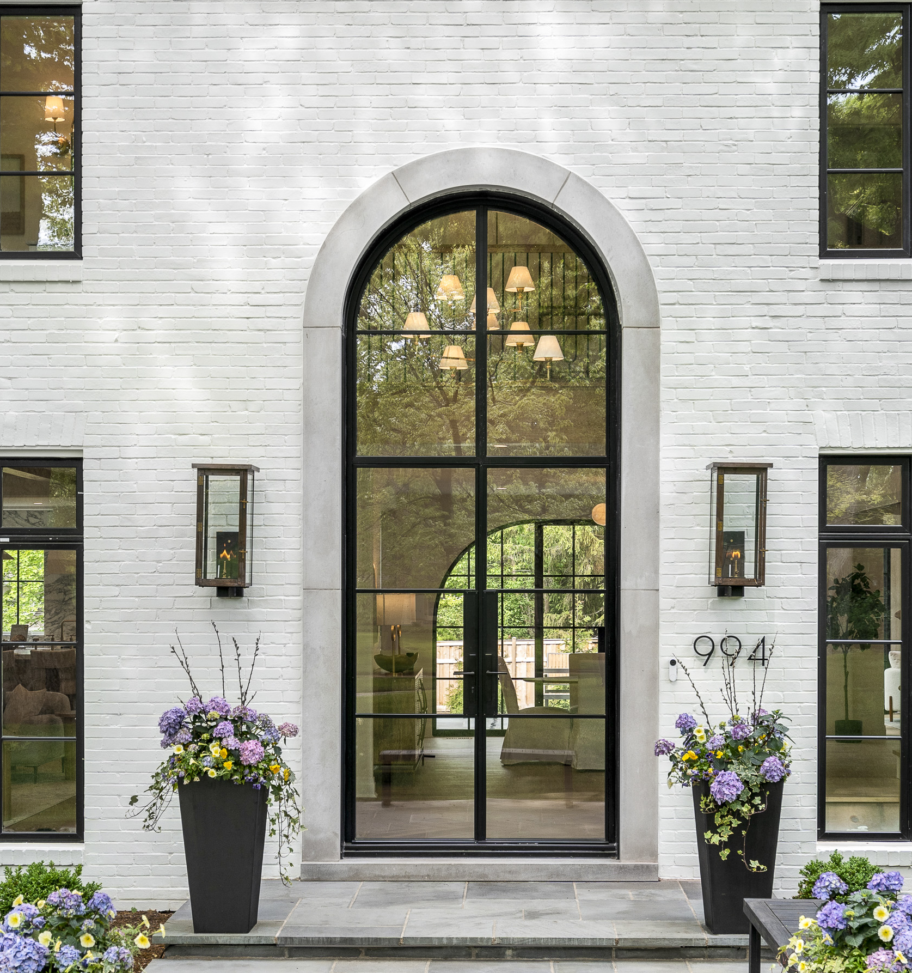
INICIO by Glenview
Styled for the Modern Build.
Core RAL finishes: Jet Black, Anthracite Grey, Black Grey, Signal White
Additional RAL colors available upon request
Specialty glazing options: Clear, Laminated White, Cathedral, & more
Emtek handle sets: 5 different designs from choose from in a variety of finishes
Thresholds & jambs optimized for energy efficiency and clean installation
Notes:
When it comes to style, the INICIO line gives you incredible freedom to tailor the look to your customer’s needs—whether that’s bold and architectural or understated and modern. Our core RAL finishes offer that clean, matte aesthetic that’s so popular right now. We can also accommodate custom RALs on request. We offer a variety of glass types—everything from Clear and laminated white to unique privacy options like cathedral and more. We utilize Emtek handle sets for most applications and offer 5 different styles to choose from.

Slide 19
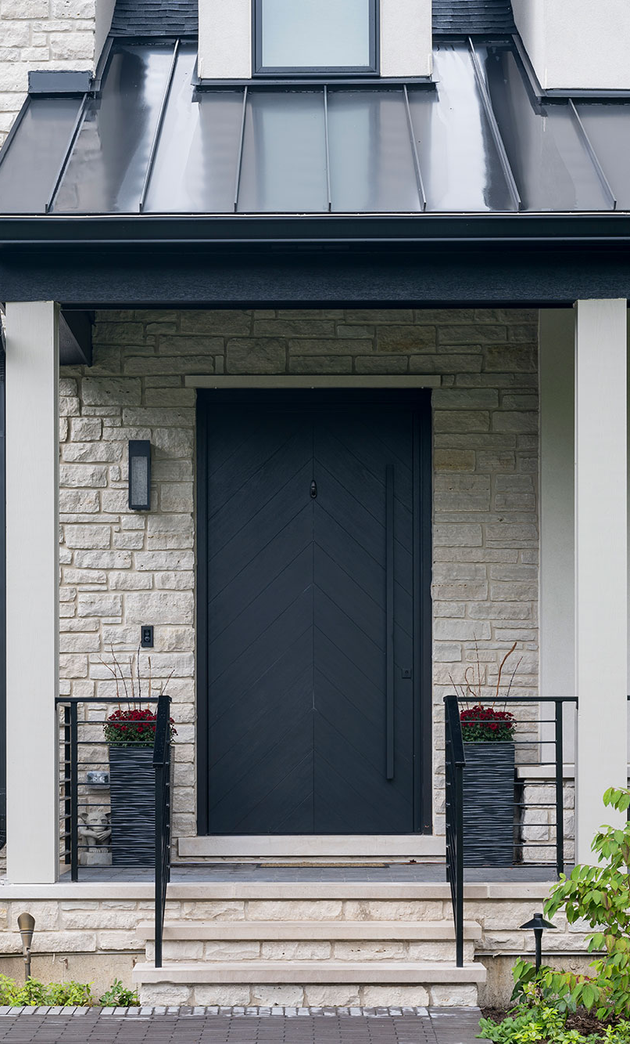
Support, Lead Time & Warranty
What to expect with Glenview Doors.
EuroTech™ Lead Time & Warranty
3-4 weeks (quick-ship), 12-16 weeks (custom)
5-year limited warranty, 10-year limited warranty for aluminum clad
Interior Doors Lead Time & Warranty
12-14 weeks (ecoline), 12-16 weeks (Luxeline), 3-4 weeks (steel quick-ship), 16-18 weeks (steel custom)
10-year limited warranty
INICIO by Glenview
18-22 weeks
10-year limited warranty
Support
Full service team of experts dedicated to Glenview and INICIO product lines
Dealer resources, training, quoting access and marketing support
Notes:
At Glenview Doors, we know that providing high-performing products is only part of the equation. The other part is delivering reliable support, clear timelines, and peace of mind for you and your customers.
Let’s break it down by product line:
Our EuroTech™ entry doors—known for their energy efficiency and stunning wood finishes—are available in as little as 3–4 weeks with our quick-ship program. Fully custom builds typically take 12–16 weeks. All EuroTech™ units come with a 10-year limited warranty.
For our interior doors:
Ecoline, our builder-focused line, delivers in 12–14 weeks.
Luxeline, our high-end architectural line, takes 12–16 weeks for custom projects.
Our steel interior doors are available both as quick-ship (3–4 weeks) or fully custom (16–18 weeks), depending on what your customer needs.
INICIO: our steel and aluminum offering carries a slightly longer lead time—about 18–22 weeks—but that’s because these doors are highly tailored and built to order with precision. They also include a 10-year limited warranty.
And importantly, all of this is backed by a dedicated Glenview Doors support team. From quoting and training to sample kits and marketing help, we are with you at every step to make sure your projects succeed.”

Slide 20
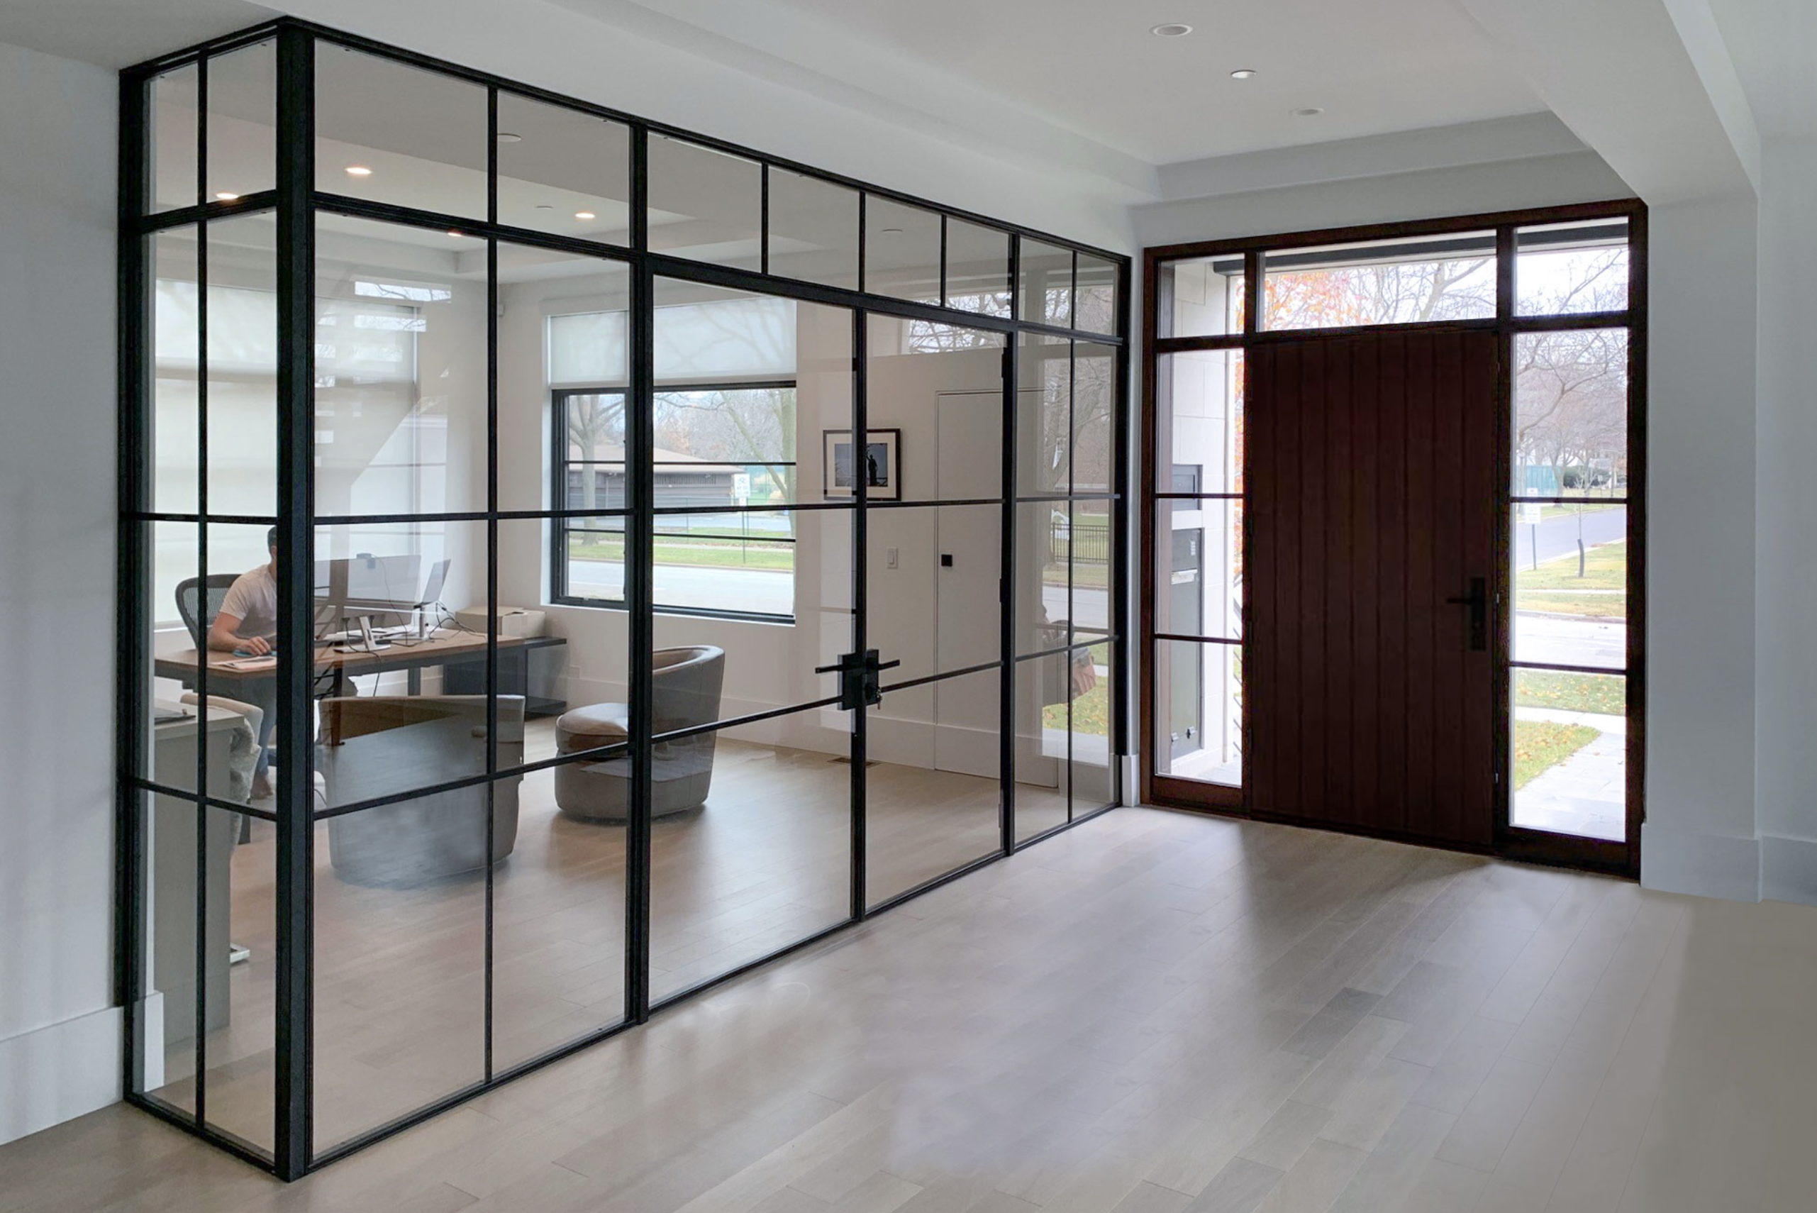
LET’S BUILD SOMETHING EXCEPTIONAL
Talk to your Glenview Doors rep today to get started on displays, dealer setup and sample kits.
Notes:
This is where the conversation begins. Whether your client is remodeling a single home or outfitting a multi-unit development, Glenview Doors is the partner that elevates the experience. From front doors that make a statement to interior doors that deliver function and elegance, we offer a full line that is customizable, thoughtfully engineered, and built to impress. Let’s build something exceptional together. We encourage you to connect with your Glenview rep to get started. Whether it’s a display door for your showroom, sample kits for your design team, or simply more information. We’re here to help you make the sale, and most importantly, make it seamless.
THANK YOU!

