Slide 1
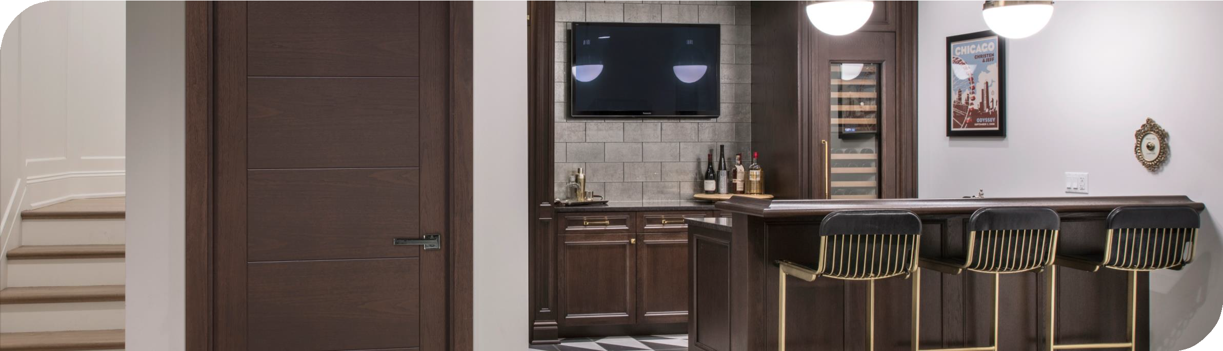


Fire Rated interior Doors
Rafal Madej & Kylie Fletcher

Slide 2

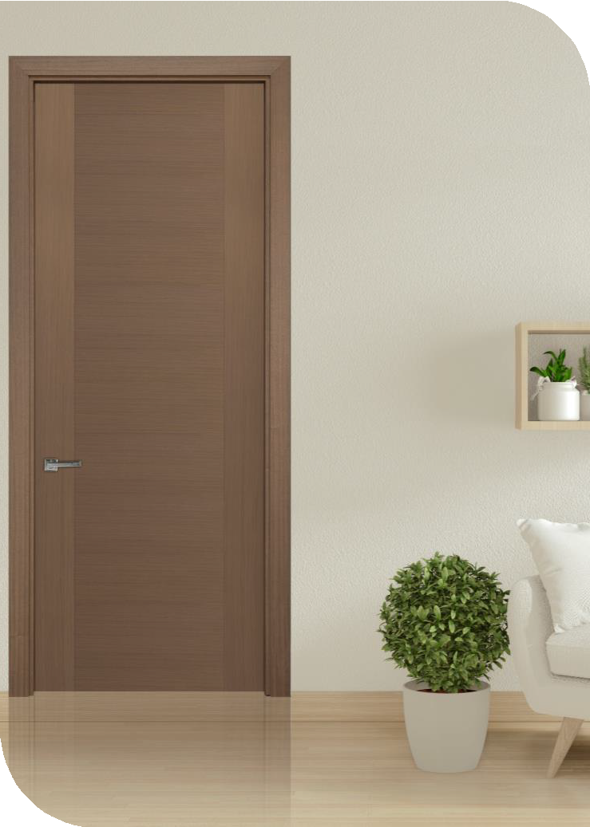

Reason for Certification
Many houses have at least 1 fire rated door
Interior door quotes had to be divided between Glenview Doors and companies such as Trustile that had the Fire Rating Certification
That created a lot of confusion between dealers and customers specifically when designs and finishes had to match
Timing / delivery issues

Slide 3


Testing Lab: QAI Laboratories
Founded in 1995
Independent third-party Testing Inspection and Certification Organization
Located in USA and Canada
Fire Door Listing Program - https://qai.org/directory/home- factories-inc-dba-bmd-manufacturing/
Listing number F496

Slide 4
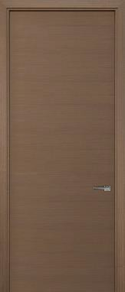



Testing Standards
The IBC (International Building Code) references: UL 10B, UL 10C and NFPA 252
The NBC (National Building Code of Canada) references: CAN/ULCS104
The Fire Test of Door Assemblies can be used for neutral or negative pressure tests
Standard for Positive Fire Pressure Test of Door
Assemblies evaluates a door’s
ability to retain its assembly during a positive pressure test.
The requirements for CAN/ULC S104 certification can be found throughout the National Building Code of Canada for various types of door and frame assemblies
The Standard Methods of Fire Tests of Door Assemblies can be used for either a positive or neutral pressure test.

Slide 5
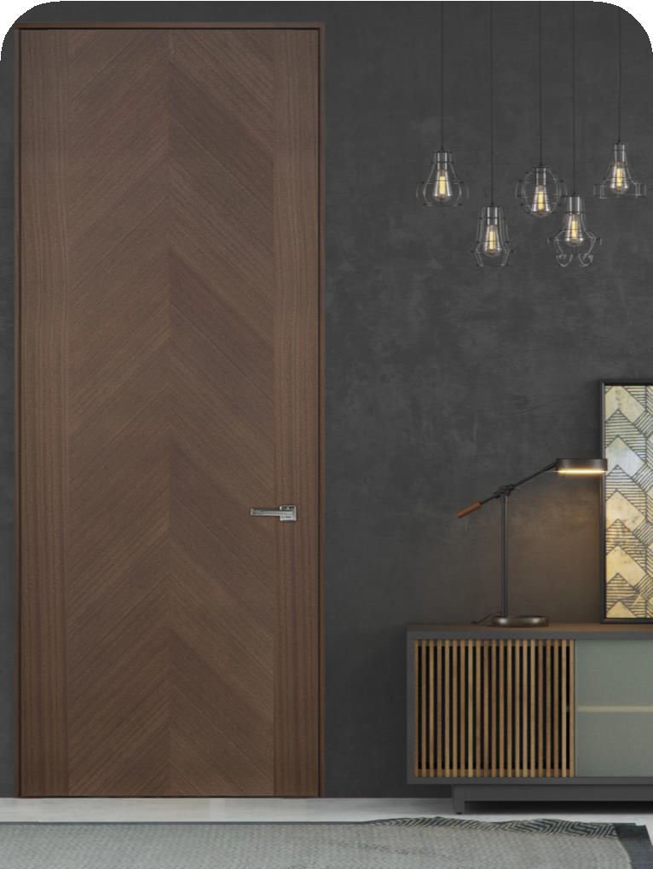
Technical: Doors
Modern Design
  Flush Panel Doors
  Single Swing
  Maximum slab dimensions 42” x 96”
  Minimum slabs thickness 44mm (1-3/4”)
Latching
  UL listed single point lockset hardware approved for use with 20-minute wood type doors
    Tubular
    Mortise
    Mortise Lock with 8mm pin handle, to match Euro style handles

Slide 6
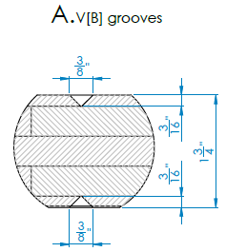
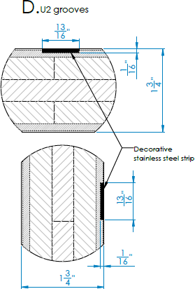
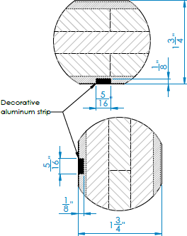
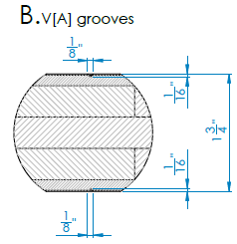
Doors: Grooving
V-groove A & B
Kerf Cut C
Metal Inlays max 1/16” deep and 13/16” wide

Slide 7

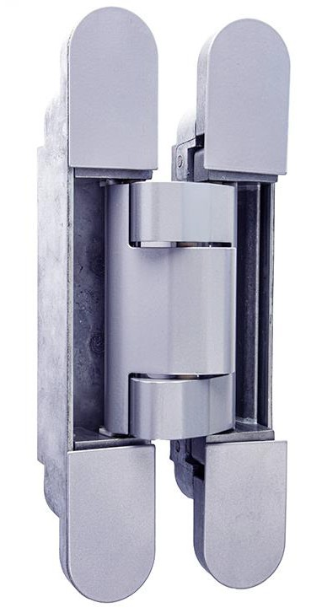

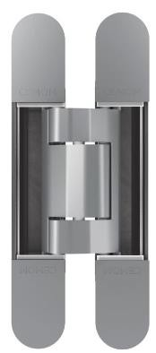
Doors: Hinges, Door Closers & Door Bottoms
Hinges
  per NFPA 80, Table 6.4.3.1.
  Pol-Soft Estetic 150
  Simonswerk Tectus 340 3D
Door closer
  Mortised closers of maximum size 19-11/16” x 2-5/16" x 1-3/8” (DormakabaITS 9625)
  Surface mounted door closers.

Slide 8
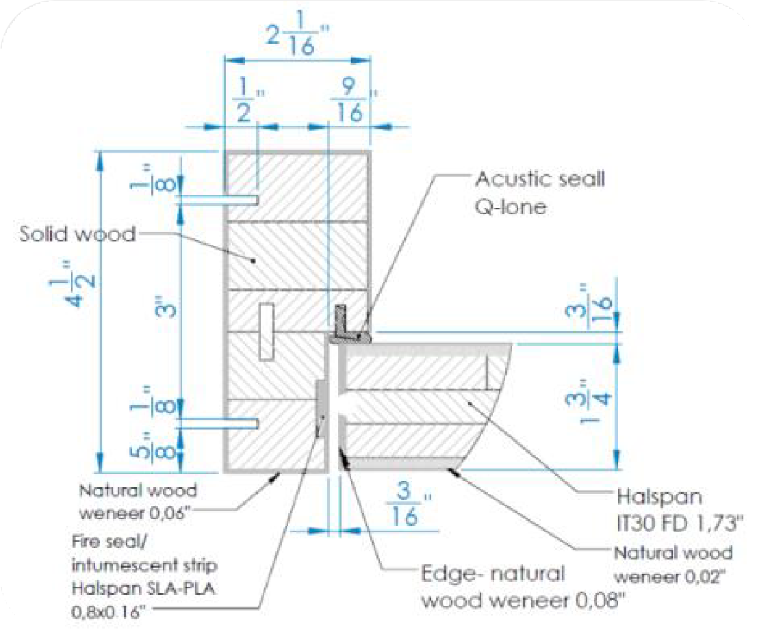
Technical: Frames
Material: Solid Wood (Solid beach wood or equivalent wood species of the same or greater specific gravity)
Minimum frame depth: 4.5 in. (114 mm)
Maximum frame depth: Equivalent to wall thickness
Minimum frame leg thickness: 2 in. (50.8 mm)
Rabbet size: 1-5/16in. (34 mm)
Q-lon weatherstrip

Slide 9

Training Tools
Addition of slides to training and sales presentations
Battle cards for how to sell against competitors
One-pager selling sheet for team
Glenview Doors and all other websites to be updated with appropriate content
Kylie to create training schedule for sales teams as needed

Slide 10
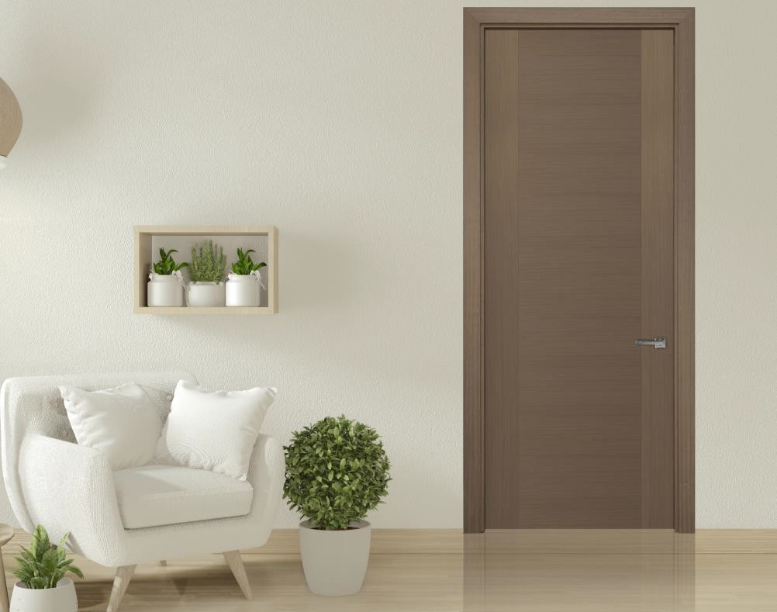
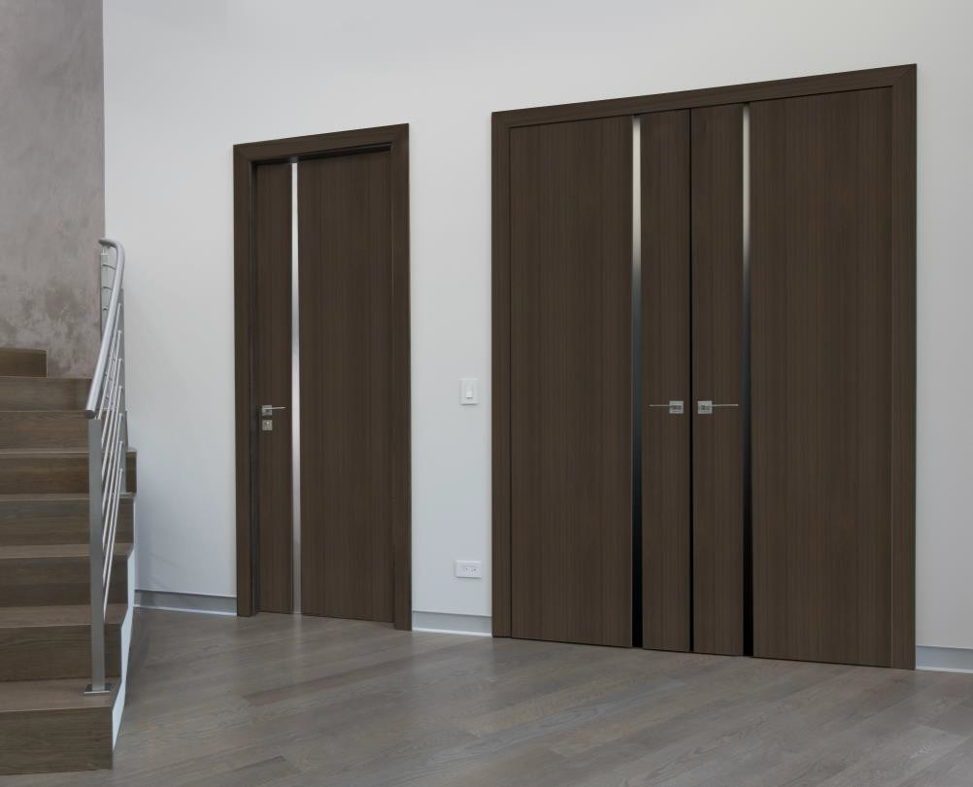
Thank You

