Slide 1
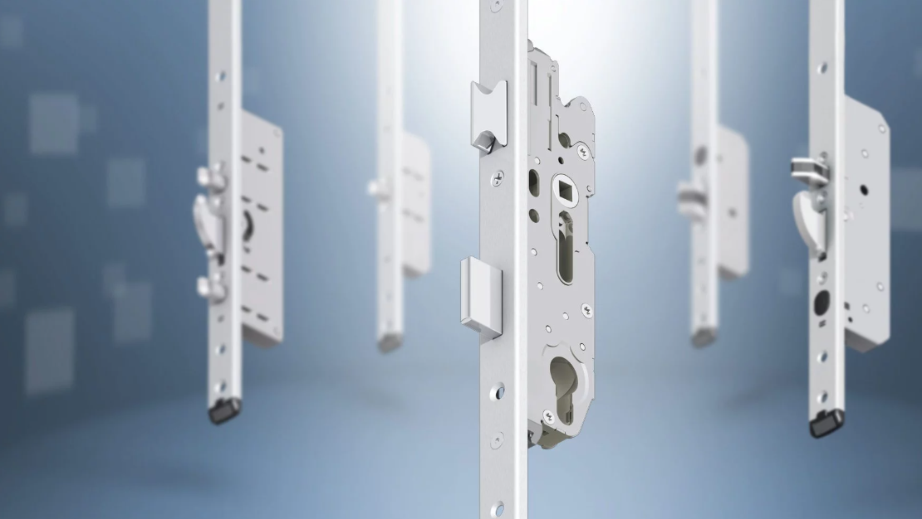
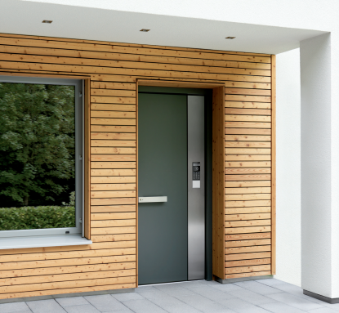

FUHR Multitronic 881 Training
Smart Locking Multipoint Offering.

Slide 2

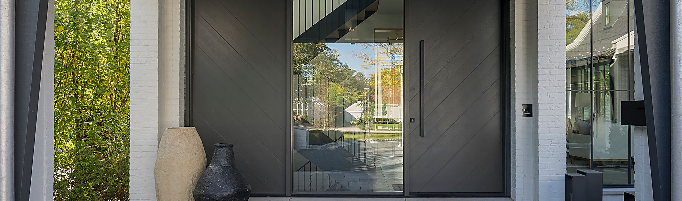
Multitronic 881
02.
Quick motorized locking and unlocking
Keypad, Fingerprint or FOB
App compatible
Day latch function available
2-year limited warranty
No panic function
No exterior handle operation
Notes:
These locks do not have a UL listing (required for fire rated doors in US)

Slide 3
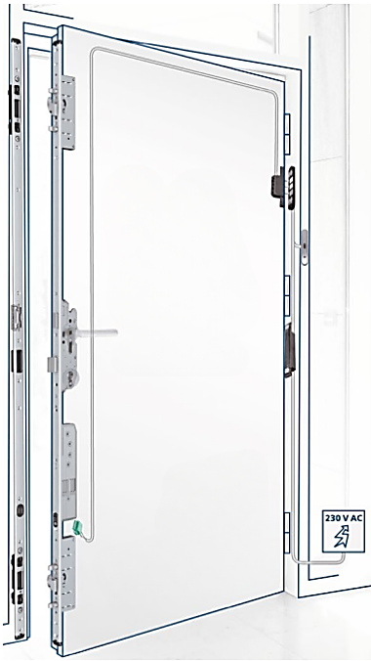
ABOUT FUHR Multitronic 881
Convenience
Opening and closing takes place electronically. As soon as the door closes, the lock automatically engages quickly, reliably and securely. It’s unlocked via modern access control systems
Security
Premium quality materials, comprehensive testing and the FUHR brand name guarantees effective security. Potential integration into monitoring systems add to the overall security.
Energy
Multipoint locking every time ensures constant impermeability. Heat remains inside the building and air does not escape. Precious energy is conserved and a comfortable environment is created.
Placement
Multitronic 881 permits opening at the press of a button, handle heights as low as 36”

Slide 4
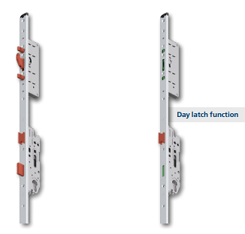

Day Latch Function
When the day latch function is engaged, only the latch secures the door during the daytime.
The day function activation eliminates the need to unlock the door at any given point- but does not provide any security.
Activation of the day function is achieved by a timer or a switch wired to the system.

Slide 5
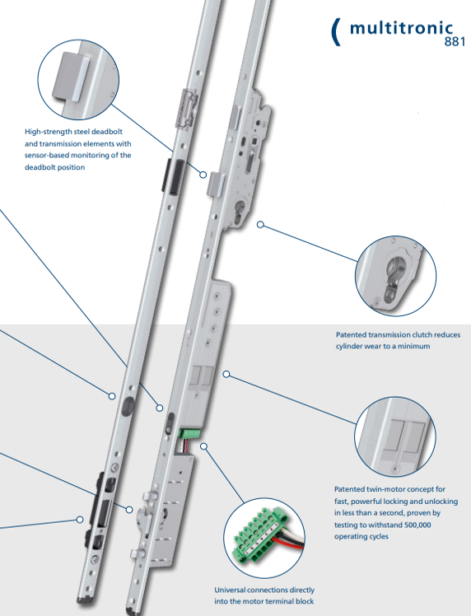
Key Components
High-strength steel deadbolt and transmission elements with sensor-based monitoring of the deadbolt position
Patented transmission clutch reduces cylinder wear to a minimum
Patented twin-motor concept for fast, powerful locking and unlocking
Universal connections directly into the monitor terminal block

Slide 6
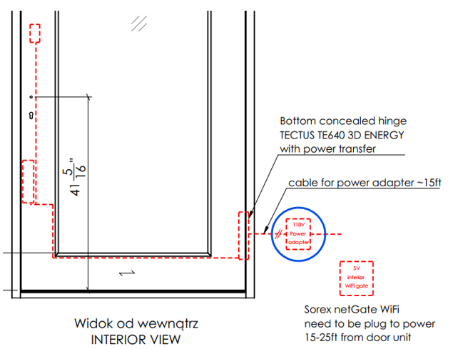
Technical Drawing
Keypad
Power supply compatible with 110v-240v is supplied and included in cost
Sorex netGate WiFi plug in is included
Exterior cylinder is included
Electric motor box

Slide 7
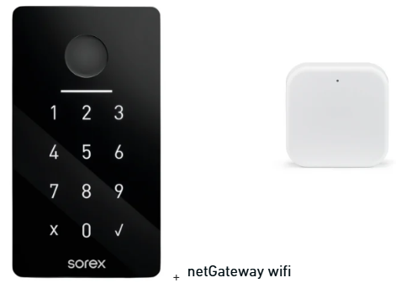
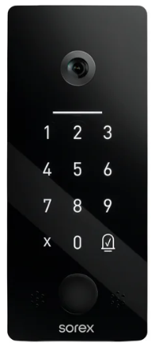
Unlocking System Options
SKD Sorex Smart Unilock+
One piece keypad that does not require additional WiFi gate. This is an upcharge from standard pricing.
Keypad
Fingerprint
RFID reader (open doors by FOB or bringing the phone towards device)
Built in Bluetooth and WiFi
Doorbell
Video camera and intercom (has not been tested yet) operated by phone
SKD Sorex Smart Unilock
Keypad
Fingerprint
RFID reader (open doors by FOB or bringing the phone towards device)
Built in Bluetooth
NetGateway to connect lock with WiFi
Notes:
The door can be opened from the app, or from a button inside the home to release the door.

Slide 8
Key Takeaways & FAQ
FAQ
Q: What if the power goes out?
A: Manual key override and battery backup options available.
Q: Is it secure if controlled by WiFi?
A: FUHR uses encrypted communication and device pairing to protect access. App-based controls can be disabled if needed.
Q: Is it hard to install?
A: Installs into standard Euro configurations. Wiring is simple with included power supply and terminal blocks.
Key Takeaways
Fully motorized locking/unlocking
Smart home integration ready
European engineering and precision
Enhanced security and energy efficiency
Due to the nature of the system, flexible installation options and more, we will be working on a list of key questions to ask customers to ensure they get exactly what they want out of this system for their project.
Notes:
We will also be working with FUHR to get some instruction manuals for your teams as well.

Slide 9
APPENDIX

Slide 10
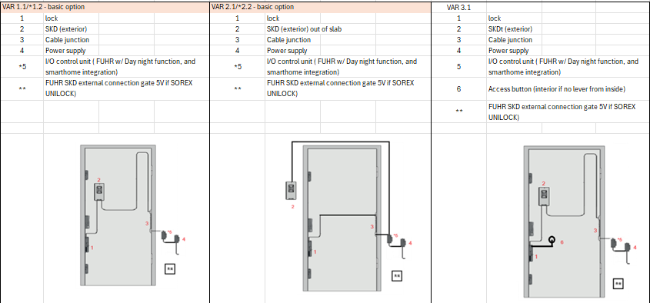
Installation Options

Slide 11
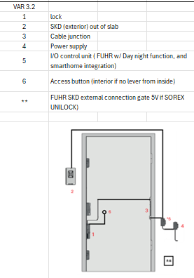
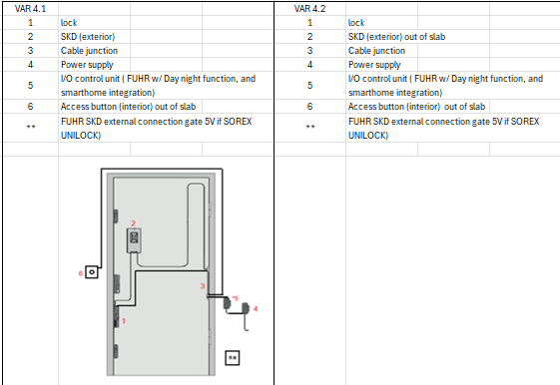
Installation Options

