Slide 1

Glenview Entry Doors
Hurricane Certification
Kylie Fletcher June 7, 2024

Slide 2
TABLE OF CONTENTS
Introduction
Timeline Page 8
Marketing Materials Page 10
Hurricane Testing Details Page 3

Slide 3

Hurricane Certification Testing
4 Categories of Doors:
Inswing Flush Doors
Inswing Aluminum Clad Doors
Inswing Glazed Doors
Outswing Flush Doors
All Doors tested for:
Maximum unit size of 43-1/2” x 98”
Design Pressure (DP Rating) +/- 60 PSF
Large Missile Impact Test

Slide 4
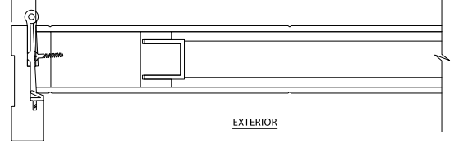
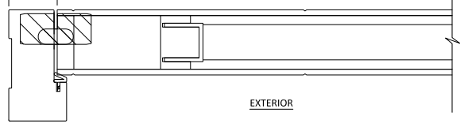
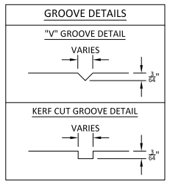
Flush and Aluminum Inswing Doors
Flush Grooved Panels:
Any number, orientation and variation of grooves are approved,
Approved for any numbers and orientation of stainless-steel inlays
Approved for steel plates
Hinges:
Standard American and Concealed Hinges
Lock Mechanism:
Approve with KFV Multipoint Lock –NO Day/Night function
Threshold:
Standard Adjustable Threshold
Aluminum Clad:
ONLY flush ALU-A1 model
Not approved with grooving, metal inlay, glass or steel plates

Slide 5
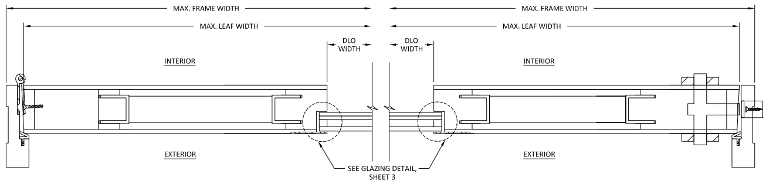
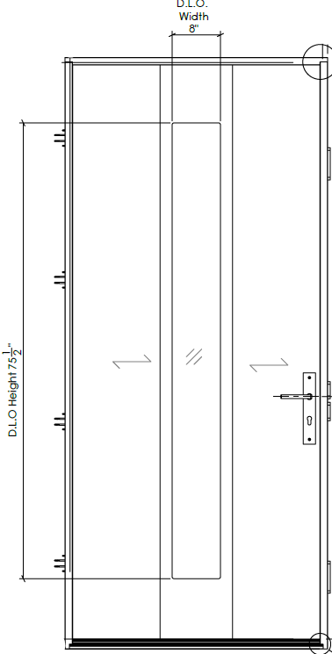

Glazed Inswing Doors
Currently only EMD-F4 Model
Glass width of 8” or smaller
WITH steel plate surround
Only Clear or Satinato Glass
Impact rated glass which means it will withstand impact of 8ft long 2x4 with speed of 50fps (34 mph).
Note: the glass cannot be simply used with other doors to satisfy any official requirements. It is the whole unit that is certified, and glass is only part of it.

Slide 6
Flush Outswing Doors
Approved with same groove details as inswing doors
Approved with KFV lock mechanism- NO DAY/NIGHT FUNCTION
Approved with standard or concealed hinges
NOT approved with aluminum clad

Slide 7
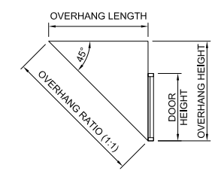
Overhang Requirements for ALL Door Types
Where water infiltration is required, doors shall be protected by overhang
Overhang Ratio 1:1

Slide 8
FAQ
Will the doors that pass this certification also be rated Miami-Dade County? – yes; obtaining Florida State Approval, tested under TAS standards allows us to sell in Miami-Dade County as well.
Will we be receiving official R and U values from this testing? – no, these are part of NFRC certification, which is not a requirement for Hurricane certification.
Will arch top doors be covered? – no
Are we only able to offer one very specific pull bar currently or are any of our pull bars an option? – all pull bars options we currently offer are available.

Slide 9
THANK YOU

