Slide 1

CURATING THE FINEST IN LUXURY FOR DISCERNING FAMILIES
SEPTEMBER 2024 | Presented to:
BMDMFG.COM | 800-334-4263

Slide 2

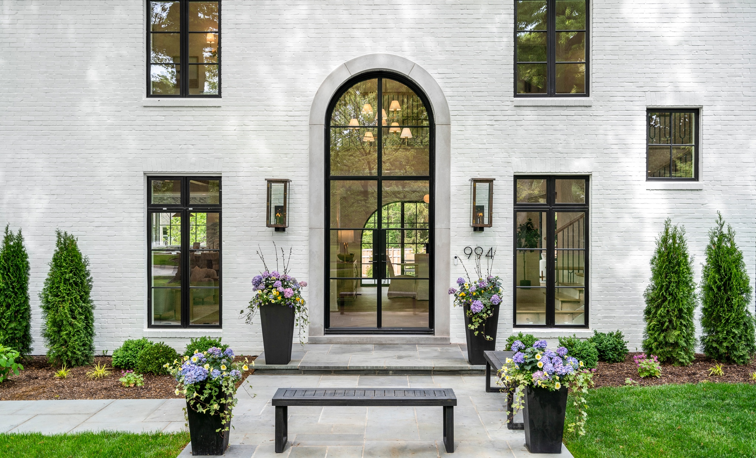
EXPERIENCE LUXURY & CRAFTSMANSHIP
CURATING THE FINEST IN LUXURY FOR DISCERNING FAMILIES
WITH BMD'S
EXCLUSIVE BRANDS
& PRODUCTS
Our premium products are designed to elevate your spaces with unparalleled quality, elegance, and innovation ensuring every detail reflects sophistication and timeless beauty.
Discover the perfect fusion of style
and functionality as you explore our
exceptional range of products, each
meticulously crafted to enhance
the aesthetics and value
of your home.
BMDMFG.COM | 800-334-4263
SEPTEMBER | 2024

Slide 3
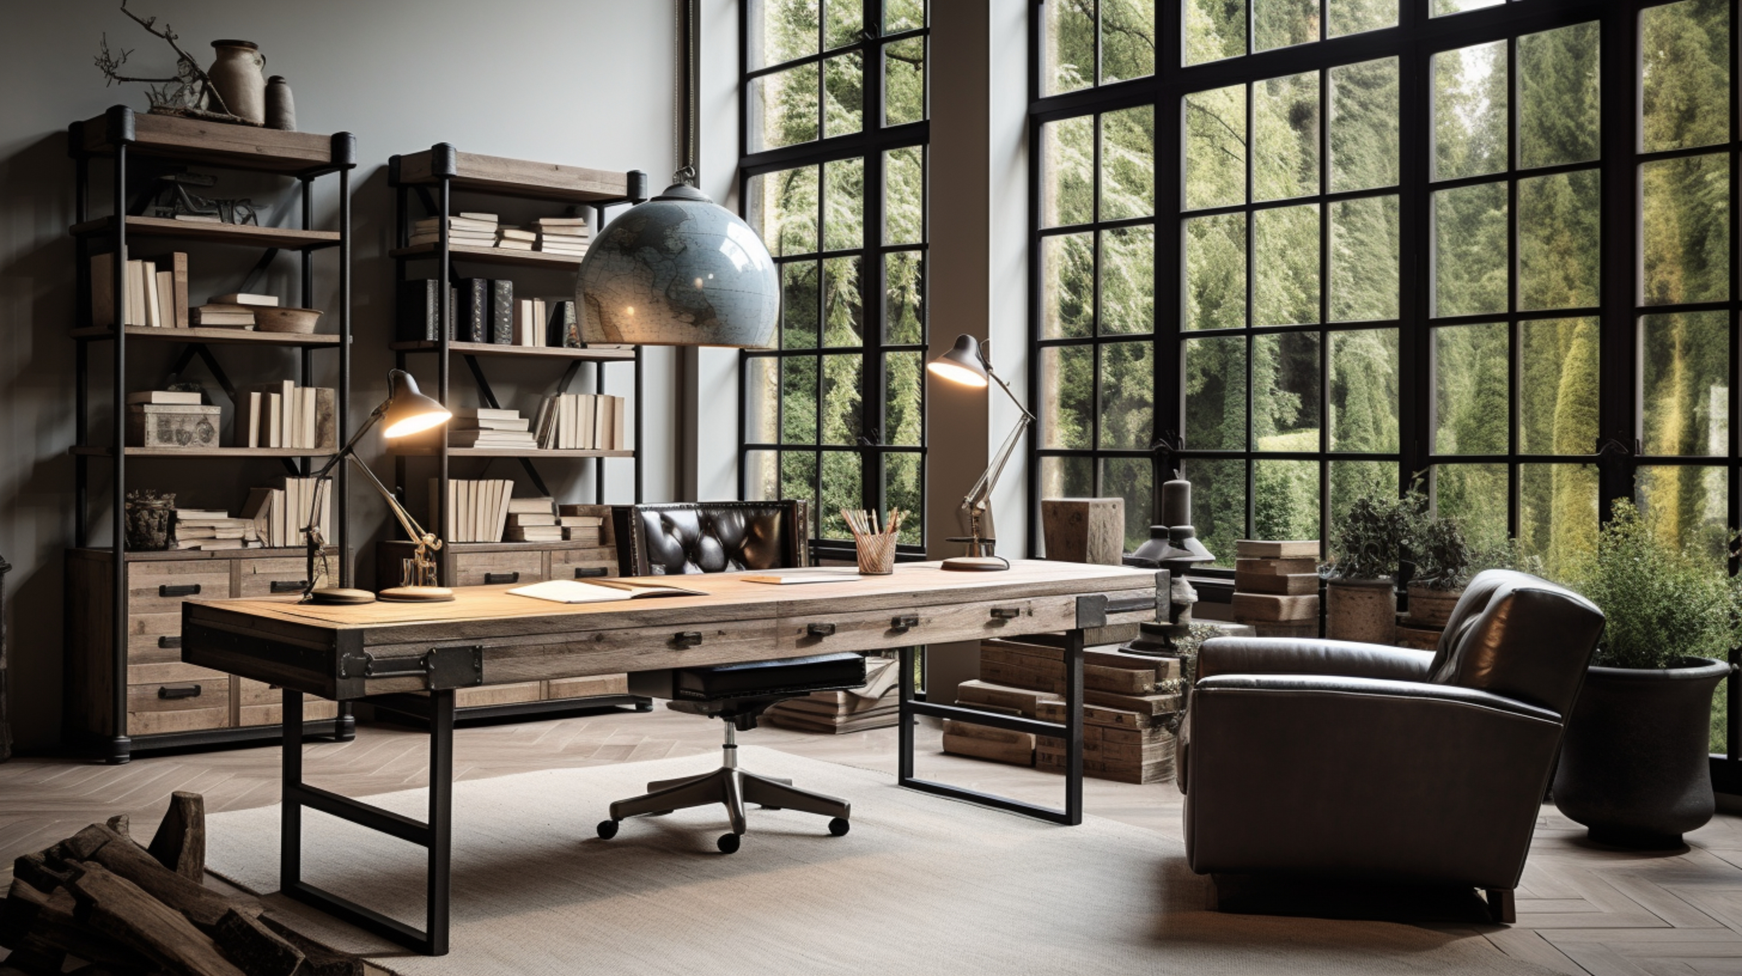

EXPERIENCE LUXURY & CRAFTSMANSHIP
CURATING THE FINEST IN LUXURY FOR DISCERNING FAMILIES
INICIO Windows + Doors presents a luxurious selection of steel and aluminum windows and doors, crafted with precision and premium materials to elevate any high-end property.
Our European-engineered steel collection offers unmatched durability, performance, and exceptional thermal insulation, while our sophisticated aluminum collection boasts stunning design with customizable options to perfectly align with your unique aesthetic vision.
BMDMFG.COM | 800-334-4263
INICIOWINDOWS.COM

Slide 4
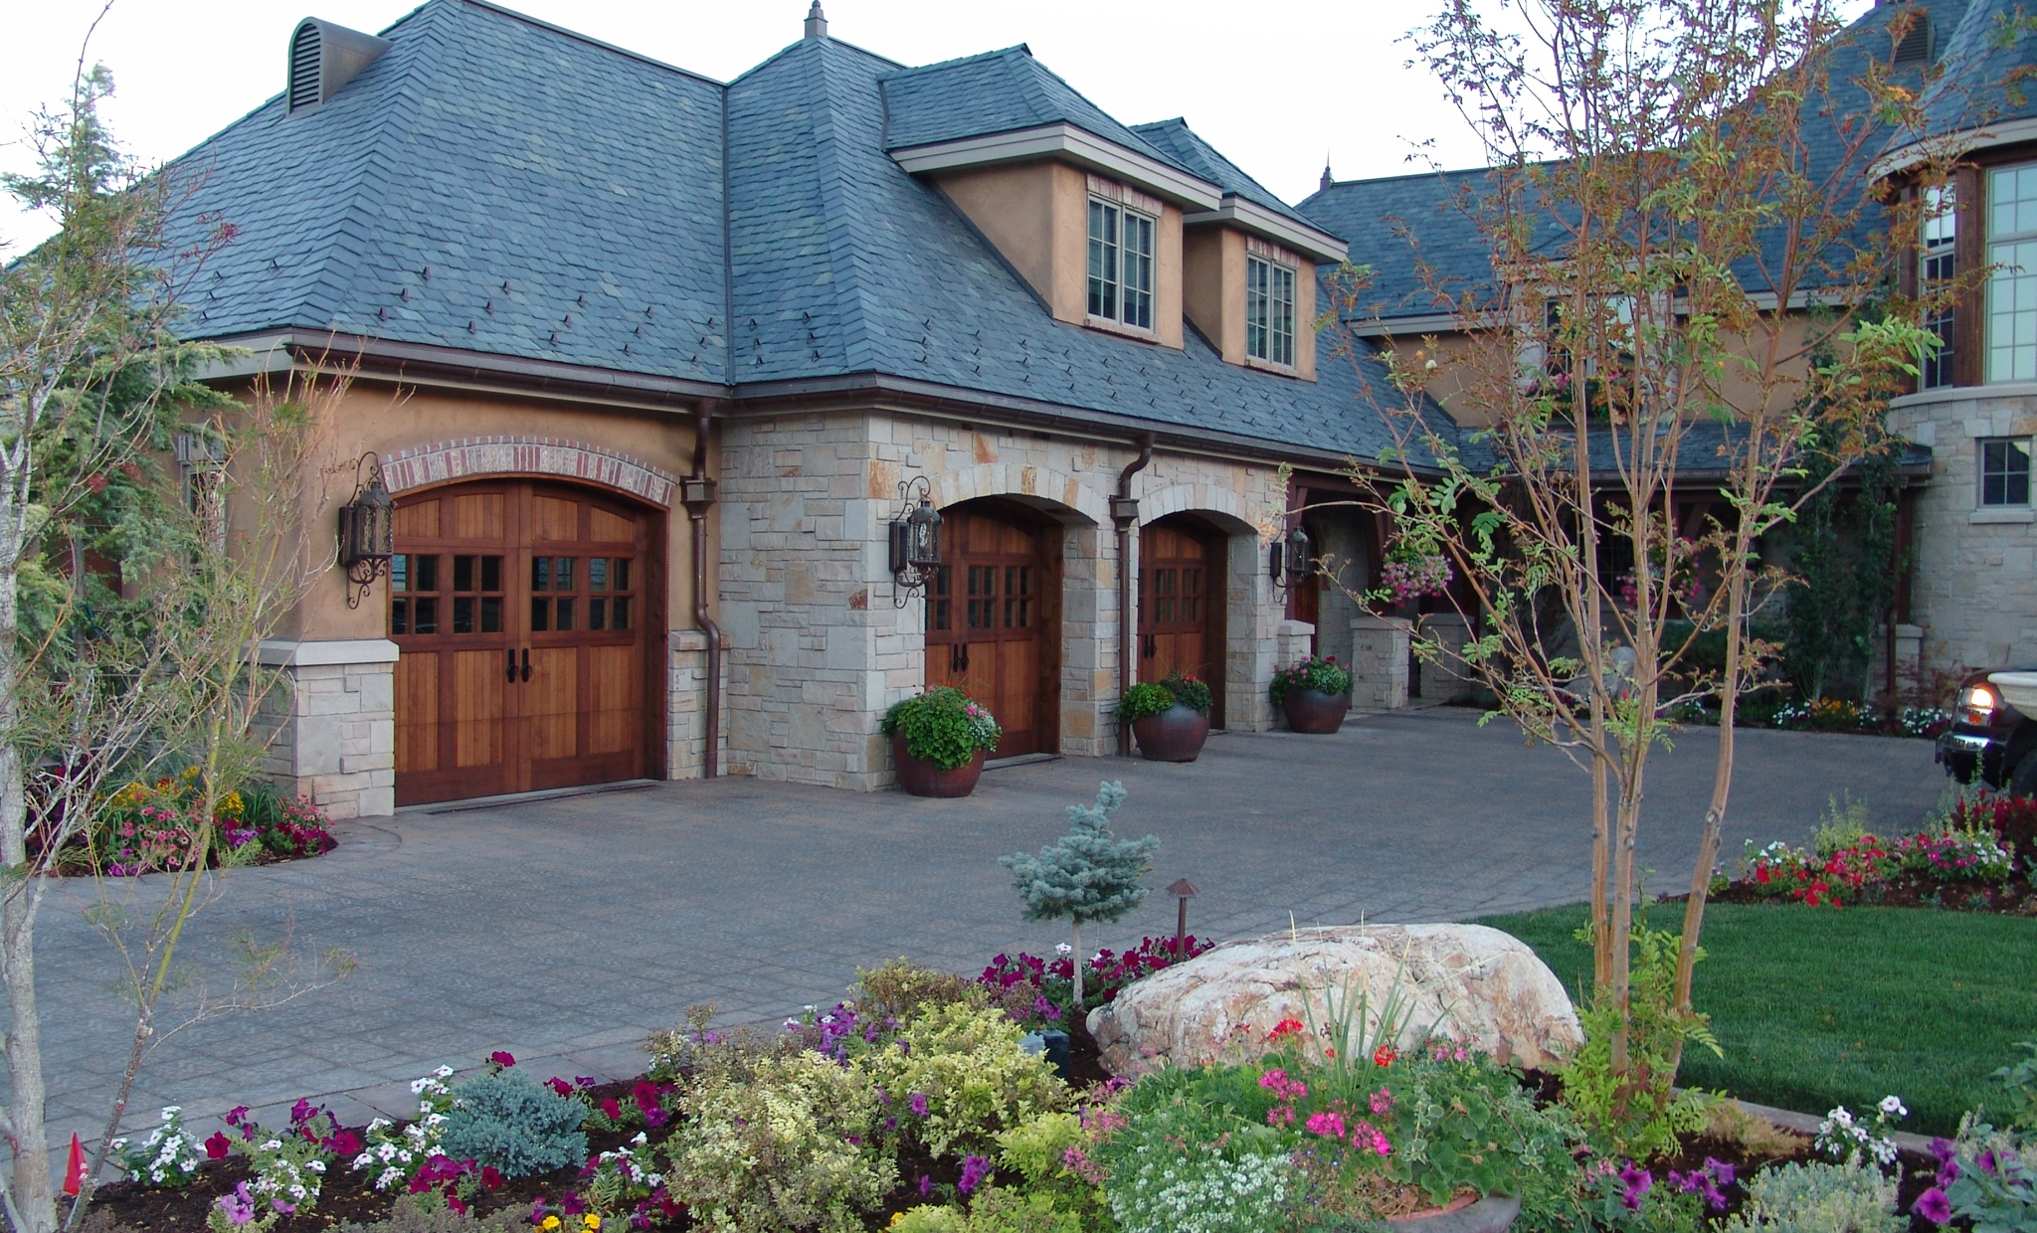

EXPERIENCE LUXURY & CRAFTSMANSHIP
CURATING THE FINEST IN LUXURY FOR DISCERNING FAMILIES
For 20 years, Carriage House Door
has upheld a tradition for handcrafting custom garage door designs of the highest quality from only the most
select materials.
Our craftsmen possess a profound understanding of woods, metals, and composites, enabling us to
create custom garage doors that are both unique and enduring. Ensuring long-lasting, luxurious performance and exceeding the expectations of designers, architects, builders, and homeowners alike.
BMDMFG.COM | 800-334-4263
CARRIAGEDOOR.COM

Slide 5
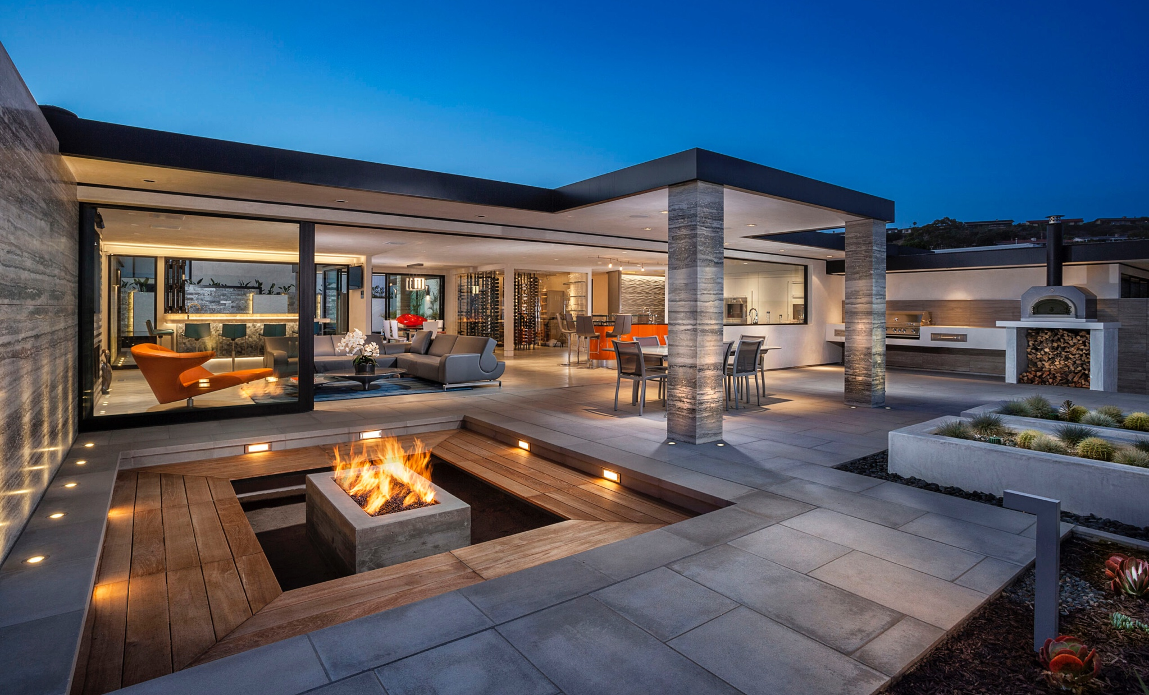


EXPERIENCE LUXURY & CRAFTSMANSHIP
CURATING THE FINEST IN LUXURY FOR DISCERNING FAMILIES
LightStyles is your premier destination for exceptional lighting solutions, offering outstanding customer service and expert guidance to ensure the perfect fixture for any project.
With an expansive selection of unique lighting options, LightStyles Architectural Design Services crafts custom lighting solutions tailored to meet the specific needs of homeowners, builders, and designers alike.
BMDMFG.COM | 800-334-4263
LIGHTSTYLES.COM

Slide 6

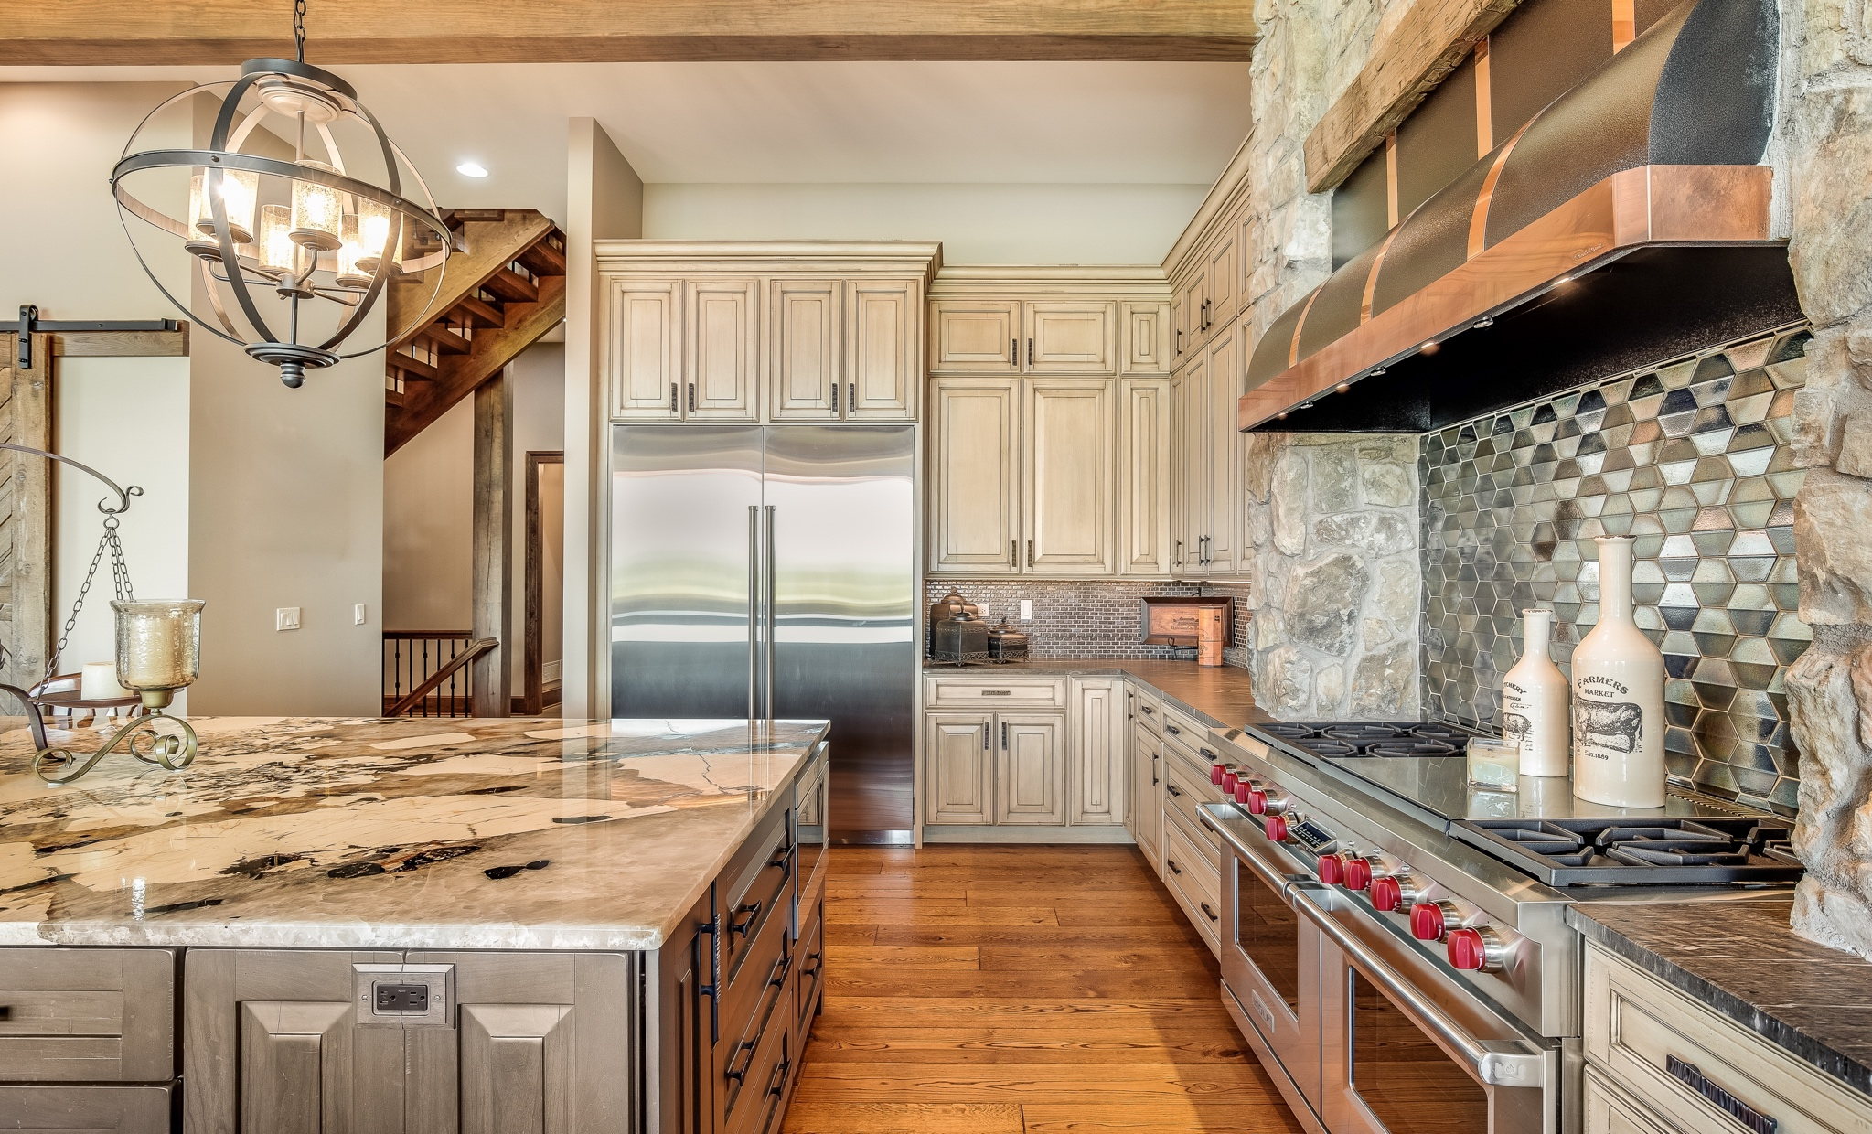

EXPERIENCE LUXURY & CRAFTSMANSHIP
CURATING THE FINEST IN LUXURY FOR DISCERNING FAMILIES
Renowned as the preferred choice among elite homeowners, builders, and developers, ALL, Inc. offers an extraordinary array of luxury appliances and cabinets that redefine sophistication.
Our exclusive selection of world-class brands is meticulously curated to satisfy the most discerning tastes, ensuring that each piece is a testament to quality and elegance.
ALL, Inc. is devoted to exceptional customer experiences through personalized service and meticulous attention to detail.
BMDMFG.COM | 800-334-4263
ALLINC.COM

Slide 7
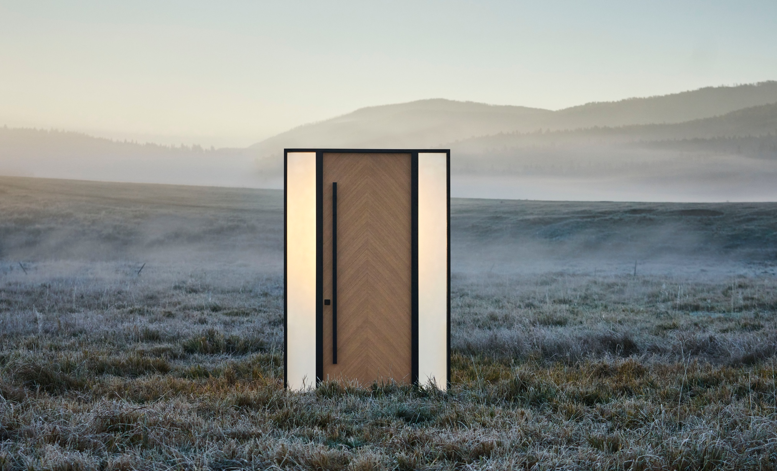


EXPERIENCE LUXURY & CRAFTSMANSHIP
CURATING THE FINEST IN LUXURY FOR DISCERNING FAMILIES
Glenview Doors presents an exceptional line of wooden entry doors that merge elegance with unmatched performance, crafted with advanced European techniques, and are available in a variety of materials and custom designs.
Each made-to-order piece allows clients to express their individuality, ensuring the interior of their homes is as stunning as the exterior with beautifully crafted, luxury furniture-grade products.
BMDMFG.COM | 800-334-4263
GLENVIEWDOORS.COM

Slide 8
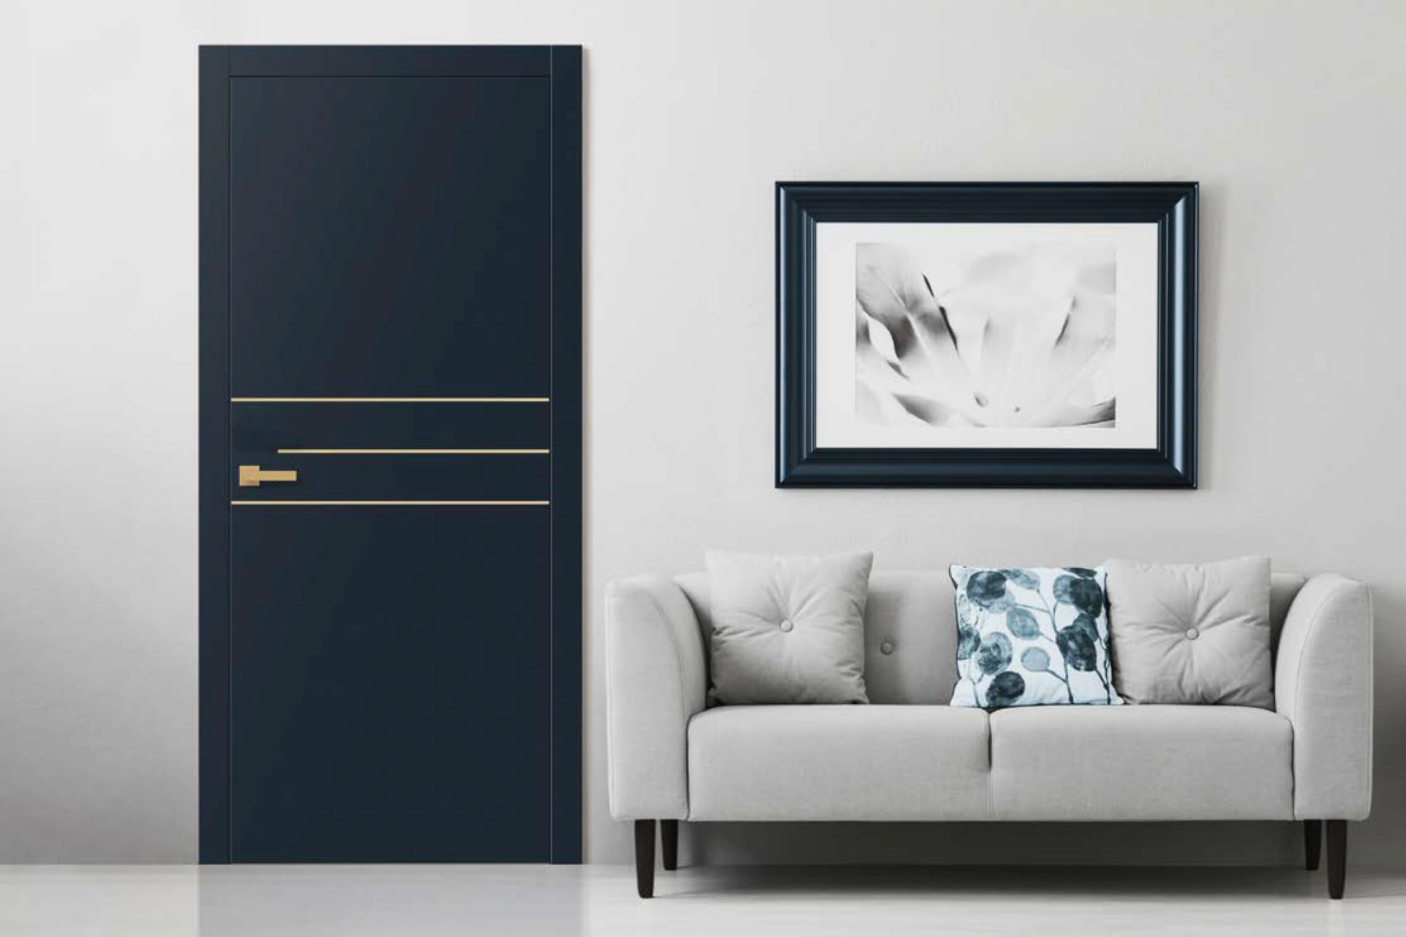
EXPERIENCE LUXURY & CRAFTSMANSHIP
CURATING THE FINEST IN LUXURY FOR DISCERNING FAMILIES
The Glenview Doors’ Collection of
Custom Interior Doors embodies consummate craftsmanship with intricate details and hand-applied multi-step finishes, tailored to exact specifications.
Offering a variety of styles from modern
to traditional, these doors seamlessly coordinate with our front door offerings.
Each made-to-order piece allows clients to express their individuality, ensuring the interior of their homes is as stunning as the exterior with beautifully crafted,
furniture-grade products.
BMDMFG.COM | 800-334-4263
GLENVIEWDOORS.COM

Slide 9
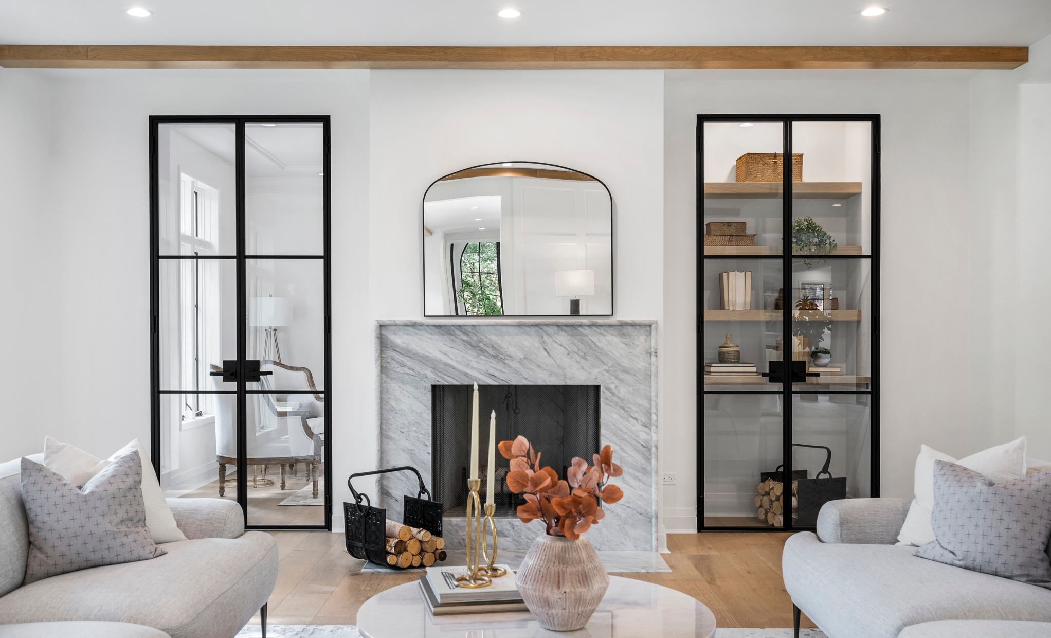
EXPERIENCE LUXURY & CRAFTSMANSHIP
CURATING THE FINEST IN LUXURY FOR DISCERNING FAMILIES
Glenview steel and glass doors, crafted from premium European steel, offer a modern touch that seamlessly blends functionality with beauty, optimizing natural light and sophistication in luxury projects.
Offering a variety of styles from modern to traditional, these doors seamlessly coordinate with our window and door offerings.
Each made-to-order piece allows clients to express their individuality, ensuring the interior of their homes is as stunning as the exterior with beautifully crafted,
furniture-grade products.
BMDMFG.COM | 800-334-4263
GLENVIEWDOORS.COM

Slide 10





FAMILY OF BRANDS
CURATING THE FINEST IN LUXURY FOR DISCERNING FAMILIES
BMDMFG.COM | 800-334-4263

