Slide 1
CURATING THE FINEST IN LUXURY FOR DISCERNING FAMILIES
SEPTEMBER 2024
BMDMFG.COM | 800-334-4263

Slide 2
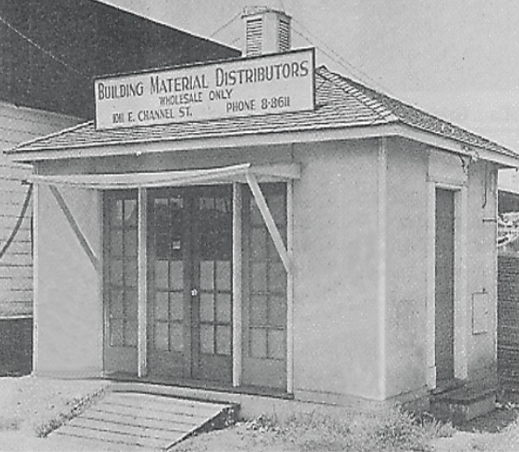
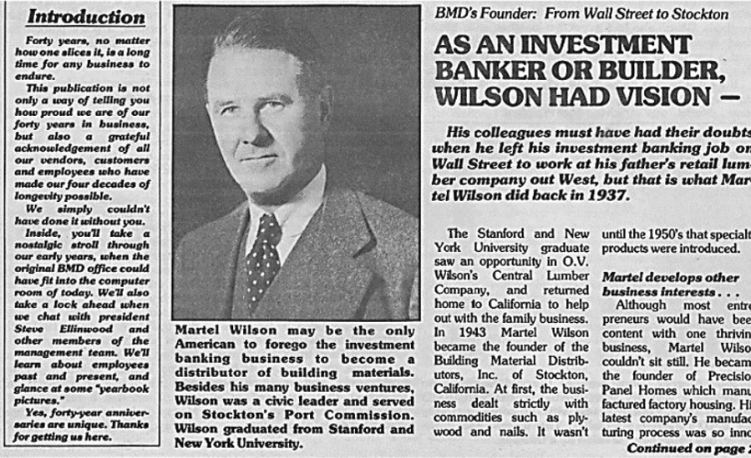
BMD Evolution over 80 years
“We simply couldn’t have done it without you”
Martel Wilson - Founder of BMD
Founded in 1943 in Stockton, CA
by Martel & Paul Wilson

Slide 3

About Us
Customer Centric
Serving 3500+ Accounts
1100+ Employees
Nationwide Expertise
20+ Businesses
30+ Locations
1.2 Million Sq. Ft. Facility Space
Powerful Partner Network
Employee Ownership
Communication
Teamwork
Accountability
Continuous Improvement
People
Excellence
Integrity

Slide 4















BMD BRANDS & REGIONS
EMP LO YEE OWNE D. BUILDING PA R TNERS.
DA LT ON SERVICE
CENTER
EMPLOYEE OWNED. BUILDING PARTNERS.
Employee Owned. Building Partners.
EMPLOYEE OWNED. BUILDING PARTNERS.
Employee Owned. Building Partners.

Slide 5
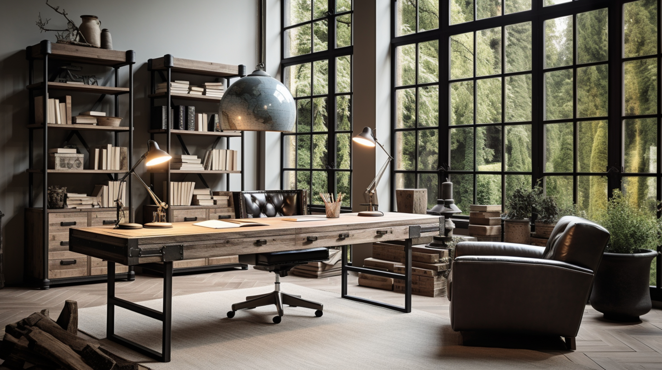

EXPERIENCE LUXURY & CRAFTSMANSHIP
CURATING THE FINEST IN LUXURY FOR DISCERNING FAMILIES
INICIO Windows + Doors presents a luxurious selection of steel windows and doors, crafted with precision and premium materials to elevate any high-end property.
Our European-engineered steel collection offers unmatched durability, performance, and exceptional thermal insulation. INICIO is one of the only steel window and door brands with third-party tested, proven performance and proprietary selection software.
From the moment inspiration strikes to installation and beyond, all you’ll see is perfection.
BMDMFG.COM | 800-334-4263
INICIOWINDOWS.COM

Slide 6
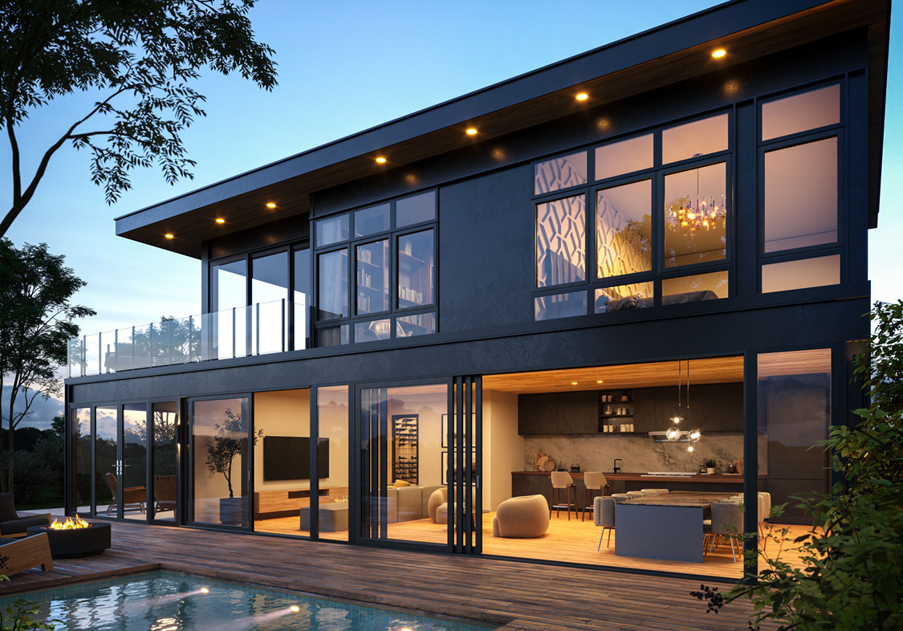
EXPERIENCE LUXURY & CRAFTSMANSHIP
CURATING THE FINEST IN LUXURY FOR DISCERNING FAMILIES
INICIO aluminum windows and doors are designed and built like no other. Sashes glide. Latch operation is satisfying to the touch. Every aspect of design has been examined to produce windows of uncompromising precision, unrivaled performance, and exacting construction.
The artisans of BMD Manufacturing in Europe combine old-world skills with state-of-the art materials to create aluminum windows and doors of enduring beauty and peerless function. Every detail has been refined, and the result is as exquisite to operate as it is to view.
BMDMFG.COM | 800-334-4263
INICIOWINDOWS.COM

Slide 7
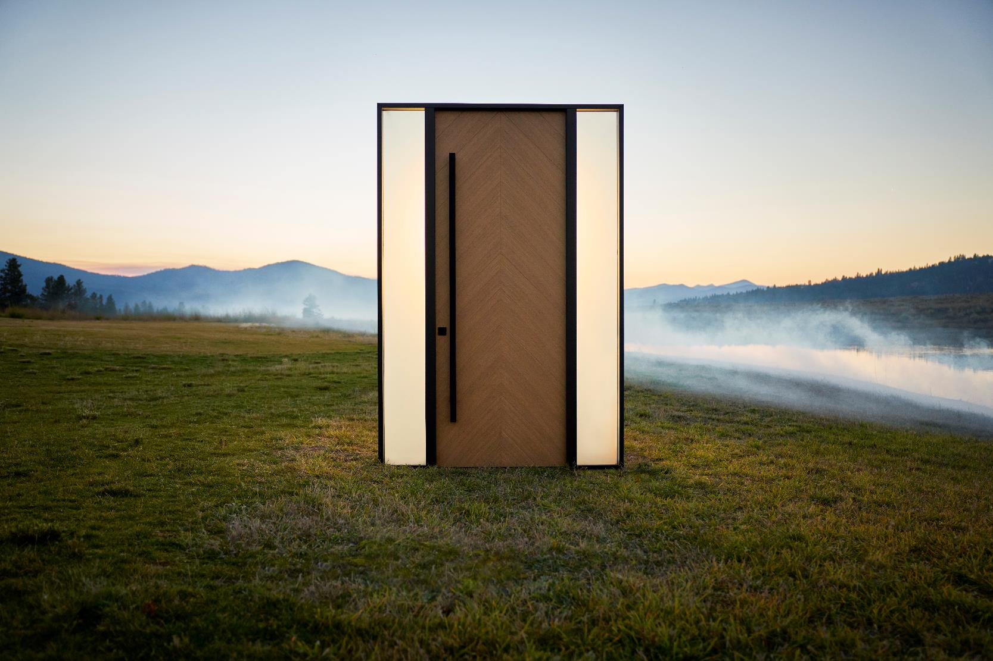

EXPERIENCE LUXURY & CRAFTSMANSHIP
CURATING THE FINEST IN LUXURY FOR DISCERNING FAMILIES
Glenview Doors presents an exceptional line of wooden entry doors that merge elegance with unmatched performance, crafted with advanced European techniques, and are available in a variety of materials and custom designs.
Each made-to-order piece allows clients to express their individuality, ensuring the interior of their homes is as stunning as the exterior with beautifully crafted, luxury furniture-grade products.
BMDMFG.COM | 800-334-4263
GLENVIEWDOORS.COM

Slide 8
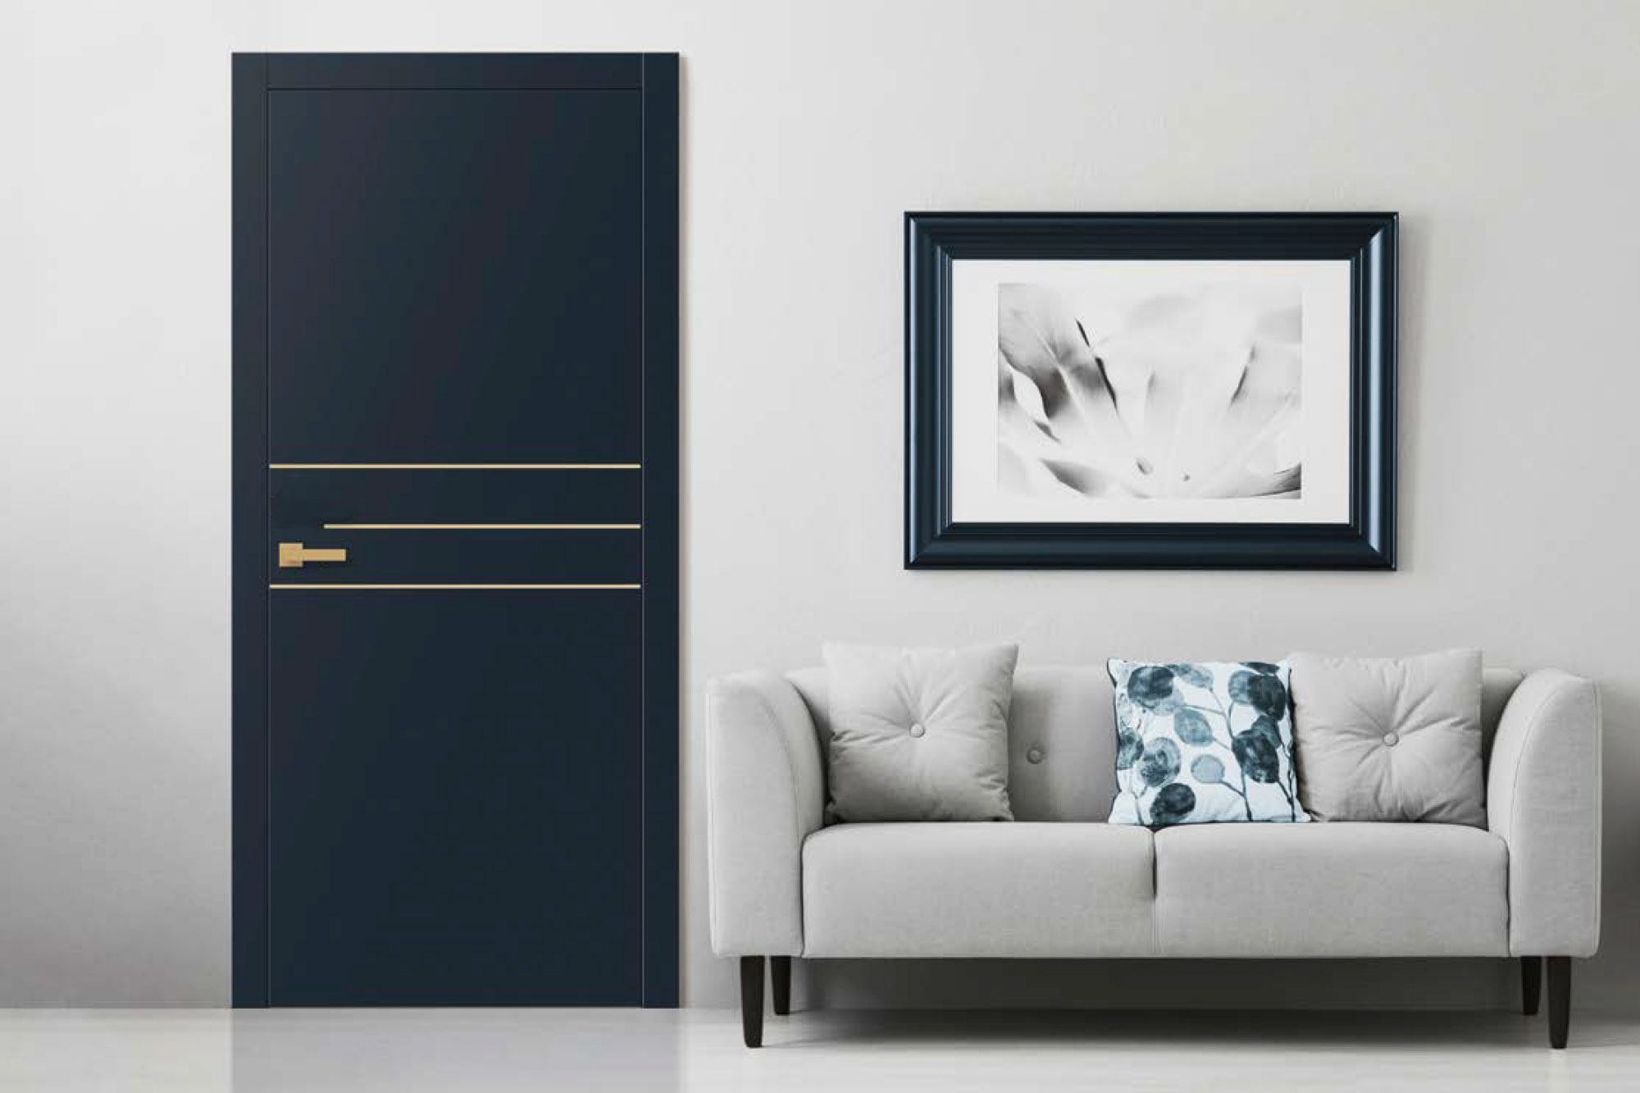
EXPERIENCE LUXURY & CRAFTSMANSHIP
CURATING THE FINEST IN LUXURY FOR DISCERNING FAMILIES
The Glenview Doors’ collection of custom interior doors embodies consummate craftsmanship with intricate details and hand-applied multi-step finishes, tailored to exact specifications.
Offering a variety of styles from modern to traditional, these doors seamlessly coordinate with our front door offerings.
Each made-to-order piece allows clients to express their individuality, ensuring the interior of their homes is as stunning as the exterior with beautifully crafted,
furniture-grade products.
BMDMFG.COM | 800-334-4263
GLENVIEWDOORS.COM

Slide 9
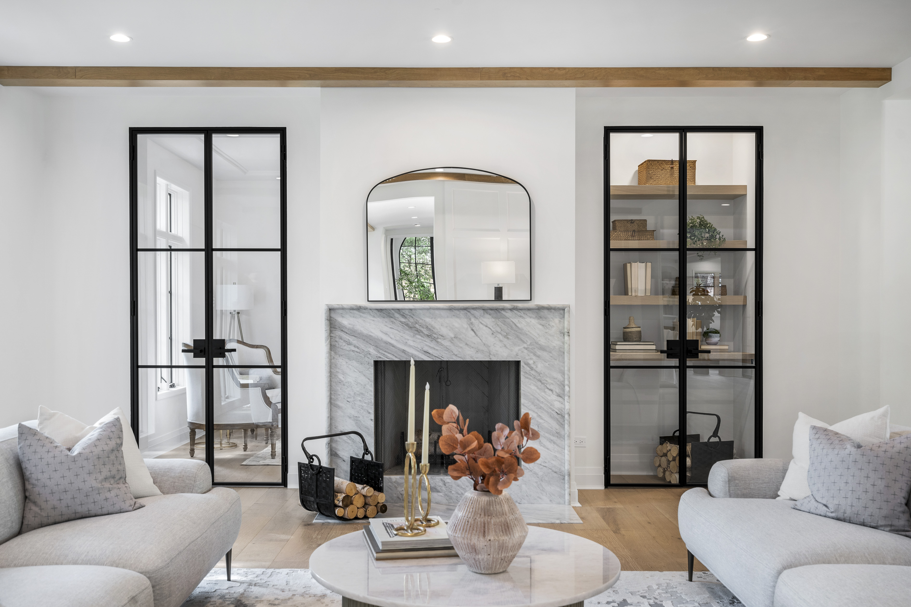
EXPERIENCE LUXURY & CRAFTSMANSHIP
CURATING THE FINEST IN LUXURY FOR DISCERNING FAMILIES
Glenview Doors proudly presents an exquisite collection of European-crafted interior steel glass doors and dividing steel glass walls. With their sleek, narrow stiles and rails, these steel doors exude luxury and timeless elegance, satisfying the aesthetic demands of even the most discerning clients.
Each design showcases impeccable craftsmanship which will last for years to come. Our minimalist lines create a striking, unobstructed look that elevates any interior, while optional insulated glass units offer a stunning solution for wine cellars and tasting rooms.
BMDMFG.COM | 800-334-4263
GLENVIEWDOORS.COM

Slide 10
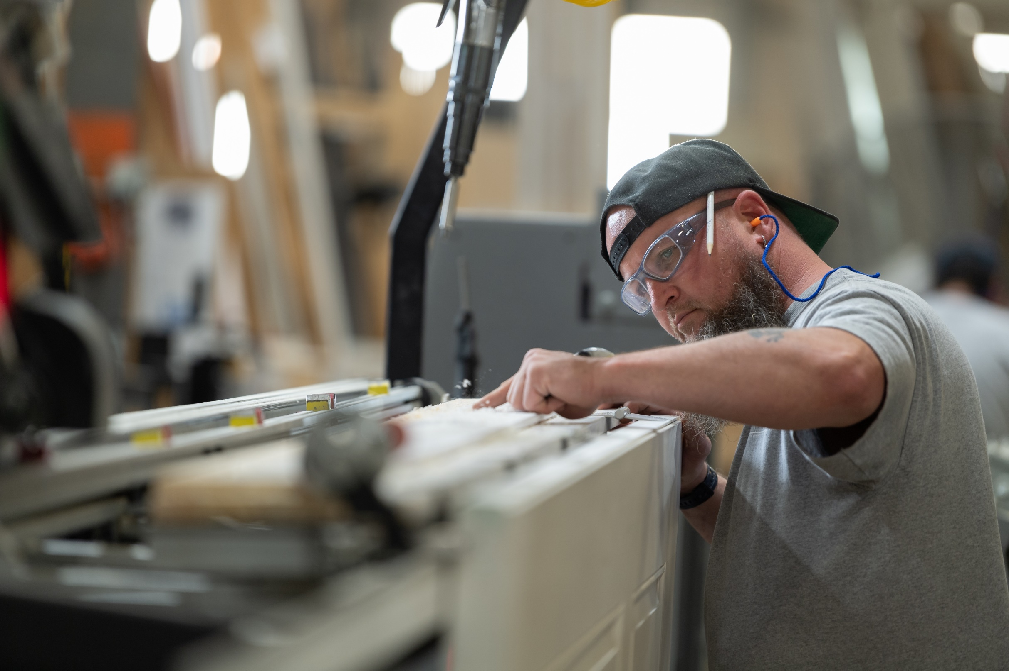

At Your Service
Expertise in Every Frame, Precision in Performance
We believe in supporting dealers, architects,
builders, contractors, and designers with:
Premium products, experiences & support
We promise you are backed by a team with proven
years of industry leading experience
We are committed to you before, during, and after any sale
We fundamentally believe that building is better when there is
more support and partnership

Slide 11
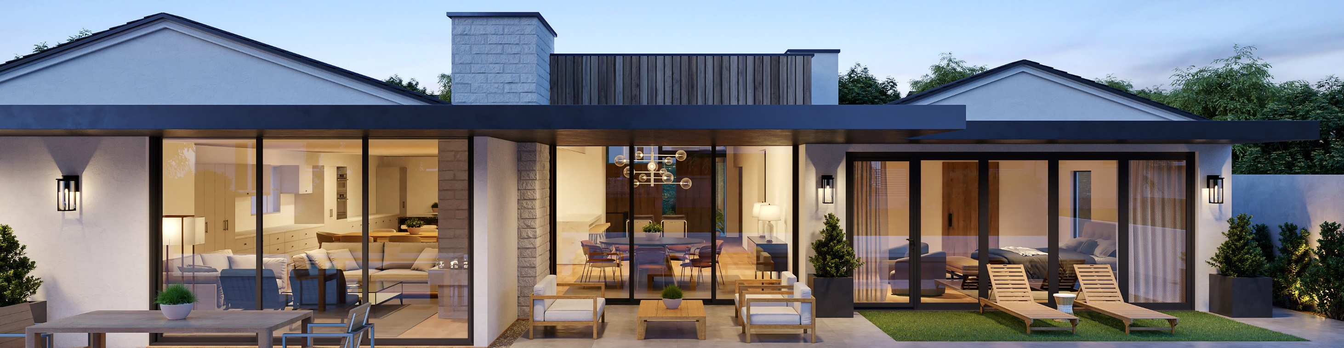
Designed for U.S. Standards
European Artistry & Engineering
Engineering products that are designed to offer much more than
the total sum of its functions.
Aiming to create customer experiences that build pride & trust ensuring
long-lasting satisfaction and exceeding expectations in surprising ways.
Collaborating closely with keen attention to detail to bring visions of one-of-a-kind
homes into reality.
We are user-focused and feel accountable for making our products the very best they can be.

Slide 12
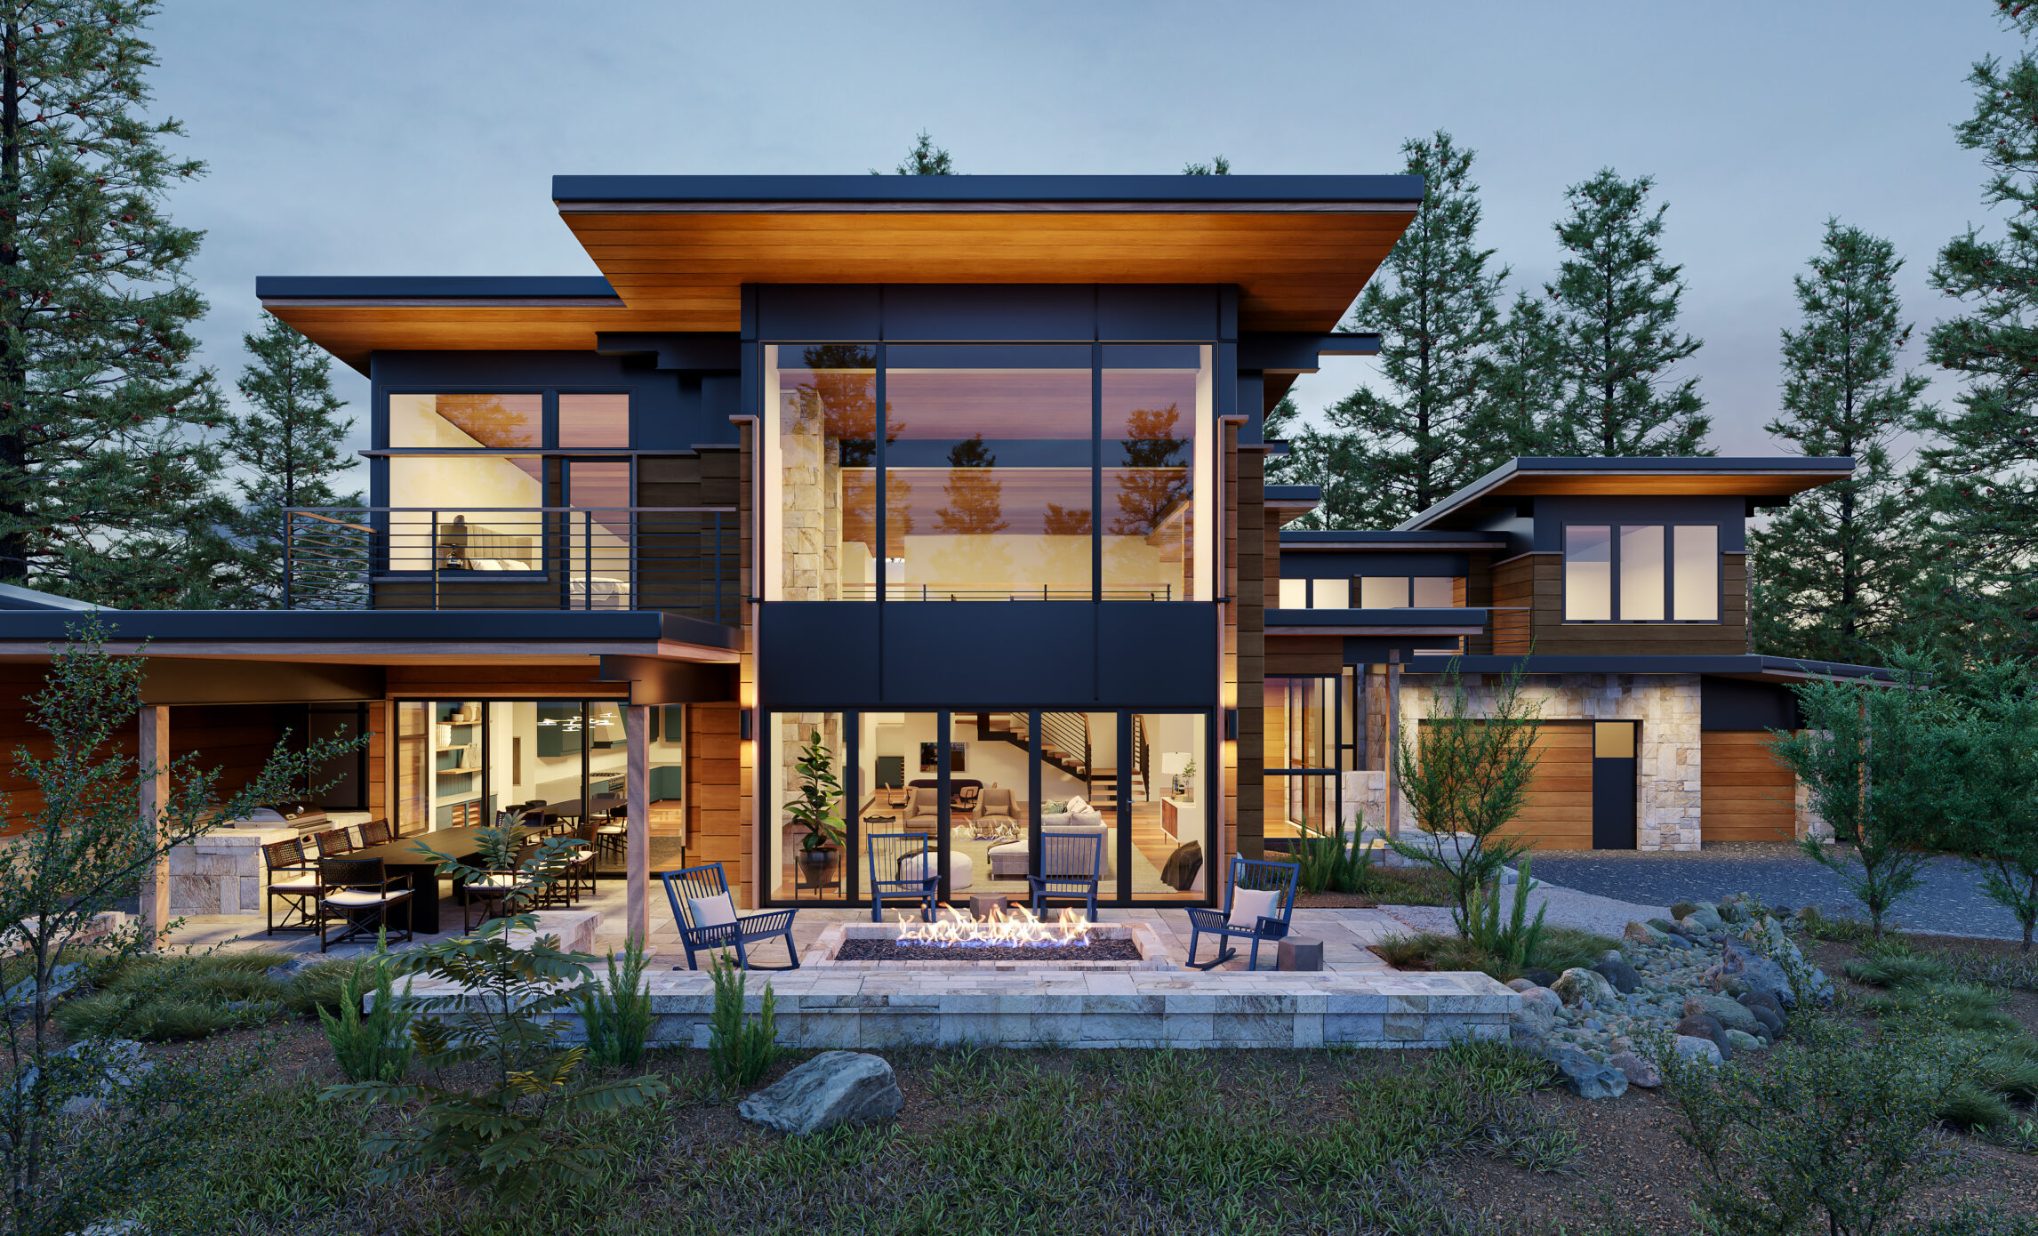
BMD MANUFACTURING & CAPACITY
Most products are manufactured in our world-class European factory by the finest traditional craftsmen aided with state-of-the-art technology.
Our factory has been producing premium, luxury window and door products for 50 years.
We are confident our capacity can meet your fulfillment demands.

Slide 13









BMD SUPPORT & SERVICES
Jobsite Delivery*
Jobsite Service*
Architectural Drafting & Services
Architectural Support
Engineering Services
Training Service
  Product
  Quoting
  Selling
Event Support
Design Support
Marketing Services
Warranty
*In select locations

Slide 14



THANK YOU
Enough About Us
How Can We Serve You?
EMPLOYEE OWNED. BUILDING PARTNERS.

