Slide 1
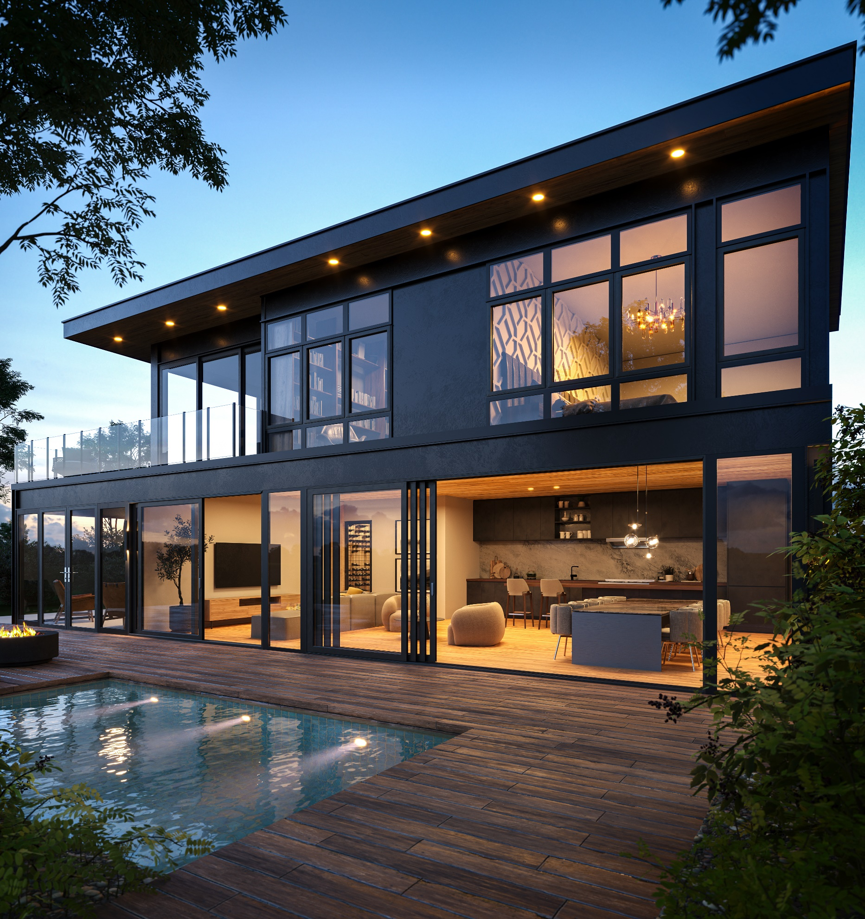
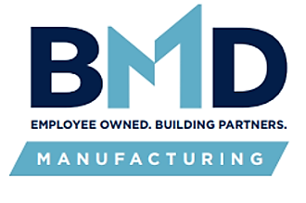
Designing with Aluminum Windows & Doors-
Modern Performance for
Luxury Residential + Low-Rise Multifamily
An AIA Presentation
by BMD Employee Name Here
Notes:
Welcome and thank you for joining us today for this AIA-accredited course on aluminum windows and doors. In this session, we’ll explore how aluminum systems are used in modern architecture, especially in luxury residential and low-rise multifamily applications. We’ll discuss the material properties that make aluminum a compelling choice for today’s design challenges, and we’ll take a deeper look at how extrusion design, thermal performance, finishes, hardware, and indoor-outdoor configurations contribute to both aesthetics and performance. This course is intended to provide a well-rounded, product-neutral understanding of how to specify aluminum window and door systems confidently — whether you're designing a minimalist coastal retreat, a modern farmhouse, or a high-performance urban infill project.

Slide 2
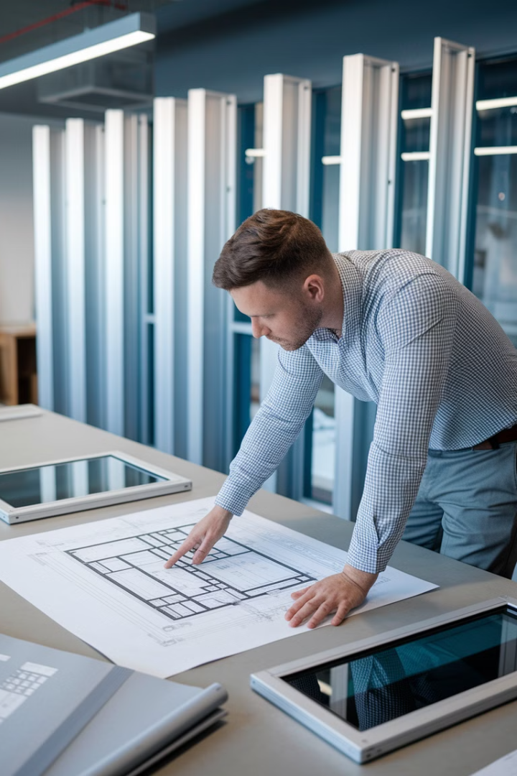
Learning Objectives
Understand Modern Design
Learn how aluminum systems support contemporary architectural vision with clean lines.
Identify Performance
Evaluate key attributes of aluminum windows and doors for optimal project outcomes.
Balance Aesthetics & Function
Master the tradeoffs between ultra-narrow sightlines and structural/thermal ratings.
Specify with Confidence
Select appropriate frame, finish, and hardware options for luxury residential applications.
Notes:
Let’s take a moment to walk through what we’ll cover in today’s course. By the end of this session, you’ll have a clearer understanding of how aluminum window and door systems align with today’s architectural goals—particularly in design-driven residential and low-rise multifamily projects. You’ll learn how to evaluate aluminum systems not just for aesthetics, but also for structural capacity, thermal performance, durability, and integration into the building envelope.
We’ll also talk about the tradeoffs between ultra-minimalist profiles and performance thresholds, and what to consider when specifying finishes, hardware, and system configurations—especially for large openings and indoor-outdoor transitions. The goal is to equip you with the knowledge to make confident, well-informed decisions when designing and specifying aluminum fenestration systems.

Slide 3
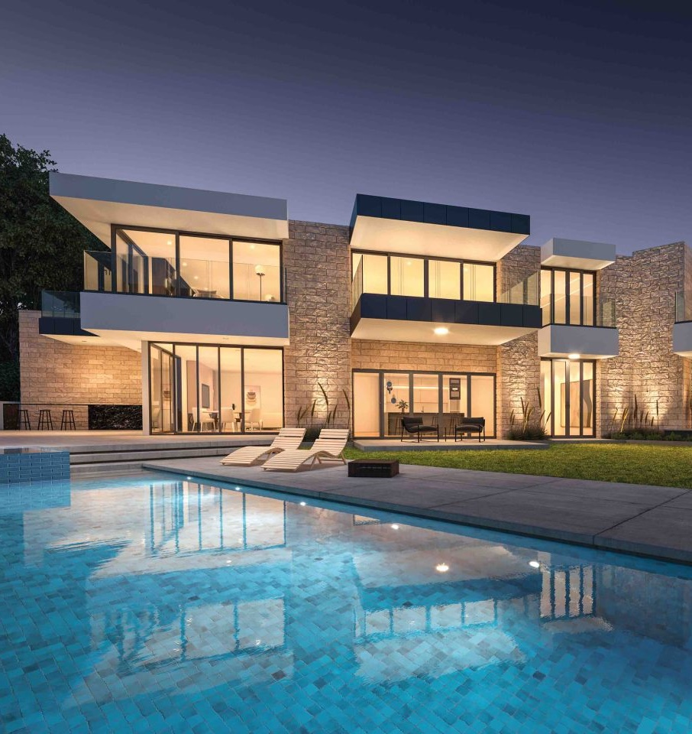
The Role of Aluminum in Modern Architecture
Clean
Lines
Expansive Openings
Aluminum creates sleek, narrow sightlines that maximize views.
Superior strength-to-weight ratio supports expansive glass panels.
Durable Protection
Sustainable Choice
Inherent corrosion resistance ensures longevity in diverse climates.
Recyclable material requires minimal upkeep throughout its lifecycle.
Notes:
Aluminum plays a unique and powerful role in modern architecture. One of the primary reasons architects turn to aluminum systems is for their ability to support clean lines and minimal profiles. Aluminum’s strength-to-weight ratio allows for large, uninterrupted openings with very little frame. Aluminum also supports the use of expansive glazing for making multi-panel doors and oversized fixed windows. These large glass surfaces allow for more natural light, better connection to views, and seamless transitions between indoor and outdoor spaces. In terms of durability, aluminum is naturally corrosion-resistant, especially when finished properly. Unlike wood, it won’t rot, swell, or warp. And unlike vinyl or composites, it holds up exceptionally well in extreme climates, including coastal and desert conditions. Lastly, aluminum is 100% recyclable and has a long material lifespan. It requires very little maintenance over time, and many systems are now made from high recycled content, making it a smart choice for both performance and sustainability.

Slide 4
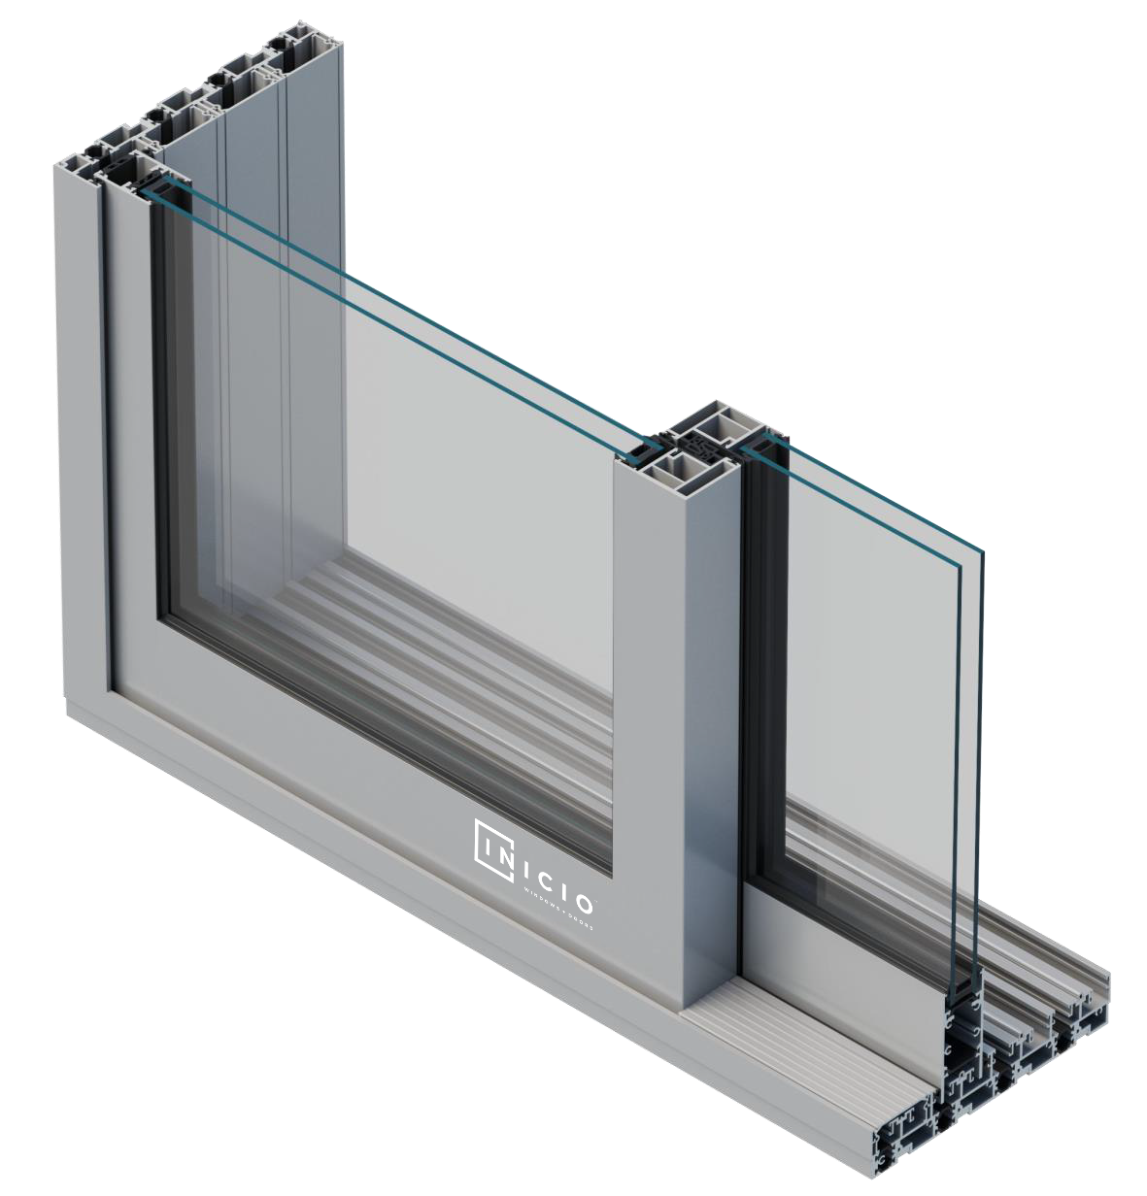
Aluminum Extrusions & Frame Construction
Material Selection
6000-series aluminum alloys offer ideal balance of strength and formability.
Extrusion Process
Custom dies shape molten aluminum into precise profiles with tight tolerances.
Frame Assembly
Mitered corners create seamless joints while square-cut frames offer structural advantages.
Performance Engineering
Internal chambers and thermal breaks enhance strength and insulation properties.
Notes:
To understand how aluminum systems perform, we need to look at how the frames are actually made. Most architectural-grade aluminum windows and doors are extruded from 6000-series aluminum, with 6063-T5 being one of the most common alloys. This alloy offers a strong balance of corrosion resistance, strength, and workability. Aluminum extrusions are created by forcing heated aluminum billets through precision-machined dies—which define the final shape of the profile. Some manufacturers use shared, standard dies, while others develop custom dies to achieve unique profiles, narrower sightlines, or accommodate specific hardware systems. When it comes to how these extrusions are assembled into frames, there are two primary methods:
Mitered corners, where the profiles are cut at 45-degree angles and joined to form crisp, clean corners—often preferred for modern design; and
Square-cut frames, which use mechanical brackets or corner keys for quick assembly and field adaptability.
Many premium systems reinforce key parts of the frame to support oversized glass, add thermal break cavities, or provide structural strength for multi-panel doors. These design decisions at the extrusion and assembly level have a direct impact on performance, aesthetics, and ease of installation.

Slide 5
Finishing &
Coating Options
AAMA 2605 Finishes
AAMA 2604 Finishes
Maximum UV resistance
Durable residential performance
Superior corrosion protection
Wide color selection
Ideal for coastal exposures
Cost-effective protection
Anodized Finishes
Textured Alternatives
Alternative Interiors
Distinctive metallic appearance
Steel-look aesthetics
Wood interior
Extremely abrasion resistant
Easier installation than steel
Other decorative unique treatments
Natural oxide protection
Premium architectural appeal
Notes:
Once the aluminum profiles are extruded and fabricated, they go through a finishing process—this is what gives the system its final color, texture, and long-term protection. There are two main performance standards to be aware of:
AAMA 2605, which is the highest-performing architectural finish standard. It’s typically used in very high end residential, commercial, or extreme exposure applications and provides exceptional resistance to UV degradation, fading, and salt spray.
AAMA 2604 is also highly durable and widely used in luxury residential and low-rise multifamily projects. It offers excellent color retention and chalk resistance for most environments.
Another finishing option is anodizing, which creates a metallic look with extreme surface hardness. Anodized finishes are long-lasting and highly UV-stable, but they are often limited in color choices and can be more difficult to touch up in the field.
One innovation that’s gaining popularity is the use of textured powder coat finishes. These finishes are engineered to mimic the appearance of steel, offering a tactile, modern look with less glare and greater surface variation.
What makes these textured finishes especially appealing is that they offer the visual impact of steel—but in lightweight aluminum. That means lower shipping, unloading, and installation costs, easier handling on-site, and often fewer crew members or machinery needed during install. That said, let’s be clear: steel is an ultra-luxury material, and in many high-end projects, there truly is no substitute. The detailing and patina of steel systems offer a distinct tactile and visual richness that discerning clients may demand. If you're working on a project where steel may be the better fit, or you simply want to learn more about steel window and door systems, we offer a separate AIA-accredited presentation focused exclusively on steel, and we'd be happy to provide that to you or your firm at a later time.
Last, because of aluminum properties, several companies have recently introduced a wood and unique facades on the interior that are applied to an aluminum core. In the next slide is an example of one of those doors.

Slide 6
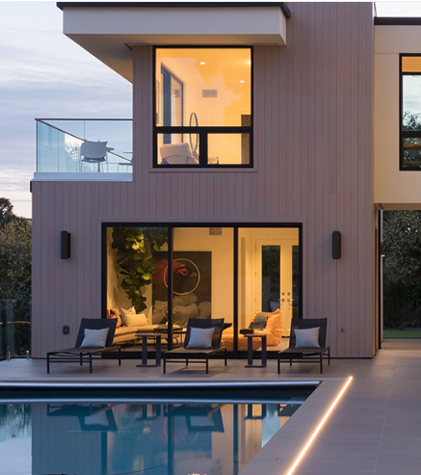
Durability of Aluminum
Weather Resistance
Aluminum naturally forms a protective oxide layer that prevents corrosion.
Structural Stability
Unlike wood, aluminum never rots, swells, or warps with moisture exposure.
Low Maintenance
Simple cleaning maintains appearance and performance for decades.
End-of-Life Recycling
Aluminum is 100% recyclable with no degradation of material properties.
Notes:
This is an aluminum door.
Now let’s talk about durability, which is one of aluminum’s greatest strengths—especially when compared to other common fenestration materials.
Aluminum is naturally corrosion-resistant, and with the right finish, it performs exceptionally well in tough environments—whether that’s oceanfront properties exposed to salt air, high-humidity regions, or dry, sun-intense climates.
Unlike wood, aluminum won’t rot, swell, or warp. It doesn’t absorb moisture, it doesn’t expand and contract dramatically with temperature changes, and it’s not prone to insect damage or mildew growth.
From a maintenance perspective, aluminum systems require very little effort over time. Occasional cleaning is typically sufficient, and the finish—if specified correctly—will retain its appearance and integrity for many years.
And finally, aluminum is a fully recyclable material, which makes it a strong choice for sustainability-conscious projects. Many high-end systems today are made with over 60% recycled content, and the material can be recycled again at the end of its service life without degradation.
In short, aluminum delivers long-term durability, structural integrity, and environmental responsibility, making it a smart, low-maintenance choice for luxury and modern architecture.

Slide 7
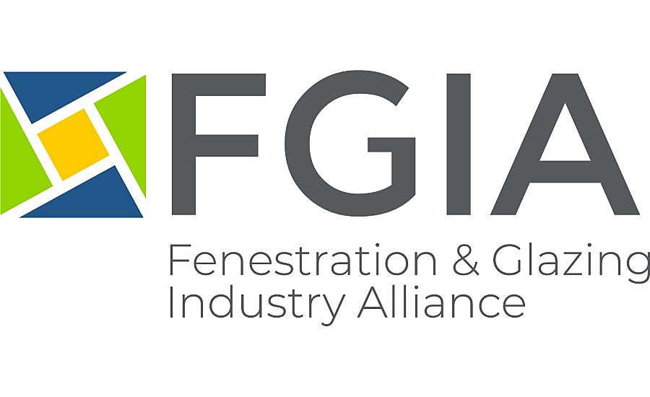
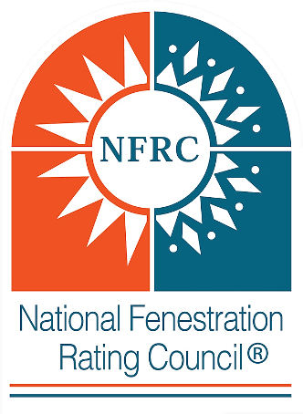
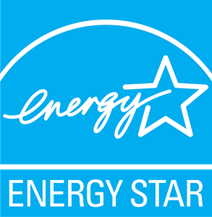
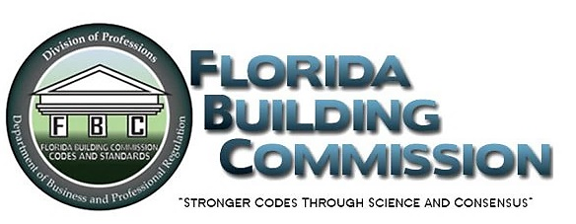
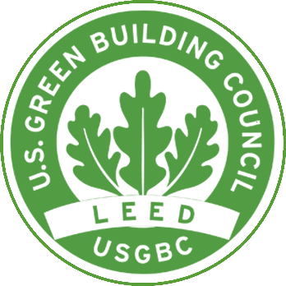
Testing & Certifications
Notes:
When talking windows and doors it is important to touch on testing and certifications that guide product performance and code compliance. Most aluminum doors and windows are evaluated under two major standards: NAFS and NFRC.
NAFS stands for the North American Fenestration Standard. It was developed by the Fenestration Glazing Industry Alliance (FGIA) –formerly AAMA– as well as the Window and Door Manufacturing Manufacturers Association (WDMA), and the Canadian Standards Association. NAFS was developed using ASTM testing methods. When you hear NAFS, think STRUCTURAL—wind, air infiltration, and water infiltration. We will walk through the NAFS rating system in a moment.
Next is NFRC which is the National Fenestration Rating Council. It rates the THERMAL performance like U-Factor, Solar Heat Gain Coefficient and Visible Light Transmittance. All windows and doors with an NFRC ratings require a sticker on the glass with their ratings.
We also see third-party certifications from programs like Energy Star (energy performance), Florida Product Approval (hurricane performance), TDI for Texas coastal hurricane performance, and WUI for fire zones. For sustainability, systems may contribute toward LEED certification through material use and thermal performance. Altogether, these organizations and certifications form the backbone of how aluminum products are verified for real-world conditions and code requirements.
We don’t have enough time to talk through all these certifications, but we will dive a little deeper in the NAFS and NFRC.

Slide 8
Performance Testing
& Ratings
NAFS Class
Typical Application
Design Pressure
R
Residential, 1-2 stories
15-25 psf
LC
Light Commercial, 1-4 stories
25-30 psf
CW
Commercial Window, mid-rise
30-40 psf
AW
Architectural Window, high-rise
40+ psf
Performance class selection should match building exposure and design intent. Testing covers structural integrity, water infiltration, and air leakage.
Notes:
Many window and door systems in North America are tested to the North American Fenestration Standard, or NAFS. This standard forms the basis for evaluating structural integrity, air infiltration, and water resistance.
When a product is tested to NAFS, it is assigned a Performance Class, which determines where the product is appropriate to use based on structural and environmental demands.
The main NAFS classes are:
R Class – Designed for basic residential use; this is the most common and least demanding classification.
LC Class – Stands for Light Commercial but is also widely used in higher-end residential applications that demand more robust performance.
CW Class – Commercial Window systems used in multifamily, exposed, or urban environments, and often in larger or taller homes where wind and water exposure may be a concern.
AW Class – Architectural Window, the most rigorous class, typically required in commercial buildings, high-rises, or projects exposed to extreme wind or rain.
These aren’t just marketing labels—they’re backed by laboratory testing using ASTM standardized methods Each unit is subjected to a series of physical performance tests, including:
Design Pressure – Measures how much wind load the system can safely withstand
Air Infiltration – Quantifies how much air leaks through the system under pressure
Water Penetration – Assesses the product’s resistance to water under simulated wind-driven rain conditions
The combined results of these tests form the Performance Grade (PG)—a numeric value that serves as a benchmark for overall system performance.
Why this matters:
Choosing the correct NAFS class is about more than just code compliance. It’s about aligning product performance with the demands of the project environment—protecting both your design intent and the long-term success of the installation.
A sheltered suburban residence may perform well with an R-Class product.
But a coastal home, urban infill, or low-rise multifamily building might require a CW or even AW rated system to meet code and ensure durability.
While over-specifying is common and often harmless, under-specifying can lead to product failure, water intrusion, or costly rework.

Slide 9
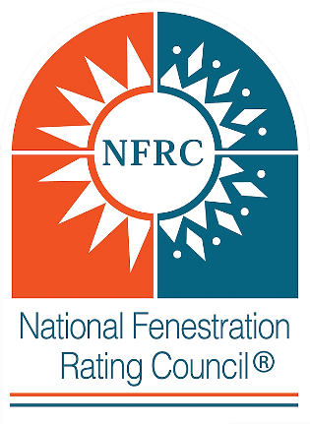
Energy Performance & Thermal Breaks
U-Factor
SHGC
Lower values indicate better insulation properties and reduced heat transfer.
Solar Heat Gain Coefficient indicates how much solar radiation passes through the glass.
Thermal Breaks
VLT
Polyamide or polyurethane barriers minimize conduction and prevent condensation.
Visible Light Transmission represents how much natural daylight is admitted through the glass. Higher numbers allow more daylight in.
Notes:
Energy performance is an essential part of any fenestration system specification. Aluminum systems have come a long way in this area—especially over the past 10 to 15 years. Let’s start by talking about the three main NFRC metrics used to evaluate THERMAL performance.
The primary NFRC ratings include:
U-Factor – Measures heat transfer through the window. Lower numbers mean better insulation and reduced heating/cooling costs in colder climates. For reference, most high-performing aluminum windows fall in the range of 0.27 to 0.45, depending on glass, frame design, and the presence of thermal breaks.
Solar Heat Gain Coefficient (SHGC) – Indicates how much solar radiation passes through the glass. Lower values are better for cooling-dominated climates. Higher are better for heating-dominated climates.
Visible Transmittance (VLT) – Represents how much natural daylight is admitted through the glass. Higher numbers allow more daylight in. High-performance systems balance light entry with occupant comfort.
While not part of the NFRC rating, thermal breaks are essential to the thermal performance of aluminum windows. Because aluminum conducts temperature, high-performance systems use polyamide thermal breaks to separate the interior and exterior portions of the frame. This helps reduce heat loss in winter and heat gain in summer, while also minimizing condensation and improving interior comfort.

Slide 10
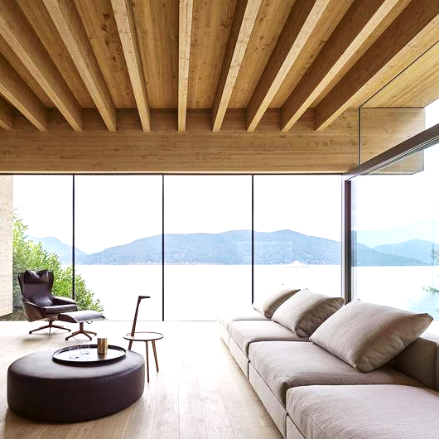
Sightlines vs.
Performance
Sightlines- Ultra-Narrow Appeal
Minimal frames create stunning visual impact with maximum glass area.
Some aluminum window and door providers showcase extremely thin profiles.
These systems prioritize aesthetics and transparency above all else.
Notes:
This is one of the most important discussions in high-end aluminum fenestration: the balance between minimal sightlines and performance. Many of today’s most design-forward systems use ultra-narrow frames—sometimes with interlocks under an inch wide. Visually, these are stunning. They create a seamless, almost invisible barrier between inside and out, and they align perfectly with modern and minimalist architecture.

Slide 11
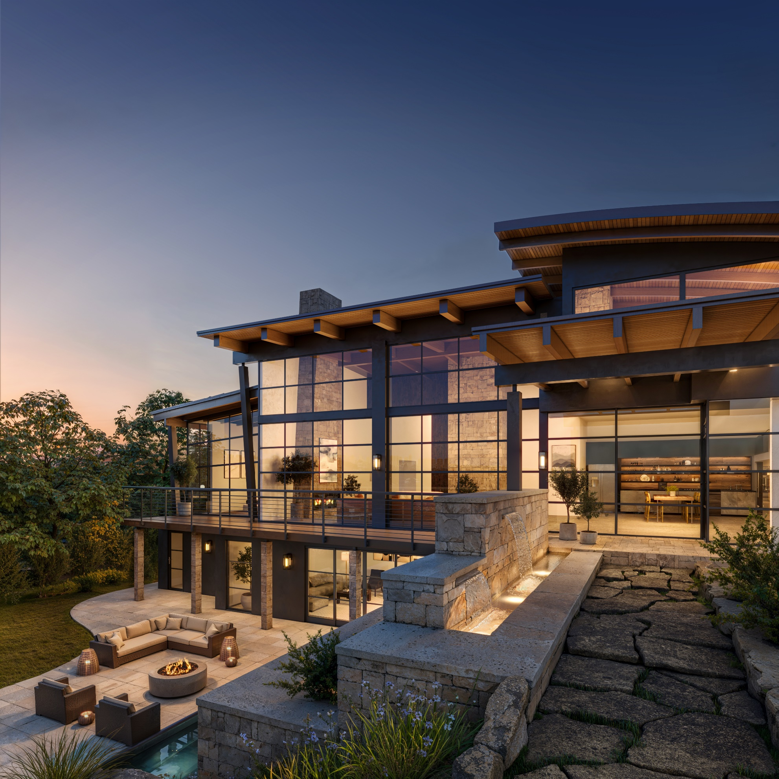
Sightlines vs.
Performance
Performance Considerations
Extremely slim profiles may have limitations in water penetration resistance.
Structural ratings often require compromise for the thinnest frames.
The glazing selection and the presence of a thermal break drives the thermal performance and prevents condensation.
Notes:
As frames become slimmer, certain performance trade-offs can emerge. While expansive glass delivers stunning visual impact, it also increases the challenge of maintaining structural performance. The frame plays a critical role in resisting air and water infiltration and supporting the overall stability—especially under high wind loads or in large-format and multi-panel configurations. Many ultra-minimal systems are either untested to NAFS standards or only meet the lowest performance classifications. While acceptable in some contexts, these ratings may not be adequate for higher end clients or harsher climates with significant wind, rain, snow, or other demanding conditions. Also, ensuring that a thermal break is included in the frame and selecting high-performance glazing are essential steps for thermal efficiency and preventing condensation.
The good new is that a modest increase in frame size—often just small fractions of an inch—can provide meaningful gains in strength, insulation, and sealing capability. This results in significantly better performance without compromising a modern, minimalist aesthetic. It’s not about choosing between form and function—it’s about making smart, informed design decisions tailored to the project’s environment and the client’s expectations.

Slide 12
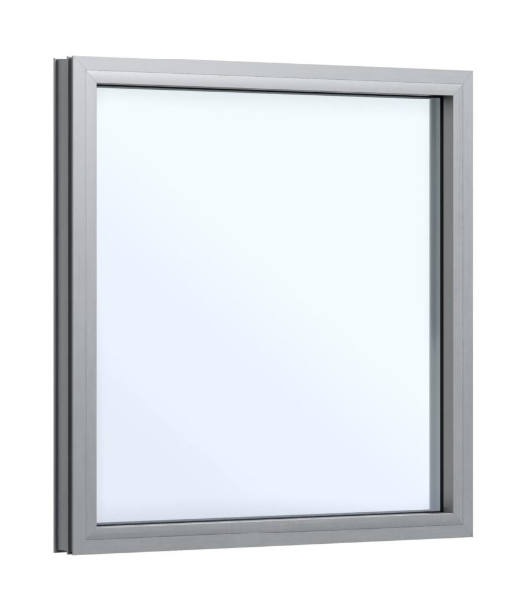
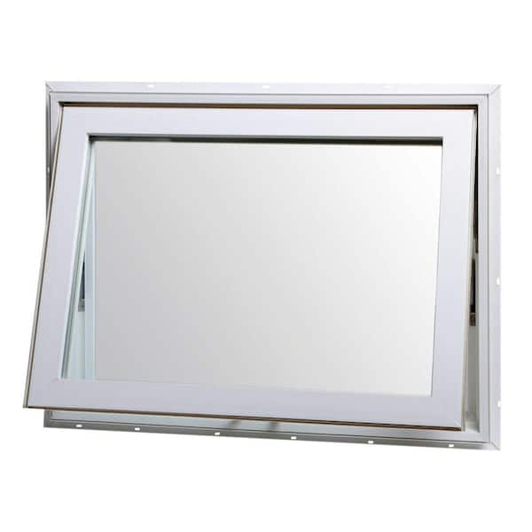
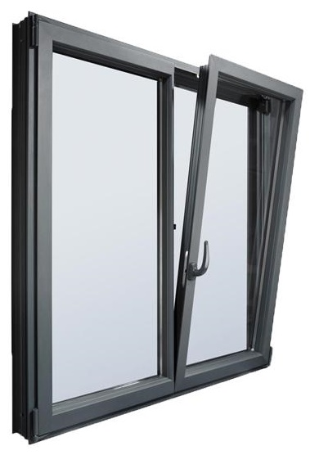
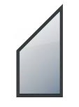
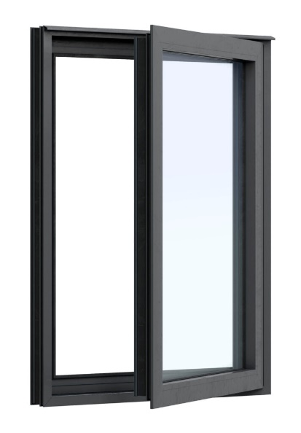
Window Operating Types
Fixed/Direct Glazed
Awnings & Hoppers
Tilt & Turns
Special Shapes
Casement
Window operation types include fixed or direct glazed, awning/hopper (top/bottom hinged), tilt-turn (European dual-action), special shapes, casements (side hinged), as well as mulled assemblies create custom architectural statements.
Notes:
Now that we’ve talked about performance, let’s look at the different window operating types available in modern aluminum systems. Because of aluminum’s strength and versatility, there are very few limitations on form. The most common operable window types in aluminum include:
Fixed or picture windows offer the cleanest look and the highest structural and thermal performance. These can be direct-glazed—meaning the glass is set directly into the frame—or they can be sash-matched to create visual consistency with operable units.
Awning windows, which are hinged at the top and swing outward, are great for ventilation even during light rain.
Hopper windows, which are hinged at the bottom and tilt inward, are more common in basements or utility areas.
Tilt-turn windows, a European-style configuration, offer both inward tilt for ventilation and full inward swing for cleaning or egress—all in one sash. These are ideal for projects looking for both performance and clean modern detailing.
Casement windows, which can be either crank-operated or push-out. These offer excellent ventilation, clear sightlines, and a modern appearance. They’re often paired with fixed units in a larger composition.
Beyond these core types, many aluminum systems can accommodate custom special shapes, like trapezoids, round tops, arches, or full glass walls.
You will see single-hung and double-hung windows less frequently with aluminum windows because of the emphasis of minimal sightlines.
Most manufacturers offer pre-mulled windows when desired. Mulling is where multiple window and door units are coupled together for a unified appearance in one rough opening.
Aluminum gives you a wide variety and provides extensive flexibility to create exactly what you need—while keeping your sightlines clean and your proportions tight.

Slide 13
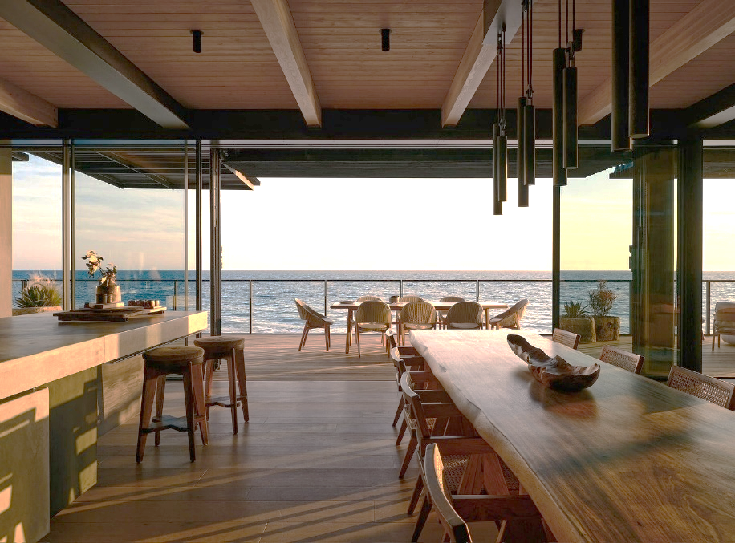
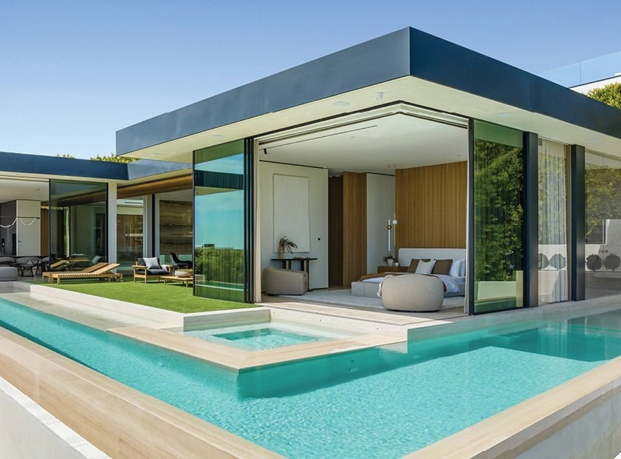
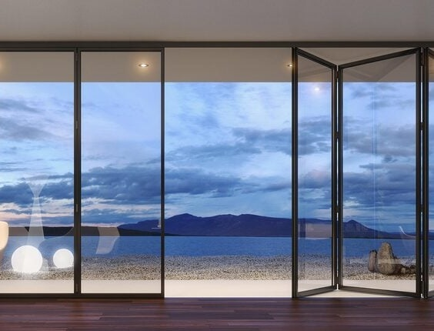
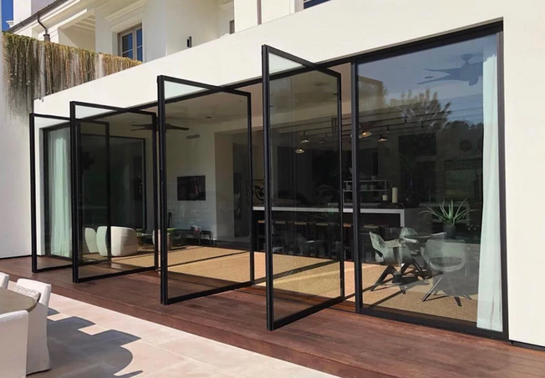
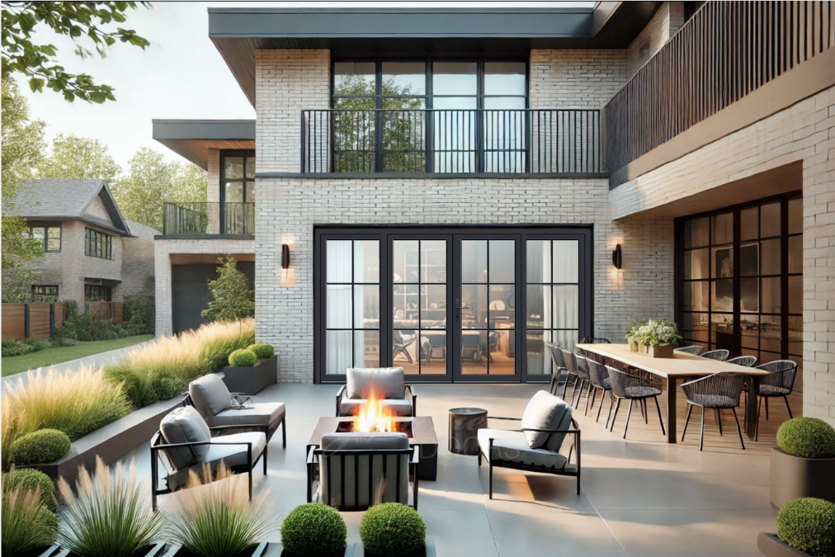
Door Systems & Indoor-Outdoor Living
Multi-Slide, Lift n Slide
& Traditional Slider Systems
Corner Sliding
Systems
Folding
Systems
Pivot
Doors
Hinged
Doors
Notes:
There is no question when it comes to aluminum, the doors are the stars of the show--seamlessly connecting interior and exterior spaces. Aluminum door systems are powerful tools available to architects.
Thanks to the material’s strength, you can design doors with large, operable glass panels that slide, stack, pivot, corner, or pocket to completely open up a room to the outdoors.
Let’s start with multi-slide doors, which are among the most sought after. These consist of multiple panels that slide along parallel tracks. Many offer unlimited tracks. Lift-slide doors use a special handle mechanism to gently lift the panel off its seals when operated. This improves both smoothness and weather sealing. This is ideal for areas with a high wind load or for expansive/oversized, heavy glass panels. Last, of course aluminum offers a standard slider door as well. Some sliding systems allow panels to stack on one side, split and slide in both directions. These are called bi-parting doors. Also, some sliding doors can pocket into the wall for a completely open experience. Last, for corner conditions, corner-stacking systems let two walls of glass meet at a 90-degree junction and slide away from the corner—opening the entire corner of the room without the need for a post. It’s a dramatic and beautiful effect.
Another popular option is the bi-folding door system. These doors consist of multiple hinged panels that fold accordion-style to one or both sides of the opening. Bi-folds are ideal when you want the flexibility of opening an entire wall without needing deep wall pockets or multi-track floor systems which can add to the depth of the frame. They’re also great for transitional spaces like kitchens, lounges, and pool areas.
Other premium door types include pivot doors, which rotate on an axis instead of swinging on side hinges. These are often used as signature entry doors or interior focal points.
Last of course is the hard-working hinged door which can swing in or swing out.
To make these systems functional in everyday life, aluminum manufacturers offer feature:
Flush sills for seamless transitions
ADA-compliant thresholds
Integrated drainage systems to prevent water intrusion
And retractable screens that disappear when not in use

Slide 14
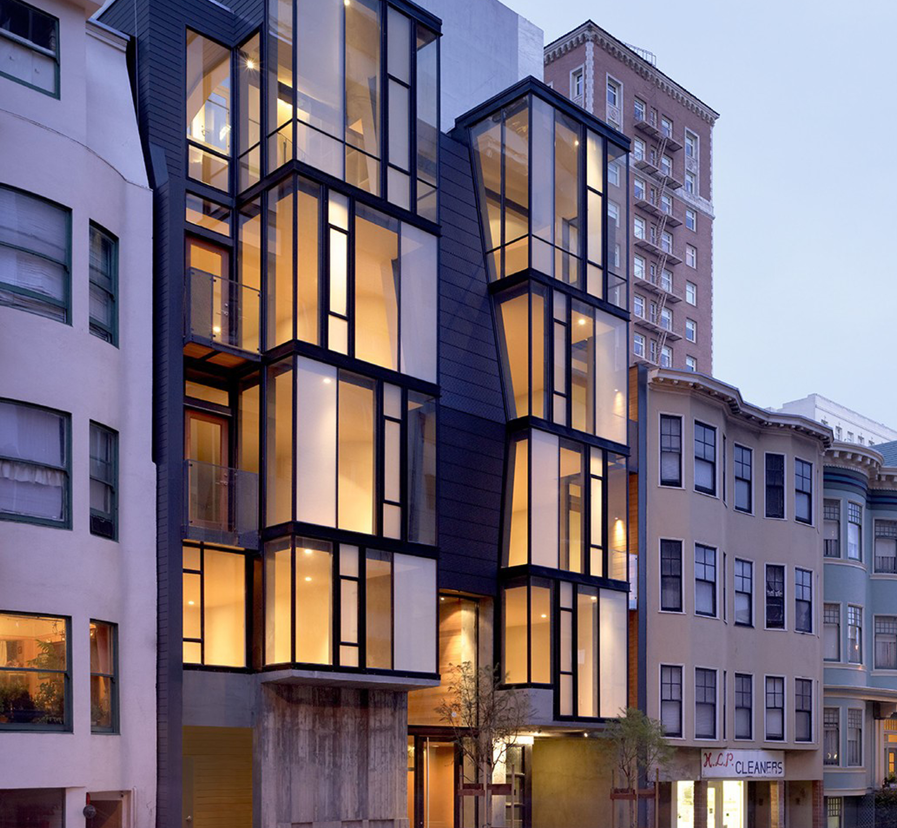
Glass & Glazing
Dual pane & triple-pane IGUs for thermal insulation
Low-E (1, 2, & 3 layer) coatings for energy performance
Laminated & tempered for safety and sound
Decorative, tinted & obscure for design and privacy
Notes:
In both aluminum windows and doors, glazing plays the lead role in performance. The frame provides structure and support—but it’s the glass that drives thermal efficiency, sound attenuation, daylighting, and aesthetics.
Most windows and doors use dual-pane Insulated Glass Units (IGUs)—two panes of glass separated by an air or gas-filled space. For more extreme weather environments or more demanding building code requirements, triple-pane IGUs add a third layer of glass and a second insulating cavity for better U-Factor and sound performance.
To improve energy efficiency, IGUs are paired with Low-E coatings—microscopically thin metallic layers, most often made of silver. The number of silver layers corresponds to performance level:
Low-E: single silver layer – basic solar and thermal control
Low-E²: double silver – improved insulation and SHGC
Low-E³: triple silver – ideal for climates with demanding SHGC and U-Factor requirements
For safety, tempered glass is required in most window and door applications—especially near floors, stairways, and walkways. Laminated glass goes a step further, offering impact resistance, sound control, and UV filtering.
From a design standpoint, there’s a broad range of decorative glazing options—including frosted, reeded, tinted, reflective, and etched glass—to meet privacy, glare, and aesthetic needs--like the one featured in the above photo.
Because maximizing the glass in design is so important in aluminum windows, glazing is one of the most impactful choices you’ll make. It drives U-Factor, SHGC, Visible light Transmittance and acoustic ratings, and helps meet both code and design intent in a wide range of climates and applications.

Slide 15
Divided Lites & Patterns
Simulated Divided Lites
Creative Patterns
Applied grilles create a modern or steel-like traditional appearance without compromising insulation.
Custom configurations express architectural intent and create visual interest.
Notes:
Divided lites and mullions are great design tools—especially when working within a modern or steel-inspired architectural style. Most aluminum systems offer Simulated Divided Lites (SDLs). SDLs use external grille bars applied to both sides of the glass paired with an internal spacer bars to enhance realism. When it comes to patterns, you can specify horizontal-only, vertical-only, or full-grid patterns depending on your architectural vision.
These can let you create a classic steel look or create a fresh contemporary pattern unique to your project.

Slide 16
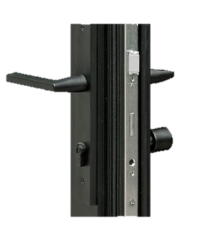
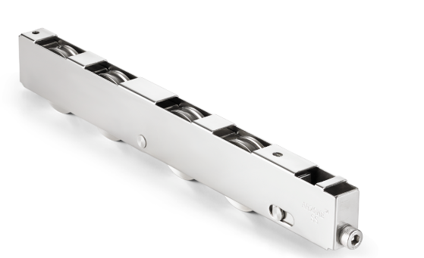
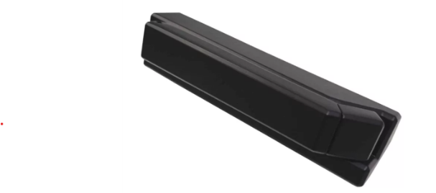
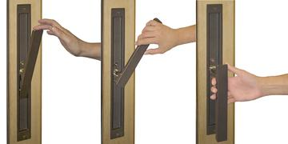
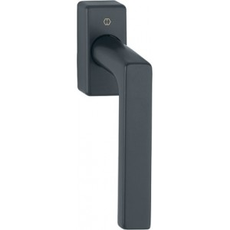
Hardware & User Experience
Security Systems
Multi-point locks ensure tight sealing and protection
Operation Components
Stainless rollers and concealed hinges provide smooth function
Touch Elements
Flush pulls and minimalist levers enhance aesthetic continuity
Movement Mechanisms
Lift-slide, tilt-turn, and pivot systems enable intuitive use
Notes:
Hardware may not always be the first thing noticed in a window or door system — but it often defines how the system feels to operate. For luxury and modern residential architecture, the tactile experience matters just as much as the visual impression.
Let’s start with multi-point locking systems, which are standard in most high-end aluminum products. These locks engage at multiple points along the sash or panel, improving both security and weather sealing — especially for large sliding and hinged doors.
Stainless steel components are preferred for their strength, smooth operation, and long-term resistance to corrosion — especially in coastal climates. You’ll also see concealed hinges and flush track rollers used to maintain clean lines and eliminate visual clutter.
When it comes to aesthetics, most systems offer a range of minimalist handle sets, including:
Flush pulls, which are recessed into the sash
Sleek levers or escutcheons in matte black, brushed nickel, or custom finishes
And low-profile tilt-turn hardware that doesn’t distract from the glazing
Specialty systems like lift-slide doors use a unique handle to raise the panel before sliding — making it easier to move heavy glass and improving performance at the sill.
Pivot doors typically include concealed floor closers or top pivots for seamless rotation, while tilt-turn windows rely on robust internal gearing for dual-mode functionality.
No matter the application, premium hardware enhances the experience — turning a window or door into something that not only looks beautiful but feels effortless to use every day.

Slide 17
Sustainability & Lifecycle Value
60%+
100%
Recycled Content
Recyclability
Most aluminum frames contain significant post-consumer material.
All aluminum components can be fully recycled at end of life.
10-20
4-8
Years
LEED Points
Typical lifespan with minimal maintenance requirements.
Potential contribution to green building certification standards.
Notes:
Aluminum is not only durable and versatile — it’s also one of the most sustainable materials used in modern building envelopes. To start, aluminum is typically made with a very high percentage of recycled content. Many premium systems on the market today contain 60 to 75% post-industrial or post-consumer recycled material, and some exceed that. This significantly reduces embodied carbon. More importantly, aluminum is infinitely recyclable. It can be melted down and reprocessed without losing its structural integrity or material quality — making it a truly circular building product. Compared to wood or vinyl, aluminum systems offer a longer service life. They won’t degrade from moisture, UV exposure, or pests, and they require very little upkeep over time — just periodic cleaning and minimal hardware maintenance. This long lifespan, combined with high recycled content and low maintenance requirements, means aluminum systems can contribute toward LEED points, net-zero goals, and other green building certifications. In fact, many manufacturers now publish Environmental Product Declarations (EPDs) and embodied carbon data — helping project teams evaluate material choices more holistically. When designed and installed correctly, aluminum offers a compelling balance of performance, design flexibility, and sustainability — making it a smart long-term investment from both an environmental and lifecycle perspective.

Slide 18
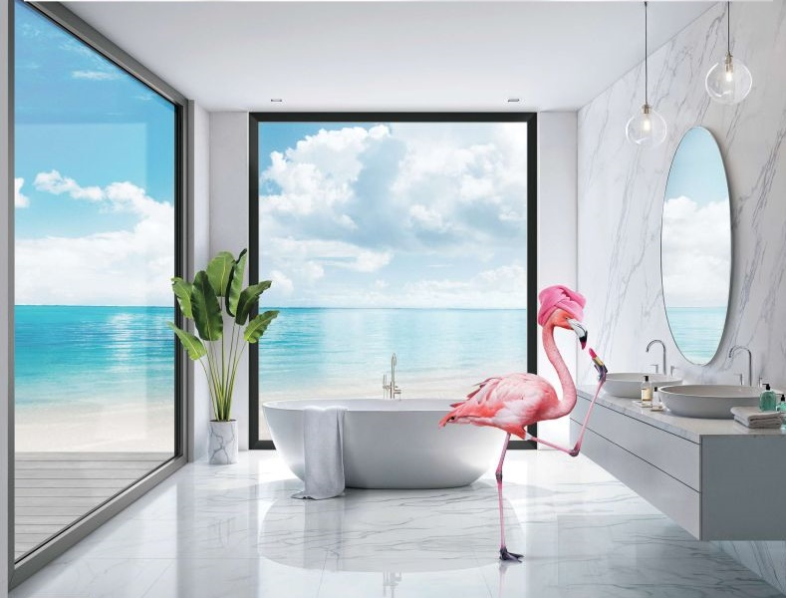
Summary & Key Takeaways
Design Precision
Aluminum supports modern architecture with strength and exact tolerances.
Balance Considerations
Narrow profiles offer beauty with performance tradeoffs to understand.
System Integration
Finishes, frames, and hardware define long-term success.
Application Focus
Ideal for luxury residential and low-rise multifamily projects.
Notes:
As we wrap up today’s course, let’s quickly revisit the key takeaways that we hope you’ll carry into your future projects.
First, aluminum is a high-performance, design-forward material. Its strength allows for large openings, clean sightlines, and bold architectural expressions that simply aren’t possible with other materials.
Second, ultra-narrow profiles are visually stunning — but they come with important tradeoffs related to structural performance, water infiltration, and thermal control. With a thoughtful approach, you can balance beauty and durability without compromise.
Third, finishing, hardware, and frame selection are not just cosmetic decisions — they shape how the system functions and holds up over time. Details like AAMA 2605 coatings, lift-slide hardware, and thermally broken frames all contribute to long-term value.
Fourth, even the best-designed product can’t perform without proper installation. Early coordination, attention to sill and flashing details, and jobsite planning all play a critical role in system success.
And finally, aluminum is a smart, scalable solution for luxury residential and low-rise multifamily projects. It aligns with the modern aesthetic, offers a sustainable profile, and supports both simple and complex architectural visions.
If you’d like to go deeper on any part of this topic — including specialty configurations or steel system comparisons — we’d be happy to provide additional resources or host a follow-up session tailored to your team.

Slide 19
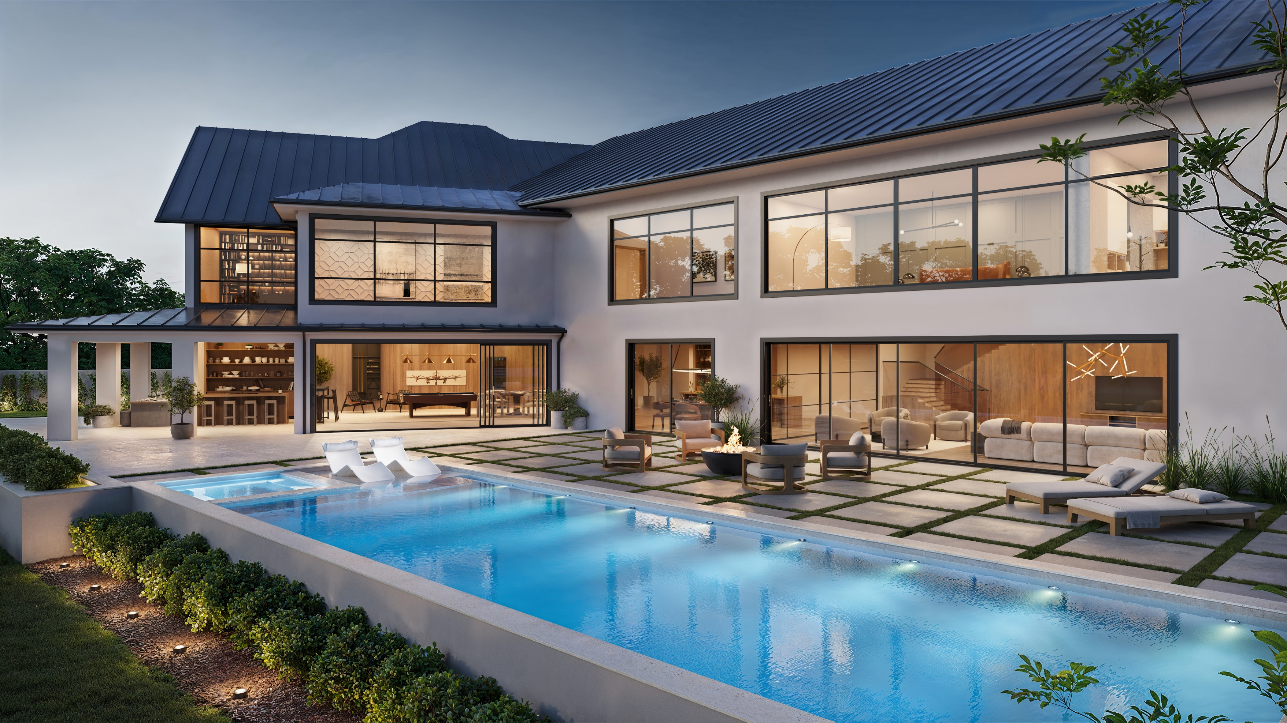
Thank You!
Scan For Your AIA
Registration & Certificate
Notes:
Thank you again for joining us today for this AIA course on aluminum windows and doors.
We hope the information shared has given you a deeper understanding of how aluminum systems support both high-performance building goals and modern architectural expression.
If you have questions about anything we covered — whether it's system configuration, energy codes, finishes, or installation practices — we’re happy to stay after and chat.
We also offer additional sessions, including an AIA-accredited course on steel windows and doors, which explores the unique qualities of that ultra-luxury category. If you or your team are interested, we’d be glad to schedule that at a later time.
Again, thank you for your time, your attention, and your dedication to great design. We look forward to staying in touch.

Slide 20
Addendum

Slide 21
Installation Best Practices
Support & Anchoring
Frame Preparation
Use proper shimming to maintain square operation.
Match frame type to wall assembly for proper integration.
Install appropriate fasteners for structural integrity.
Logistics Planning
Waterproofing
Pre-plan for large panel delivery and handling.
Flash sills correctly to direct water away from interior.
Ensure adequate site access for installation equipment.
Create continuous drainage plane with building envelope.
Notes:
Installation is where everything comes together — and it’s also where things can go wrong if proper planning and execution aren’t in place. Even the best-performing aluminum system will underperform or fail prematurely if it’s not installed correctly.
First, it’s essential to match the frame type to your wall assembly and construction method. Whether you’re using a nail-fin frame for new construction, a block frame for a retrofit, or a direct-set frame for minimal transitions — each type requires a specific integration approach with sheathing, waterproofing, and insulation.
Shimming and anchoring also matter. Frames should be square, plumb, and securely fastened to structural framing — especially for large multi-slide or lift-slide units. Uneven support can lead to deflection, air leakage, or binding over time.
When it comes to sill and drainage management, proper pan flashing is critical. Most systems are designed with integrated weep paths or sloped sills, but those don’t function as intended unless they’re combined with effective waterproofing — including pre-sloped pans, sealant, back dams, and integration with your weather-resistive barrier.
For large-panel systems, it’s vital to pre-plan jobsite access and logistics. Some panels may be 400–600 pounds or more. Know in advance whether the opening is accessible from the outside, whether mechanical lifts are required, and whether staging or sequencing will be necessary to avoid field damage or delays.
The bottom line: working with aluminum systems doesn’t just require the right product — it requires the right team, the right detailing, and the right planning. When all three are in place, these systems can deliver exceptional long-term performance, beauty, and value.

Slide 22
Sill & Frame Options
Frame Types
Block frame, nail-fin, and direct-set options for various wall conditions
Sill Profiles
ADA-compliant and performance-focused thresholds for different needs
Multi-Track Systems
2-6 track configurations for sliding and stacking door applications
Thermal Transitions
Continuous insulation at floor boundaries prevents energy loss
Notes:
One of the most important and often overlooked aspects of aluminum system specification is the frame and sill design. These are the parts of the system that interact with the building envelope — and they play a critical role in both performance and installation.
Let’s start with frame types. Most high-end systems offer multiple options:
Block frames, which are typically used in replacement applications.
Nail-fin frames, which allow direct attachment into the sheathing for new construction and remodels.
And direct-set frames, which eliminate sash profiles to achieve ultra-thin sightlines
Choosing the right frame type ensures proper integration with your wall assemblies, flashing, and insulation strategy.
Next, we have sill profiles, which are just as important. For door systems, there are often several options available:
Performance sills include deeper drainage channels and tighter seals for projects with higher water exposure
ADA-compliant sills offer low thresholds for accessibility, while still incorporating weep systems to manage moisture
Many sliding doors now offer multi-track sills that accommodate two, three, or even four-panel door systems, including pocketing and corner-sliding setups
And finally, a key design and performance detail is thermal continuity—ensuring the floor or sill doesn’t create a thermal bridge between interior and exterior. This is often addressed with insulated sill pans, thermal breaks at the threshold, or extended jamb covers that align with floor finishes.
Choosing the right sill and frame configuration upfront helps ensure not only better performance, but also easier coordination with interior finishes, waterproofing details, and code compliance.

